Slide 1

Equations and Inequalities
Chapter 2
Algebra and Trigonometry 2e
OpenStax
Jay Abramson
Notes:
Images and notes within these slides are from the OpenStax textbook Algebra and Trigonometry 2e

Slide 2
The Rectangular Coordinate System and Graphs
Section 2.1
Notes:
Plot ordered pairs in a Cartesian coordinate system.
Graph equations by plotting points.
Graph equations with a graphing utility.
Find x-intercepts and y-intercepts.
Use the distance formula.
Use the midpoint formula.

Slide 3
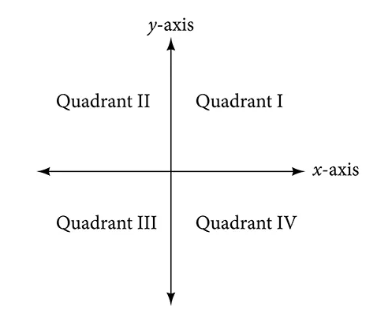
Plotting Ordered Pairs in the Cartesian Coordinate System
Notes:
An old story describes how seventeenth-century philosopher/mathematician René Descartes, while sick in bed, invented the system that has become the foundation of algebra. According to the story, Descartes was staring at a fly crawling on the ceiling when he realized that he could describe the fly’s location in relation to the perpendicular lines formed by the adjacent walls of his room. He viewed the perpendicular lines as horizontal and vertical axes. Further, by dividing each axis into equal unit lengths, Descartes saw that it was possible to locate any object in a two-dimensional plane using just two numbers—the displacement from the horizontal axis and the displacement from the vertical axis.
While there is evidence that ideas similar to Descartes’ grid system existed centuries earlier, it was Descartes who introduced the components that comprise the Cartesian coordinate system, a grid system having perpendicular axes. Descartes named the horizontal axis the x-axis and the vertical axis the y-axis.
The Cartesian coordinate system, also called the rectangular coordinate system, is based on a two-dimensional plane consisting of the x-axis and the y-axis. Perpendicular to each other, the axes divide the plane into four sections. Each section is called a quadrant; the quadrants are numbered counterclockwise as shown here.
The center of the plane is the point at which the two axes cross. It is known as the origin, or point (0,0).(0,0). From the origin, each axis is further divided into equal units: increasing, positive numbers to the right on the x-axis and up the y-axis; decreasing, negative numbers to the left on the x-axis and down the y-axis. The axes extend to positive and negative infinity.

Slide 4
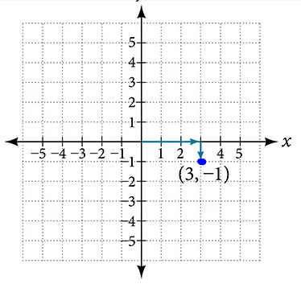
Plotting Ordered Pairs in the Cartesian Coordinate System
Notes:
Each point in the plane is identified by its x-coordinate, or horizontal displacement from the origin, and its y-coordinate, or vertical displacement from the origin. Together, we write them as an ordered pair indicating the combined distance from the origin in the form (x,y). An ordered pair is also known as a coordinate pair because it consists of x- and y-coordinates. For example, we can represent the point (3,−1) in the plane by moving three units to the right of the origin in the horizontal direction, and one unit down in the vertical direction.

Slide 5
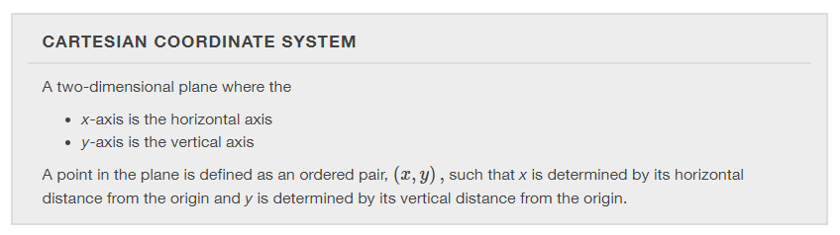

Slide 6
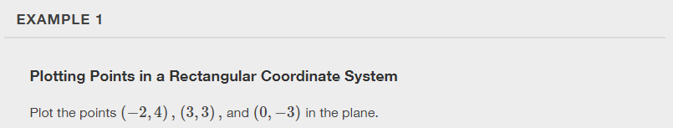
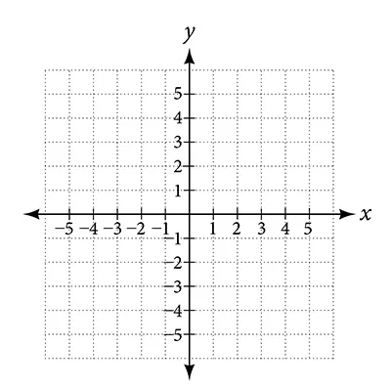

Slide 7
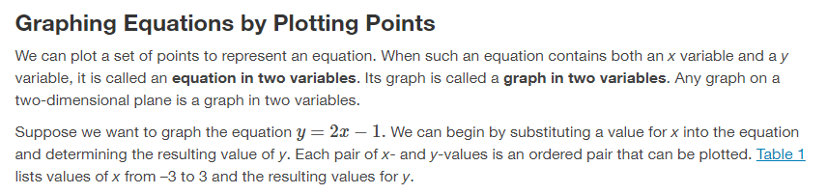
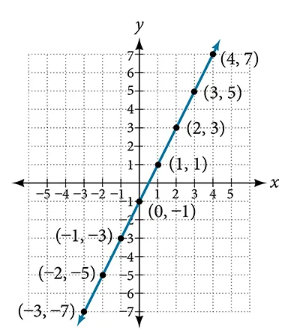
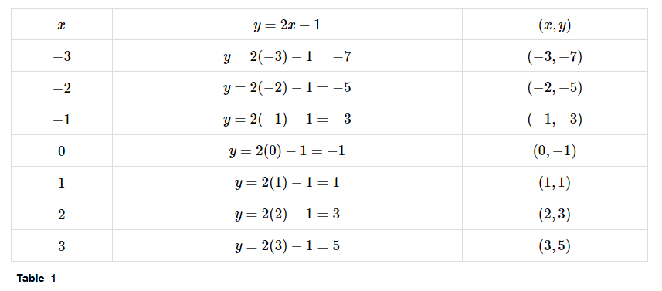

Slide 8
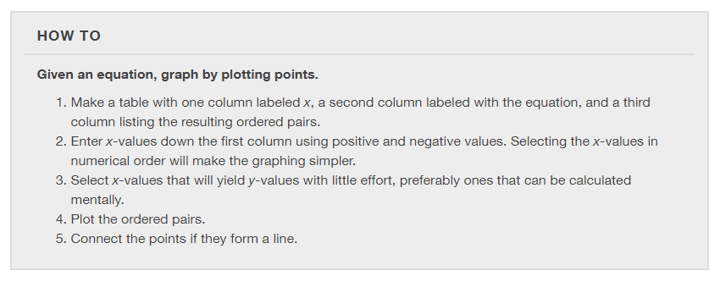

Slide 9
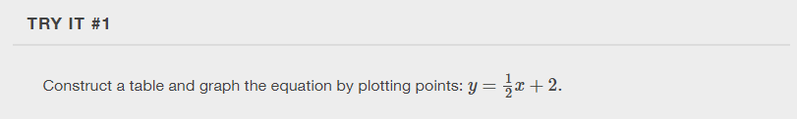

Slide 10
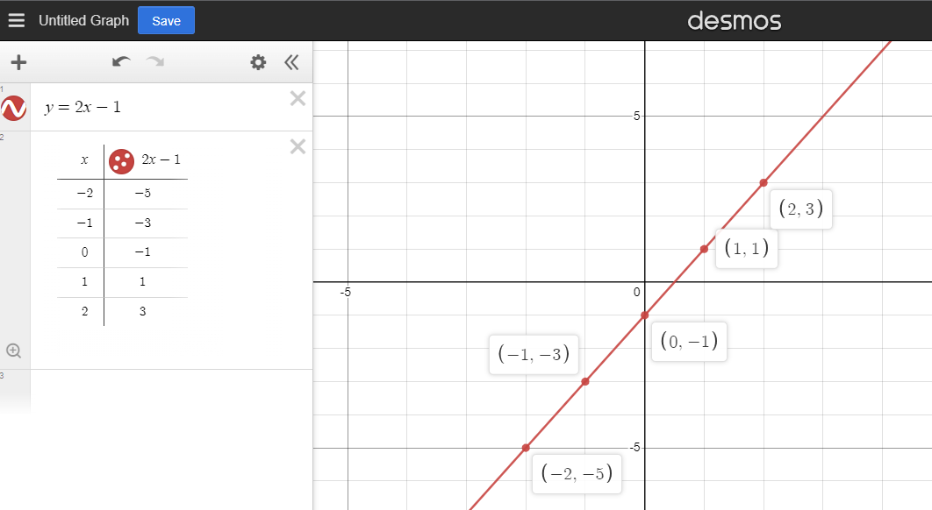
Graphing Equations with a Graphing Utility: https://www.desmos.com/calculator
Notes:
Use desmos.com/calculator. Type in the equation of the line. Click the gear icon and select the table icon. Click on the plotted points to show the coordinates.

Slide 11
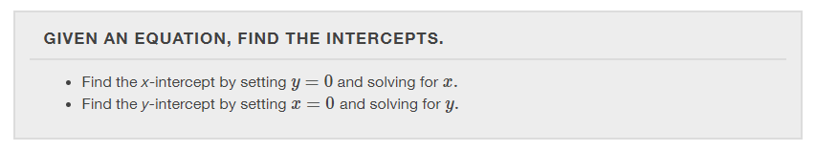
Finding x-intercepts and y-intercepts
The intercepts of a graph are points at which the graph crosses the axes.
The x-intercept is the point at which the graph crosses the x-axis. At this point, the y-coordinate is zero.
The y-intercept is the point at which the graph crosses the y-axis. At this point, the x-coordinate is zero.

Slide 12
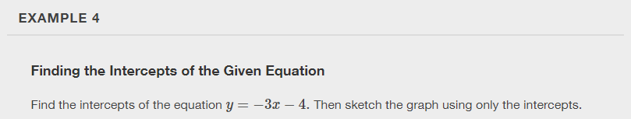
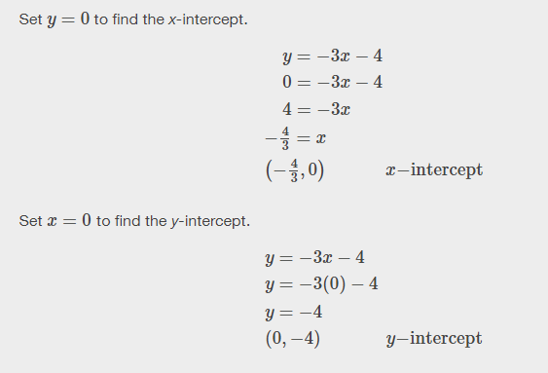
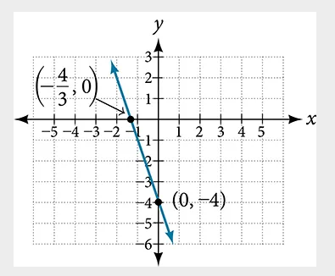

Slide 13


Slide 14
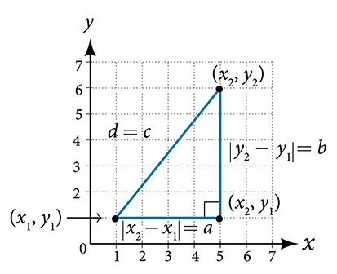



Deriving the Distance Formula
Notes:
Derived from the Pythagorean Theorem, the distance formula is used to find the distance between two points in the plane. The Pythagorean Theorem, a^2+b^2=c^2, is based on a right triangle where a and b are the lengths of the legs adjacent to the right angle, and c is the length of the hypotenuse. We do not have to use the absolute value symbols in this definition because any number squared is positive.

Slide 15
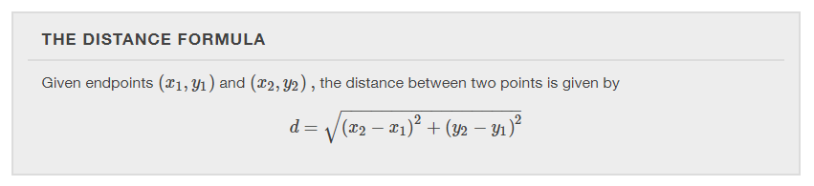

Slide 17
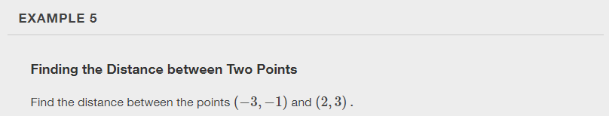

Slide 18


Slide 19
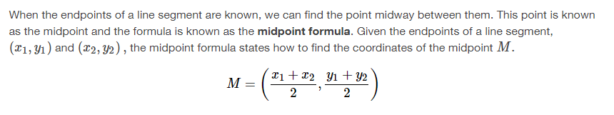
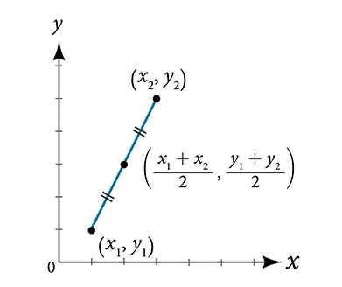
Using the Midpoint Formula

Slide 20
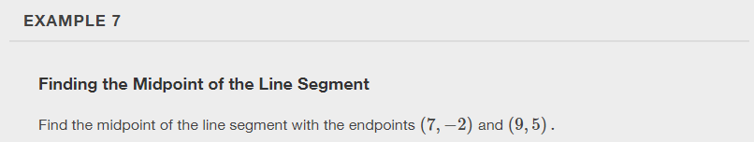

Slide 21


Slide 22
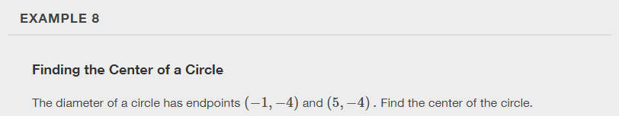

Slide 23
What did you learn in this section?
  Plot ordered pairs in a Cartesian coordinate system.
  Graph equations by plotting points.
  Graph equations with a graphing utility.
  Find x-intercepts and y-intercepts.
  Use the distance formula.
  Use the midpoint formula.
Notes:
Do you have any questions?

Slide 24
This resource is an adaptation of the OpenStax Algebra and Trigonometry 2e open textbook and is © Susan Aydelotte under a CC BY-NC-SA 4.0 International license; it may be reproduced or modified for noncommercial purposes only but must be attributed to OpenStax, Rice University and any changes must be noted. Any adaptation must be shared under the same type of license.

