Slide 1

Sequences, Probability, and Counting Theory
Chapter 13
Algebra and Trigonometry 2e, OpenStax, Jay Abramson
Notes:
Images and notes within these slides are from the OpenStax textbook Algebra and Trigonometry 2e

Slide 2
13.7 Probability
Algebra and Trigonometry 2e, OpenStax, Jay Abramson
Notes:
Images and notes within these slides are from the OpenStax textbook Algebra and Trigonometry 2e

Slide 3
What are the learning objectives for this section?
Construct probability models.
Compute probabilities of equally likely outcomes.
Compute probabilities of the union of two events.
Use the complement rule to find probabilities.
Compute probability using counting theory.

Slide 4
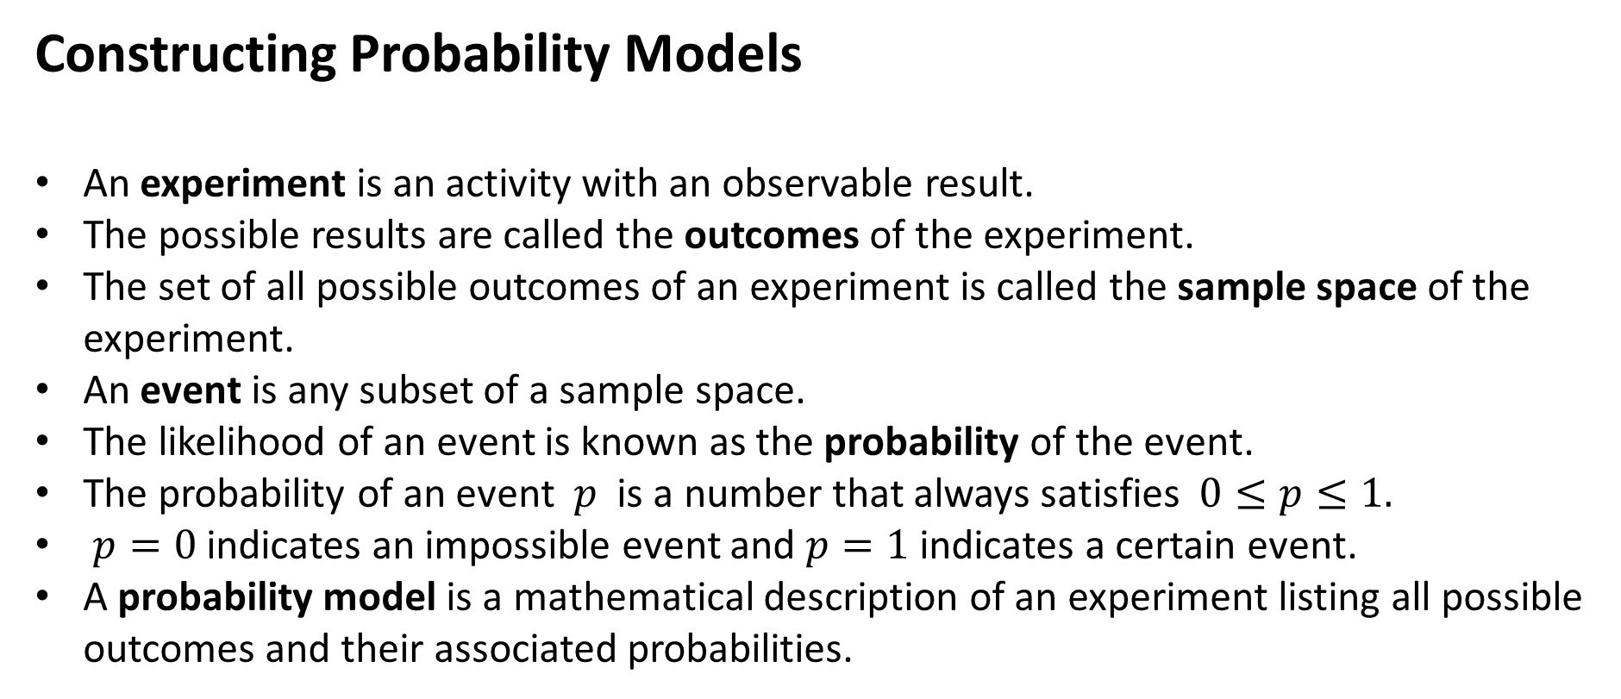
Constructing Probability Models
An experiment is an activity with an observable result.
The possible results are called the outcomes of the experiment.
The set of all possible outcomes of an experiment is called the sample space of the experiment.
An event is any subset of a sample space.
The likelihood of an event is known as the probability of the event.
The probability of an event $p$ is a number that always satisfies $0≤p≤1.$
$p=0$ indicates an impossible event and $p=1$ indicates a certain event.
A probability model is a mathematical description of an experiment listing all possible outcomes and their associated probabilities.

Slide 5
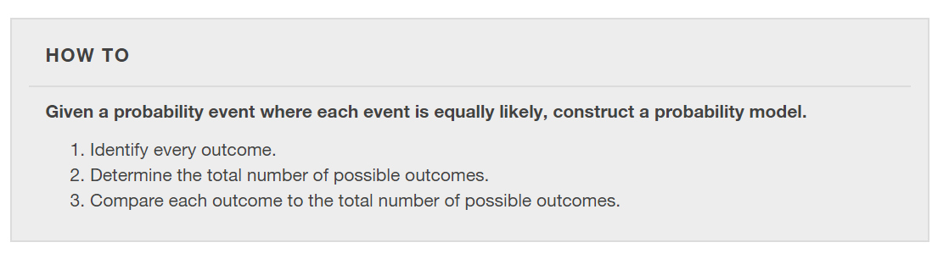

Slide 6
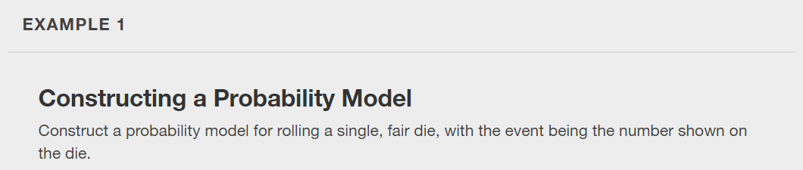

Slide 7
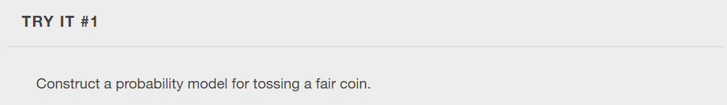

Slide 8
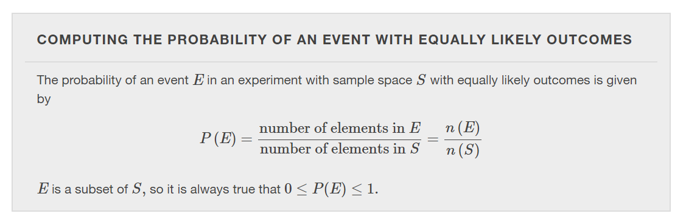

Slide 9
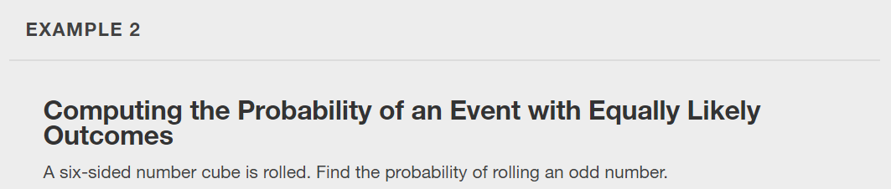

Slide 10
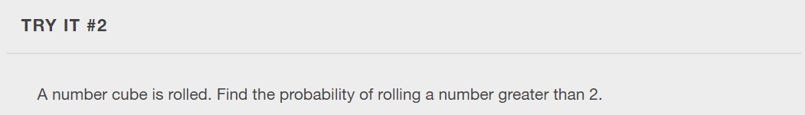

Slide 11
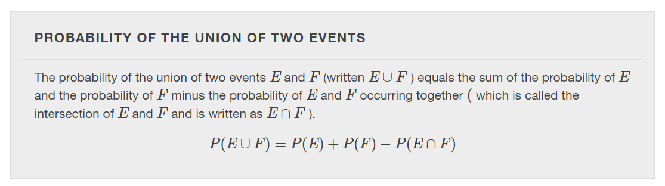

Slide 12
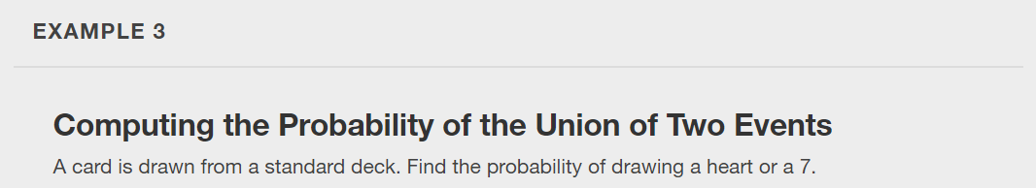

Slide 13
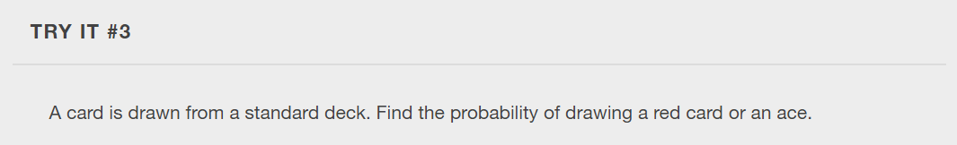

Slide 14
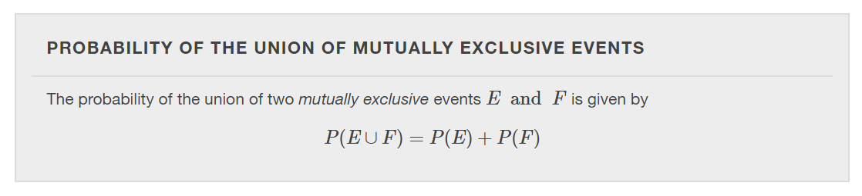
Events are mutually exclusive events when they have no outcomes in common.

Slide 15
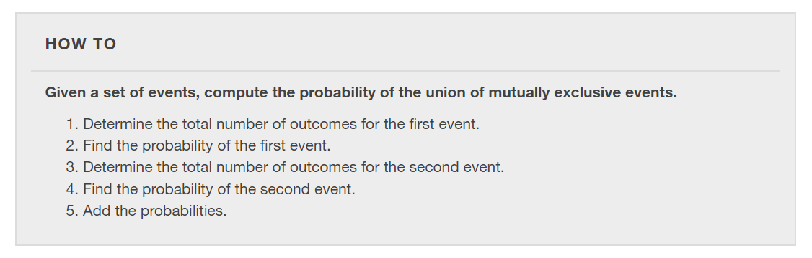

Slide 16
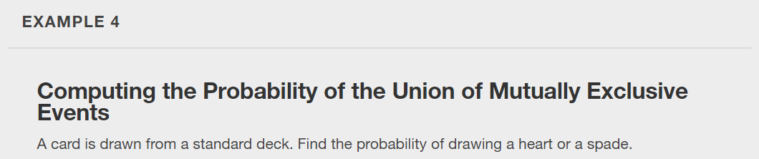

Slide 17
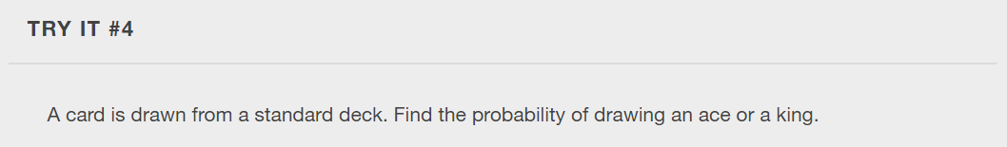

Slide 18
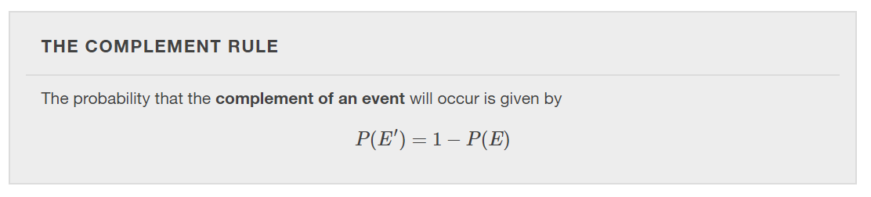
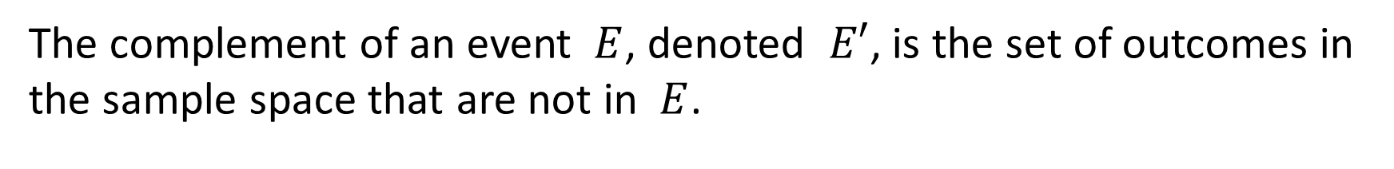
The complement of an event $E$, denoted $E′$, is the set of outcomes in the sample space that are not in $E$.
Notes:
For example, suppose we are interested in the probability that a horse will lose a race. If event W is the horse winning the race, then the complement of event W is the horse losing the race.

Slide 19
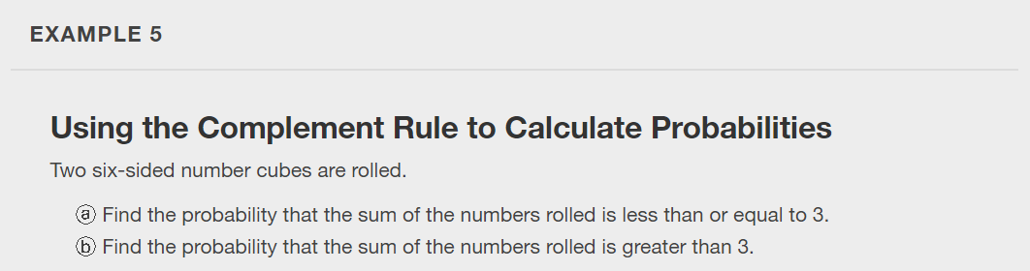

Slide 20
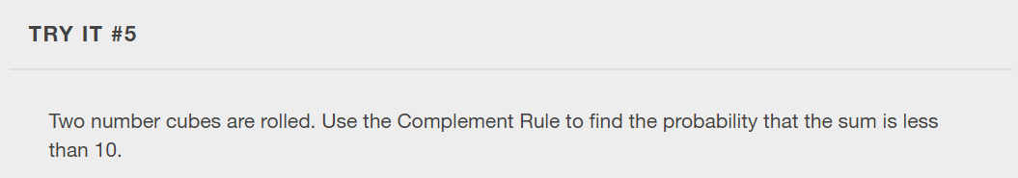

Slide 21
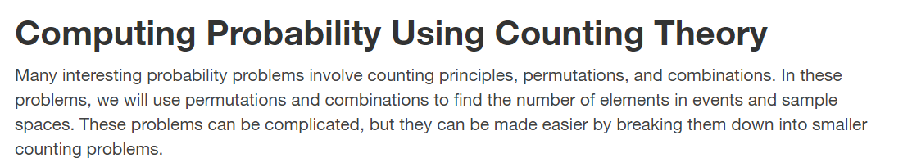

Slide 22
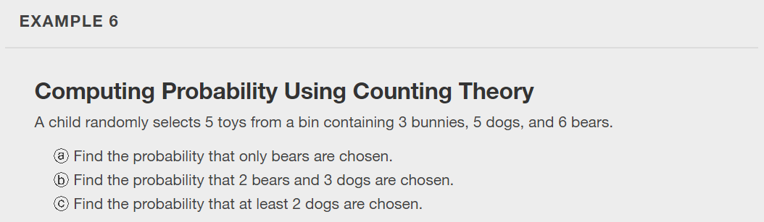

Slide 23
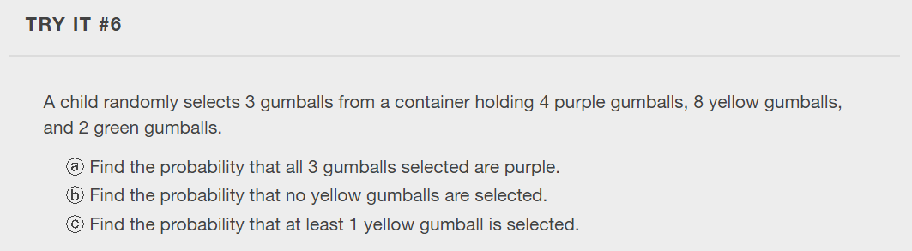

Slide 24
What did you learn in this section?
Construct probability models.
Compute probabilities of equally likely outcomes.
Compute probabilities of the union of two events.
Use the complement rule to find probabilities.
Compute probability using counting theory.
Notes:
Do you have any questions?

Slide 25
This resource is an adaptation of the OpenStax Algebra and Trigonometry 2e open textbook and is © Susan Aydelotte under a CC BY-NC-SA 4.0 International license; it may be reproduced or modified for noncommercial purposes only but must be attributed to OpenStax, Rice University and any changes must be noted. Any adaptation must be shared under the same type of license.

