Slide 1
Sequences, Probability, and Counting Theory
Chapter 13
Algebra and Trigonometry 2e, OpenStax, Jay Abramson
Notes:
Images and notes within these slides are from the OpenStax textbook Algebra and Trigonometry 2e

Slide 2
13.6 Binomial Theorem
Algebra and Trigonometry 2e, OpenStax, Jay Abramson
Notes:
Images and notes within these slides are from the OpenStax textbook Algebra and Trigonometry 2e

Slide 3
What are the learning objectives for this section?
Apply the Binomial Theorem.

Slide 5
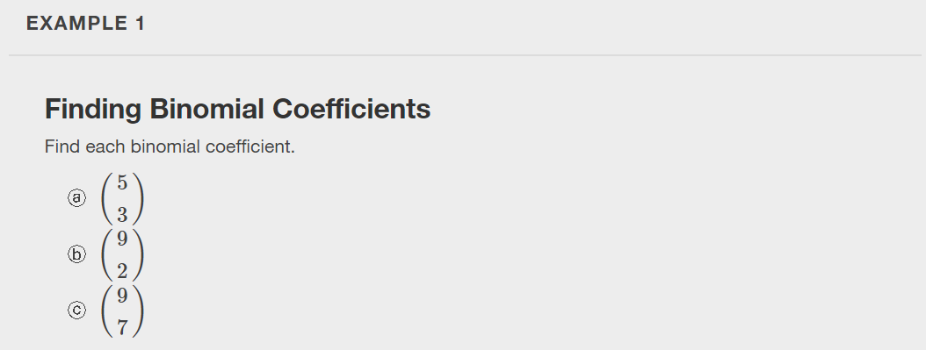

Slide 7
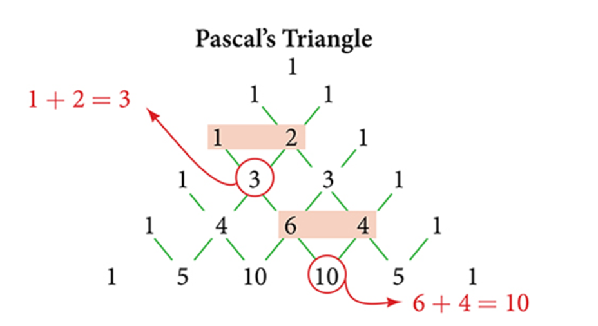
Notes:
First, let’s examine the exponents. With each successive term, the exponent for x decreases and the exponent for y increases. The sum of the two exponents is n for each term.
Next, let’s examine the coefficients. Notice that the coefficients increase and then decrease in a symmetrical pattern. The coefficients follow a pattern (described in Pascal’s Triangle) which leads us to the Binomial Theorem, which can be used to expand any binomial..

Slide 16
What did you learn in this section?
Apply the Binomial Theorem.
Notes:
Do you have any questions?

Slide 17
This resource is an adaptation of the OpenStax Algebra and Trigonometry 2e open textbook and is © Susan Aydelotte under a CC BY-NC-SA 4.0 International license; it may be reproduced or modified for noncommercial purposes only but must be attributed to OpenStax, Rice University and any changes must be noted. Any adaptation must be shared under the same type of license.

