Slide 1
Sequences, Probability, and Counting Theory
Chapter 13
Algebra and Trigonometry 2e, OpenStax, Jay Abramson
Notes:
Images and notes within these slides are from the OpenStax textbook Algebra and Trigonometry 2e

Slide 2
13.5 Counting Principles
Algebra and Trigonometry 2e, OpenStax, Jay Abramson
Notes:
Images and notes within these slides are from the OpenStax textbook Algebra and Trigonometry 2e

Slide 3
What are the learning objectives for this section?
Solve counting problems using the Addition Principle.
Solve counting problems using the Multiplication Principle.
Solve counting problems using permutations involving n distinct objects.
Solve counting problems using combinations.
Find the number of subsets of a given set.
Solve counting problems using permutations involving n non-distinct objects.

Slide 5
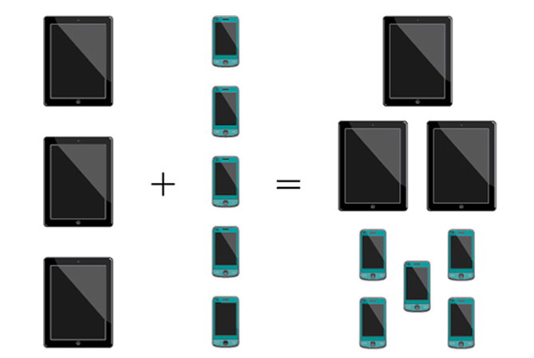
Using the Addition Principle
The company that sells customizable cases offers cases for tablets and smartphones. There are 3 supported tablet models and 5 supported smartphone models. The Addition Principle tells us that we can add the number of tablet options to the number of smartphone options to find the total number of options. By the Addition Principle, there are 8 total options.

Slide 9
Using the Multiplication Principle
The Multiplication Principle applies when we are making more than one selection. Suppose we are choosing an appetizer, an entrée, and a dessert. If there are 2 appetizer options, 3 entrée options, and 2 dessert options on a fixed-price dinner menu, there are a total of 12 possible choices of one each

Slide 12
Permutations of Objects
An ordering of objects is called a permutation.
Notes:
To solve permutation problems, it is often helpful to draw line segments for each option, then we write the number of possibilities for each option, and finally multiply the numbers together to find the number of permutations. For instance, suppose we have four paintings, and we want to find the number of ways we can hang three of the paintings in order on the wall. We can draw three lines to represent the three places on the wall. There are four options for the first place, three options for the second place, and two options for the third place. There are 24 possible permutations of the paintings, or in other words there are 24 different orderings to put the paintings on the wall.

Slide 14
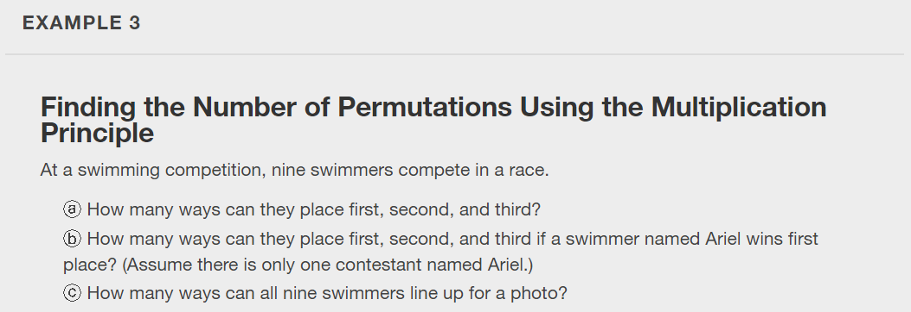

Slide 20
Combinations of Objects
A combination is a selection of objects where the order of the objects does not matter.
For example, selecting two people from a group of twenty individuals.
Notes:
To solve permutation problems, it is often helpful to draw line segments for each option, then we write the number of possibilities for each option, and finally multiply the numbers together to find the number of permutations. For instance, suppose we have four paintings, and we want to find the number of ways we can hang three of the paintings in order on the wall. We can draw three lines to represent the three places on the wall. There are four options for the first place, three options for the second place, and two options for the third place. There are 24 possible permutations of the paintings, or in other words there are 24 different orderings to put the paintings on the wall.

Slide 32
What did you learn in this section?
Solve counting problems using the Addition Principle.
Solve counting problems using the Multiplication Principle.
Solve counting problems using permutations involving n distinct objects.
Solve counting problems using combinations.
Find the number of subsets of a given set.
Solve counting problems using permutations involving n non-distinct objects.
Notes:
Do you have any questions?

Slide 33
This resource is an adaptation of the OpenStax Algebra and Trigonometry 2e open textbook and is © Susan Aydelotte under a CC BY-NC-SA 4.0 International license; it may be reproduced or modified for noncommercial purposes only but must be attributed to OpenStax, Rice University and any changes must be noted. Any adaptation must be shared under the same type of license.

