Slide 1
Sequences, Probability, and Counting Theory
Chapter 13
Algebra and Trigonometry 2e, OpenStax, Jay Abramson
Notes:
Images and notes within these slides are from the OpenStax textbook Algebra and Trigonometry 2e

Slide 2
13.4 Series and Their Notations
Algebra and Trigonometry 2e, OpenStax, Jay Abramson
Notes:
Images and notes within these slides are from the OpenStax textbook Algebra and Trigonometry 2e

Slide 3
What are the learning objectives for this section?
Use summation notation.
Use the formula for the sum of the ﬁrst n terms of an arithmetic series.
Use the formula for the sum of the ﬁrst n terms of a geometric series.
Use the formula for the sum of an inﬁnite geometric series.
Solve annuity problems.

Slide 4
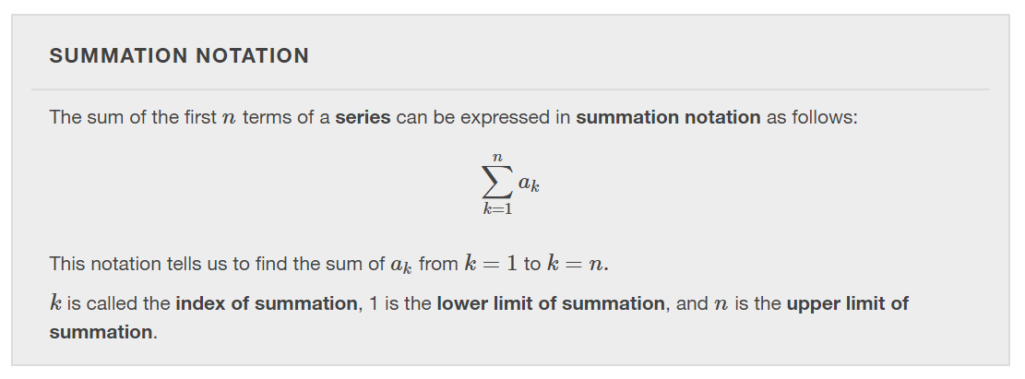

Slide 29
Solving Annuity Problems
An annuity is an investment in which the purchaser makes a sequence of periodic, equal payments. To find the amount of an annuity, we need to find the sum of all the payments and the interest earned.

Slide 30
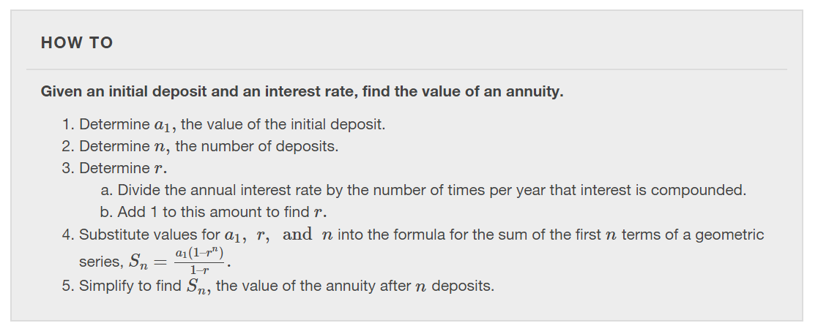

Slide 33
What did you learn in this section?
Notes:
Do you have any questions?

Slide 34
This resource is an adaptation of the OpenStax Algebra and Trigonometry 2e open textbook and is © Susan Aydelotte under a CC BY-NC-SA 4.0 International license; it may be reproduced or modified for noncommercial purposes only but must be attributed to OpenStax, Rice University and any changes must be noted. Any adaptation must be shared under the same type of license.

