Slide 1
Analytic Geometry
Chapter 12
Algebra and Trigonometry 2e, OpenStax, Jay Abramson
Notes:
Images and notes within these slides are from the OpenStax textbook Algebra and Trigonometry 2e

Slide 2
12.5 Conic Sections in Polar Coordinates
Algebra and Trigonometry 2e, OpenStax, Jay Abramson
Notes:
Images and notes within these slides are from the OpenStax textbook Algebra and Trigonometry 2e

Slide 3
What are the learning objectives for this section?
Identify a conic in polar form.
Graph the polar equations of conics.
Deﬁne conics in terms of a focus and a directrix.

Slide 4
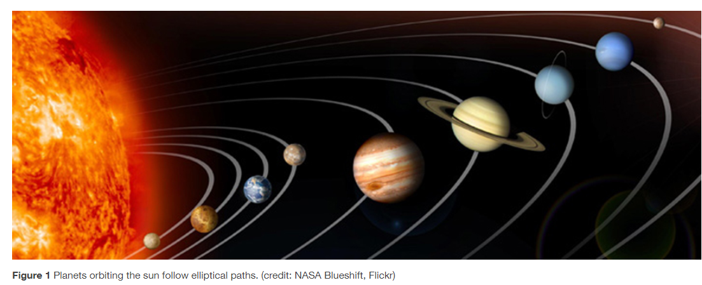
Notes:
Most of us are familiar with orbital motion, such as the motion of a planet around the sun or an electron around an atomic nucleus. Within the planetary system, orbits of planets, asteroids, and comets around a larger celestial body are often elliptical. Comets, however, may take on a parabolic or hyperbolic orbit instead. And, in reality, the characteristics of the planets’ orbits may vary over time. Each orbit is tied to the location of the celestial body being orbited and the distance and direction of the planet or other object from that body. As a result, we tend to use polar coordinates to represent these orbits.

Slide 5
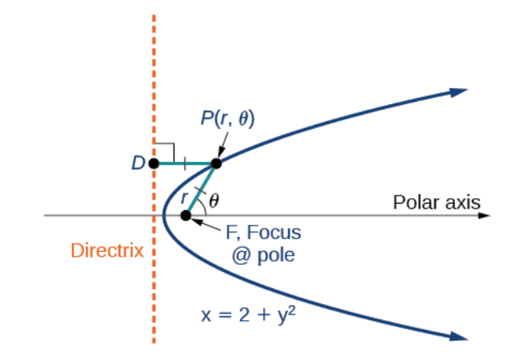

Slide 15
Notes:
So far we have been using polar equations of conics to describe and graph the curve. Now we will work in reverse; we will use information about the origin, eccentricity, and directrix to determine the polar equation.

Slide 21
What did you learn in this section?
Identify a conic in polar form.
Graph the polar equations of conics.
Deﬁne conics in terms of a focus and a directrix.
Notes:
Do you have any questions?

Slide 22
This resource is an adaptation of the OpenStax Algebra and Trigonometry 2e open textbook and is © Susan Aydelotte under a CC BY-NC-SA 4.0 International license; it may be reproduced or modified for noncommercial purposes only but must be attributed to OpenStax, Rice University and any changes must be noted. Any adaptation must be shared under the same type of license.

