Slide 1
Analytic Geometry
Chapter 12
Algebra and Trigonometry 2e, OpenStax, Jay Abramson
Notes:
Images and notes within these slides are from the OpenStax textbook Algebra and Trigonometry 2e

Slide 2
12.4 Rotation of Axes
Algebra and Trigonometry 2e, OpenStax, Jay Abramson
Notes:
Images and notes within these slides are from the OpenStax textbook Algebra and Trigonometry 2e

Slide 3
What are the learning objectives for this section?
Identify nondegenerate conic sections given their general form equations.
Use rotation of axes formulas.
Write equations of rotated conics in standard form.
Identify conics without rotating axes.

Slide 4
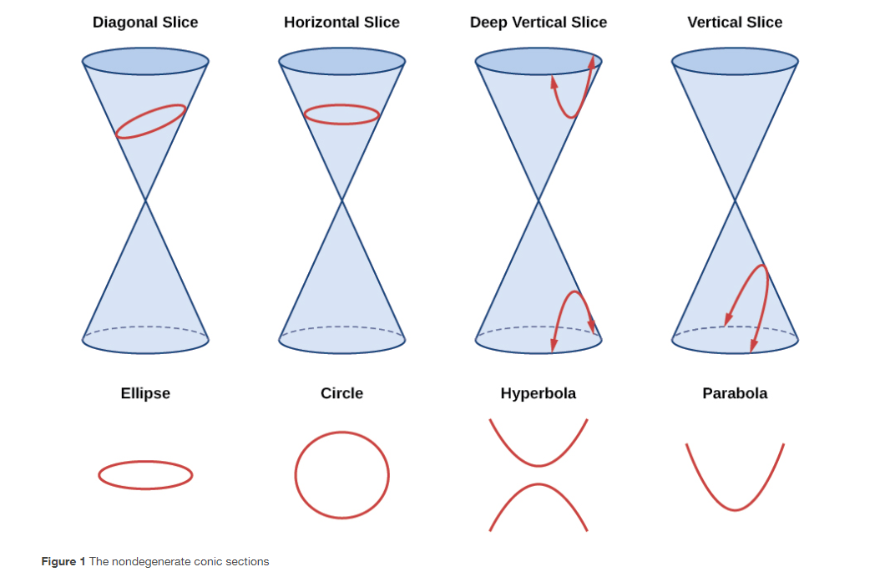

Slide 5
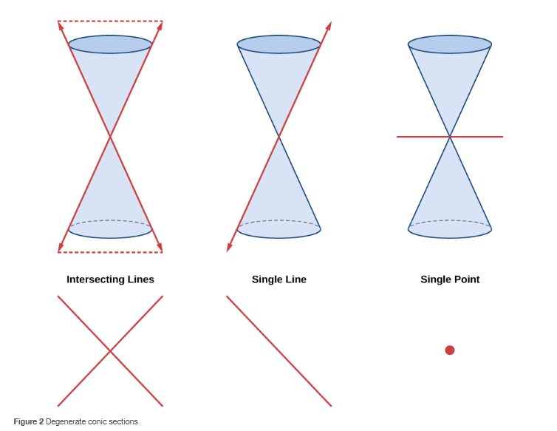

Slide 11
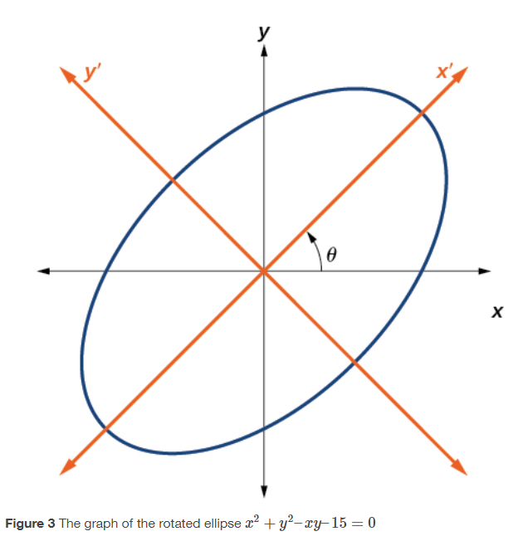

Slide 14
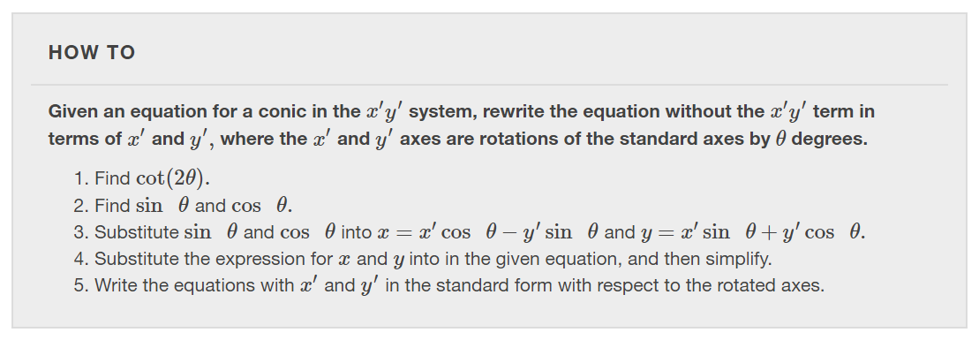

Slide 21
What did you learn in this section?
Identify nondegenerate conic sections given their general form equations.
Use rotation of axes formulas.
Write equations of rotated conics in standard form.
Identify conics without rotating axes.
Notes:
Do you have any questions?

Slide 22
This resource is an adaptation of the OpenStax Algebra and Trigonometry 2e open textbook and is © Susan Aydelotte under a CC BY-NC-SA 4.0 International license; it may be reproduced or modified for noncommercial purposes only but must be attributed to OpenStax, Rice University and any changes must be noted. Any adaptation must be shared under the same type of license.

