Slide 1
Analytic Geometry
Chapter 12
Algebra and Trigonometry 2e, OpenStax, Jay Abramson
Notes:
Images and notes within these slides are from the OpenStax textbook Algebra and Trigonometry 2e

Slide 2
12.3 The Parabola
Algebra and Trigonometry 2e, OpenStax, Jay Abramson
Notes:
Images and notes within these slides are from the OpenStax textbook Algebra and Trigonometry 2e

Slide 3
What are the learning objectives for this section?
Graph parabolas with vertices at the origin.
Write equations of parabolas in standard form.
Graph parabolas with vertices not at the origin.
Solve applied problems involving parabolas.

Slide 4
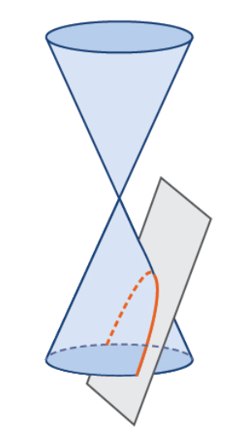
Parabolas
A parabola is formed when a plane cuts through a right circular cone and the plane is parallel to the edge of the cone. Notice that an unbounded curve is formed.

Slide 5
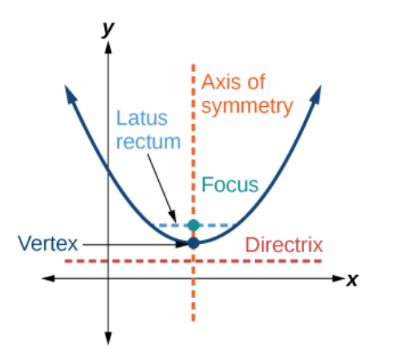
Key features of the Parabola
Notes:
Like the ellipse and hyperbola, the parabola can also be defined by a set of points in the coordinate plane. A parabola is the set of all points (x,y) in a plane that are the same distance from a fixed line, called the directrix, and a fixed point (the focus) not on the directrix. Notice that the axis of symmetry passes through the focus and vertex and is perpendicular to the directrix. The vertex is the midpoint between the directrix and the focus. The line segment that passes through the focus and is parallel to the directrix is called the latus rectum. The endpoints of the latus rectum lie on the curve. By definition, the distance dd from the focus to any point P on the parabola is equal to the distance from P to the directrix.

Slide 6
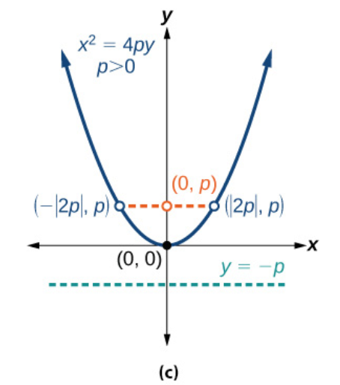
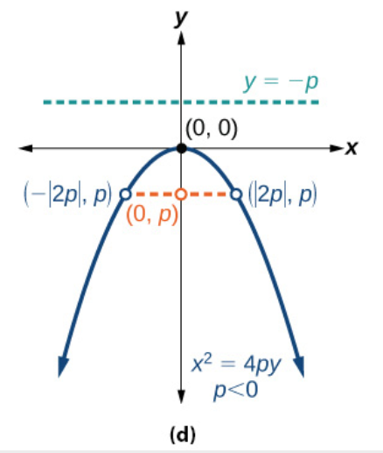
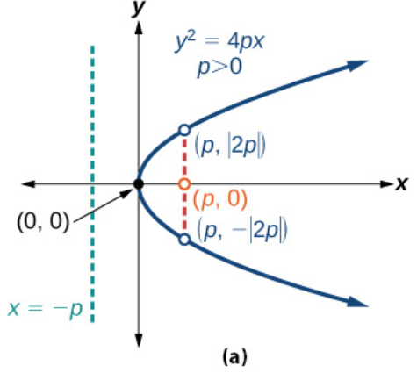
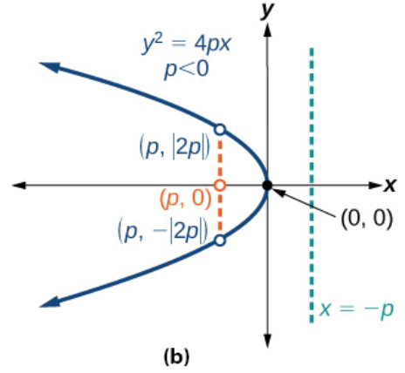
Notes:
(a) When p>0 and the axis of symmetry is the x-axis, the parabola opens right. (b) When p<0 and the axis of symmetry is the x-axis, the parabola opens left. (c) When p>0 and the axis of symmetry is the y-axis, the parabola opens up. (d) When p<0 and the axis of symmetry is the y-axis, the parabola opens down. The key features of a parabola are its vertex, axis of symmetry, focus, directrix, and latus rectum. See Figure 5. When given a standard equation for a parabola centered at the origin, we can easily identify the key features to graph the parabola.

Slide 7
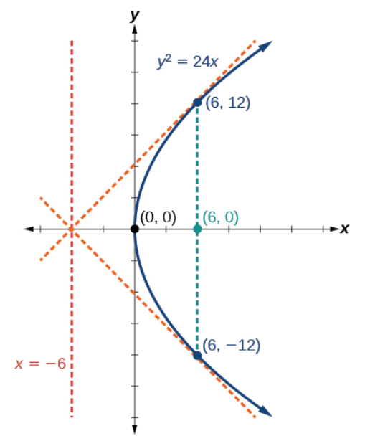
A line is said to be tangent to a curve if it intersects the curve at exactly one point. If we sketch lines tangent to the parabola at the endpoints of the latus rectum, these lines intersect on the axis of symmetry.

Slide 14
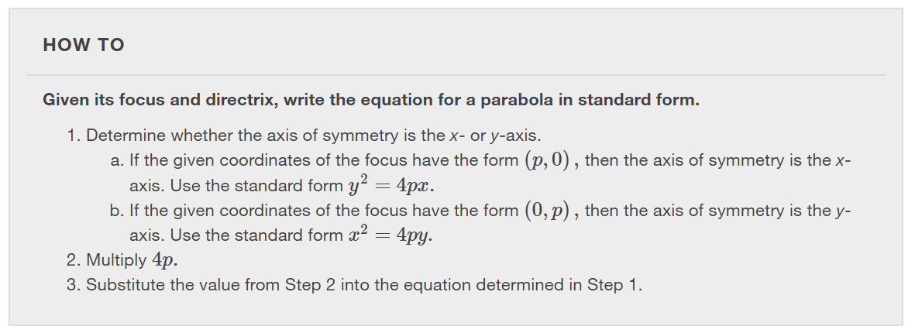

Slide 17
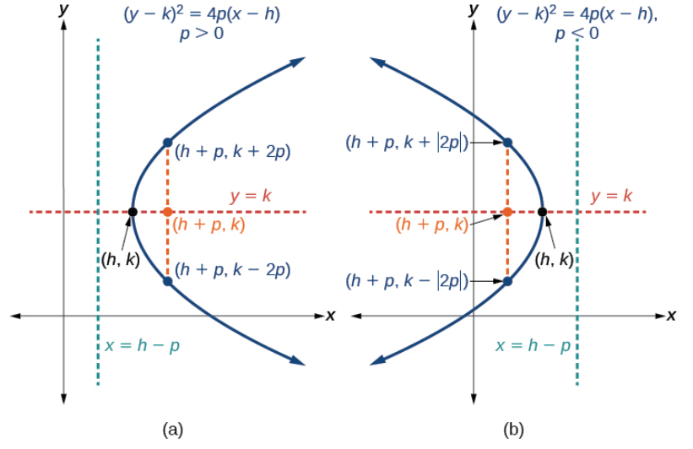
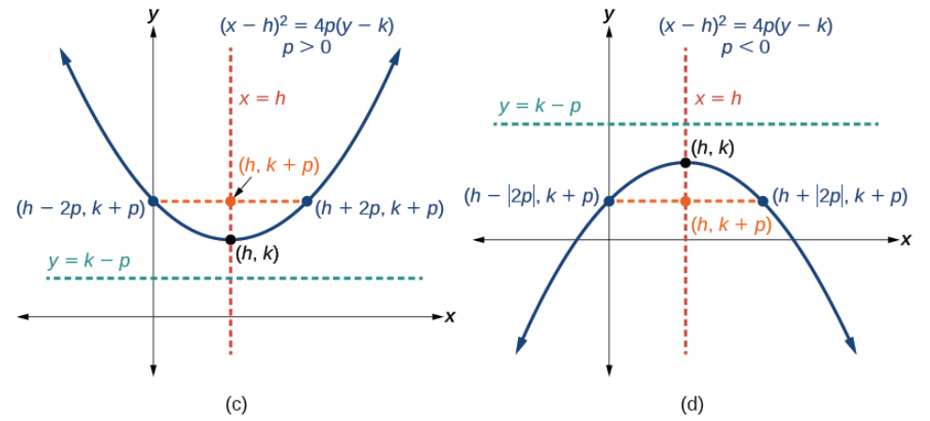
Notes:
See next two slides for larger images for the four figures.

Slide 19
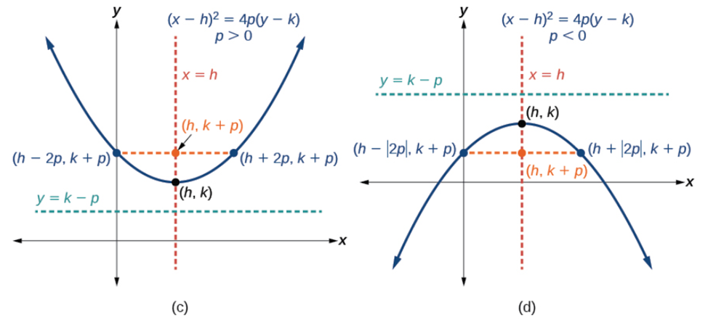

Slide 20
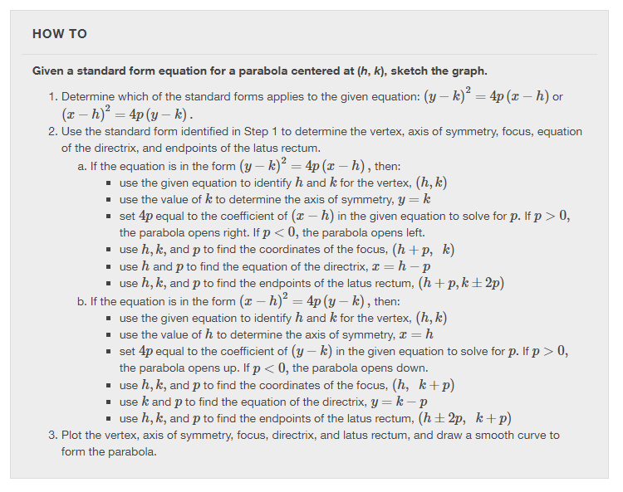

Slide 25
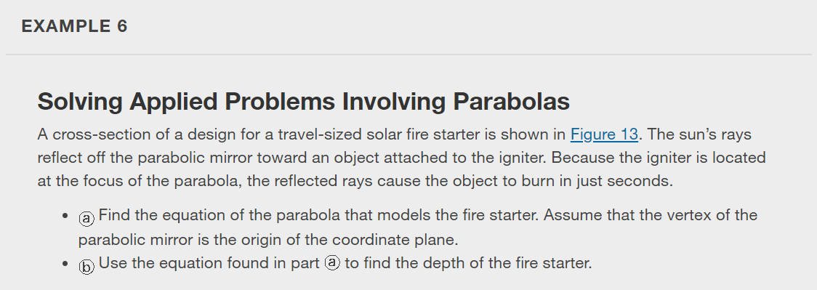
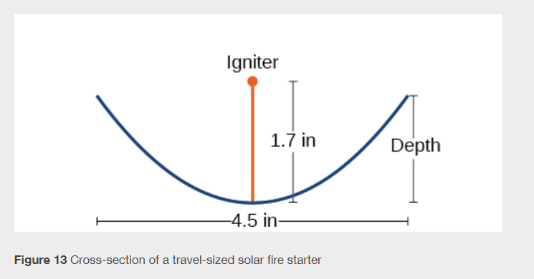

Slide 26
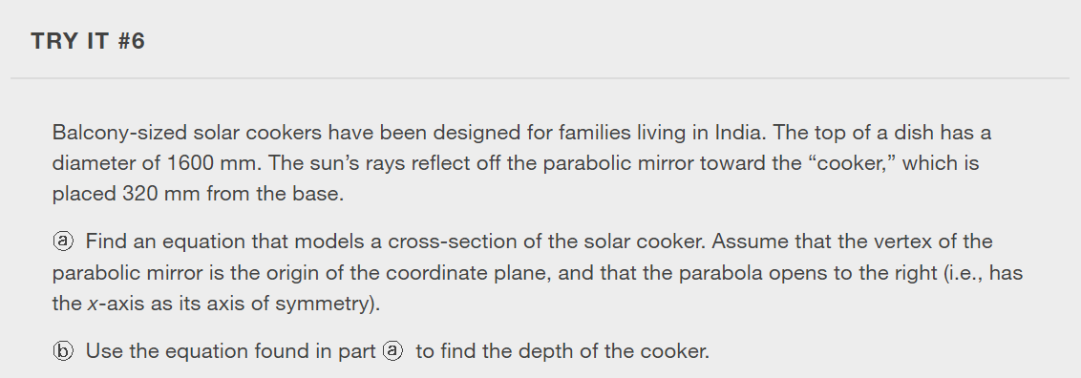

Slide 27
What did you learn in this section?
Graph parabolas with vertices at the origin.
Write equations of parabolas in standard form.
Graph parabolas with vertices not at the origin.
Solve applied problems involving parabolas.
Notes:
Do you have any questions?

Slide 28
This resource is an adaptation of the OpenStax Algebra and Trigonometry 2e open textbook and is © Susan Aydelotte under a CC BY-NC-SA 4.0 International license; it may be reproduced or modified for noncommercial purposes only but must be attributed to OpenStax, Rice University and any changes must be noted. Any adaptation must be shared under the same type of license.

