Slide 1
Analytic Geometry
Chapter 12
Algebra and Trigonometry 2e, OpenStax, Jay Abramson
Notes:
Images and notes within these slides are from the OpenStax textbook Algebra and Trigonometry 2e

Slide 2
12.2 The Hyperbola
Algebra and Trigonometry 2e, OpenStax, Jay Abramson
Notes:
Images and notes within these slides are from the OpenStax textbook Algebra and Trigonometry 2e

Slide 3
What are the learning objectives for this section?
Locate a hyperbola’s vertices and foci.
Write equations of hyperbolas in standard form.
Graph hyperbolas centered at the origin.
Graph hyperbolas not centered at the origin.
Solve applied problems involving hyperbolas.

Slide 4
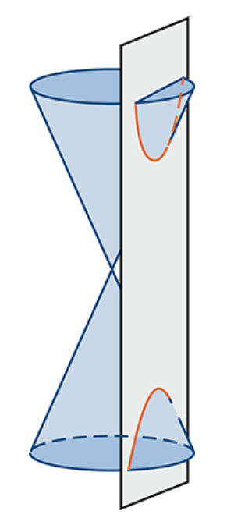
Hyperbola
A hyperbola is a conic section formed by intersecting a right circular cone with a plane at an angle such that both halves of the cone are intersected. This intersection produces two separate unbounded curves that are mirror images of each other.
Notes:
Like the ellipse, the hyperbola can also be defined as a set of points in the coordinate plane. A hyperbola is the set of all points (x,y) in a plane such that the difference of the distances between (x,y) and the foci is a positive constant. Notice that the definition of a hyperbola is very similar to that of an ellipse. The distinction is that the hyperbola is defined in terms of the difference of two distances, whereas the ellipse is defined in terms of the sum of two distances.

Slide 5
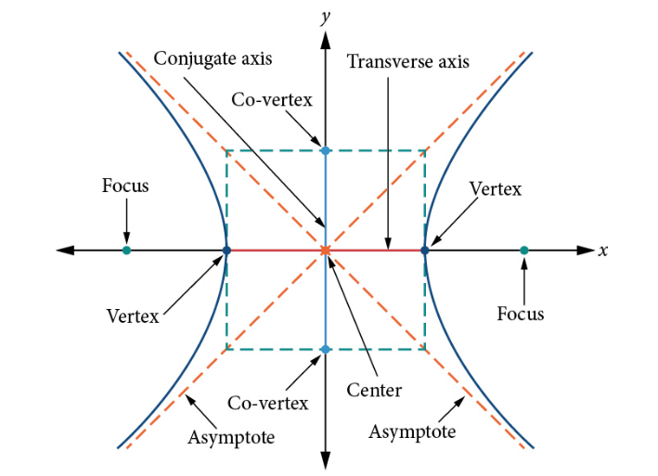
Key features of a Hyperbola
Notes:
As with the ellipse, every hyperbola has two axes of symmetry. The transverse axis is a line segment that passes through the center of the hyperbola and has vertices as its endpoints. The foci lie on the line that contains the transverse axis. The conjugate axis is perpendicular to the transverse axis and has the co-vertices as its endpoints. The center of a hyperbola is the midpoint of both the transverse and conjugate axes, where they intersect. Every hyperbola also has two asymptotes that pass through its center. As a hyperbola recedes from the center, its branches approach these asymptotes. The central rectangle of the hyperbola is centered at the origin with sides that pass through each vertex and co-vertex; it is a useful tool for graphing the hyperbola and its asymptotes. To sketch the asymptotes of the hyperbola, simply sketch and extend the diagonals of the central rectangle.

Slide 6
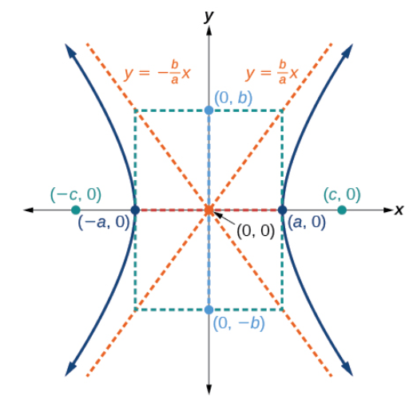
Notes:
Note that the vertices, co-vertices, and foci are related by the equation c^2=a^2+b^2. When we are given the equation of a hyperbola, we can use this relationship to identify its vertices and foci.

Slide 7
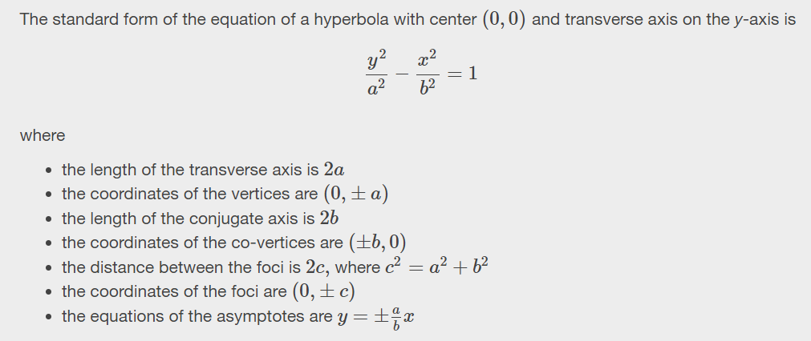
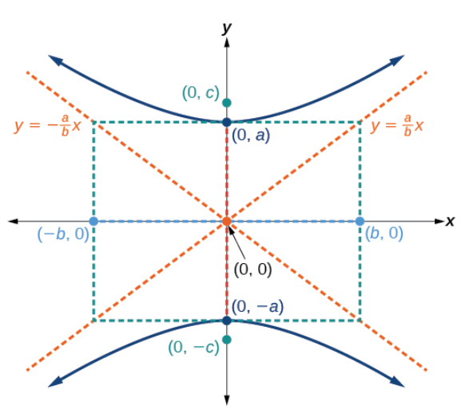

Slide 14
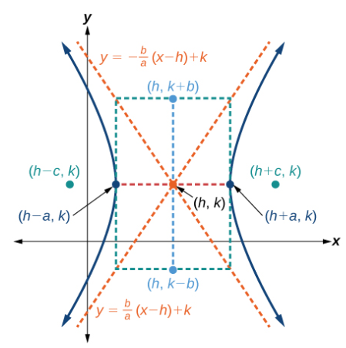

Slide 15
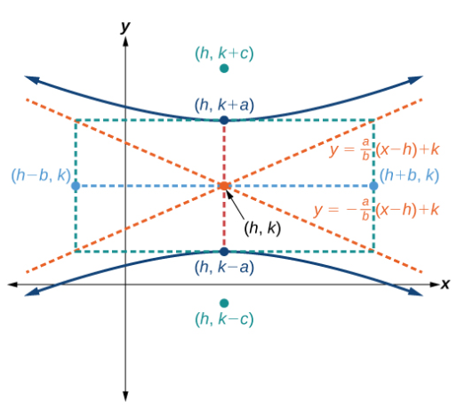

Slide 22
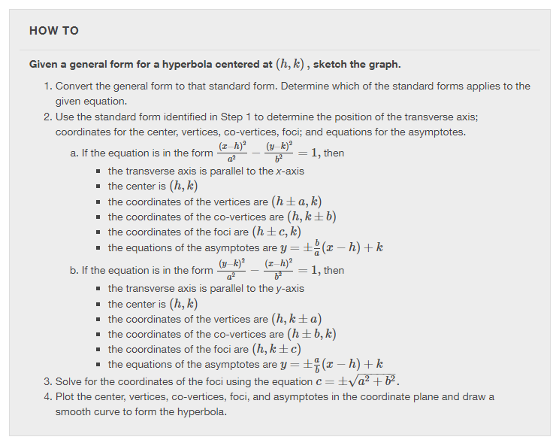

Slide 25
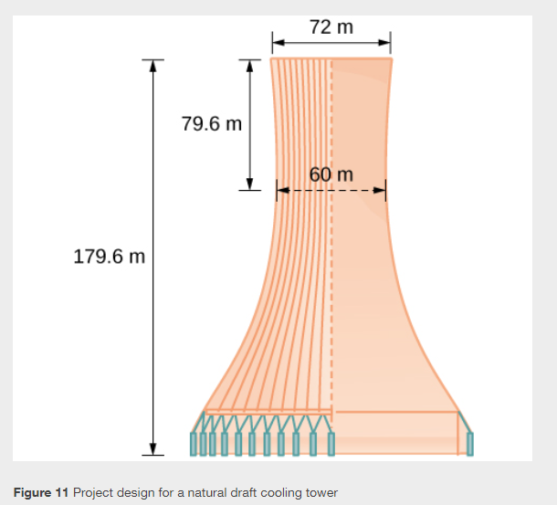

Slide 26
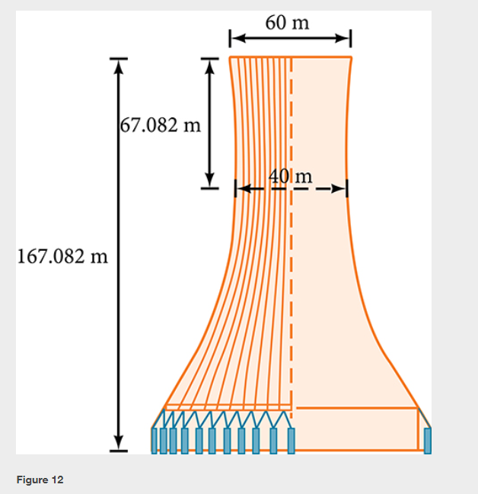

Slide 27
What did you learn in this section?
Locate a hyperbola’s vertices and foci.
Write equations of hyperbolas in standard form.
Graph hyperbolas centered at the origin.
Graph hyperbolas not centered at the origin.
Solve applied problems involving hyperbolas.
Notes:
Do you have any questions?

Slide 28
This resource is an adaptation of the OpenStax Algebra and Trigonometry 2e open textbook and is © Susan Aydelotte under a CC BY-NC-SA 4.0 International license; it may be reproduced or modified for noncommercial purposes only but must be attributed to OpenStax, Rice University and any changes must be noted. Any adaptation must be shared under the same type of license.

