Slide 1

Analytic Geometry
Chapter 12
Algebra and Trigonometry 2e, OpenStax, Jay Abramson
Notes:
Images and notes within these slides are from the OpenStax textbook Algebra and Trigonometry 2e

Slide 2
12.1 The Ellipse
Algebra and Trigonometry 2e, OpenStax, Jay Abramson
Notes:
Images and notes within these slides are from the OpenStax textbook Algebra and Trigonometry 2e

Slide 3
What are the learning objectives for this section?
Write equations of ellipses in standard form.
Graph ellipses centered at the origin.
Graph ellipses not centered at the origin.
Solve applied problems involving ellipses.

Slide 4
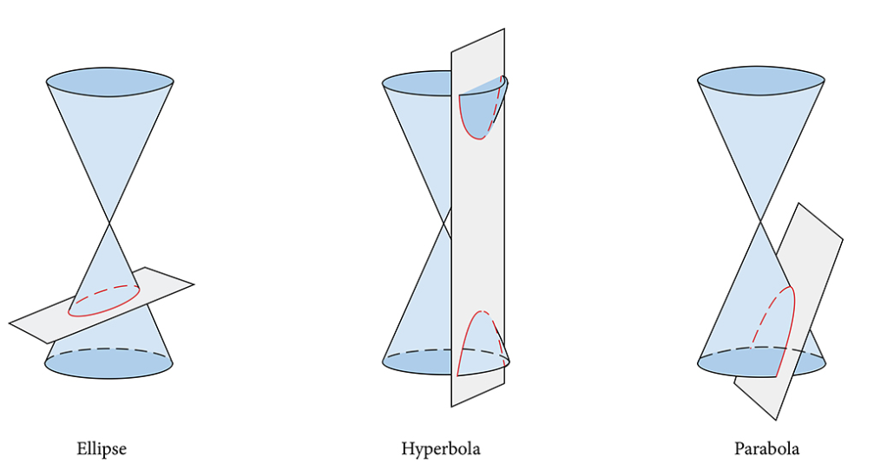
Conic Section
A conic section, or conic, is a shape resulting from intersecting a right circular cone with a plane. The angle at which the plane intersects the cone determines the shape.

Slide 5
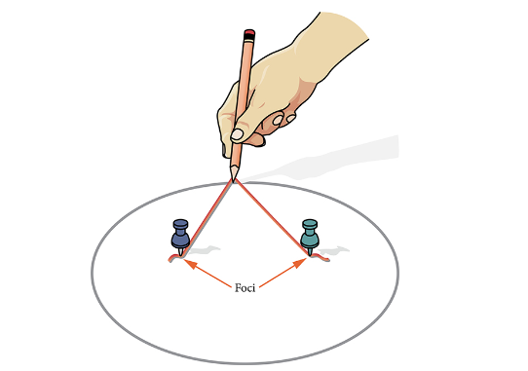
Ellipse
An ellipse is the set of all points (x,y) in a plane such that the sum of their distances from two fixed points is a constant. Each fixed point is called a focus (plural: foci).
Notes:
We can draw an ellipse using a piece of cardboard, two thumbtacks, a pencil, and string. Place the thumbtacks in the cardboard to form the foci of the ellipse. Cut a piece of string longer than the distance between the two thumbtacks (the length of the string represents the constant in the definition). Tack each end of the string to the cardboard, and trace a curve with a pencil held taut against the string. The result is an ellipse. See

Slide 6
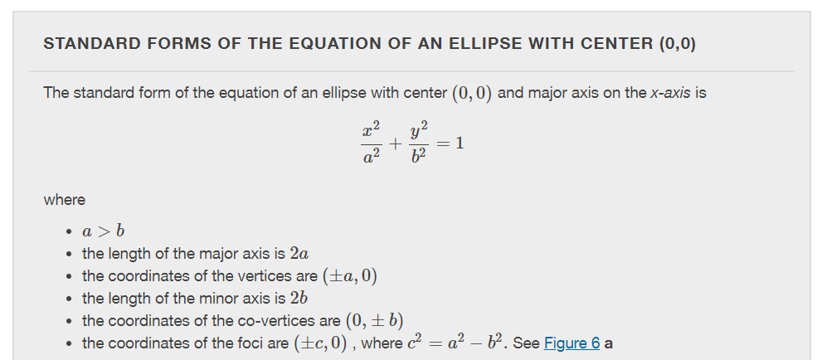
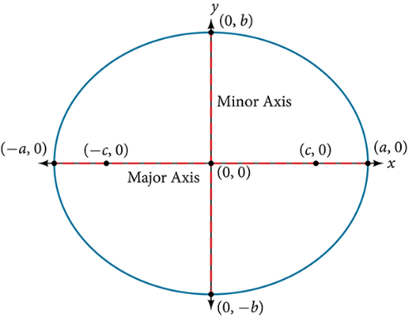

Slide 7
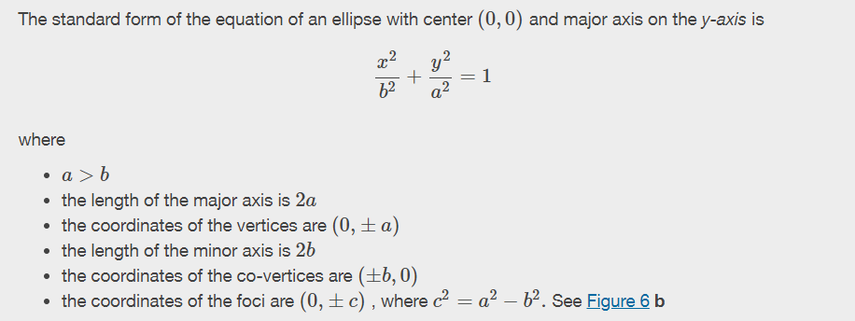
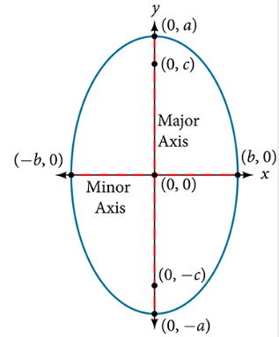

Slide 8
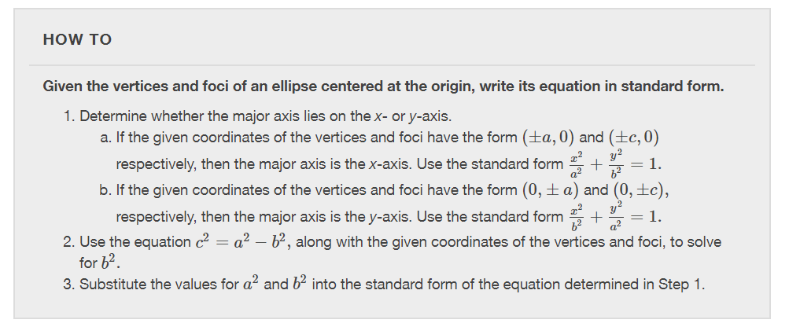

Slide 9
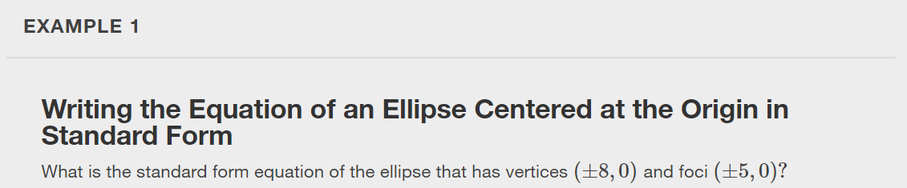

Slide 10
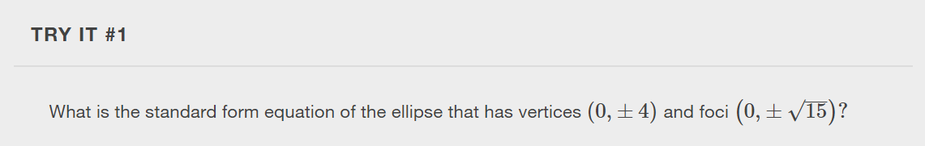

Slide 11
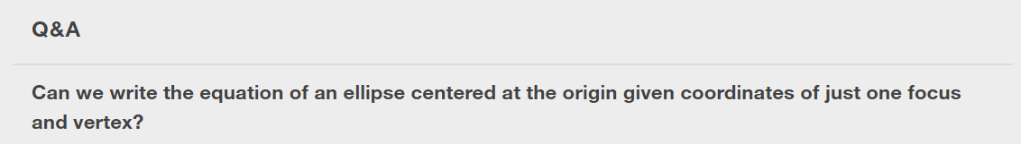
Notes:
Yes. Ellipses are symmetrical, so the coordinates of the vertices of an ellipse centered around the origin will always have the form (±a,0) or (0,±a). Similarly, the coordinates of the foci will always have the form (±c,0) or (0,±c). Knowing this, we can use a and c from the given points, along with the equation c^2=a^2−b^2, to find b^2.

Slide 12
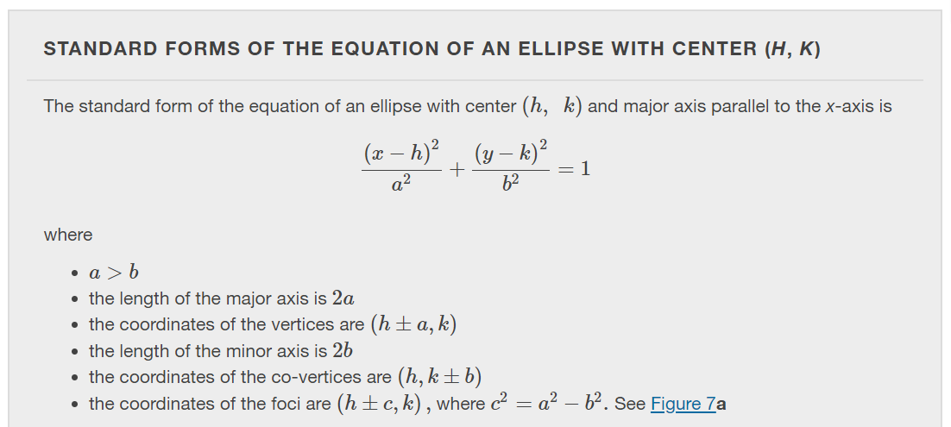
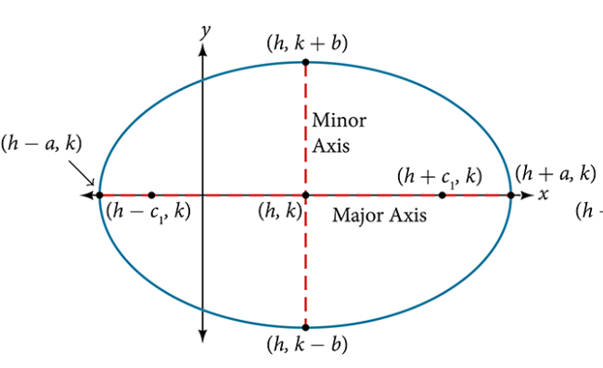
Notes:
Like the graphs of other equations, the graph of an ellipse can be translated. If an ellipse is translated h units horizontally and k units vertically, the center of the ellipse will be (h,k). This translation results in the standard form of the equation we saw previously, with x replaced by (x−h) and y replaced by (y−k).

Slide 13
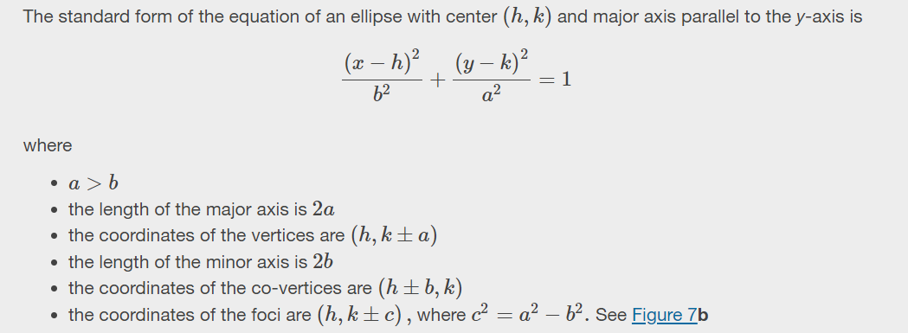
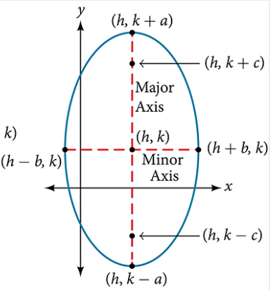

Notes:
Like the graphs of other equations, the graph of an ellipse can be translated. If an ellipse is translated h units horizontally and k units vertically, the center of the ellipse will be (h,k). This translation results in the standard form of the equation we saw previously, with x replaced by (x−h) and y replaced by (y−k).

Slide 14
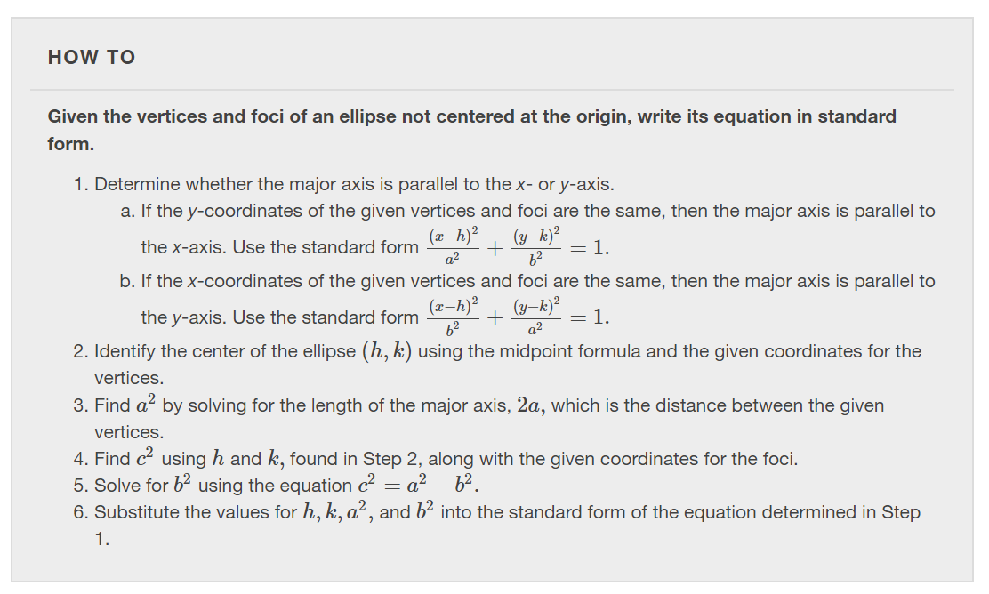

Slide 15
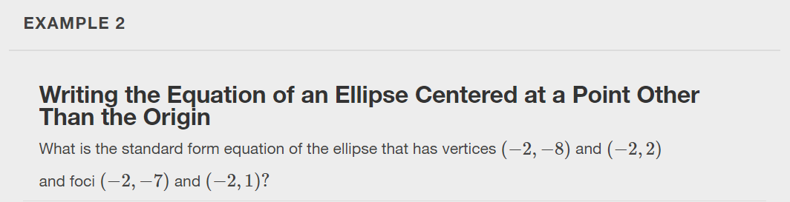

Slide 16
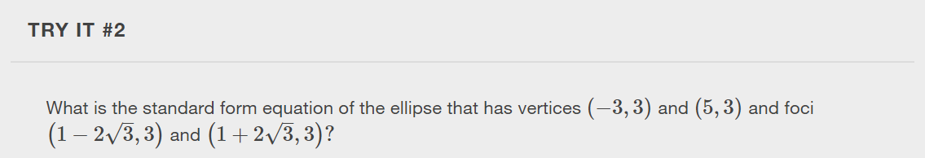

Slide 17
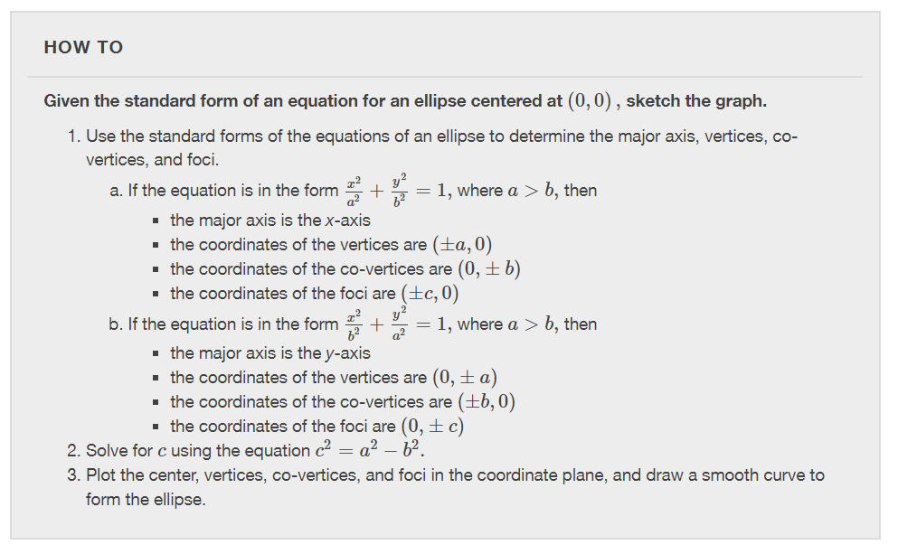

Slide 18
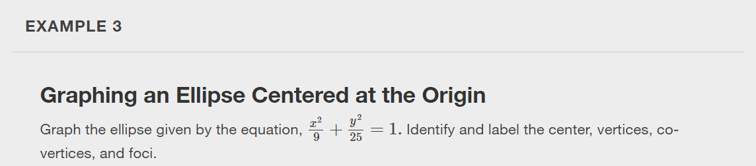

Slide 19
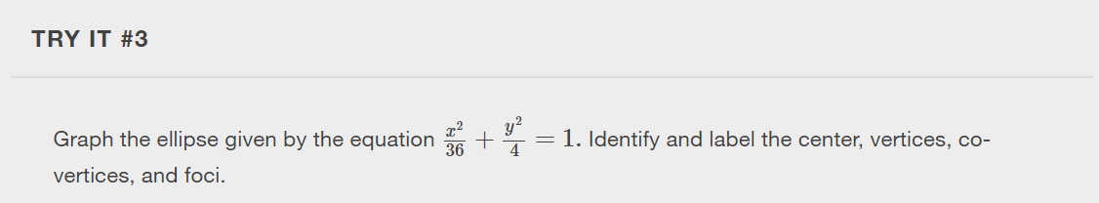

Slide 20
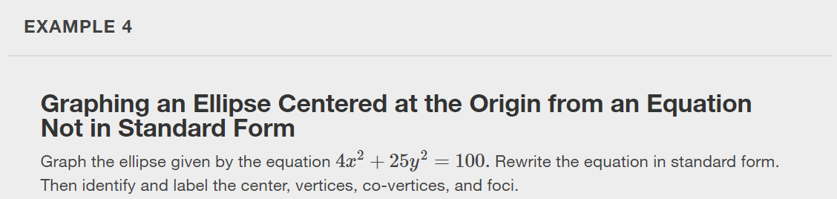

Slide 21
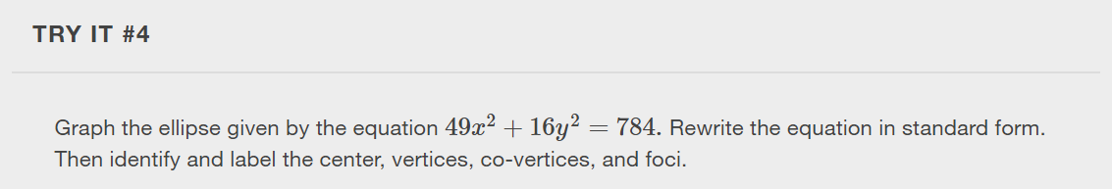

Slide 22
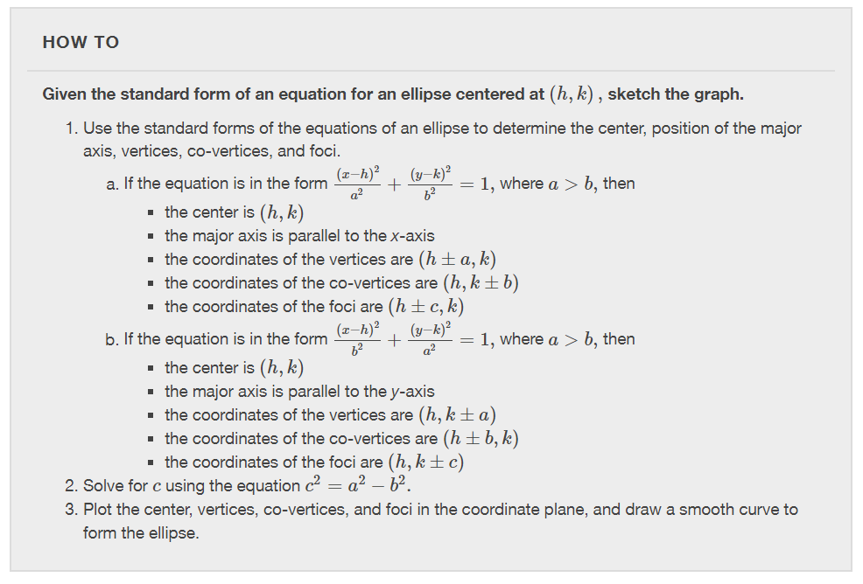

Slide 23
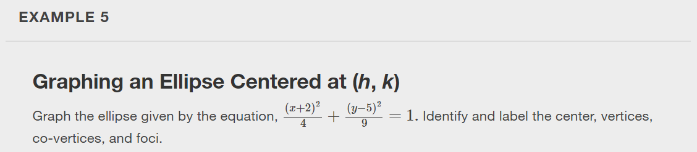

Slide 24
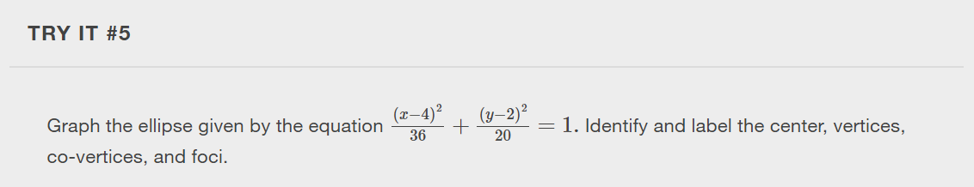

Slide 25
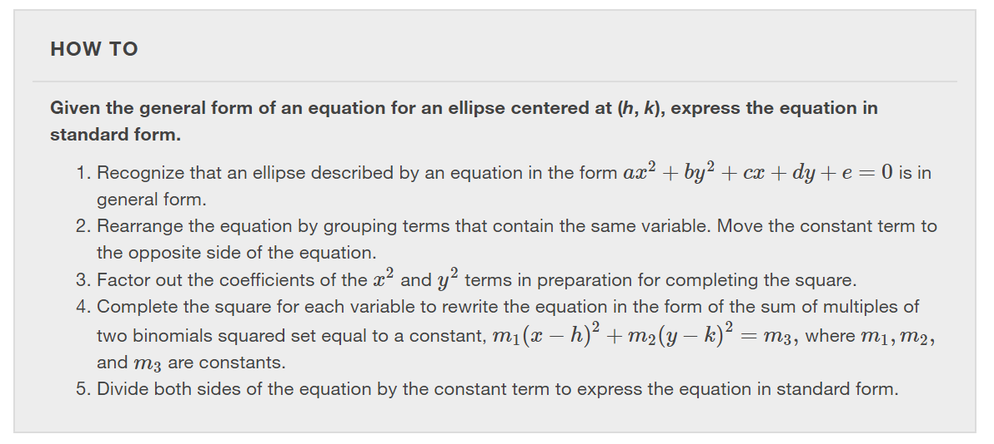

Slide 26
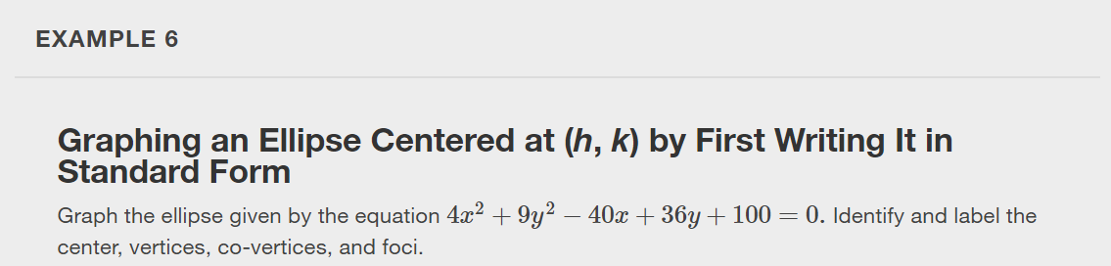

Slide 27
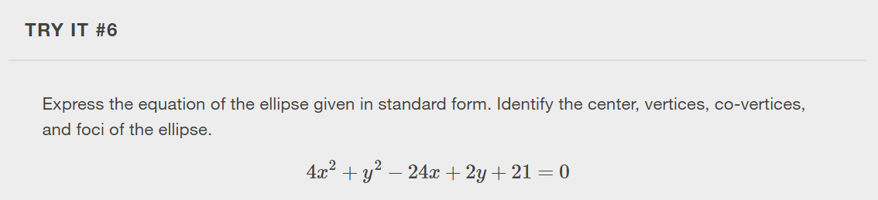

Slide 28
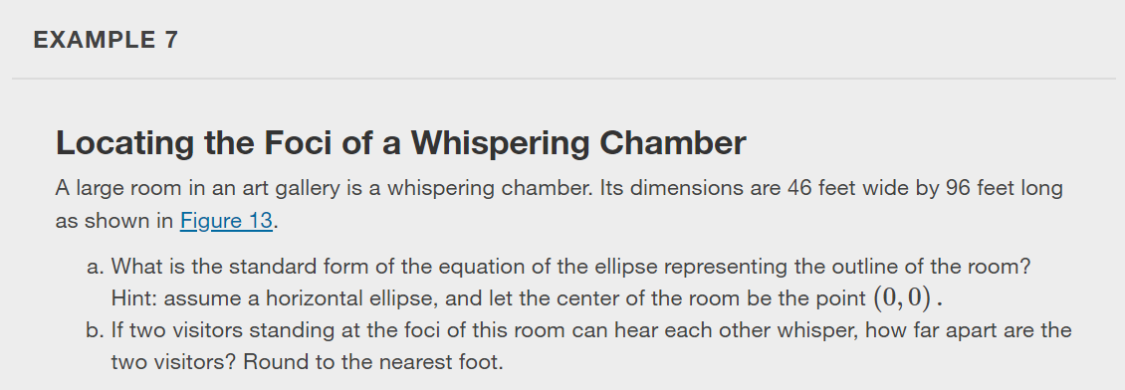
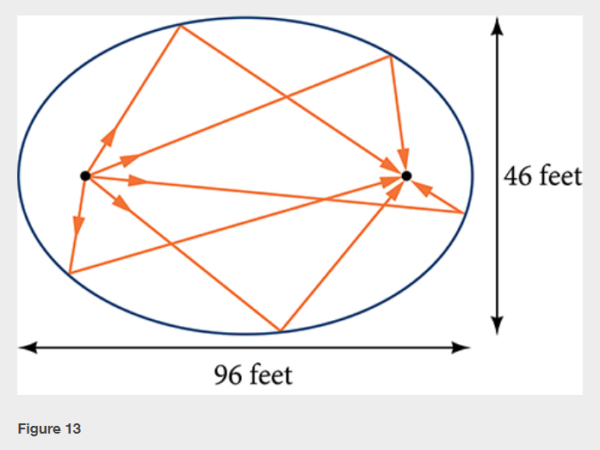

Slide 29
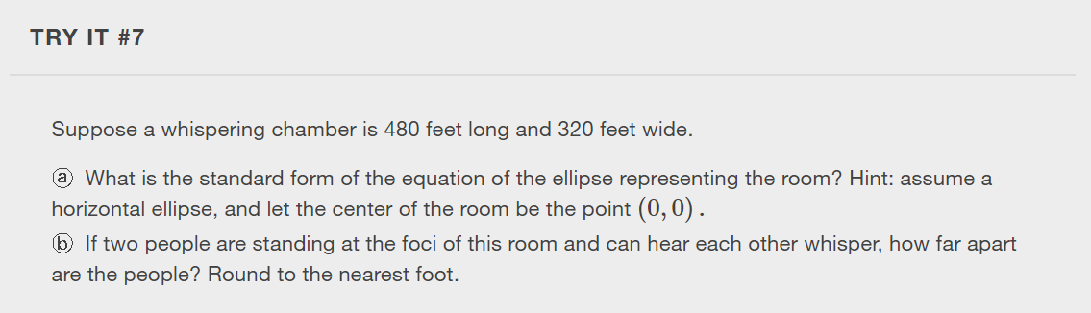

Slide 30
What did you learn in this section?
Write equations of ellipses in standard form.
Graph ellipses centered at the origin.
Graph ellipses not centered at the origin.
Solve applied problems involving ellipses.
Notes:
Do you have any questions?

Slide 31
This resource is an adaptation of the OpenStax Algebra and Trigonometry 2e open textbook and is © Susan Aydelotte under a CC BY-NC-SA 4.0 International license; it may be reproduced or modified for noncommercial purposes only but must be attributed to OpenStax, Rice University and any changes must be noted. Any adaptation must be shared under the same type of license.

