Slide 1

Systems of Equations and Inequalities
Chapter 11
Algebra and Trigonometry 2e, OpenStax, Jay Abramson
Notes:
Images and notes within these slides are from the OpenStax textbook Algebra and Trigonometry 2e

Slide 2
11.8 Solving Systems with Cramer's Rule
Algebra and Trigonometry 2e, OpenStax, Jay Abramson
Notes:
Images and notes within these slides are from the OpenStax textbook Algebra and Trigonometry 2e

Slide 3
What are the learning objectives for this section?
Evaluate 2 × 2 determinants.
Use Cramer’s Rule to solve a system of equations in two variables.
Evaluate 3 × 3 determinants.
Use Cramer’s Rule to solve a system of three equations in three variables.
Know the properties of determinants.

Slide 4
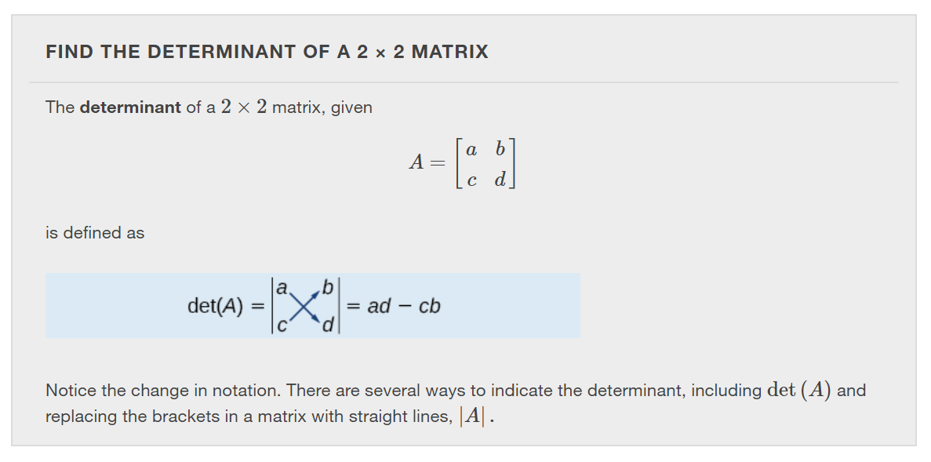
Notes:
A determinant is a real number that can be very useful in mathematics because it has multiple applications, such as calculating area, volume, and other quantities. Here, we will use determinants to reveal whether a matrix is invertible by using the entries of a square matrix to determine whether there is a solution to the system of equations. Perhaps one of the more interesting applications, however, is their use in cryptography. Secure signals or messages are sometimes sent encoded in a matrix. The data can only be decrypted with an invertible matrix and the determinant. For our purposes, we focus on the determinant as an indication of the invertibility of the matrix. Calculating the determinant of a matrix involves following the specific patterns that are outlined in this section.

Slide 5
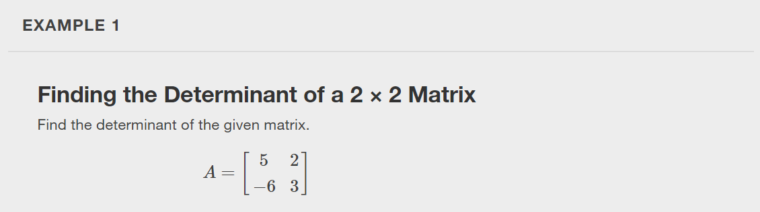

Slide 6
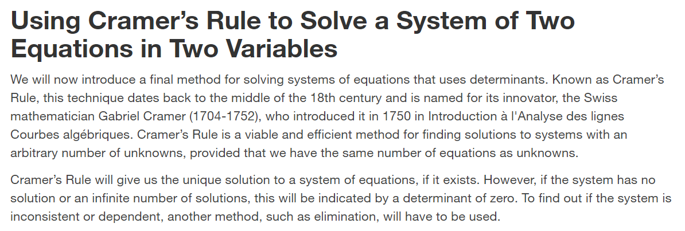

Slide 7
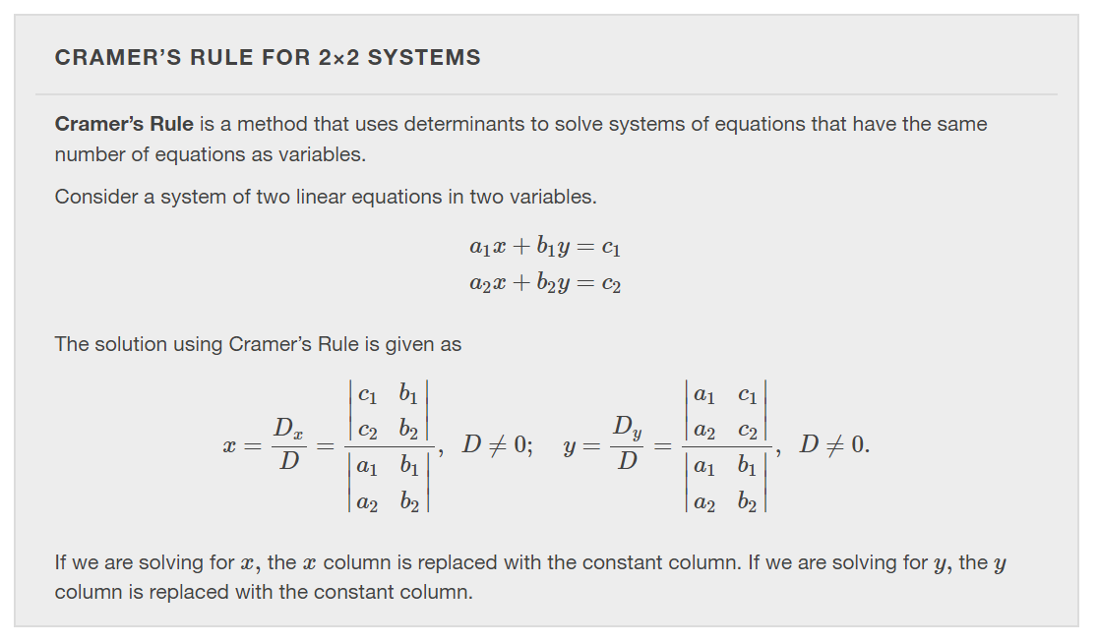

Slide 8
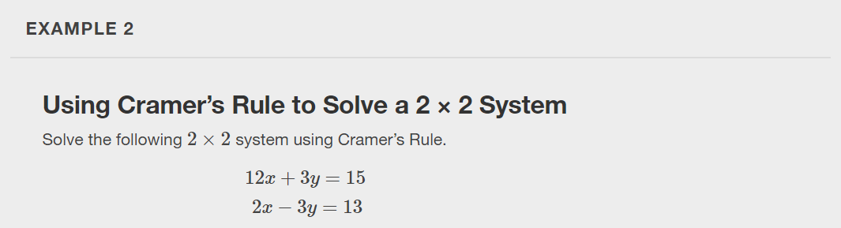

Slide 9
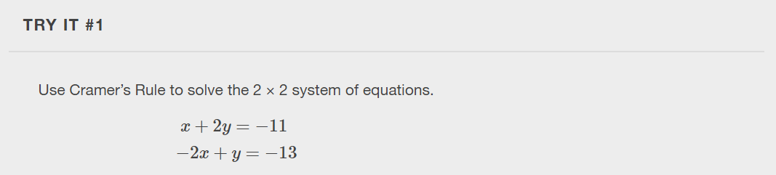

Slide 10
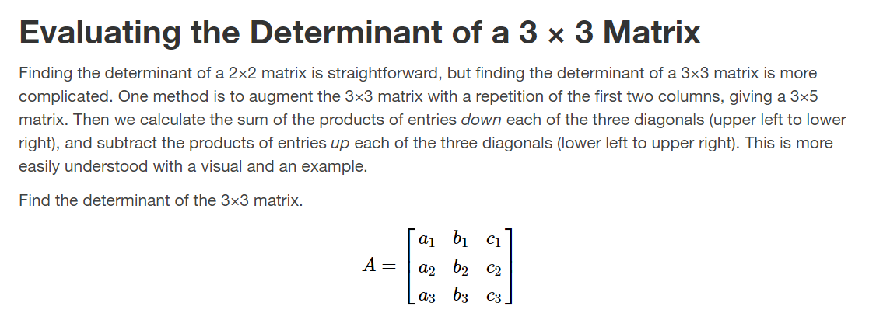

Slide 11
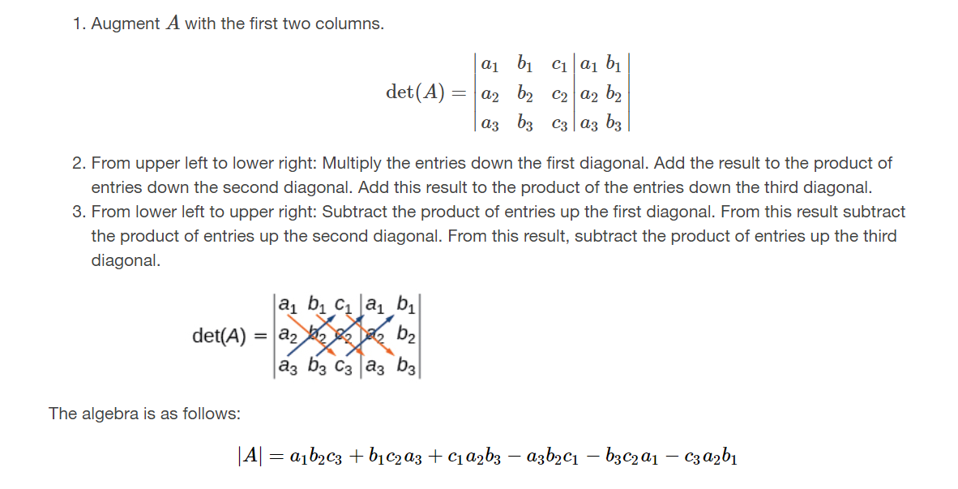

Slide 12
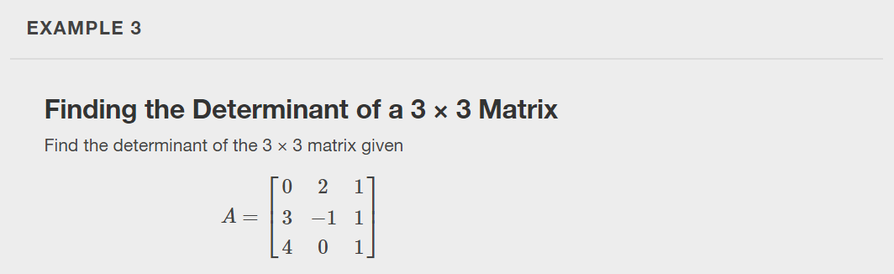

Slide 13
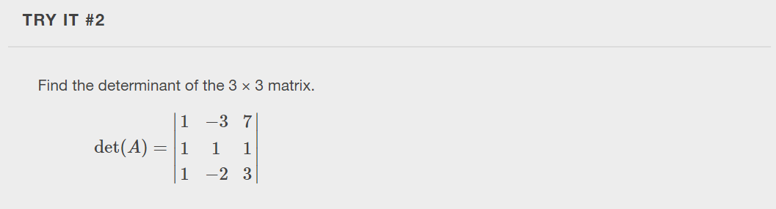

Slide 14
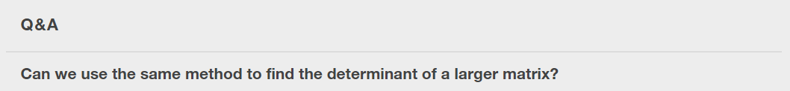
Notes:
No, this method only works for 2×2 and 3×3 matrices. For larger matrices it is best to use a graphing utility or computer software.

Slide 15
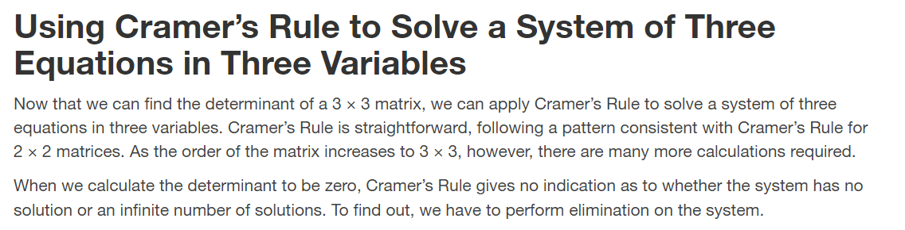

Slide 16
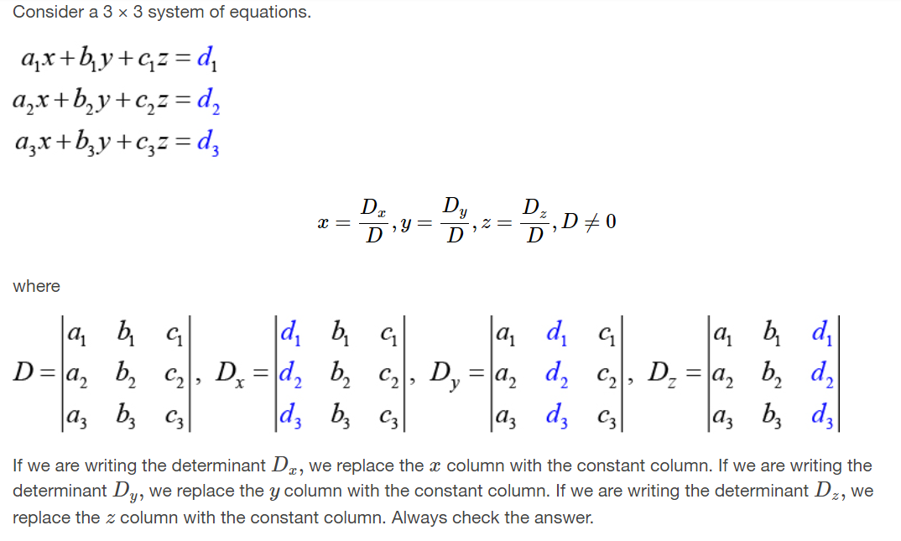

Slide 17
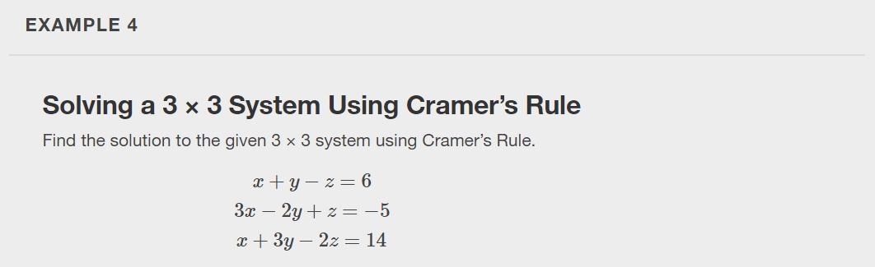

Slide 18
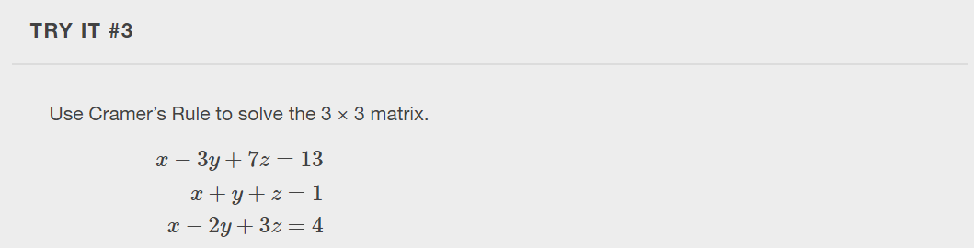

Slide 19
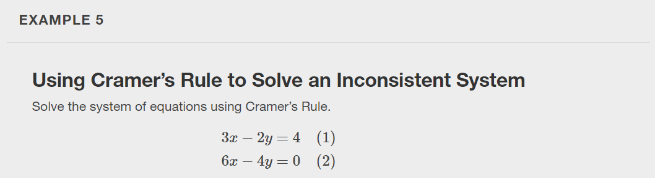

Slide 20
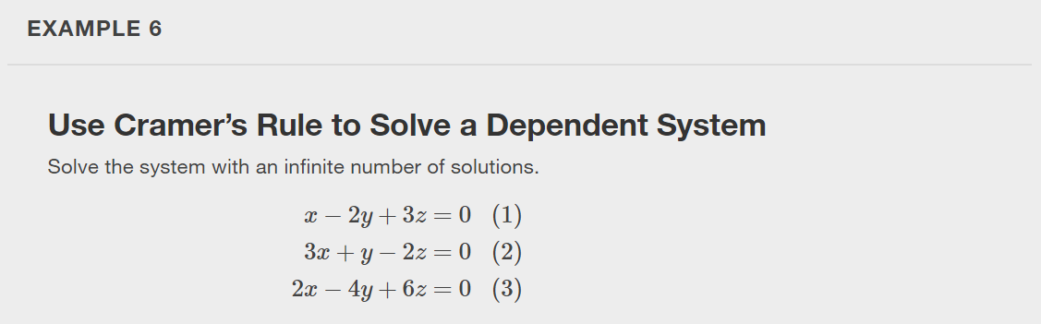

Slide 21
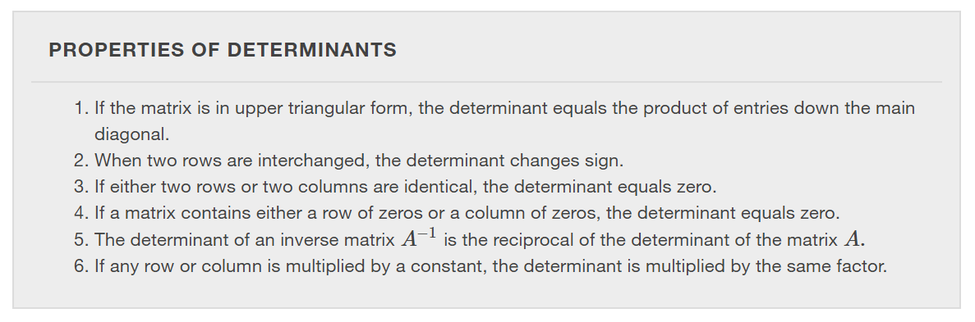

Slide 22
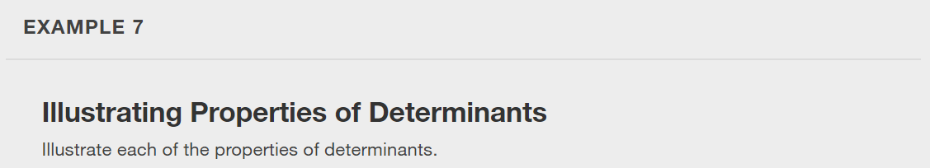

Slide 23
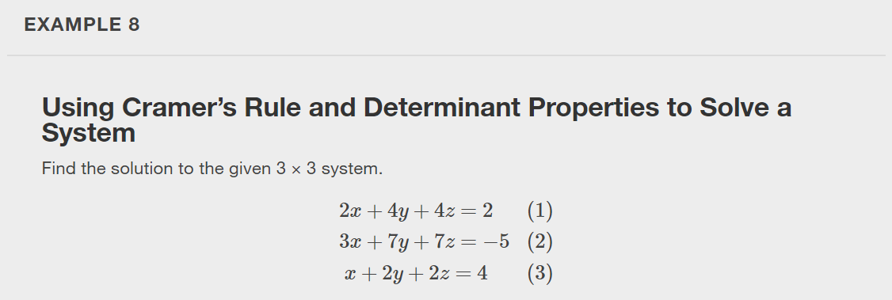

Slide 24
What did you learn in this section?
Evaluate 2 × 2 determinants.
Use Cramer’s Rule to solve a system of equations in two variables.
Evaluate 3 × 3 determinants.
Use Cramer’s Rule to solve a system of three equations in three variables.
Know the properties of determinants.
Notes:
Do you have any questions?

Slide 25
This resource is an adaptation of the OpenStax Algebra and Trigonometry 2e open textbook and is © Susan Aydelotte under a CC BY-NC-SA 4.0 International license; it may be reproduced or modified for noncommercial purposes only but must be attributed to OpenStax, Rice University and any changes must be noted. Any adaptation must be shared under the same type of license.

