Slide 1

Systems of Equations and Inequalities
Chapter 11
Algebra and Trigonometry 2e, OpenStax, Jay Abramson
Notes:
Images and notes within these slides are from the OpenStax textbook Algebra and Trigonometry 2e

Slide 2
11.7 Solving Systems with Inverses
Algebra and Trigonometry 2e, OpenStax, Jay Abramson
Notes:
Images and notes within these slides are from the OpenStax textbook Algebra and Trigonometry 2e

Slide 3
What are the learning objectives for this section?
Find the inverse of a matrix.
Solve a system of linear equations using an inverse matrix.

Slide 4
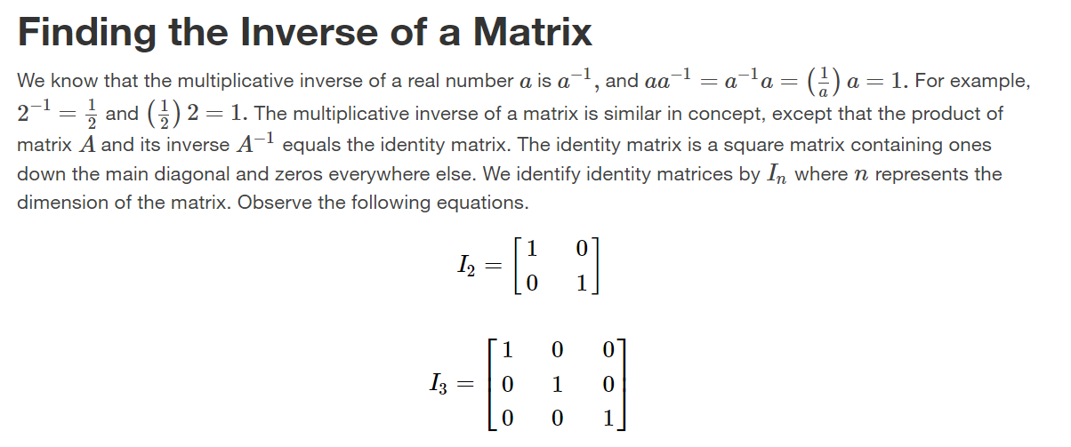

Slide 5
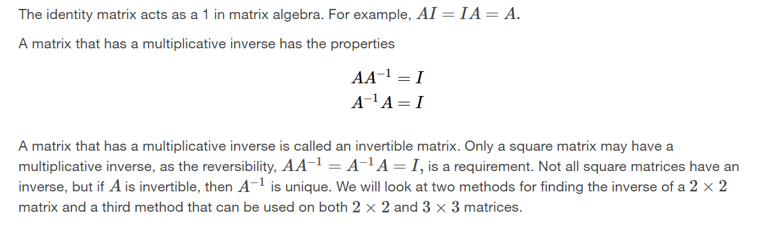

Slide 6
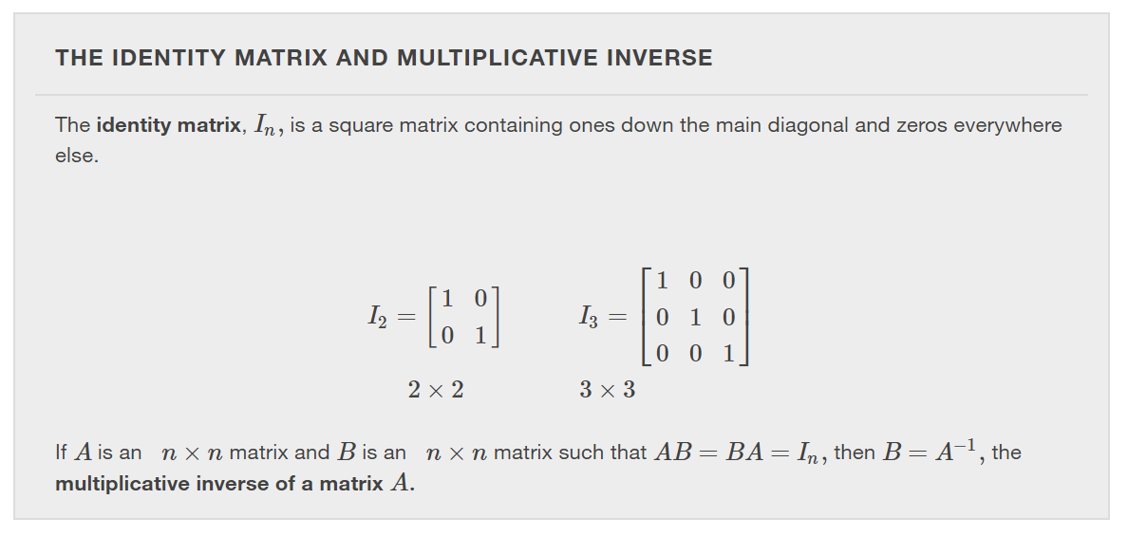

Slide 7
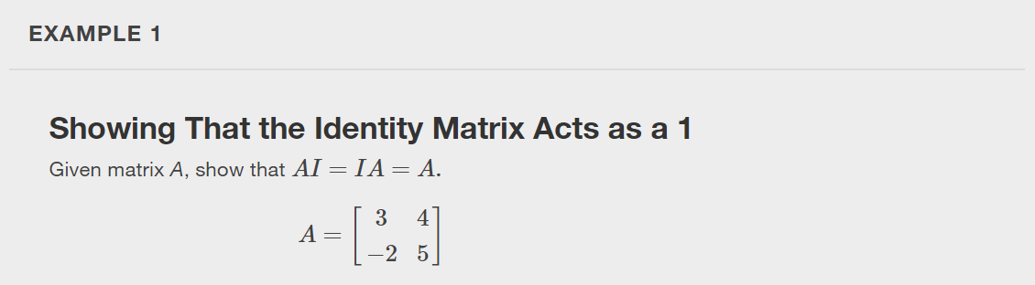

Slide 8
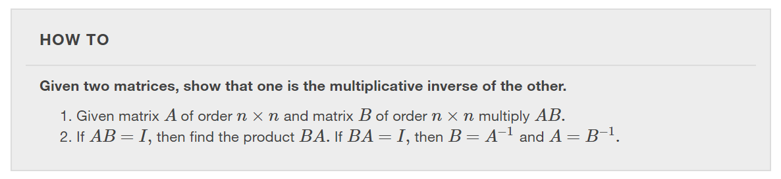

Slide 9
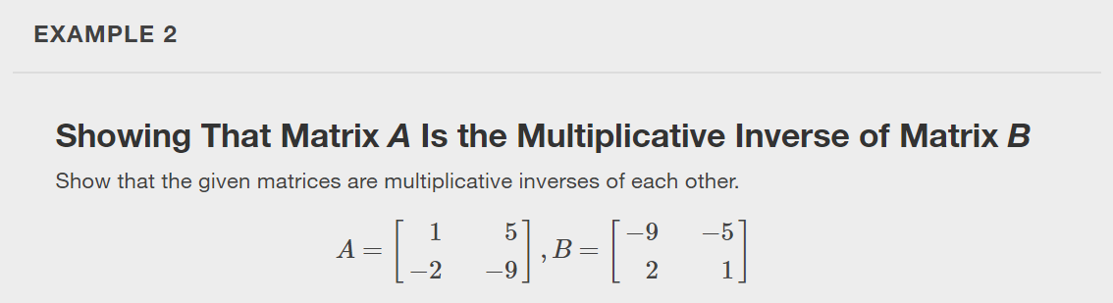

Slide 10
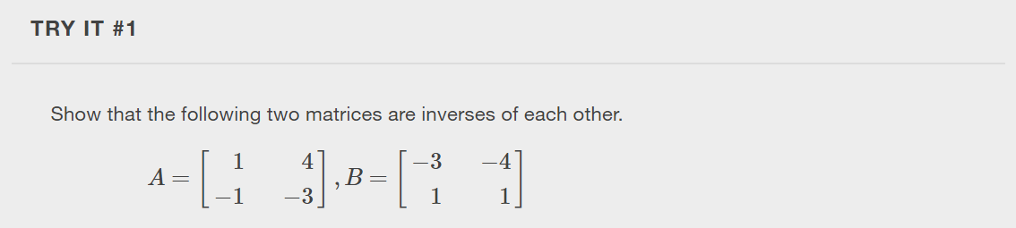

Slide 11
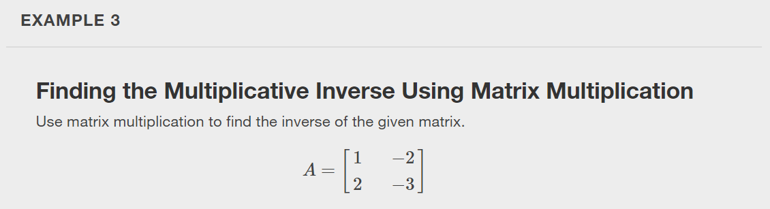
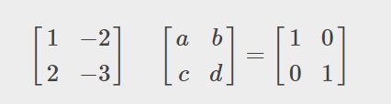
Notes:
We can now determine whether two matrices are inverses, but how would we find the inverse of a given matrix? Since we know that the product of a matrix and its inverse is the identity matrix, we can find the inverse of a matrix by setting up an equation using matrix multiplication.

Slide 12
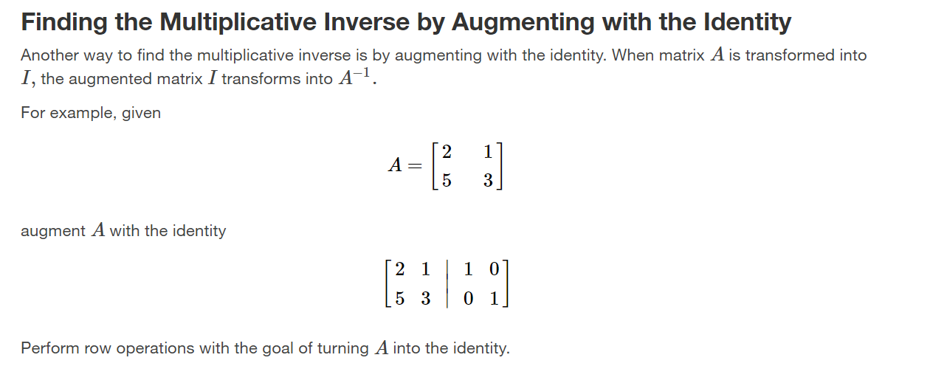

Slide 13
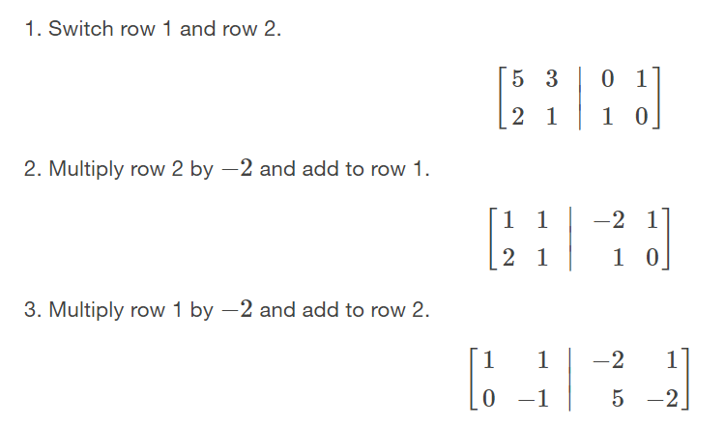
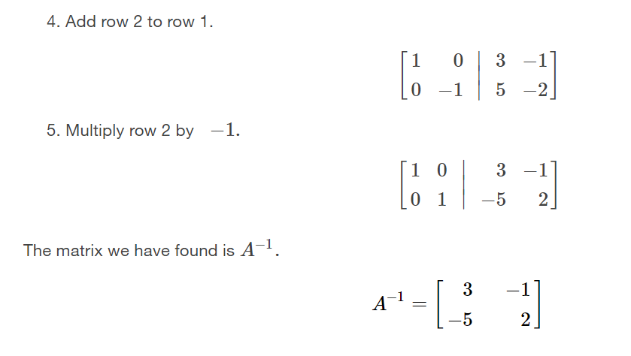

Slide 14
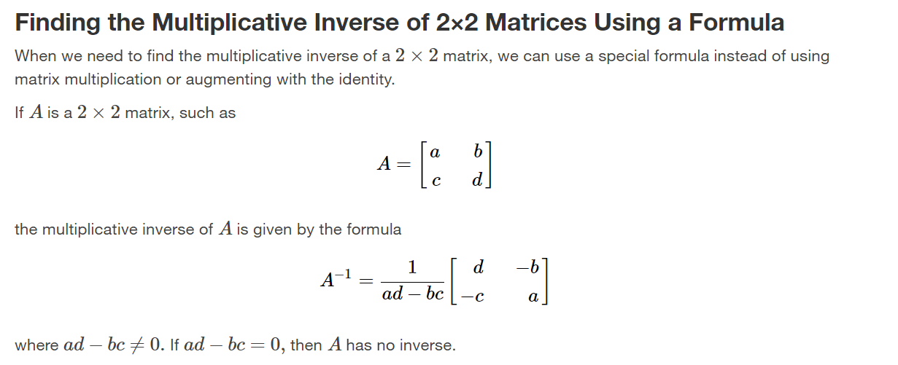

Slide 15
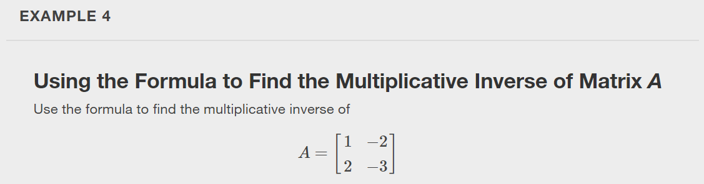

Slide 16
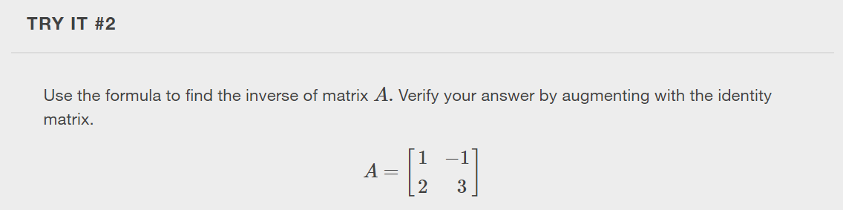

Slide 17
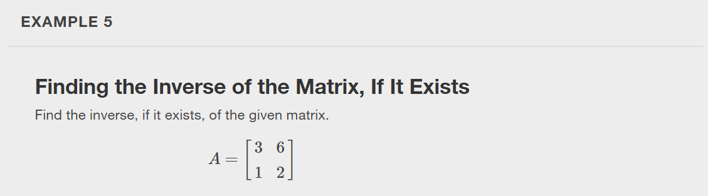

Slide 18
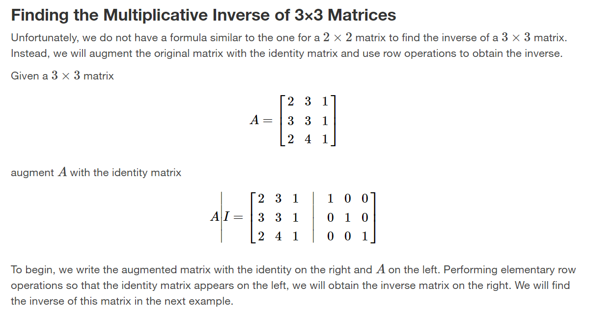

Slide 19
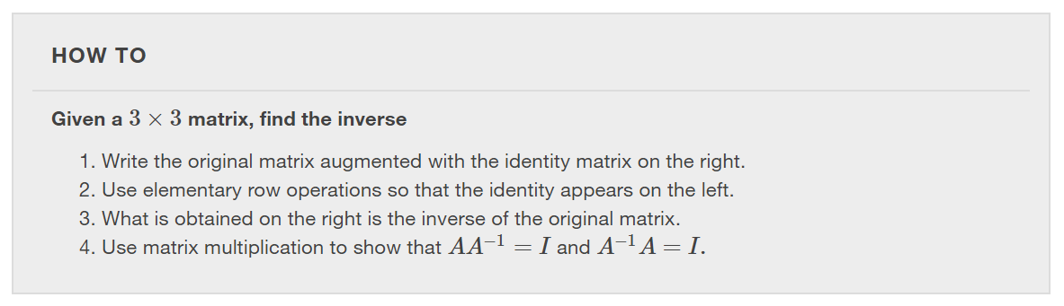

Slide 20
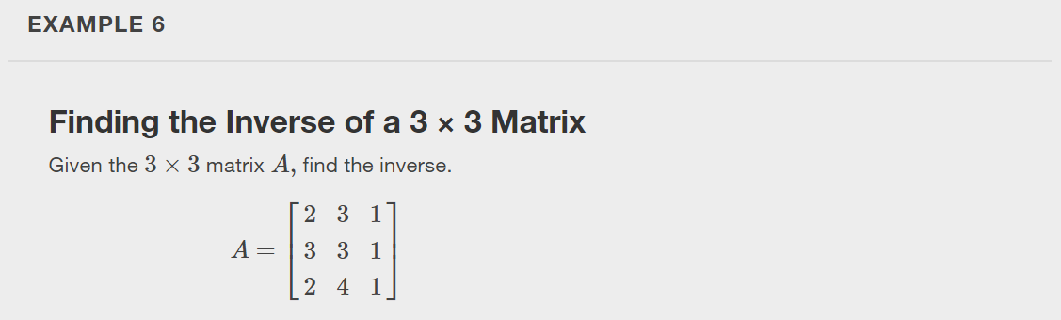

Slide 21
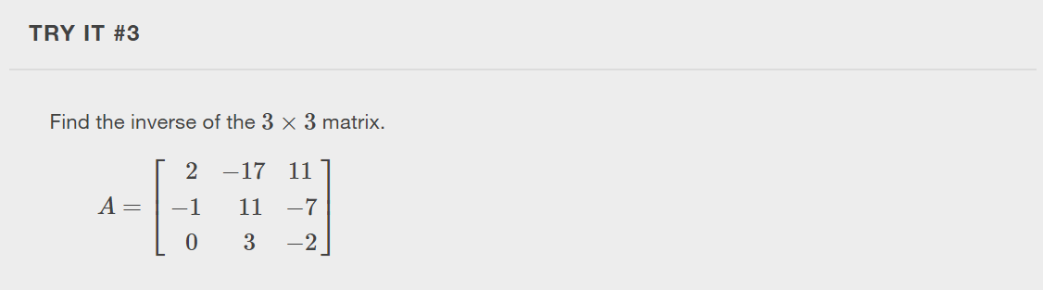

Slide 22
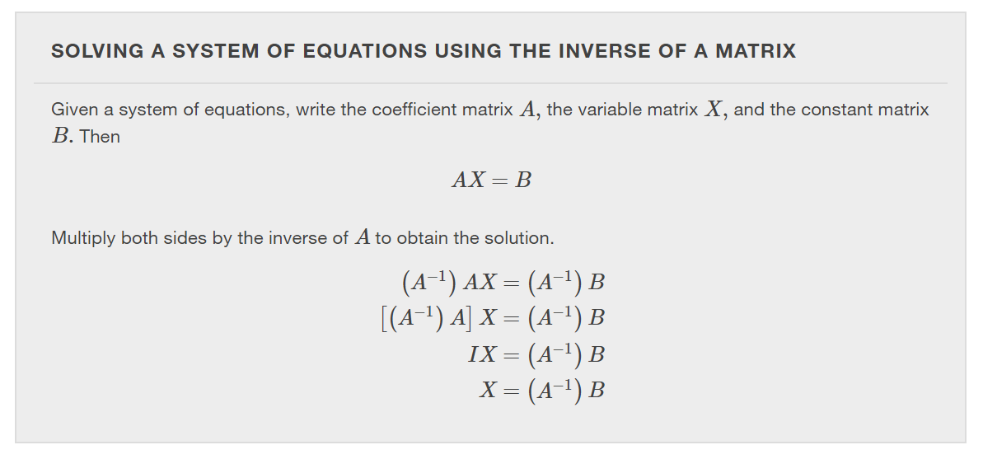

Slide 23
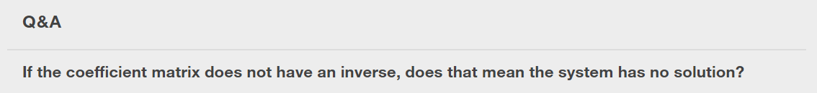
Notes:
No, if the coefficient matrix is not invertible, the system could be inconsistent and have no solution, or be dependent and have infinitely many solutions.

Slide 24
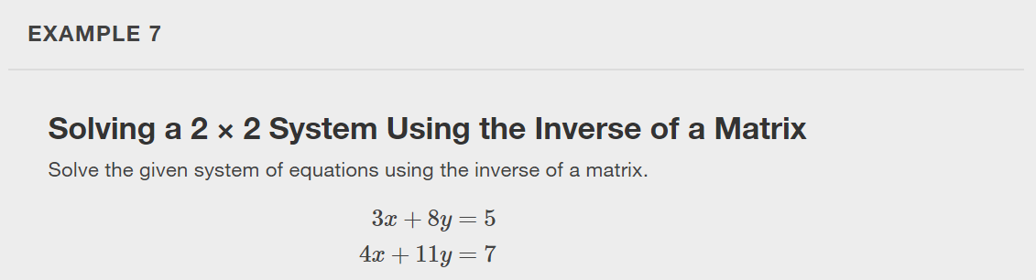

Slide 25
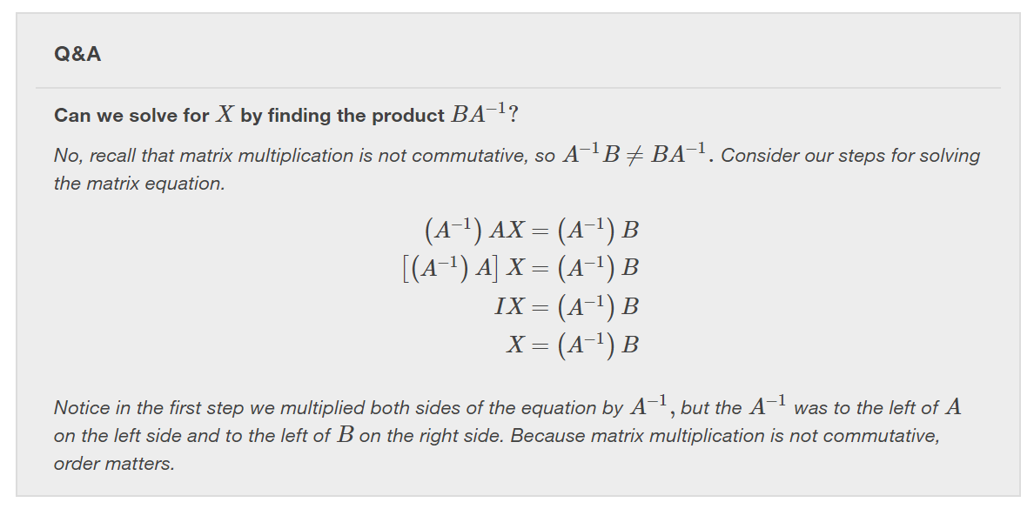

Slide 26
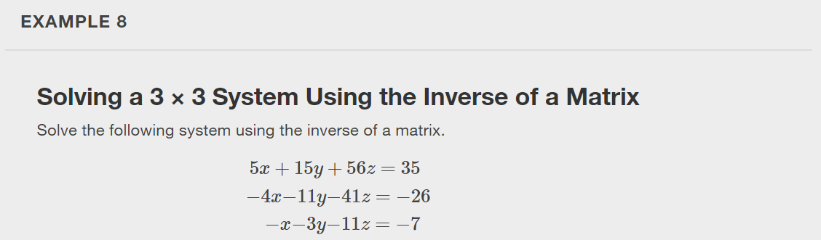

Slide 27
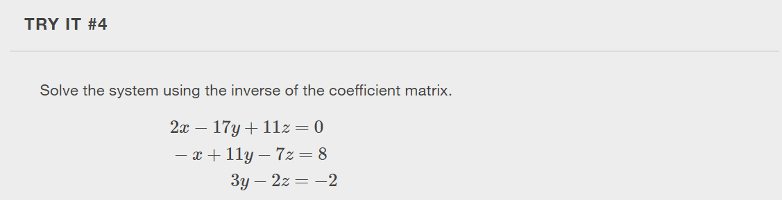

Slide 28
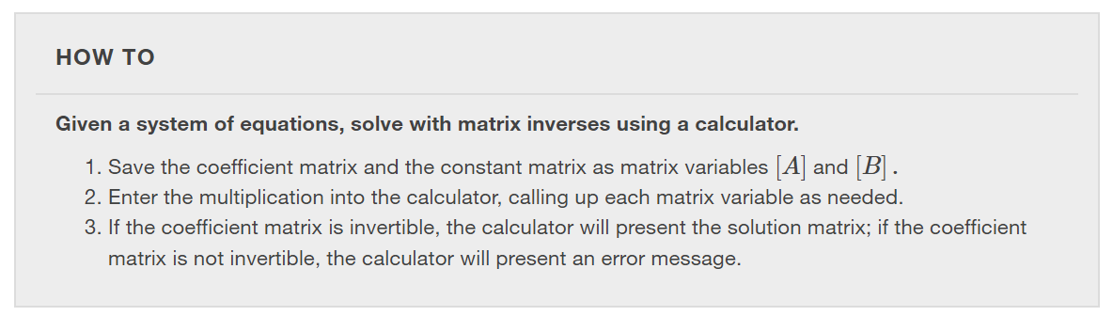

Slide 29
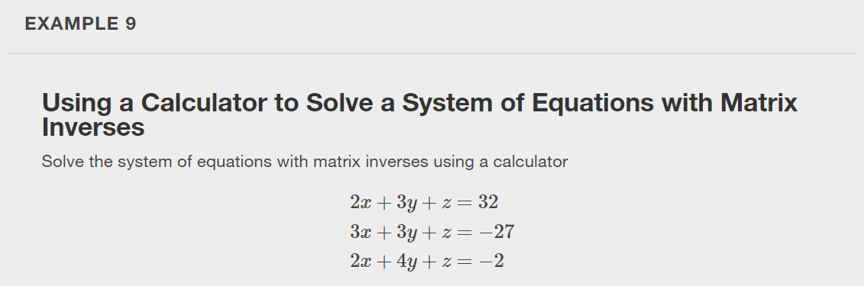

Slide 30
What did you learn in this section?
Find the inverse of a matrix.
Solve a system of linear equations using an inverse matrix.
Notes:
Do you have any questions?

Slide 31
This resource is an adaptation of the OpenStax Algebra and Trigonometry 2e open textbook and is © Susan Aydelotte under a CC BY-NC-SA 4.0 International license; it may be reproduced or modified for noncommercial purposes only but must be attributed to OpenStax, Rice University and any changes must be noted. Any adaptation must be shared under the same type of license.

