Slide 1

Systems of Equations and Inequalities
Chapter 11
Algebra and Trigonometry 2e, OpenStax, Jay Abramson
Notes:
Images and notes within these slides are from the OpenStax textbook Algebra and Trigonometry 2e

Slide 2
11.6 Solving Systems with Gaussian Elimination
Algebra and Trigonometry 2e, OpenStax, Jay Abramson
Notes:
Images and notes within these slides are from the OpenStax textbook Algebra and Trigonometry 2e

Slide 3
What are the learning objectives for this section?
Write the augmented matrix of a system of equations.
Write the system of equations from an augmented matrix.
Perform row operations on a matrix.
Solve a system of linear equations using matrices.

Slide 4
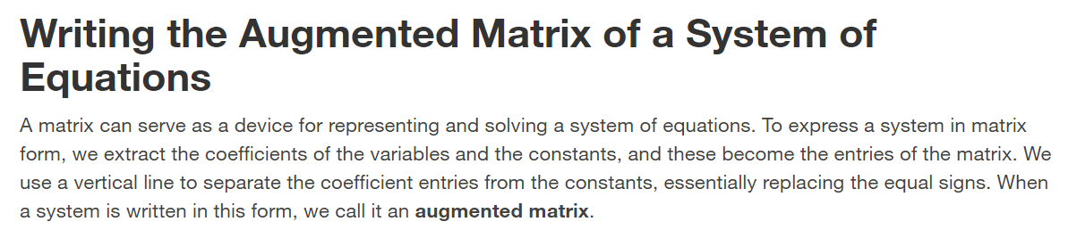

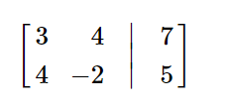
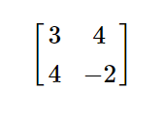



Slide 5
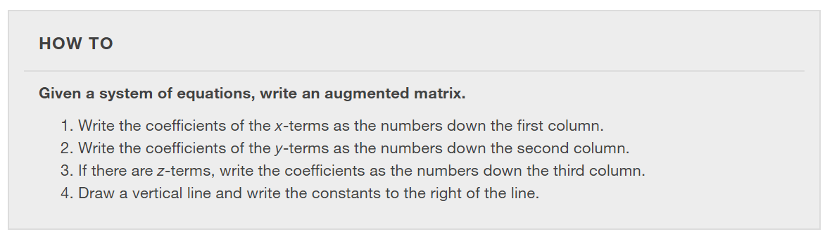

Slide 6
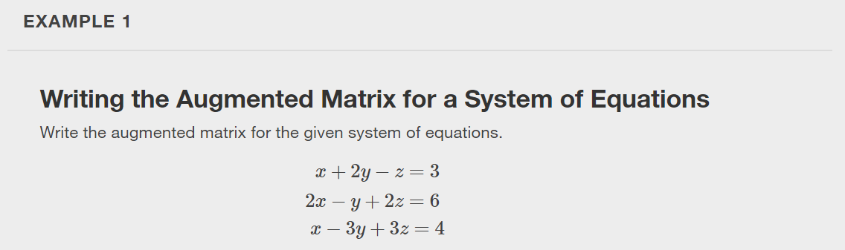

Slide 7
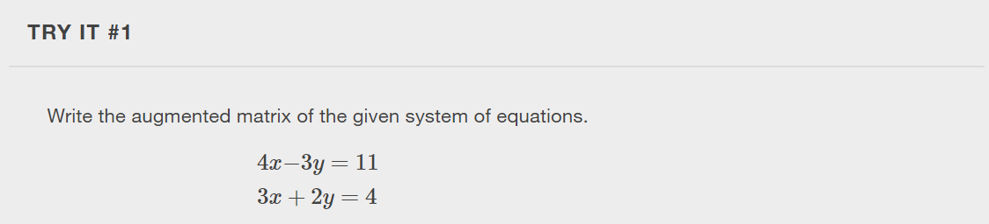

Slide 8
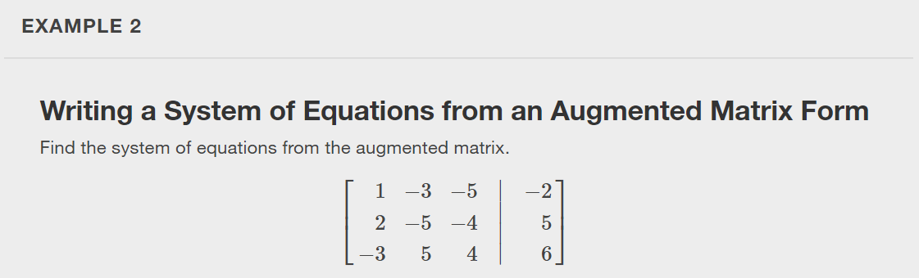
Notes:
We can use augmented matrices to help us solve systems of equations because they simplify operations when the systems are not encumbered by the variables. However, it is important to understand how to move back and forth between formats in order to make finding solutions smoother and more intuitive. Here, we will use the information in an augmented matrix to write the system of equations in standard form.

Slide 9
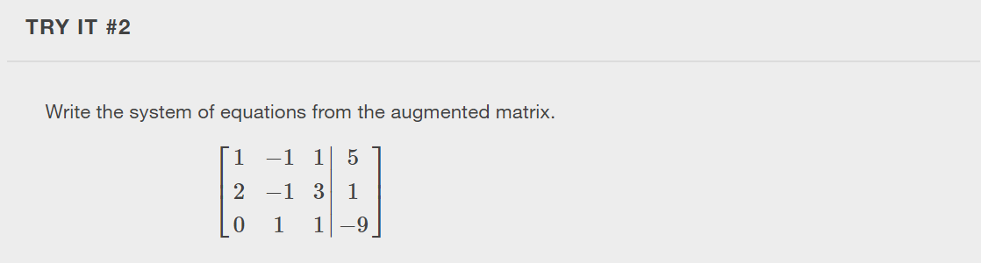

Slide 10
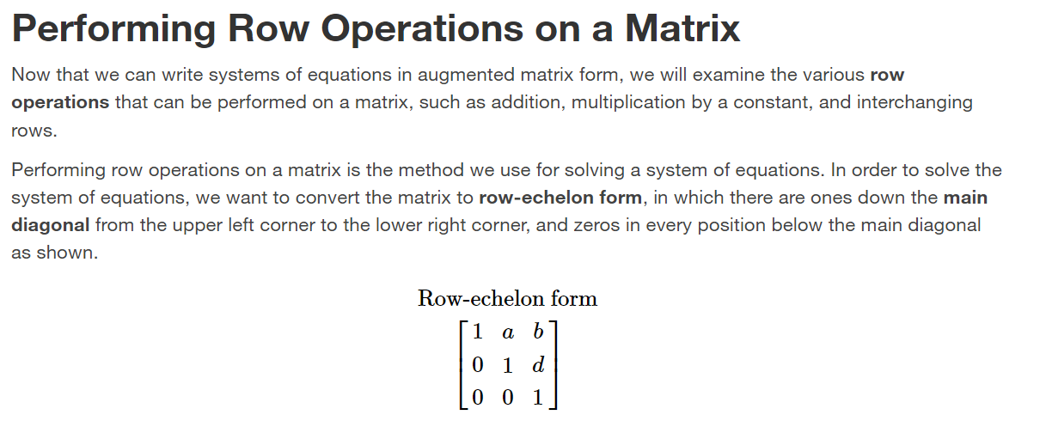

Slide 11
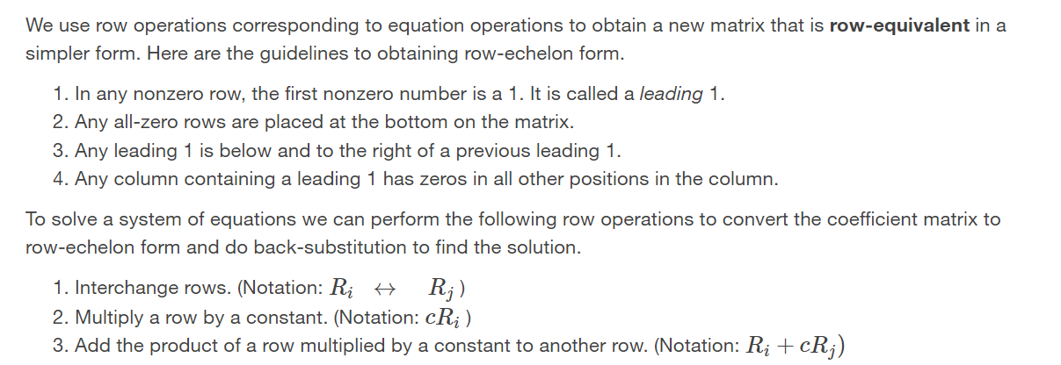

Slide 12
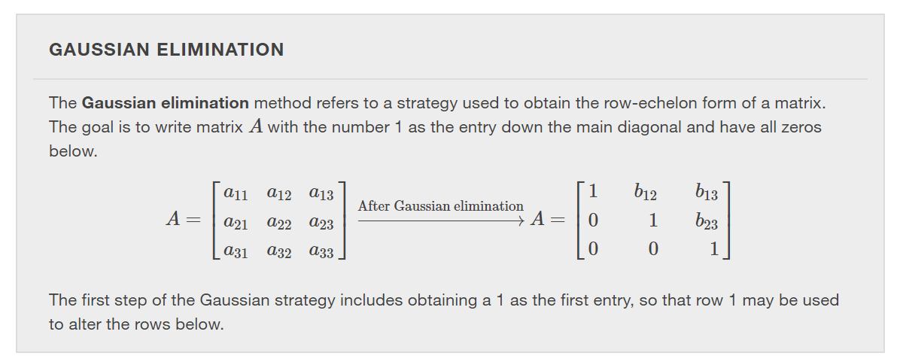

Slide 13
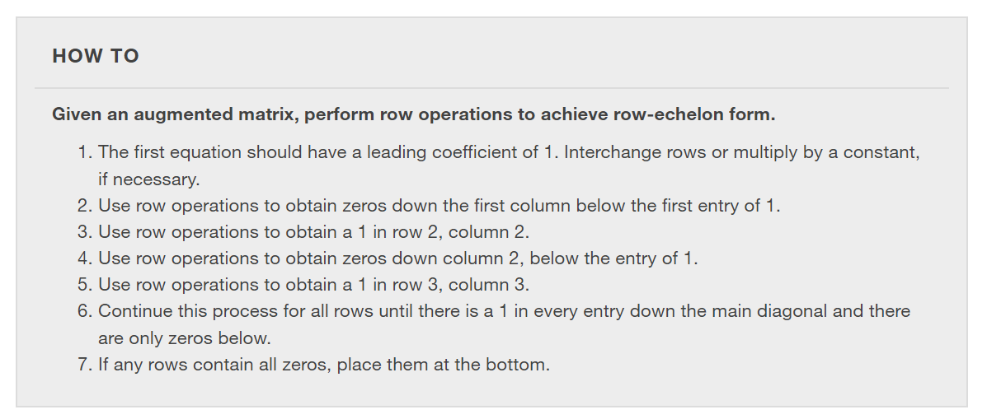

Slide 14
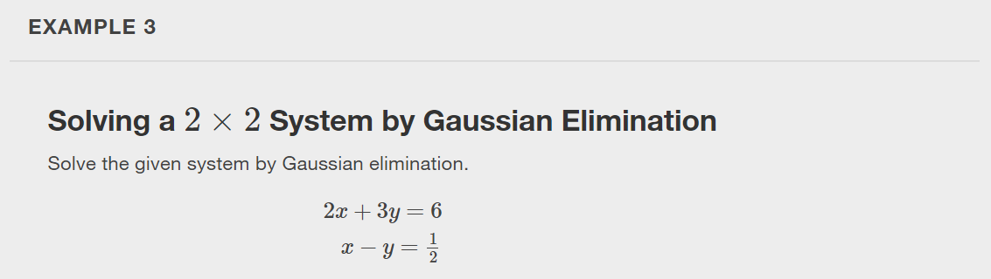

Slide 15
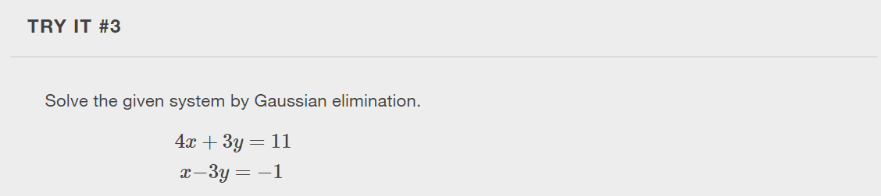

Slide 16
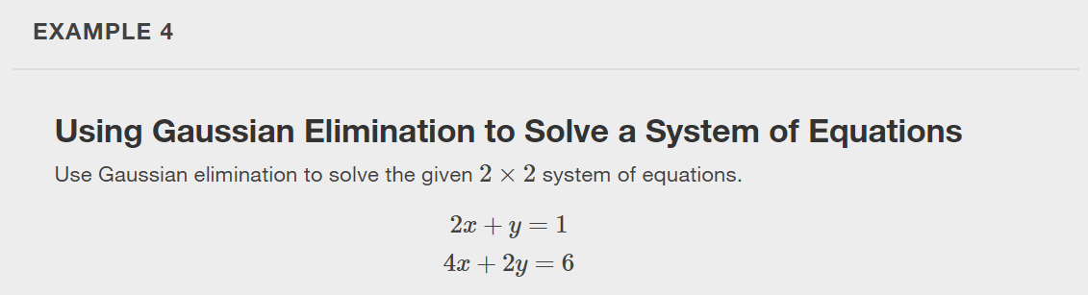

Slide 17
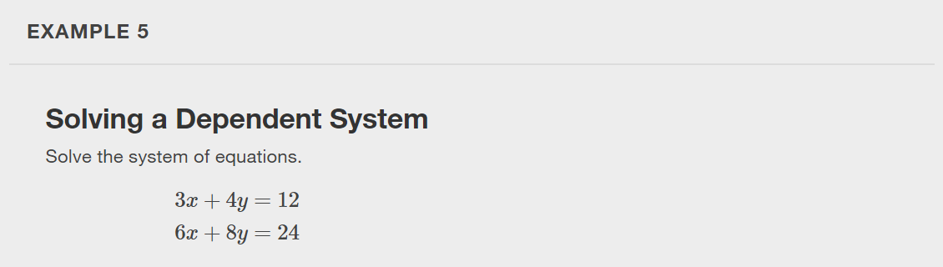

Slide 18
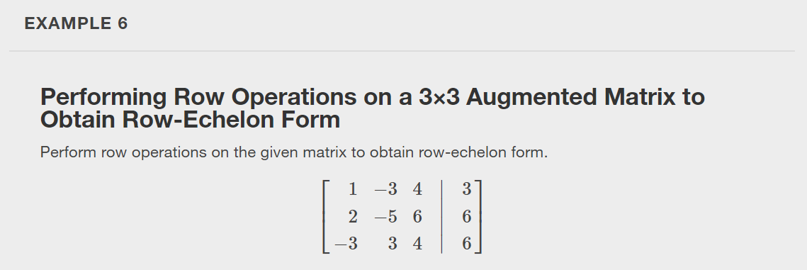

Slide 19
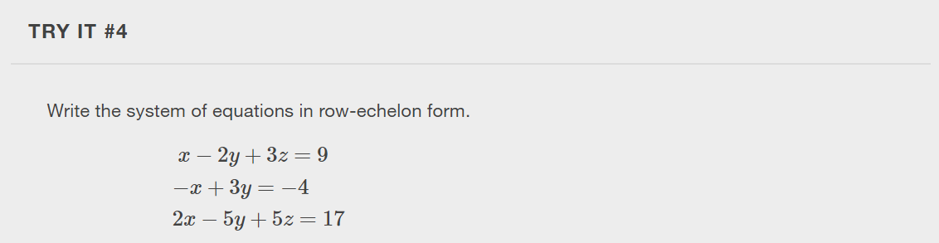

Slide 20
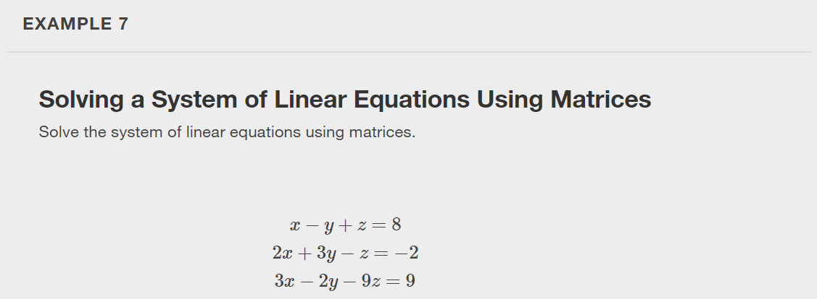
Notes:
We have seen how to write a system of equations with an augmented matrix, and then how to use row operations and back-substitution to obtain row-echelon form. Now, we will take row-echelon form a step farther to solve a 3 by 3 system of linear equations. The general idea is to eliminate all but one variable using row operations and then back-substitute to solve for the other variables.

Slide 21
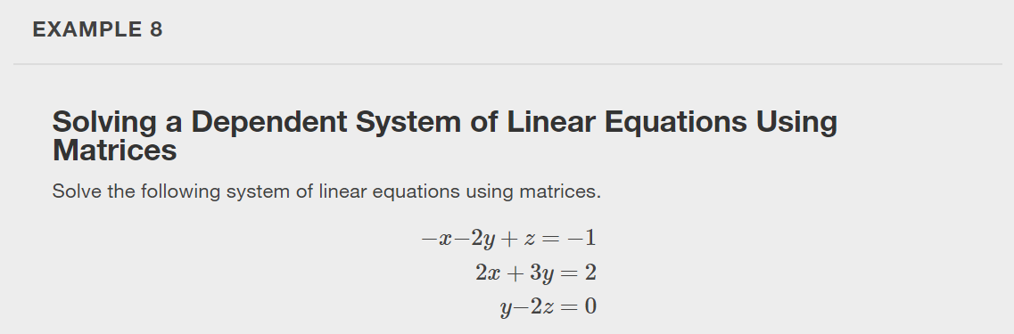

Slide 22
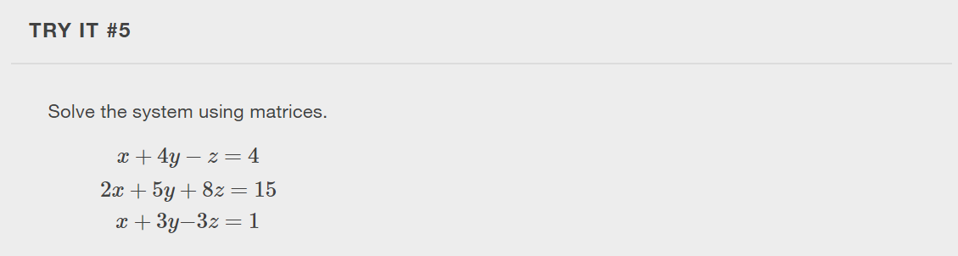

Slide 23
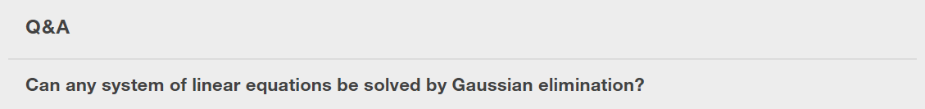
Notes:
Yes, a system of linear equations of any size can be solved by Gaussian elimination.

Slide 24
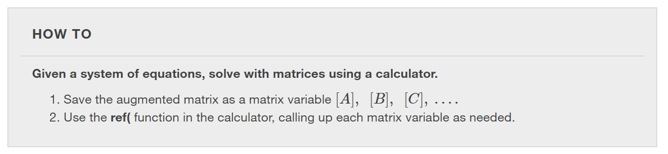

Slide 25
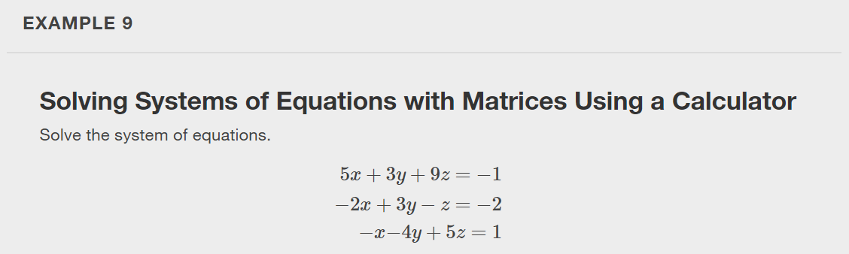

Slide 26
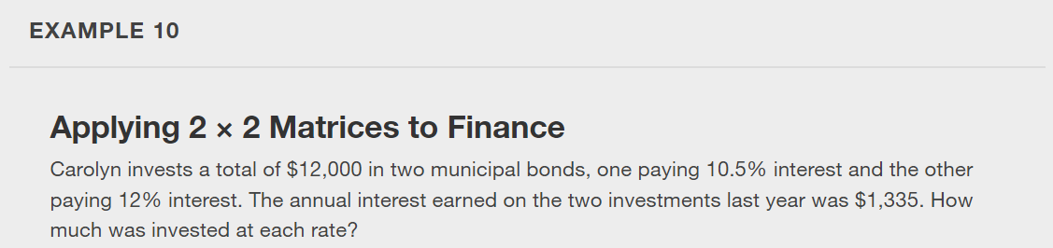

Slide 27
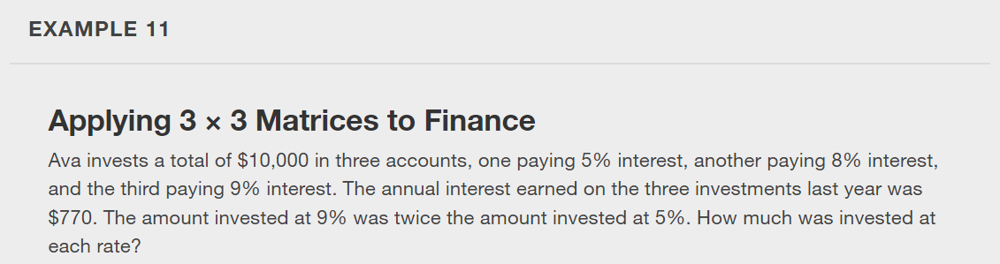

Slide 28
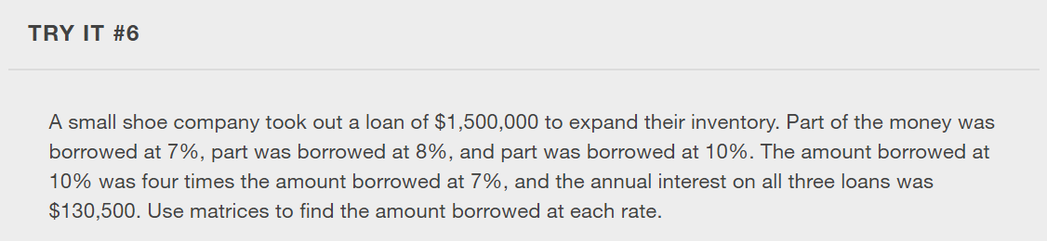

Slide 29
What did you learn in this section?
Write the augmented matrix of a system of equations.
Write the system of equations from an augmented matrix.
Perform row operations on a matrix.
Solve a system of linear equations using matrices.
Notes:
Do you have any questions?

Slide 30
This resource is an adaptation of the OpenStax Algebra and Trigonometry 2e open textbook and is © Susan Aydelotte under a CC BY-NC-SA 4.0 International license; it may be reproduced or modified for noncommercial purposes only but must be attributed to OpenStax, Rice University and any changes must be noted. Any adaptation must be shared under the same type of license.

