Slide 1
Systems of Equations and Inequalities
Chapter 11
Algebra and Trigonometry 2e, OpenStax, Jay Abramson
Notes:
Images and notes within these slides are from the OpenStax textbook Algebra and Trigonometry 2e

Slide 2
11.5 Matrices and Matrix Operations
Algebra and Trigonometry 2e, OpenStax, Jay Abramson
Notes:
Images and notes within these slides are from the OpenStax textbook Algebra and Trigonometry 2e

Slide 3
What are the learning objectives for this section?
Find the sum and difference of two matrices.
Find scalar multiples of a matrix.
Find the product of two matrices.

Slide 5
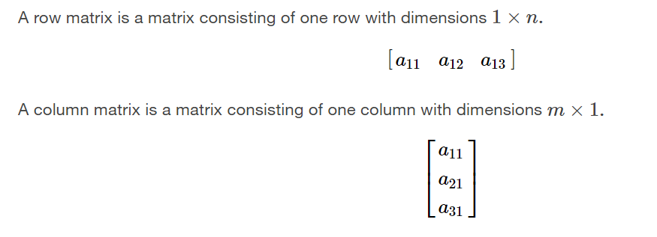

Slide 13
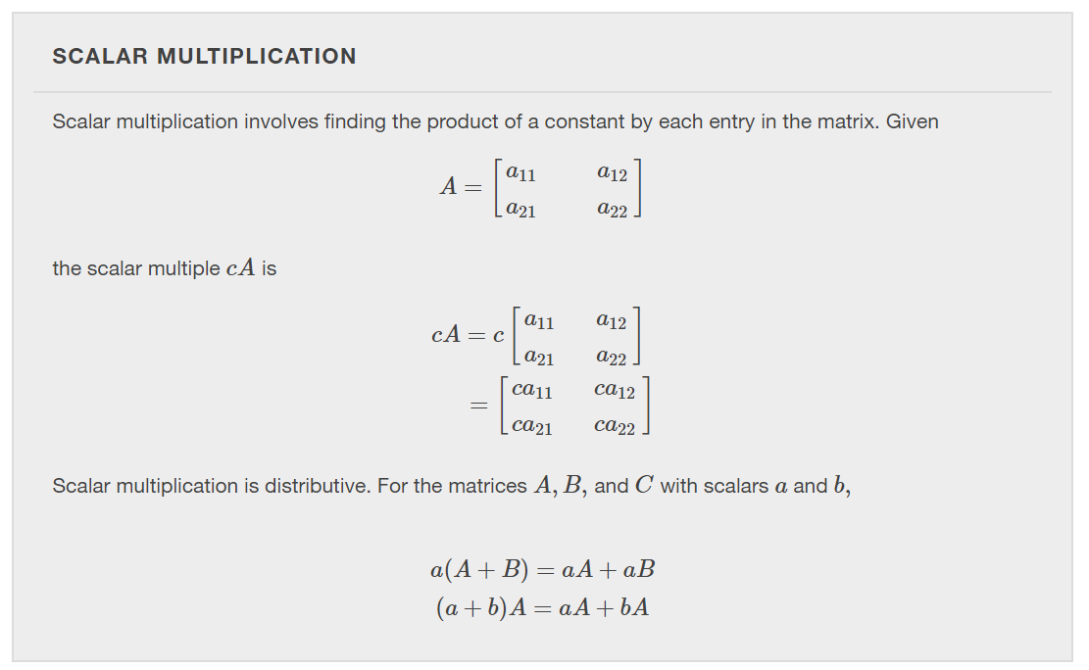

Slide 17
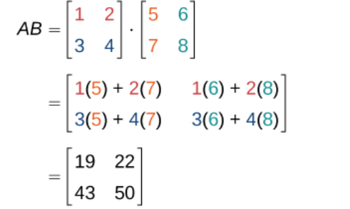
Notes:
Multiply the first row of matrix A times the first column of matrix B to find the entry in the first row first column of the matrix AB.
Multiply the first row of matrix A times the second column of matrix B to find the entry in the first row second column of the matrix AB.
Multiply the second row of matrix A times the first column of matrix B to find the entry in the second row first column of the matrix AB.
Multiply the second row of matrix A times the second column of matrix B to find the entry in the second row second column of the matrix AB.
Multiply the i th row of matrix A times the j th column of matrix B to find the entry in the i th row j th column of the matrix AB.

Slide 19
Notes:
Yes, consider a matrix A with dimension 3×4 and matrix B with dimension 4×2. For the product AB the inner dimensions are 4 and the product is defined, but for the product BA the inner dimensions are 2 and 3 so the product is undefined.

Slide 22
What did you learn in this section?
Find the sum and difference of two matrices.
Find scalar multiples of a matrix.
Find the product of two matrices.
Notes:
Do you have any questions?

Slide 23
This resource is an adaptation of the OpenStax Algebra and Trigonometry 2e open textbook and is © Susan Aydelotte under a CC BY-NC-SA 4.0 International license; it may be reproduced or modified for noncommercial purposes only but must be attributed to OpenStax, Rice University and any changes must be noted. Any adaptation must be shared under the same type of license.

