Slide 1

Systems of Equations and Inequalities
Chapter 11
Algebra and Trigonometry 2e, OpenStax, Jay Abramson
Notes:
Images and notes within these slides are from the OpenStax textbook Algebra and Trigonometry 2e

Slide 2
11.4 Partial Fractions
Algebra and Trigonometry 2e, OpenStax, Jay Abramson
Notes:
Images and notes within these slides are from the OpenStax textbook Algebra and Trigonometry 2e

Slide 3
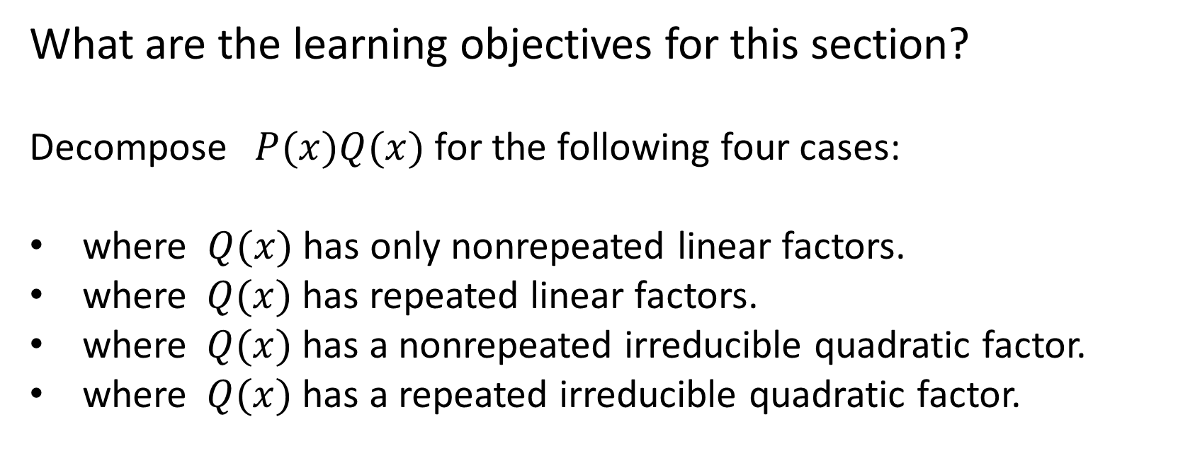
What are the learning objectives for this section?
Decompose $P(x)Q(x)$for the following four cases:
where $Q(x)$has only nonrepeated linear factors.
where $Q(x)$has repeated linear factors.
where $Q(x)$has a nonrepeated irreducible quadratic factor.
where $Q(x)$has a repeated irreducible quadratic factor.

Slide 4

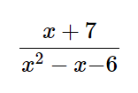

Adding rational expressions:
Partial fraction decomposition:
“partial fractions”
Notes:
We will investigate rational expressions with linear factors and quadratic factors in the denominator where the degree of the numerator is less than the degree of the denominator. Regardless of the type of expression we are decomposing, the first and most important thing to do is factor the denominator.

Slide 5
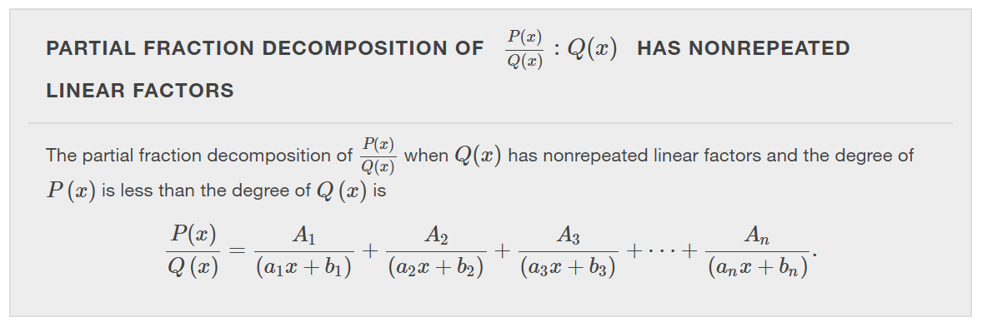
Notes:
Note that the denominators for the partial fractions are factors of Q(x). The numerators of the partial fractions are unknown values that we are trying to find.

Slide 6
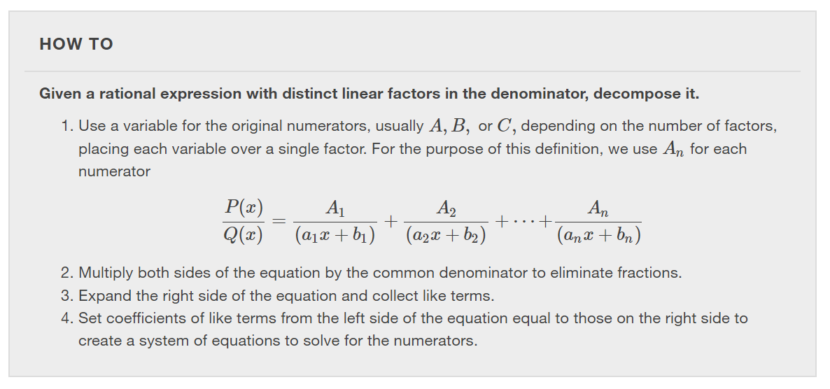

Slide 7
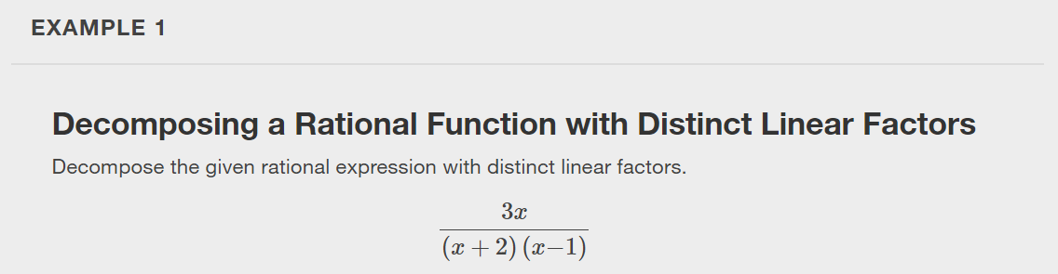

Slide 8
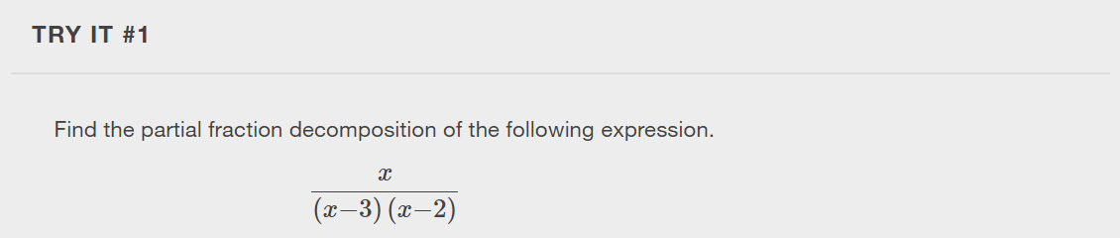

Slide 9
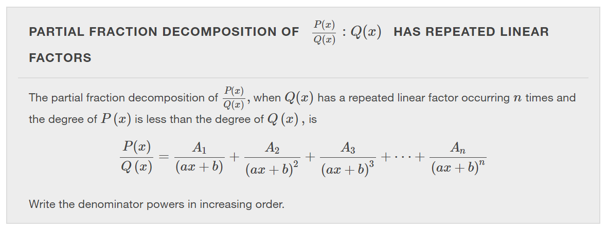

Slide 10
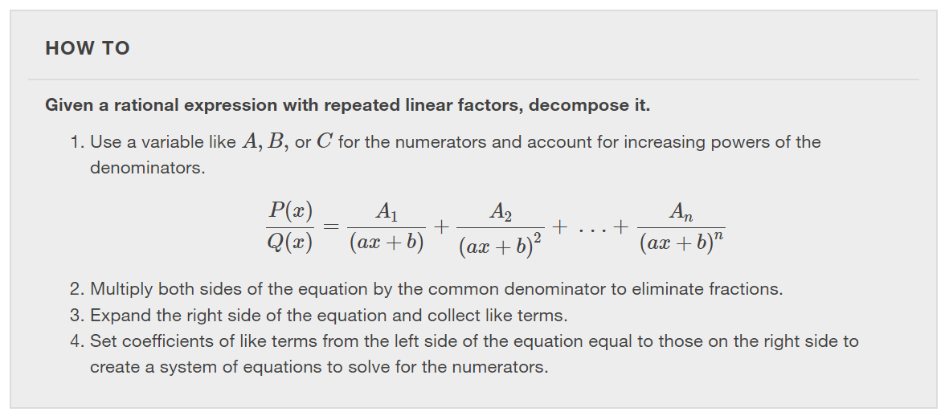

Slide 11
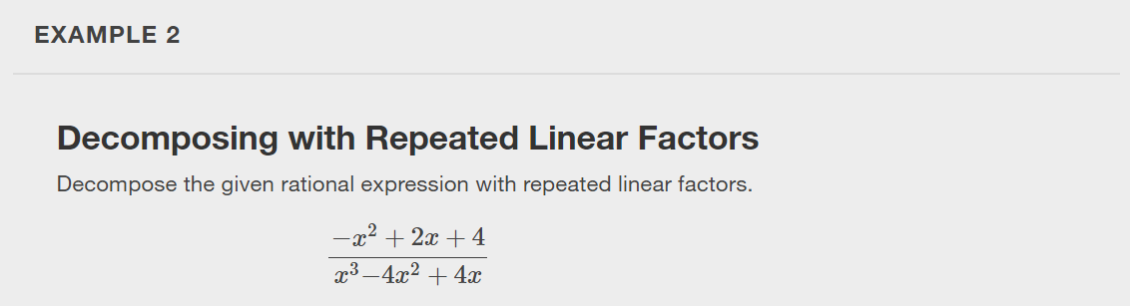

Slide 12
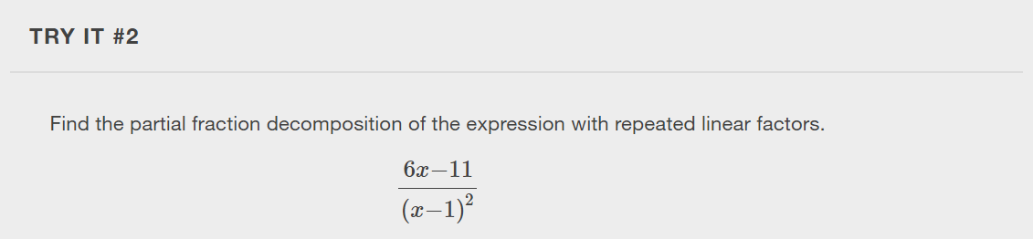

Slide 13
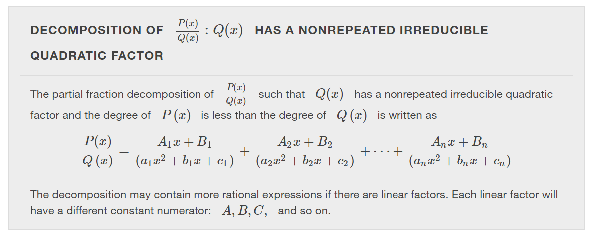

Slide 14
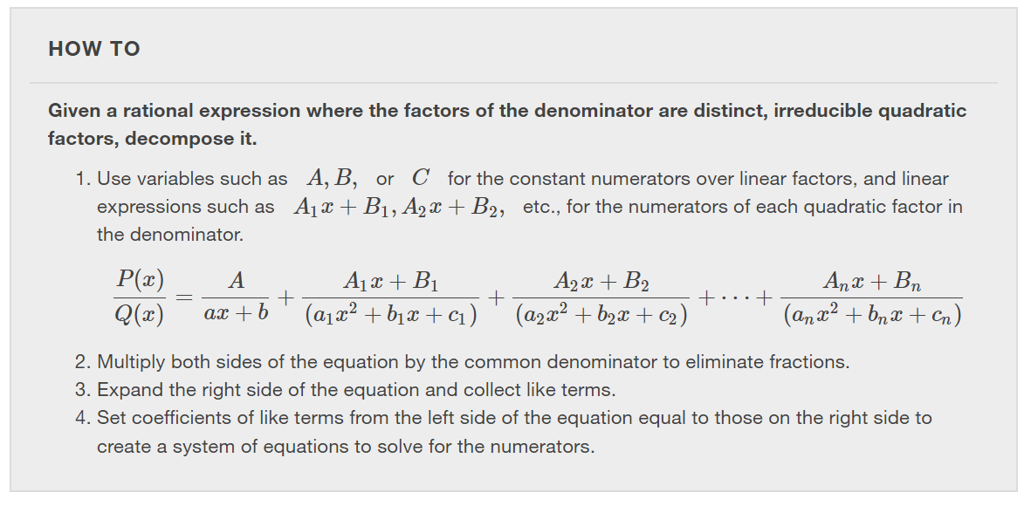

Slide 15
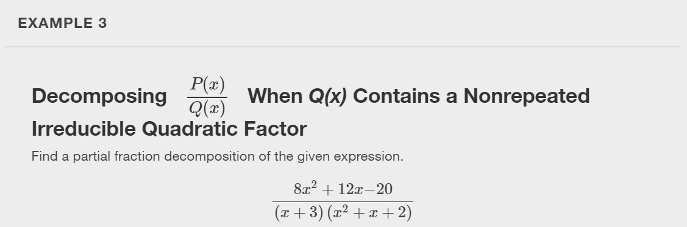

Slide 16
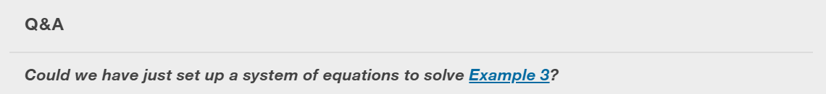
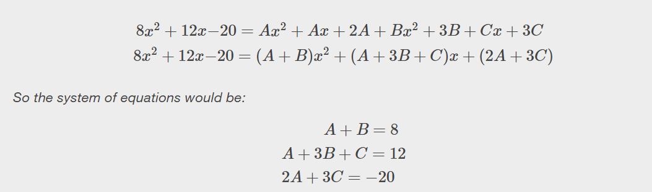
Notes:
Yes, we could have solved it by setting up a system of equations without solving for A first.

Slide 17
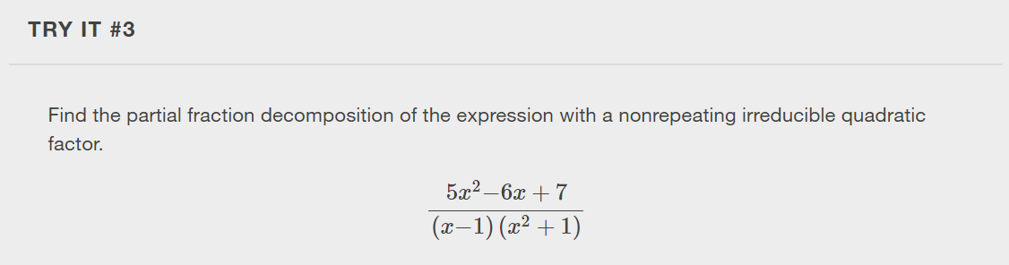

Slide 18
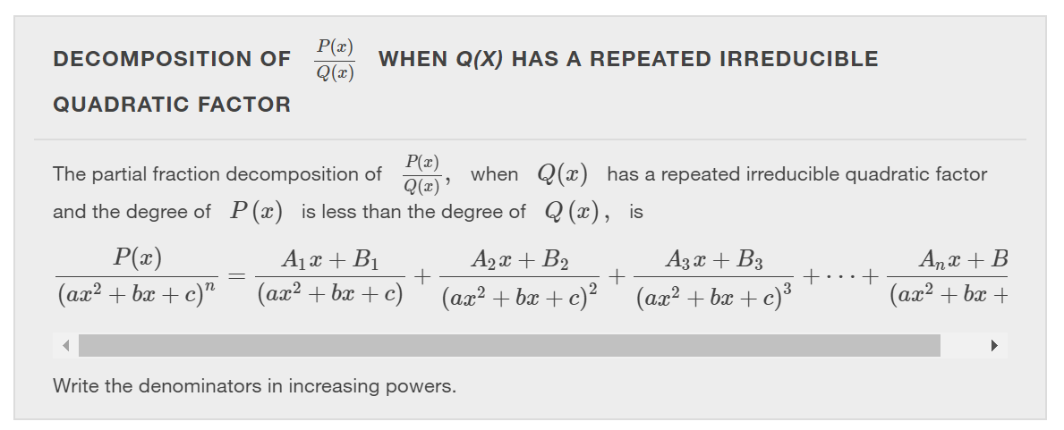

Slide 19
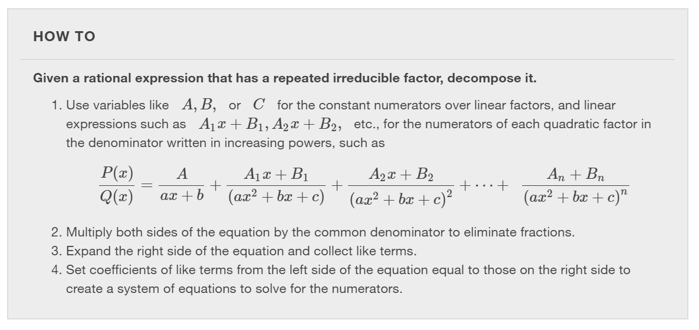

Slide 20
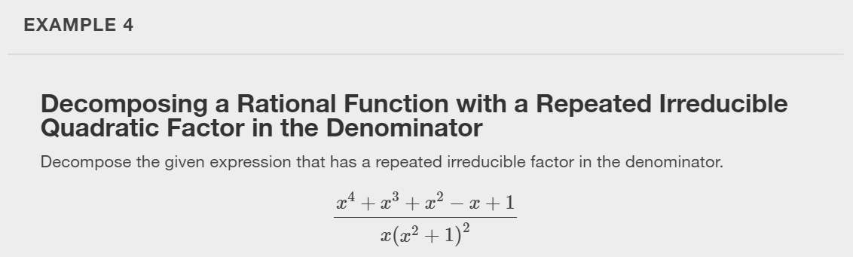

Slide 21
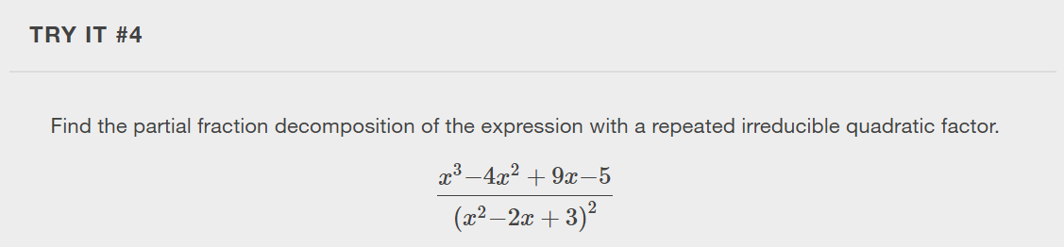

Slide 22
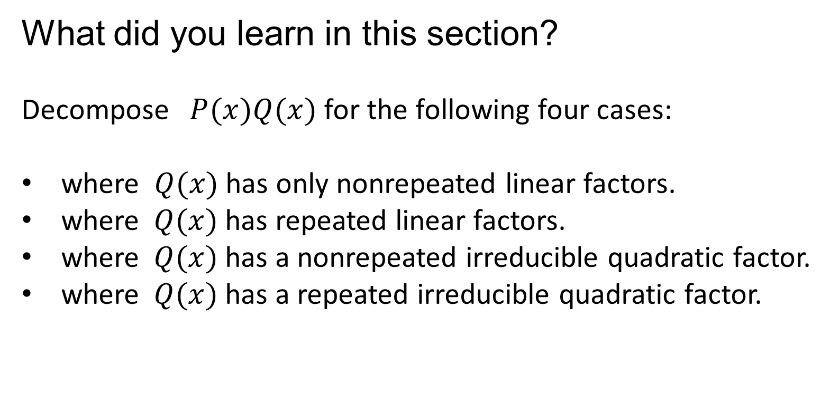
What did you learn in this section?
Decompose $P(x)Q(x)$for the following four cases:
where $Q(x)$has only nonrepeated linear factors.
where $Q(x)$has repeated linear factors.
where $Q(x)$has a nonrepeated irreducible quadratic factor.
where $Q(x)$has a repeated irreducible quadratic factor.
Notes:
Do you have any questions?

Slide 23
This resource is an adaptation of the OpenStax Algebra and Trigonometry 2e open textbook and is © Susan Aydelotte under a CC BY-NC-SA 4.0 International license; it may be reproduced or modified for noncommercial purposes only but must be attributed to OpenStax, Rice University and any changes must be noted. Any adaptation must be shared under the same type of license.

