Slide 1

Systems of Equations and Inequalities
Chapter 11
Algebra and Trigonometry 2e, OpenStax, Jay Abramson
Notes:
Images and notes within these slides are from the OpenStax textbook Algebra and Trigonometry 2e

Slide 2
11.2 Systems of Linear Equations: Three Variables
Algebra and Trigonometry 2e, OpenStax, Jay Abramson
Notes:
Images and notes within these slides are from the OpenStax textbook Algebra and Trigonometry 2e

Slide 3
What are the learning objectives for this section?
Solve systems of three equations in three variables.
Identify inconsistent systems of equations containing three variables.
Express the solution of a system of dependent equations containing three variables.

Slide 4
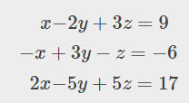
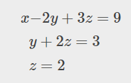
Solving Systems of Three Equations in Three Variables
Gaussian elimination
To write the system in upper triangular form, we can:
  Interchange the order of any two equations.
  Multiply both sides of an equation by a nonzero constant.
  Add a nonzero multiple of one equation to another equation.
Notes:
In order to solve systems of equations in three variables, known as three-by-three systems, the primary tool we will be using is called Gaussian elimination, named after the prolific German mathematician Karl Friedrich Gauss. While there is no definitive order in which operations are to be performed, there are specific guidelines as to what type of moves can be made. We may number the equations to keep track of the steps we apply. The goal is to eliminate one variable at a time to achieve upper triangular form, the ideal form for a three-by-three system because it allows for straightforward back-substitution to find a solution (x,y,z), which we call an ordered triple.

Slide 5
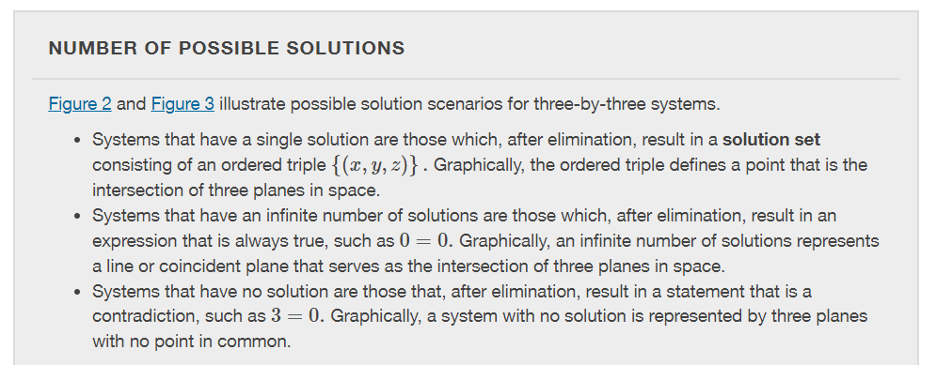
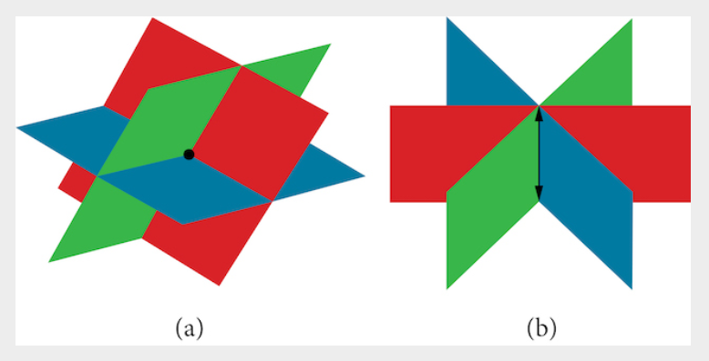
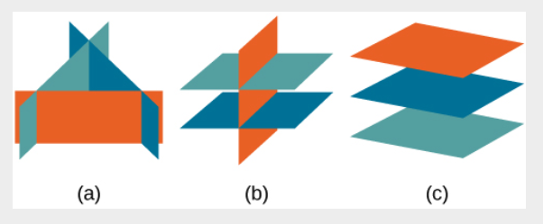
Notes:
Figure 2 (a)Three planes intersect at a single point, representing a three-by-three system with a single solution. (b) Three planes intersect in a line, representing a three-by-three system with infinite solutions.
Figure 3 All three figures represent three-by-three systems with no solution. (a) The three planes intersect with each other, but not at a common point. (b) Two of the planes are parallel and intersect with the third plane, but not with each other. (c) All three planes are parallel, so there is no point of intersection.

Slide 6
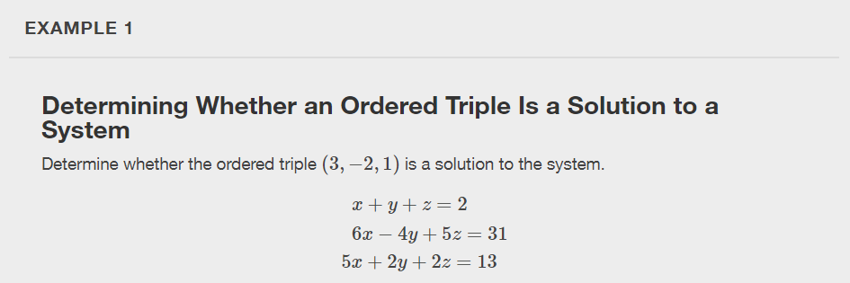

Slide 7
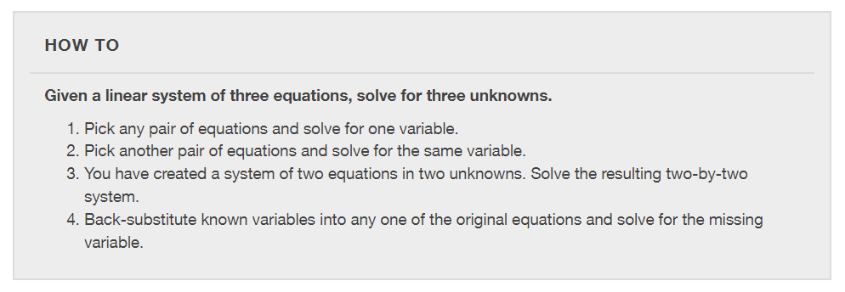

Slide 8
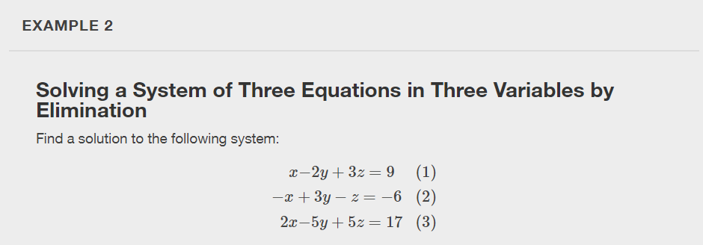

Slide 9
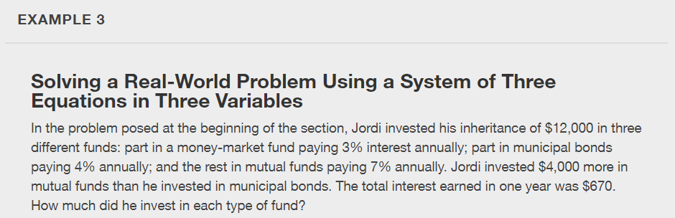

Slide 10
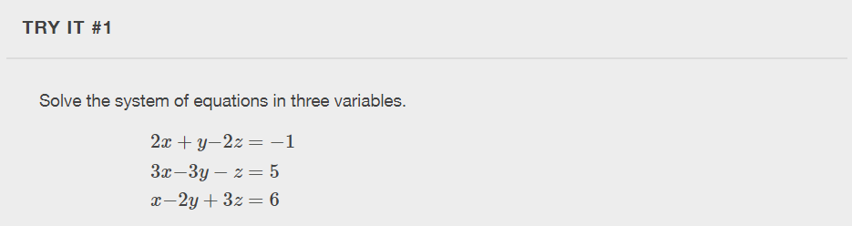

Slide 11
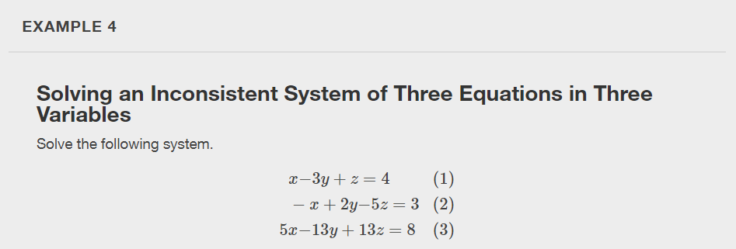
Notes:
Just as with systems of equations in two variables, we may come across an inconsistent system of equations in three variables, which means that it does not have a solution that satisfies all three equations. The equations could represent three parallel planes, two parallel planes and one intersecting plane, or three planes that intersect the other two but not at the same location. The process of elimination will result in a false statement, such as 3=7 or some other contradiction.

Slide 12
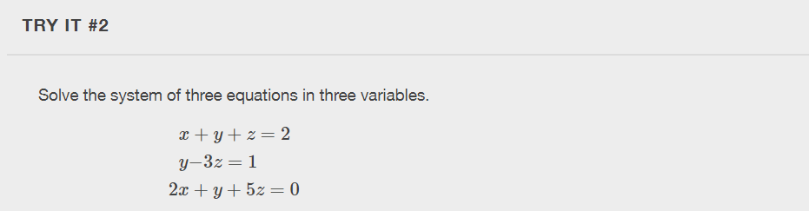

Slide 13
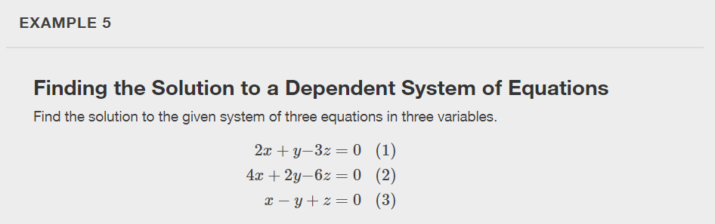
Notes:
We know from working with systems of equations in two variables that a dependent system of equations has an infinite number of solutions. The same is true for dependent systems of equations in three variables. An infinite number of solutions can result from several situations. The three planes could be the same, so that a solution to one equation will be the solution to the other two equations. All three equations could be different but they intersect on a line, which has infinite solutions. Or two of the equations could be the same and intersect the third on a line.

Slide 14

Notes:
No, you can write the generic solution in terms of any of the variables, but it is common to write it in terms of x and if needed xx and y.

Slide 15
What did you learn in this section?
Solve systems of three equations in three variables.
Identify inconsistent systems of equations containing three variables.
Express the solution of a system of dependent equations containing three variables.
Notes:
Do you have any questions?

Slide 16
This resource is an adaptation of the OpenStax Algebra and Trigonometry 2e open textbook and is © Susan Aydelotte under a CC BY-NC-SA 4.0 International license; it may be reproduced or modified for noncommercial purposes only but must be attributed to OpenStax, Rice University and any changes must be noted. Any adaptation must be shared under the same type of license.

