Slide 1

Systems of Equations and Inequalities
Chapter 11
Algebra and Trigonometry 2e, OpenStax, Jay Abramson
Notes:
Images and notes within these slides are from the OpenStax textbook Algebra and Trigonometry 2e

Slide 2
11.1 Systems of Linear Equations: Two Variables
Algebra and Trigonometry 2e, OpenStax, Jay Abramson
Notes:
Images and notes within these slides are from the OpenStax textbook Algebra and Trigonometry 2e

Slide 3
What are the learning objectives for this section?
Solve systems of equations by graphing.
Solve systems of equations by substitution.
Solve systems of equations by addition.
Identify inconsistent systems of equations containing two variables.
Express the solution of a system of dependent equations containing two variables.

Slide 4
A system of linear equations consists of two or more linear equations made up of two or more variables such that all equations in the system are considered simultaneously.
To find the unique solution to a system of linear equations, we must find a numerical value for each variable in the system that will satisfy all equations in the system at the same time.

Slide 5
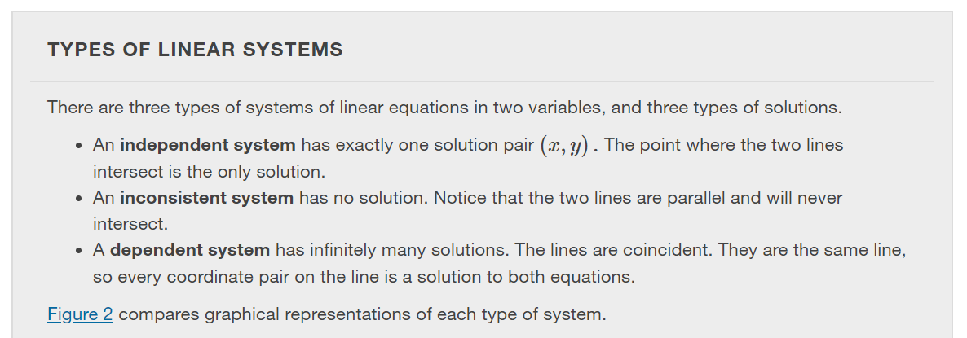
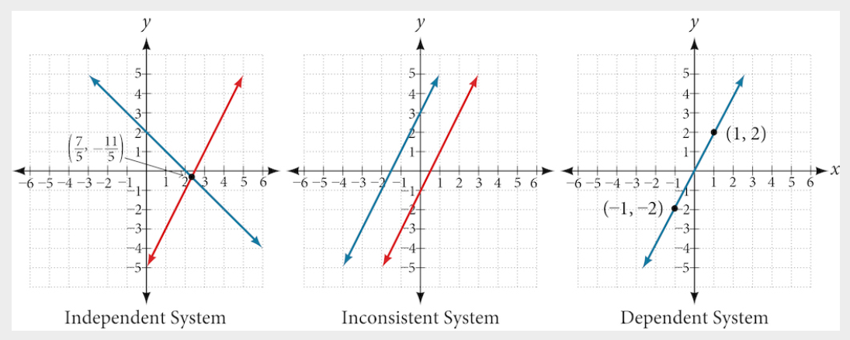

Slide 6
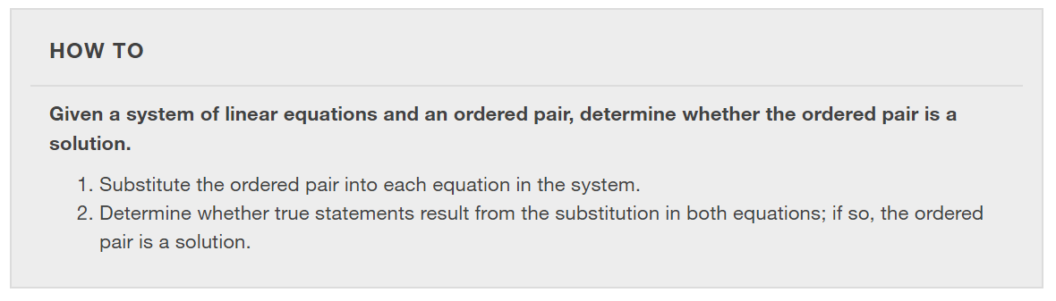

Slide 7
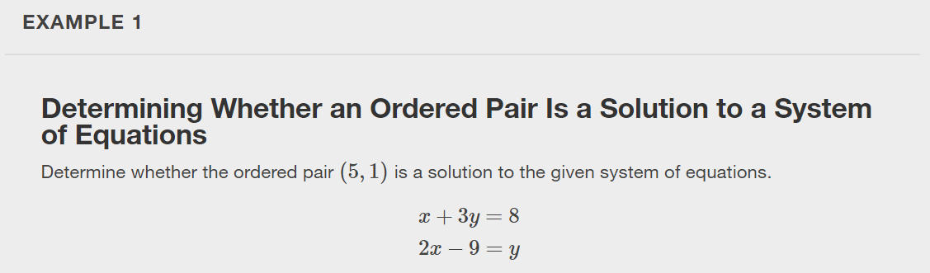

Slide 8
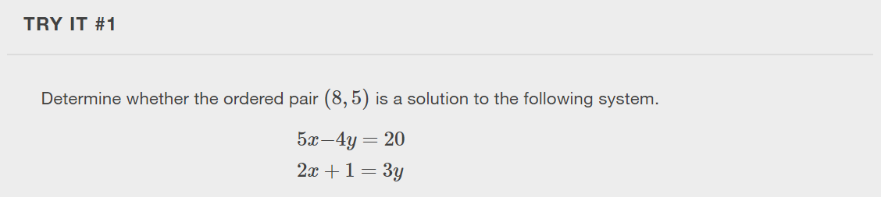

Slide 9
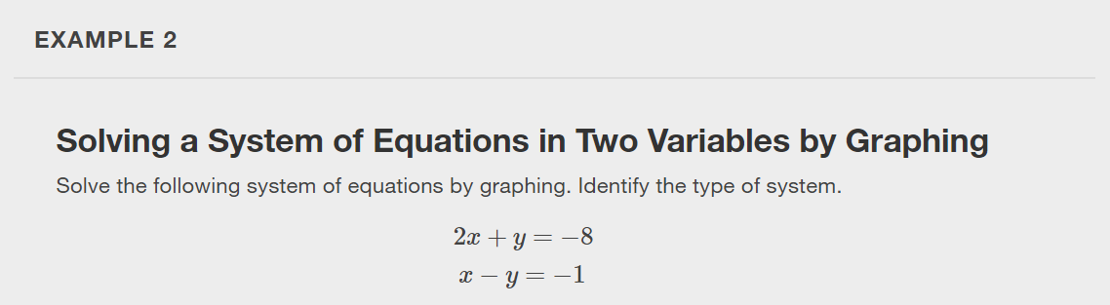
Notes:
There are multiple methods of solving systems of linear equations. For a system of linear equations in two variables, we can determine both the type of system and the solution by graphing the system of equations on the same set of axes.

Slide 10
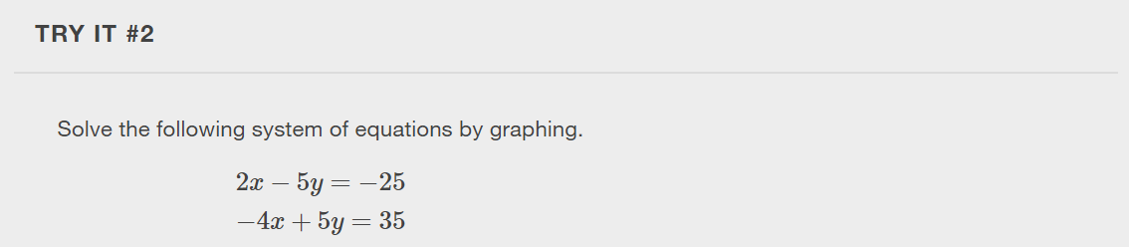

Slide 11
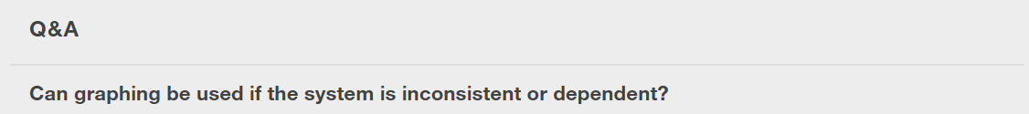
Notes:
Yes, in both cases we can still graph the system to determine the type of system and solution. If the two lines are parallel, the system has no solution and is inconsistent. If the two lines are identical, the system has infinite solutions and is a dependent system.

Slide 12
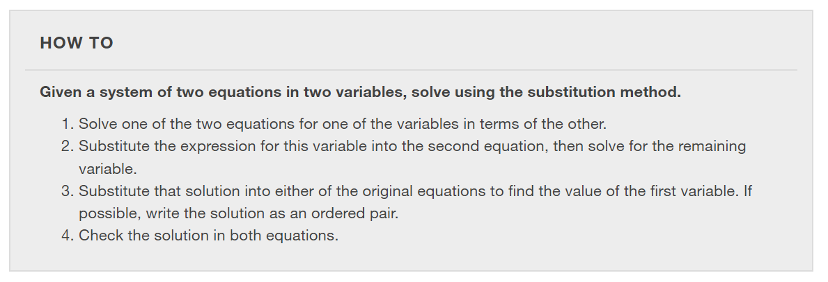
Notes:
Solving a linear system in two variables by graphing works well when the solution consists of integer values, but if our solution contains decimals or fractions, it is not the most precise method. We will consider two more methods of solving a system of linear equations that are more precise than graphing. One such method is solving a system of equations by the substitution method, in which we solve one of the equations for one variable and then substitute the result into the second equation to solve for the second variable.

Slide 13
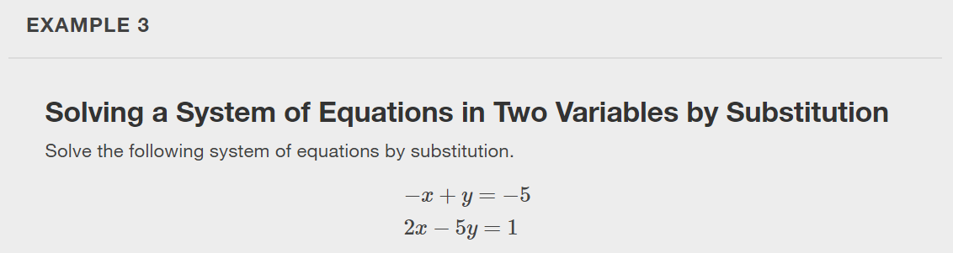

Slide 14
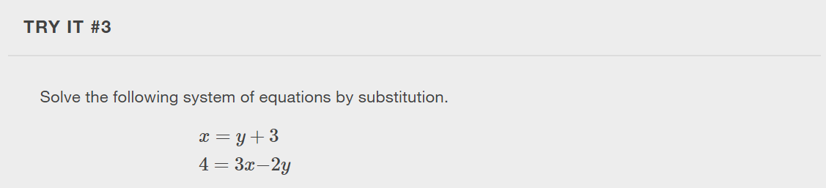

Slide 15
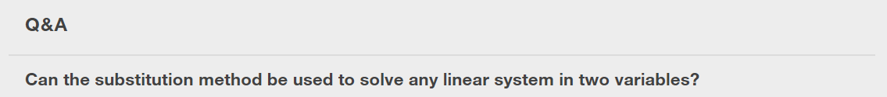
Notes:
Yes, but the method works best if one of the equations contains a coefficient of 1 or –1 so that we do not have to deal with fractions.

Slide 16
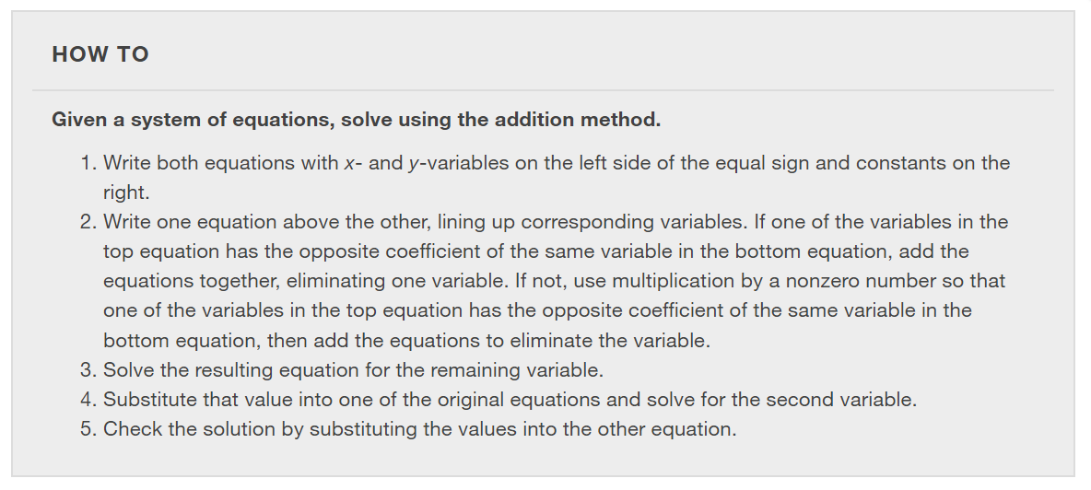
Notes:
A third method of solving systems of linear equations is the addition method. In this method, we add two terms with the same variable, but opposite coefficients, so that the sum is zero. Of course, not all systems are set up with the two terms of one variable having opposite coefficients. Often we must adjust one or both of the equations by multiplication so that one variable will be eliminated by addition.

Slide 17
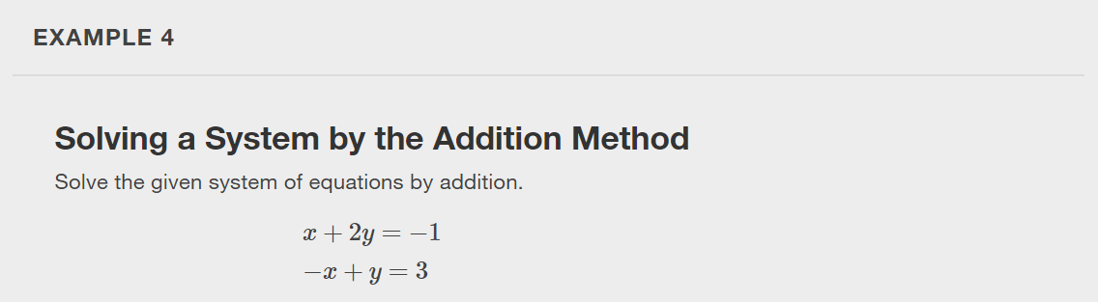

Slide 18
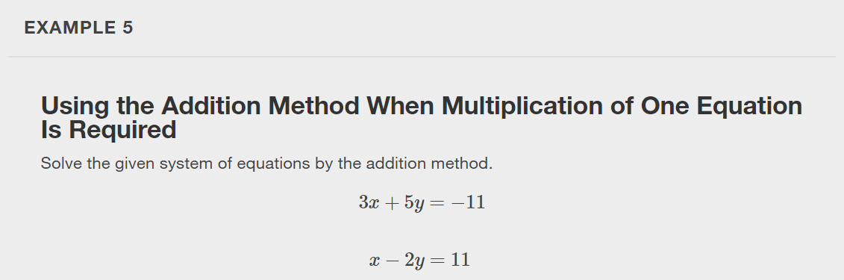

Slide 19
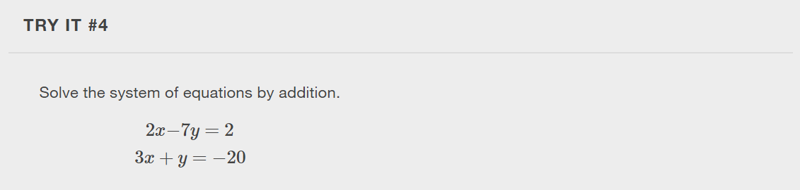

Slide 20
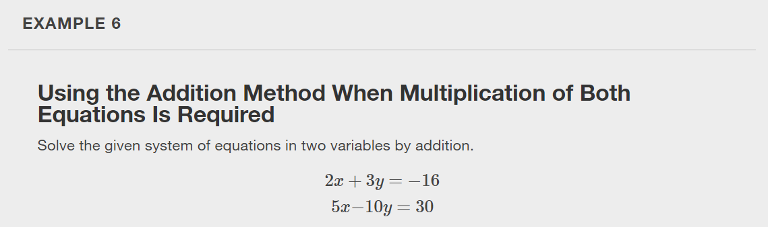

Slide 21
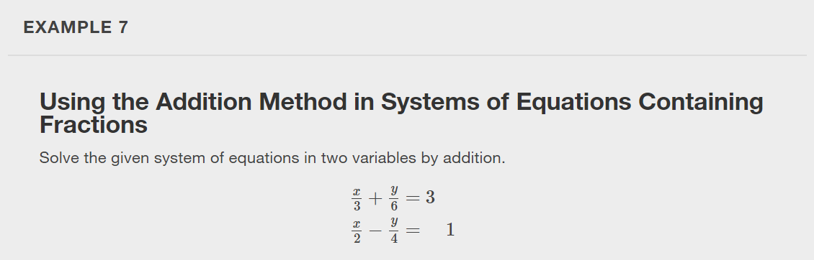

Slide 22
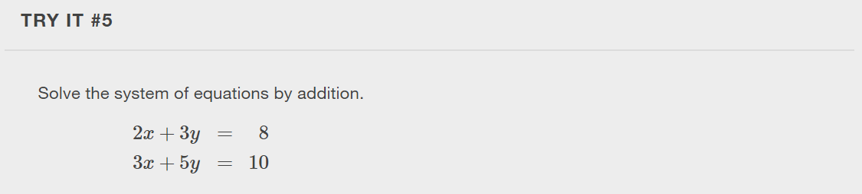

Slide 23
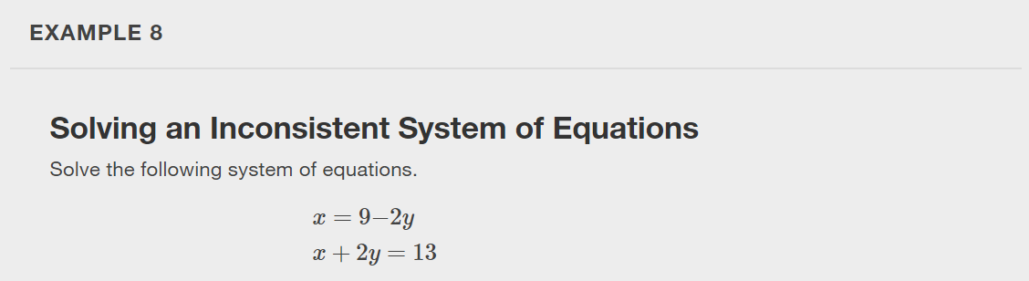
Notes:
Now that we have several methods for solving systems of equations, we can use the methods to identify inconsistent systems. Recall that an inconsistent system consists of parallel lines that have the same slope but different y -intercepts. They will never intersect. When searching for a solution to an inconsistent system, we will come up with a false statement, such as 12=0.

Slide 24
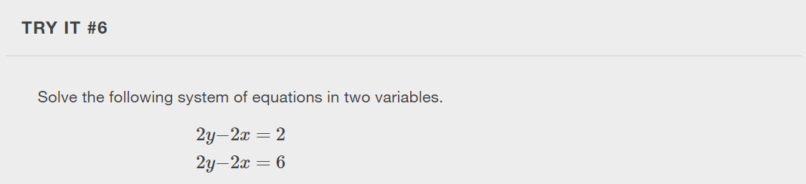

Slide 25
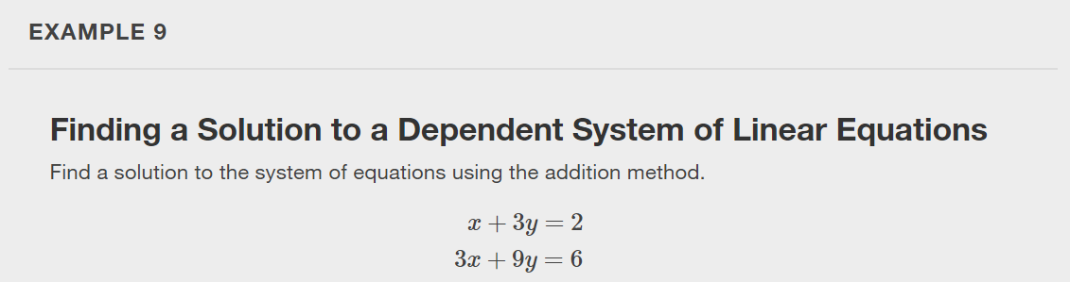
Notes:
Recall that a dependent system of equations in two variables is a system in which the two equations represent the same line. Dependent systems have an infinite number of solutions because all of the points on one line are also on the other line. After using substitution or addition, the resulting equation will be an identity, such as 0=0.

Slide 26
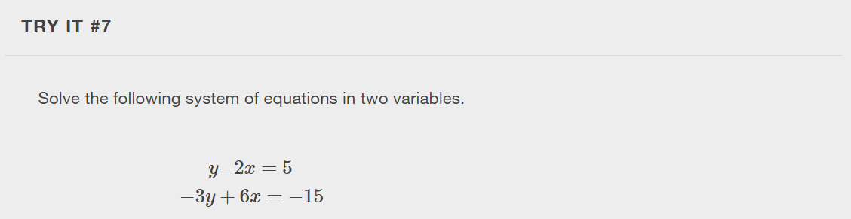

Slide 27
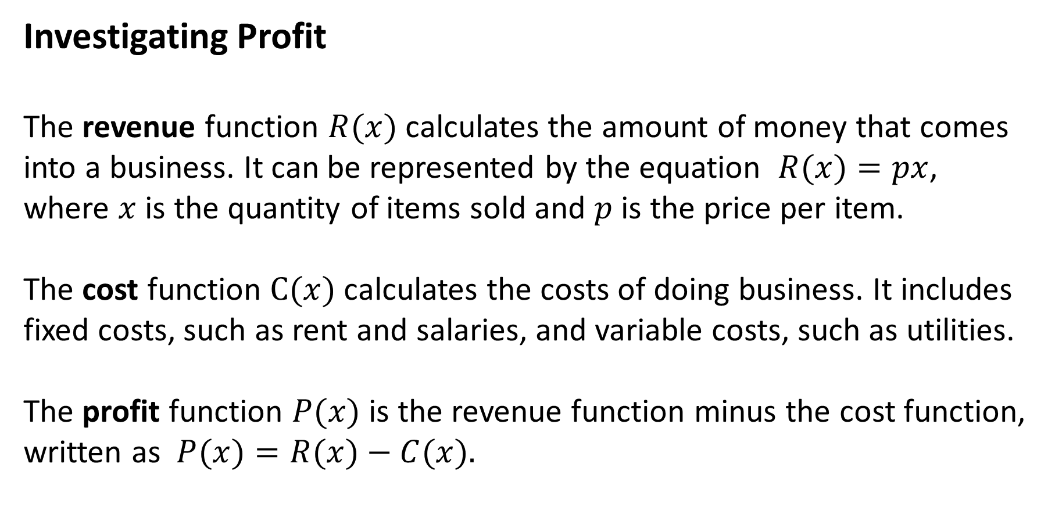
Investigating Profit
The revenue function $R(x)$calculates the amount of money that comes into a business. It can be represented by the equation $R(x)=px$, where $x$ is the quantity of items sold and $p$ is the price per item.
The cost function $C(x)$calculates the costs of doing business. It includes fixed costs, such as rent and salaries, and variable costs, such as utilities.
The profit function $P(x)$ is the revenue function minus the cost function, written as $P(x)=R(x)−C(x).$

Slide 28
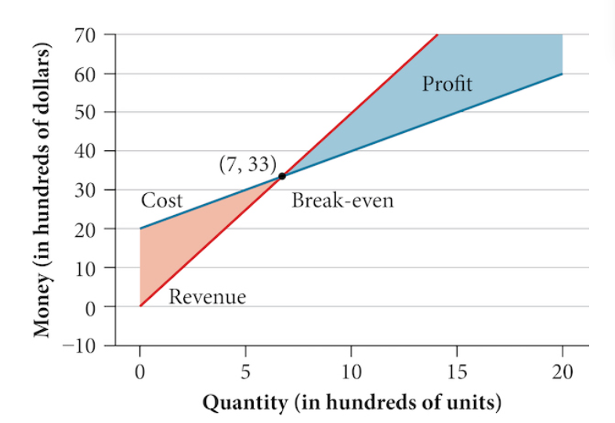
The point at which the cost is equal to the revenue is called the break-even point.
Notes:
We can see from the graph that if 700 units are produced, the cost is $3,300 and the revenue is also $3,300. In other words, the company breaks even if they produce and sell 700 units.

Slide 29
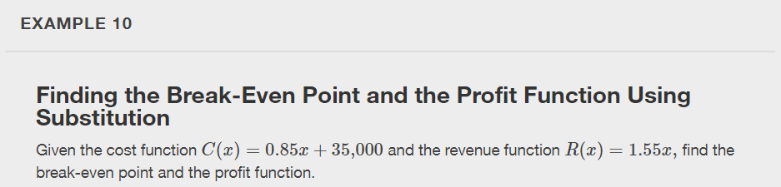

Slide 30
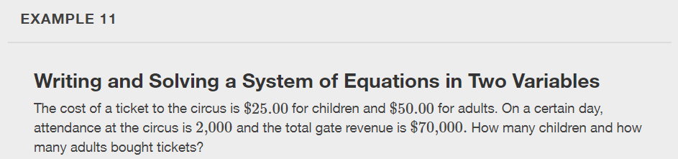

Slide 31
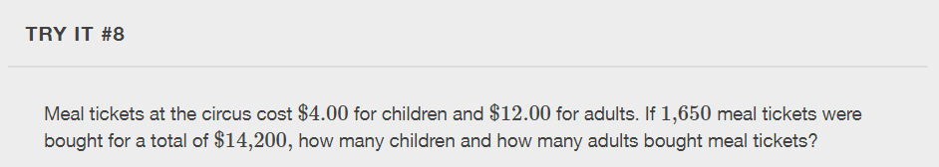

Slide 32
What did you learn in this section?
Solve systems of equations by graphing.
Solve systems of equations by substitution.
Solve systems of equations by addition.
Identify inconsistent systems of equations containing two variables.
Express the solution of a system of dependent equations containing two variables.
Notes:
Do you have any questions?

Slide 33
This resource is an adaptation of the OpenStax Algebra and Trigonometry 2e open textbook and is © Susan Aydelotte under a CC BY-NC-SA 4.0 International license; it may be reproduced or modified for noncommercial purposes only but must be attributed to OpenStax, Rice University and any changes must be noted. Any adaptation must be shared under the same type of license.

