Slide 1
Further Applications of Trigonometry
Chapter 10
Algebra and Trigonometry 2e, OpenStax, Jay Abramson
Notes:
Images and notes within these slides are from the OpenStax textbook Algebra and Trigonometry 2e

Slide 2
10.8 Vectors
Notes:
Images and notes within these slides are from the OpenStax textbook Algebra and Trigonometry 2e

Slide 3
What are the learning objectives for this section?
View vectors geometrically.
Find magnitude and direction.
Perform vector addition and scalar multiplication.
Find the component form of a vector.
Find the unit vector in the direction of $v$.
Perform operations with vectors in terms of $i$ and $j$ .
Find the dot product of two vectors.

Slide 4
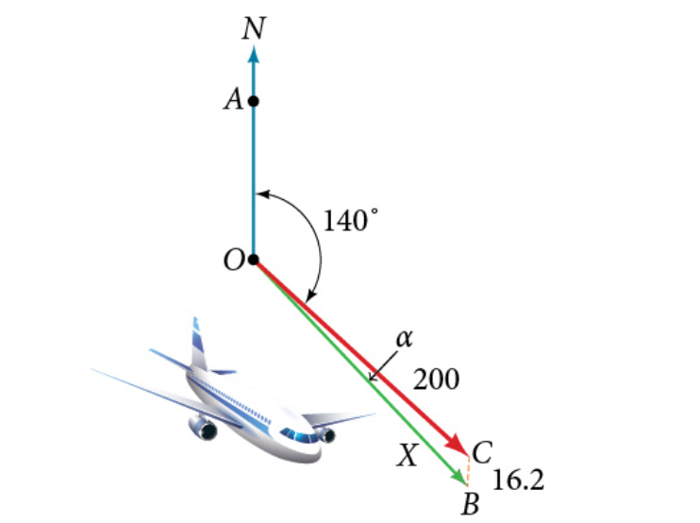
Notes:
An airplane is flying at an airspeed of 200 miles per hour headed on a SE bearing of 140°. A north wind (from north to south) is blowing at 16.2 miles per hour, as shown in the figure. What are the ground speed and actual bearing of the plane? Ground speed refers to the speed of a plane relative to the ground. Airspeed refers to the speed a plane can travel relative to its surrounding air mass. These two quantities are not the same because of the effect of wind. In an earlier section, we used triangles to solve a similar problem involving the movement of boats. Later in this section, we will find the airplane’s groundspeed and bearing, while investigating another approach to problems of this type. First, however, let’s examine the basics of vectors.

Slide 6
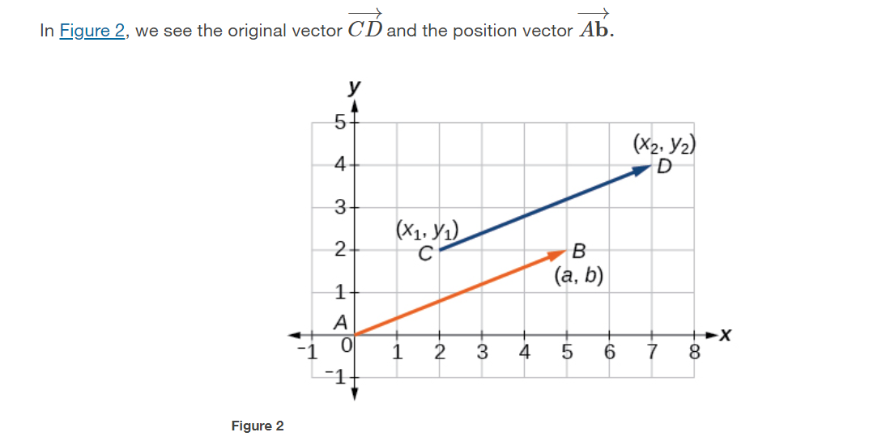
$$\vec{AB}=\left\langle a,b\right\rangle =\left\langle x_{2}−x_{1},y_{2}−y_{1}\right\rangle$$

Slide 10
Notes:
To work with a vector, we need to be able to find its magnitude and its direction. We find its magnitude using the Pythagorean Theorem or the distance formula, and we find its direction using the inverse tangent function.

Slide 13
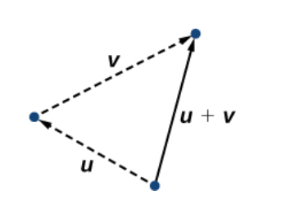
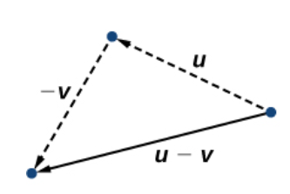
Vector Addition and Subtraction
The sum of two vectors u and v, or vector addition, produces a third vector u + v, the resultant vector.
The difference of two vectors u and v, or vector subtraction, produces a third vector u - v, the resultant vector.
Notes:
Now that we understand the properties of vectors, we can perform operations involving them. While it is convenient to think of the vector u =⟨x,y〉 as an arrow or directed line segment from the origin to the point (x,y), vectors can be situated anywhere in the plane. Notice that to find u − v, view it as u + (−v). Adding −v is reversing direction of v and adding it to the end of u. The new vector begins at the start of u and stops at the end point of −v

Slide 14
Performing Vector Addition and Subtraction
Given two vectors $u= \left\langle a,b\right\rangle$ and $v= \left\langle c,d\right\rangle$ where $a, b, c$, and $d$ are real numbers,
$$u+v=\left\langle a+c,b+d\right\rangle$$
and
$$u−v=\left\langle a−c,b−d\right\rangle$$

Slide 20
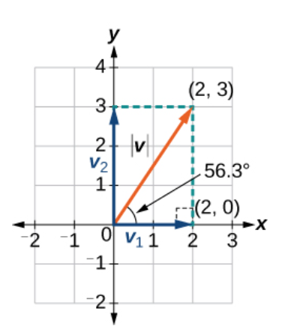
Finding the Components of a Vector
Vectors can be expressed as the sum of two vectors, namely
the horizontal component, which is the $x$ direction, and
the vertical component, which is the $y$ direction.
$u= \left\langle a,b\right\rangle =\left\langle a,0\right\rangle +\left\langle 0,b\right\rangle$

Slide 21
Notes:
Hint: First find the standard position vector. Note the graphs of the horizontal and vertical components are on the next slide.

Slide 22
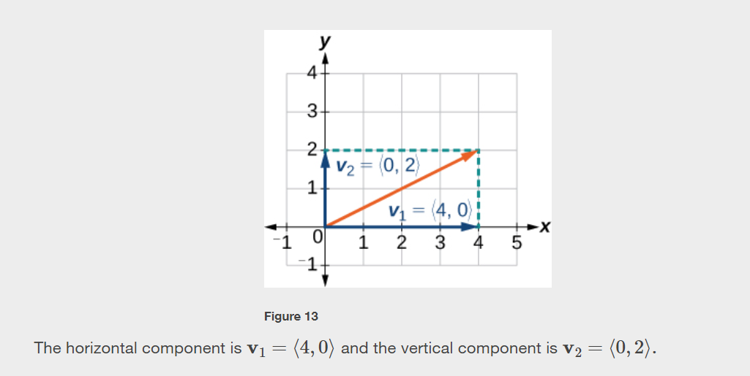

Slide 23
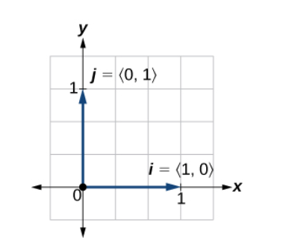
Horizontal and Vertical Unit Vectors
We call a vector with a magnitude of 1 a unit vector.
The horizontal unit vector is written as $i=⟨1,0⟩$ and is directed along the positive horizontal axis. The vertical unit vector is written as $j=⟨0,1⟩$
and is directed along the positive vertical axis.

Slide 26
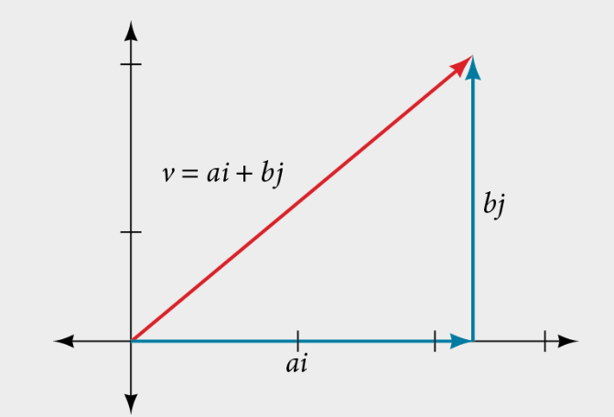

Slide 32
Notes:
We have seen how to draw vectors according to their initial and terminal points and how to find the position vector. We have also examined notation for vectors drawn specifically in the Cartesian coordinate plane using i and j. For any of these vectors, we can calculate the magnitude. Now, we want to combine the key points, and look further at the ideas of magnitude and direction.
Calculating direction follows the same straightforward process we used for polar coordinates. We find the direction of the vector by finding the angle to the horizontal. We do this by using the basic trigonometric identities, but with |v| replacing r.

Slide 35
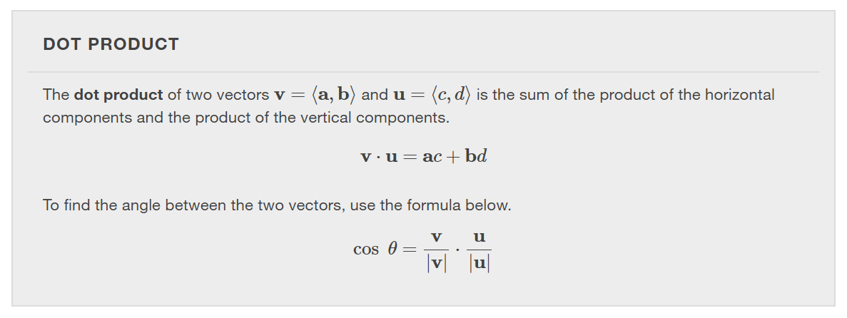
Notes:
As we discussed earlier in the section, scalar multiplication involves multiplying a vector by a scalar, and the result is a vector. As we have seen, multiplying a vector by a number is called scalar multiplication. If we multiply a vector by a vector, there are two possibilities: the dot product and the cross product. We will only examine the dot product here; you may encounter the cross product in more advanced mathematics courses.
The dot product of two vectors involves multiplying two vectors together, and the result is a scalar.

Slide 39
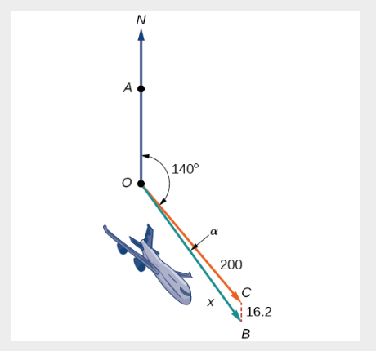

Slide 40
What did you learn in this section?
View vectors geometrically.
Find magnitude and direction.
Perform vector addition and scalar multiplication.
Find the component form of a vector.
Find the unit vector in the direction of $v$.
Perform operations with vectors in terms of $i$ and $j$ .
Find the dot product of two vectors.
Notes:
Do you have any questions?

Slide 41
This resource is an adaptation of the OpenStax Algebra and Trigonometry 2e open textbook and is © Susan Aydelotte under a CC BY-NC-SA 4.0 International license; it may be reproduced or modified for noncommercial purposes only but must be attributed to OpenStax, Rice University and any changes must be noted. Any adaptation must be shared under the same type of license.

