Slide 1
Further Applications of Trigonometry
Chapter 10
Algebra and Trigonometry 2e, OpenStax, Jay Abramson
Notes:
Images and notes within these slides are from the OpenStax textbook Algebra and Trigonometry 2e

Slide 2
10.7 Parametric Equations: Graphs
Notes:
Images and notes within these slides are from the OpenStax textbook Algebra and Trigonometry 2e

Slide 3
What are the learning objectives for this section?
Graph plane curves described by parametric equations by plotting points.
Graph parametric equations.

Slide 4
Notes:
In lieu of a graphing calculator or a computer graphing program, plotting points to represent the graph of an equation is the standard method. As long as we are careful in calculating the values, point-plotting is highly dependable.

Slide 12
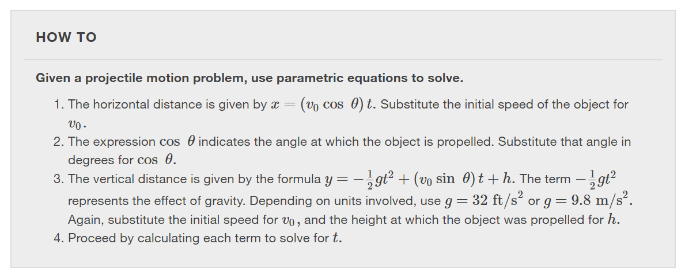
Notes:
Many of the advantages of parametric equations become obvious when applied to solving real-world problems. Although rectangular equations in x and y give an overall picture of an object's path, they do not reveal the position of an object at a specific time. Parametric equations, however, illustrate how the values of x and y change depending on t, as the location of a moving object at a particular time.
A common application of parametric equations is solving problems involving projectile motion. In

Slide 13
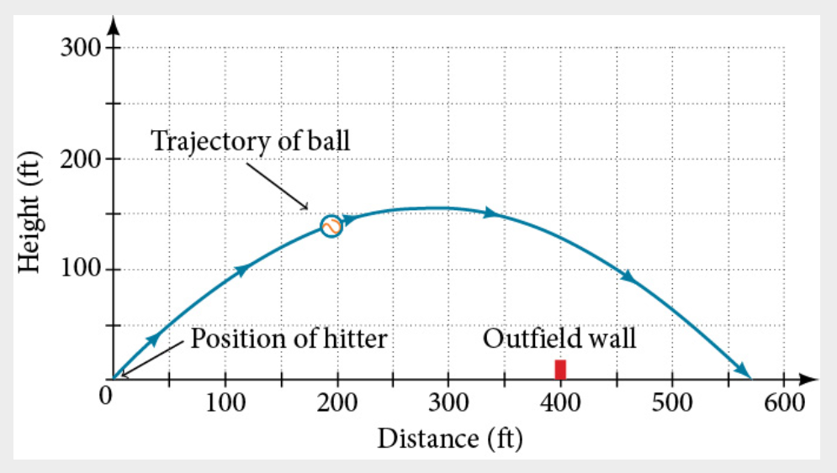

Slide 14
What did you learn in this section?
Graph plane curves described by parametric equations by plotting points.
Graph parametric equations.
Notes:
Do you have any questions?

Slide 15
This resource is an adaptation of the OpenStax Algebra and Trigonometry 2e open textbook and is © Susan Aydelotte under a CC BY-NC-SA 4.0 International license; it may be reproduced or modified for noncommercial purposes only but must be attributed to OpenStax, Rice University and any changes must be noted. Any adaptation must be shared under the same type of license.

