Slide 1

Further Applications of Trigonometry
Chapter 10
Algebra and Trigonometry 2e, OpenStax, Jay Abramson
Notes:
Images and notes within these slides are from the OpenStax textbook Algebra and Trigonometry 2e

Slide 2
10.6 Parametric Equations
Notes:
Images and notes within these slides are from the OpenStax textbook Algebra and Trigonometry 2e

Slide 3
What are the learning objectives for this section?
Parameterize a curve.
Eliminate the parameter.
Find a rectangular equation for a curve defined parametrically.
Find parametric equations for curves defined by rectangular equations.

Slide 4
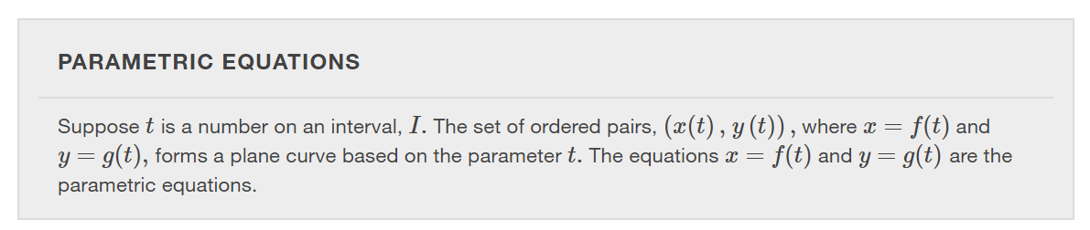
Notes:
When we parameterize a curve, we are translating a single equation in two variables, such as xx and y ,y , into an equivalent pair of equations in three variables, x,y,x,y, and t.t. One of the reasons we parameterize a curve is because the parametric equations yield more information: specifically, the direction of the object’s motion over time.

Slide 5
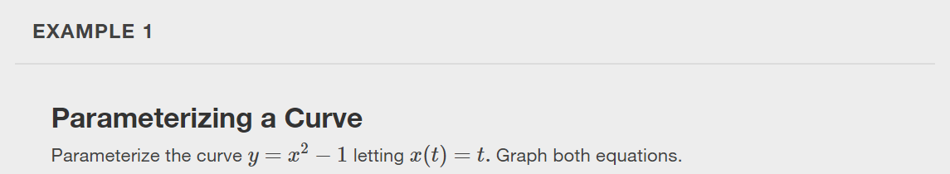

Slide 6
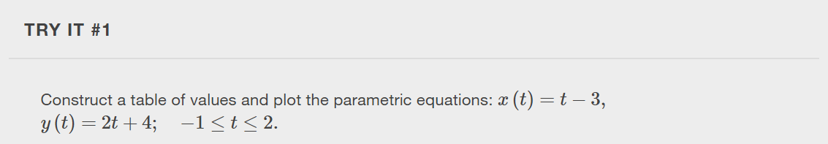

Slide 7
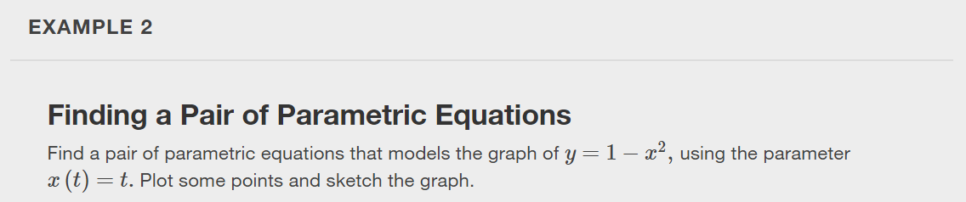

Slide 8
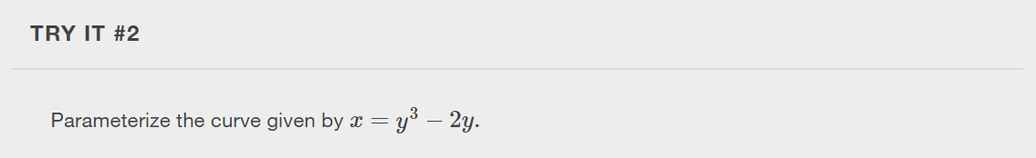

Slide 9
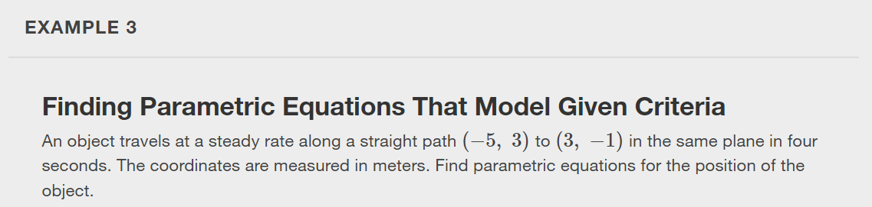

Slide 10
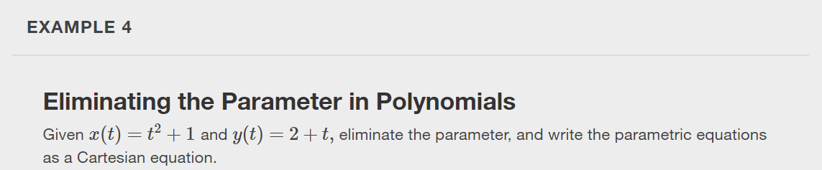
Notes:
In many cases, we may have a pair of parametric equations but find that it is simpler to draw a curve if the equation involves only two variables, such as x and y. Eliminating the parameter is a method that may make graphing some curves easier. For polynomial, exponential, or logarithmic equations expressed as two parametric equations, we choose the equation that is most easily manipulated and solve for t. We substitute the resulting expression for t into the second equation. This gives one equation in x and y.

Slide 11
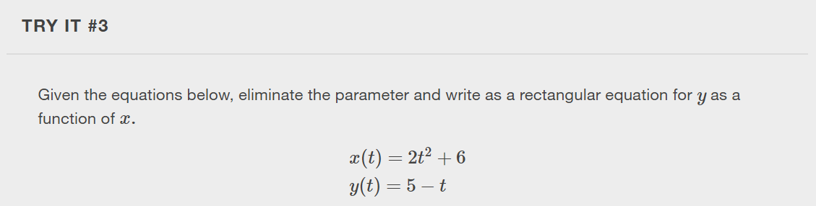

Slide 12
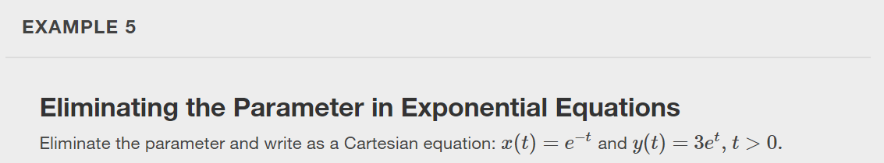

Slide 13
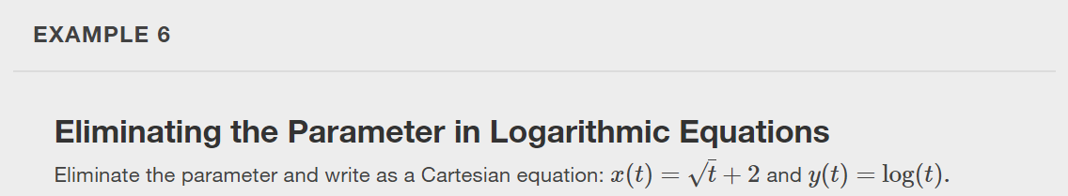

Slide 14
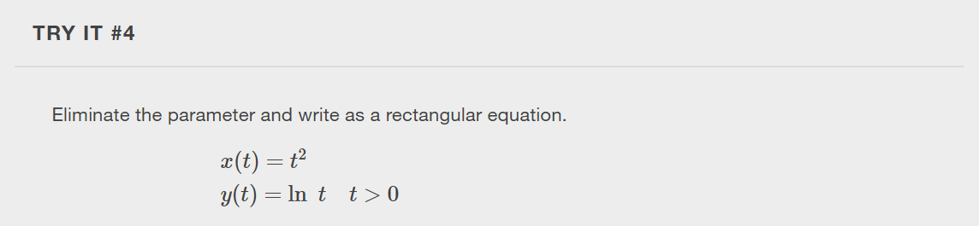

Slide 15
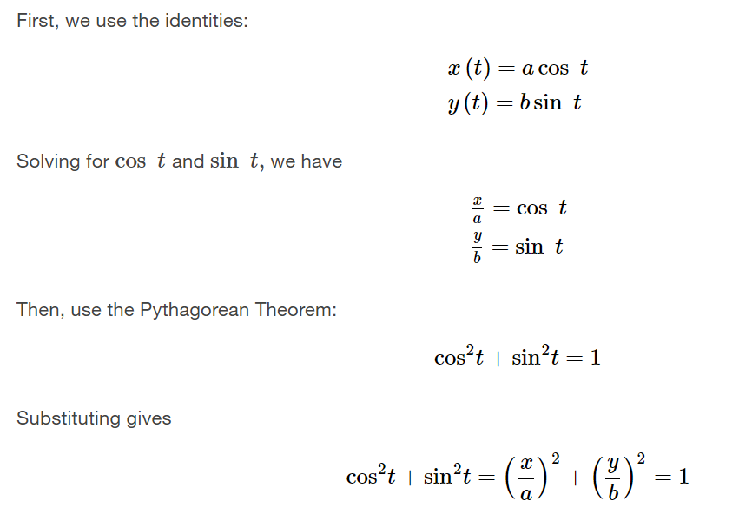
Eliminating the Parameter from Trigonometric Equations
Notes:
Eliminating the parameter from trigonometric equations is a straightforward substitution. We can use a few of the familiar trigonometric identities and the Pythagorean Theorem.

Slide 16
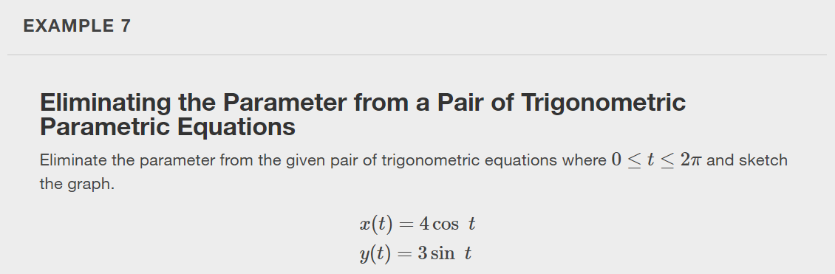

Slide 17
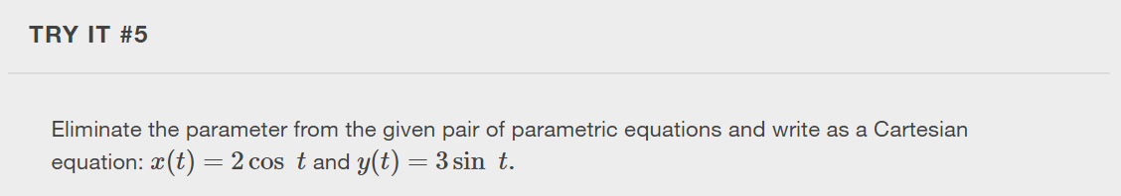

Slide 18
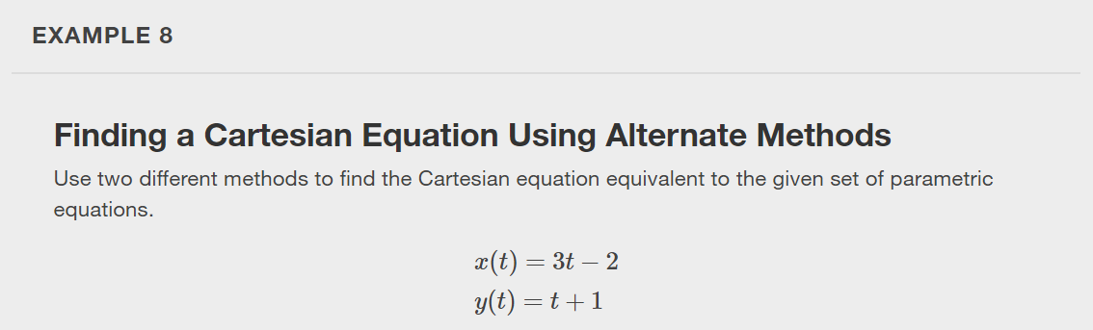
Notes:
When we are given a set of parametric equations and need to find an equivalent Cartesian equation, we are essentially “eliminating the parameter.” However, there are various methods we can use to rewrite a set of parametric equations as a Cartesian equation. The simplest method is to solve one equation for the parameter and then substitute for the parameter in the other equation.

Slide 19
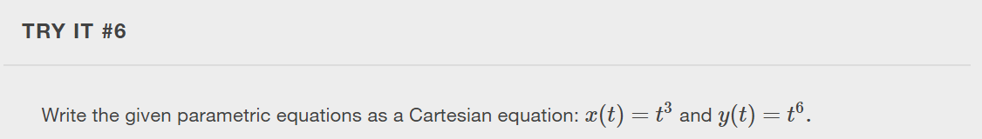
Notes:
Notice that for Example 8 and Try It #6, there is only one rectangular equation. However, if we are given a rectangular equation and asked to find equivalent paramentric equations, there are multiple possibilities.

Slide 20
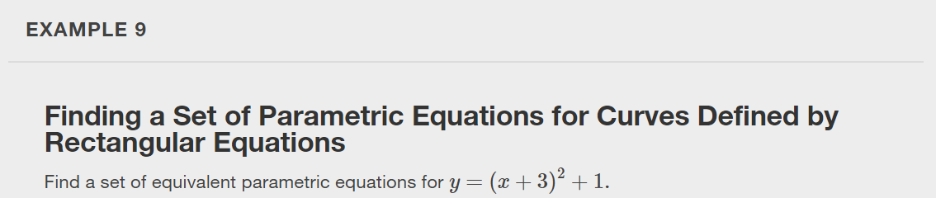
Notes:
First try t=x. Then try t=x+3. Can you think of another substitution to find a set of parametric equations? Verify your set of parametric equations are equivalent by graphing.

Slide 21
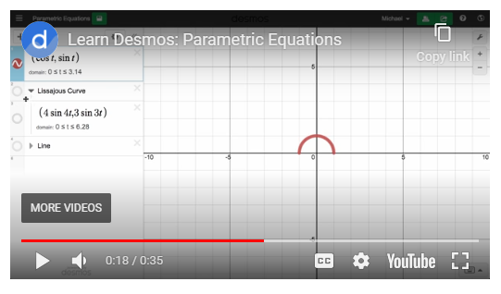
Graphing Parametric Equations using Desmos.com/calculator
https://youtu.be/D_ReUSRRpd0
Notes:
Use the link: https://youtu.be/D_ReUSRRpd0 to watch a quick video on how to graph parametric equations using desmos.com/calculator.

Slide 22
What did you learn in this section?
Parameterize a curve.
Eliminate the parameter.
Find a rectangular equation for a curve defined parametrically.
Find parametric equations for curves defined by rectangular equations.
Notes:
Do you have any questions?

Slide 23
This resource is an adaptation of the OpenStax Algebra and Trigonometry 2e open textbook and is © Susan Aydelotte under a CC BY-NC-SA 4.0 International license; it may be reproduced or modified for noncommercial purposes only but must be attributed to OpenStax, Rice University and any changes must be noted. Any adaptation must be shared under the same type of license.

