Slide 1
Further Applications of Trigonometry
Chapter 10
Algebra and Trigonometry 2e, OpenStax, Jay Abramson
Notes:
Images and notes within these slides are from the OpenStax textbook Algebra and Trigonometry 2e

Slide 2
10.5 Polar Form of Complex Numbers
Notes:
Images and notes within these slides are from the OpenStax textbook Algebra and Trigonometry 2e

Slide 3
What are the learning objectives for this section?
Plot complex numbers in the complex plane.
Find the absolute value of a complex number.
Write complex numbers in polar form.
Convert a complex number from polar to rectangular form.
Find products of complex numbers in polar form.
Find quotients of complex numbers in polar form.
Find powers of complex numbers in polar form.
Find roots of complex numbers in polar form.

Slide 4
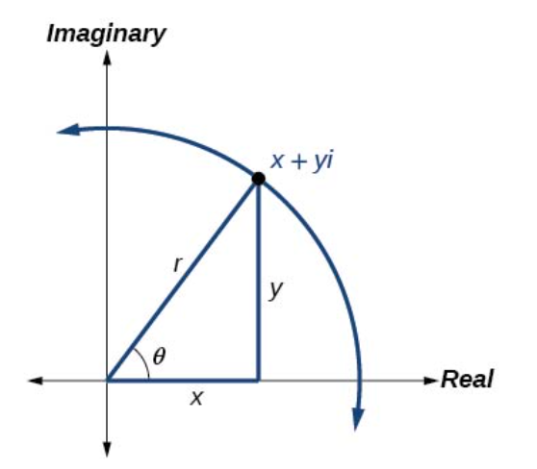
Plotting Complex Numbers in the Complex Plane
Plotting a complex number $x+yi$ is similar to plotting the ordered pair $(x,y),$except that the horizontal axis represents the real part of the number, $x$, and the vertical axis represents the imaginary part of the number, $yi$.
Notes:
Recall that $i= \sqrt{−1}$.

Slide 5
Notes:
Recall that $i= \sqrt{−1}$.

Slide 8
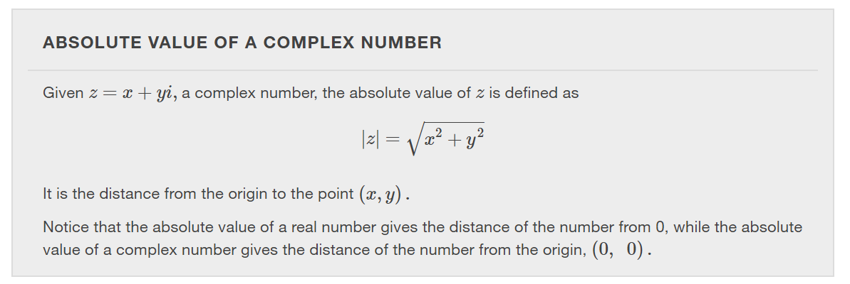

Slide 13
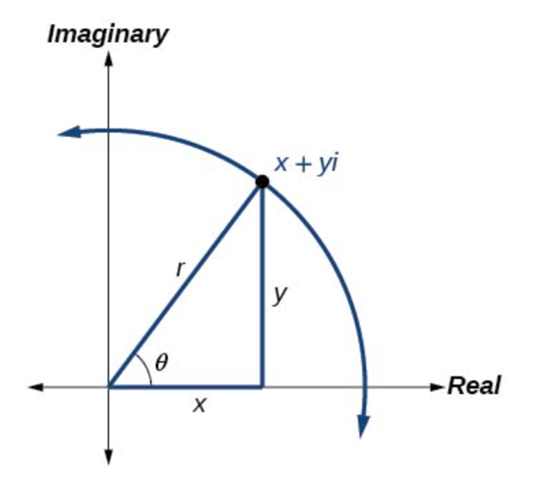

Slide 18
Converting a Complex Number from Polar to Rectangular Form
Converting a complex number from polar form to rectangular form is a matter of evaluating what is given and using the distributive property.
In other words, given
$z=r(cosθ+isinθ),$
first evaluate the trigonometric functions $cosθ$ and $sinθ$.
Then, multiply through by $r$.

Slide 22
Notes:
Now that we can convert complex numbers to polar form we will learn how to perform operations on complex numbers in polar form. For the rest of this section, we will work with formulas developed by French mathematician Abraham De Moivre (1667-1754). These formulas have made working with products, quotients, powers, and roots of complex numbers much simpler than they appear. The rules are based on multiplying the moduli and adding the arguments.

Slide 24
Notes:
The quotient of two complex numbers in polar form is the quotient of the two moduli and the difference of the two arguments.

Slide 28
Notes:
Finding powers of complex numbers is greatly simplified using De Moivre’s Theorem. It states that, for a positive integer n, z^n is found by raising the modulus to the nth power and multiplying the argument by n. It is the standard method used in modern mathematics.

Slide 30
Notes:
To find the nth root of a complex number in polar form, we use the nth Root Theorem.

Slide 33
What did you learn in this section?
Plot complex numbers in the complex plane.
Find the absolute value of a complex number.
Write complex numbers in polar form.
Convert a complex number from polar to rectangular form.
Find products of complex numbers in polar form.
Find quotients of complex numbers in polar form.
Find powers of complex numbers in polar form.
Find roots of complex numbers in polar form.
Notes:
Do you have any questions?

Slide 34
This resource is an adaptation of the OpenStax Algebra and Trigonometry 2e open textbook and is © Susan Aydelotte under a CC BY-NC-SA 4.0 International license; it may be reproduced or modified for noncommercial purposes only but must be attributed to OpenStax, Rice University and any changes must be noted. Any adaptation must be shared under the same type of license.

