Slide 1
Further Applications of Trigonometry
Chapter 10
Algebra and Trigonometry 2e, OpenStax, Jay Abramson
Notes:
Images and notes within these slides are from the OpenStax textbook Algebra and Trigonometry 2e

Slide 2
10.4 Polar Coordinates: Graphs
Notes:
Images and notes within these slides are from the OpenStax textbook Algebra and Trigonometry 2e

Slide 3
What are the learning objectives for this section?
Test polar equations for symmetry.
Graph polar equations by plotting points.

Slide 4
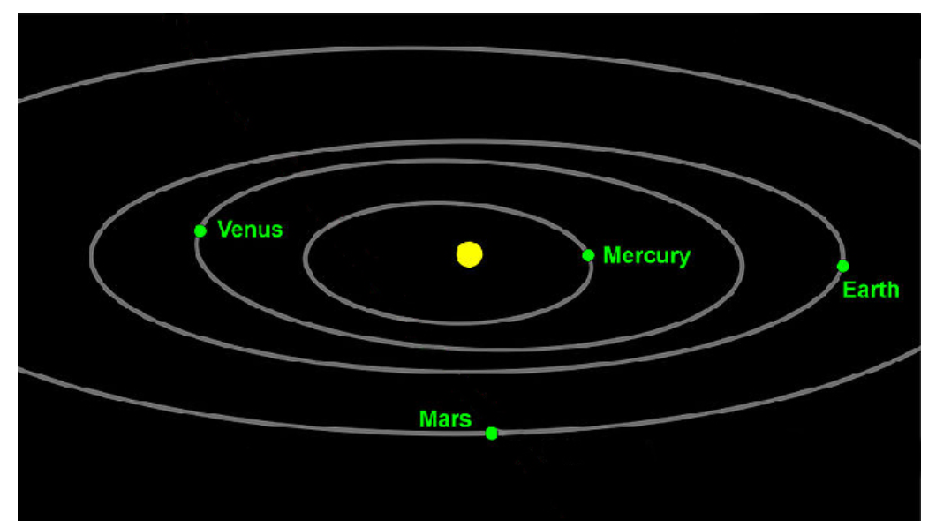
Notes:
We can use polar coordinates for the position of the planets relative to the sun. We interpret r as the distance from the center of the sun and θ as the planet’s angular bearing, or its direction from the center of the sun. We can use polar equations to model the path of a planet.

Slide 5
Notes:
A graph is symmetric with respect to the line θ=π/2 (y-axis) if replacing (r,θ) with (−r,−θ) yields an equivalent equation.
A graph is symmetric with respect to the polar axis (x-axis) if replacing (r,θ) with (r,−θ) or (−r,π−θ) yields an equivalent equation.
A graph is symmetric with respect to the pole (origin) if replacing (r,θ) with (−r,θ) yields an equivalent equation.

Slide 7
Notes:
Confirm your result by checking the graph of the polar equation.

Slide 9
Graphing Polar Equations by Plotting Points
To graph in the rectangular coordinate system we construct a table of $x$ and $y$ values. To graph in the polar coordinate system we construct a table of $θ$ and $r$ values.
We enter values of $θ$ into a polar equation and calculate $r$. However, using the properties of symmetry and finding key values of $θ$ and $r$ means fewer calculations will be needed.

Slide 10
Notes:
Another important consideration for graphing a polar equation is determining the zeros and maximum values.

Slide 12
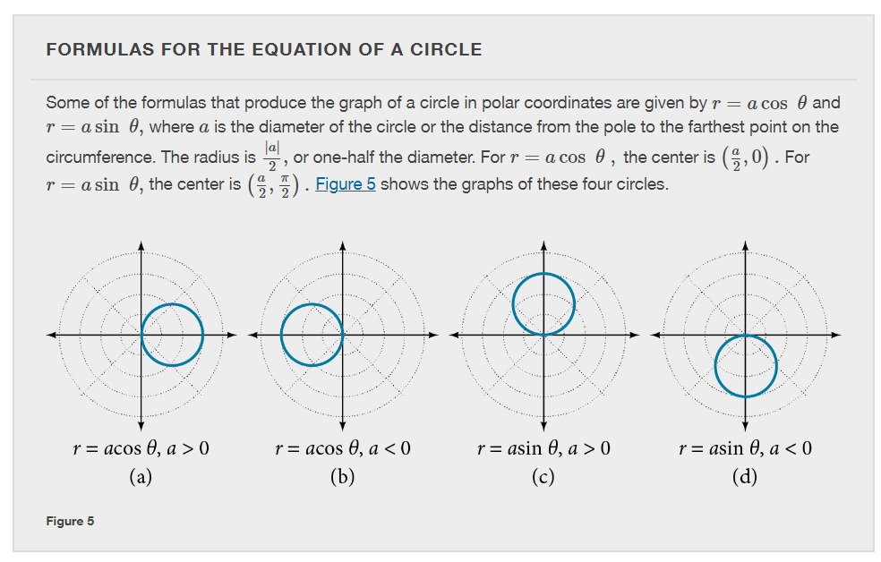
Notes:
There are five classic polar curves: cardioids, limaҫons, lemniscates, rose curves, and Archimedes’ spirals. We will briefly touch on the polar formulas for the circle before moving on to the classic curves and their variations.

Slide 14
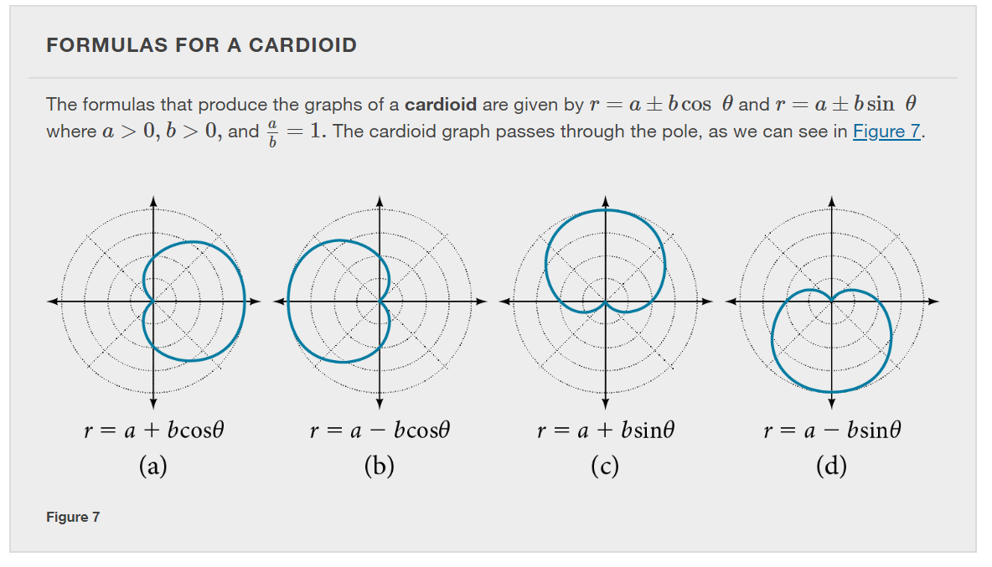

Slide 17
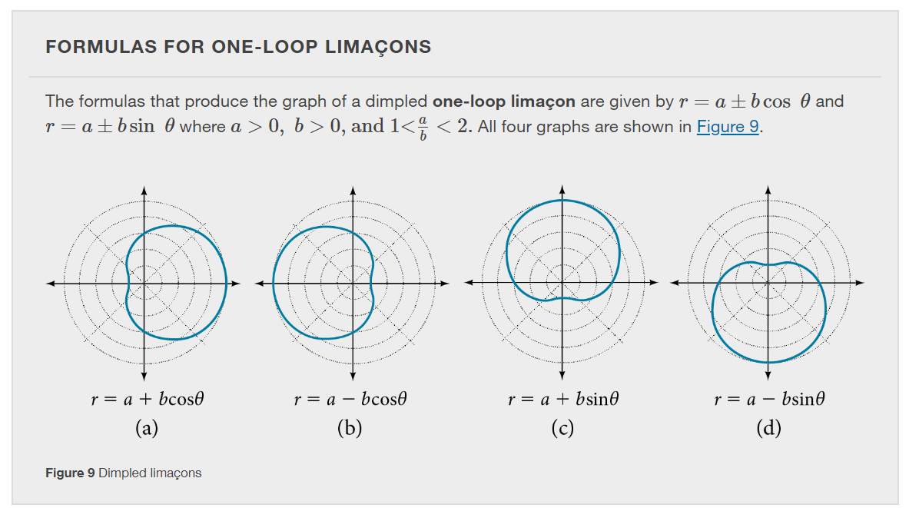

Slide 23
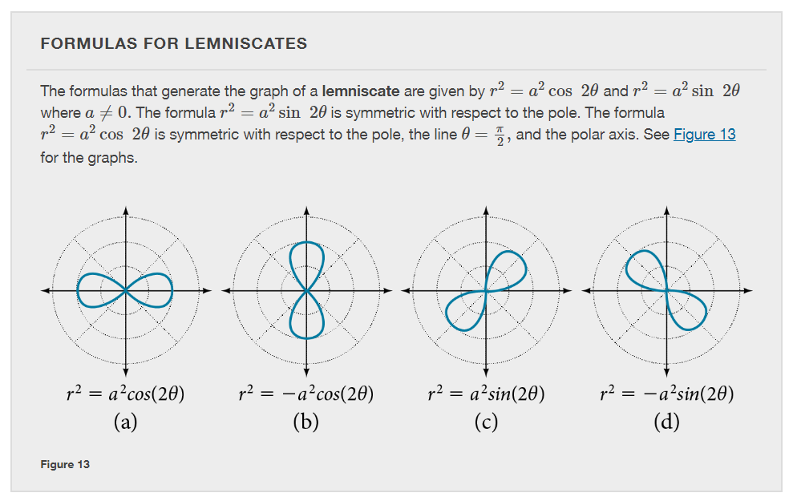

Slide 25
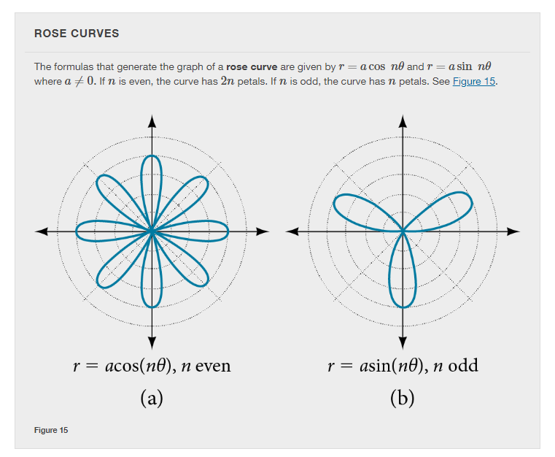

Slide 30
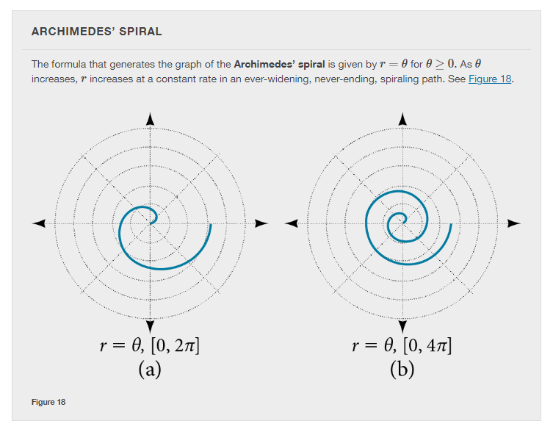
Notes:
The final polar equation we will discuss is the Archimedes’ spiral, named for its discoverer, the Greek mathematician Archimedes (c. 287 BCE-c. 212 BCE), who is credited with numerous discoveries in the fields of geometry and mechanics.

Slide 34
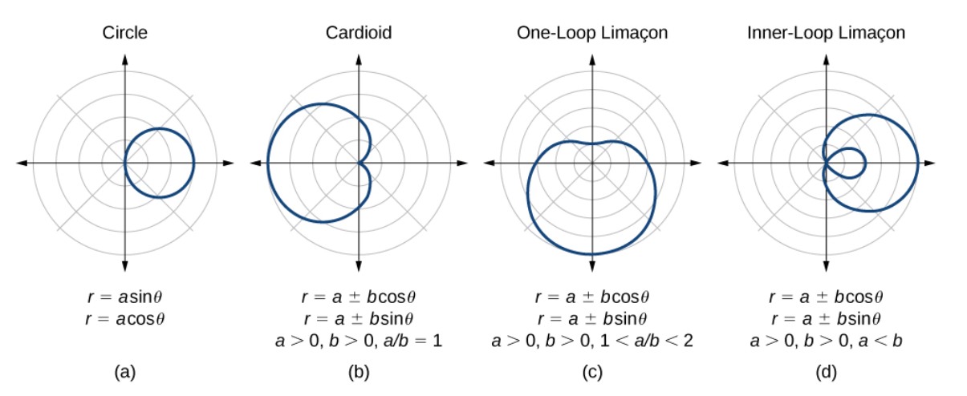
Notes:
In summary, we have studied eight different types of polar curves. This slide and the next slide review the graphs and equations for each of these polar curves.

Slide 35
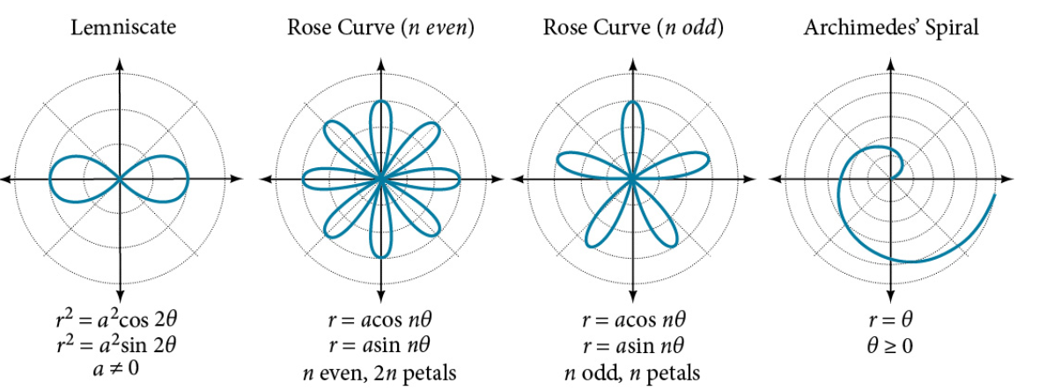

Slide 36
What did you learn in this section?
Test polar equations for symmetry.
Graph polar equations by plotting points.
Notes:
Do you have any questions?

Slide 37
This resource is an adaptation of the OpenStax Algebra and Trigonometry 2e open textbook and is © Susan Aydelotte under a CC BY-NC-SA 4.0 International license; it may be reproduced or modified for noncommercial purposes only but must be attributed to OpenStax, Rice University and any changes must be noted. Any adaptation must be shared under the same type of license.

