Slide 1

Further Applications of Trigonometry
Chapter 10
Algebra and Trigonometry 2e, OpenStax, Jay Abramson
Notes:
Images and notes within these slides are from the OpenStax textbook Algebra and Trigonometry 2e

Slide 2
10.3 Polar Coordinates
Notes:
Images and notes within these slides are from the OpenStax textbook Algebra and Trigonometry 2e

Slide 3
What are the learning objectives for this section?
Plot points using polar coordinates.
Convert from polar coordinates to rectangular coordinates.
Convert from rectangular coordinates to polar coordinates.
Transform equations between polar and rectangular forms.
Identify and graph polar equations by converting to rectangular equations.

Slide 4
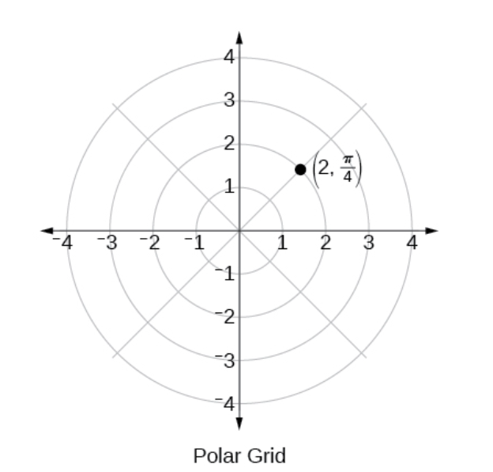
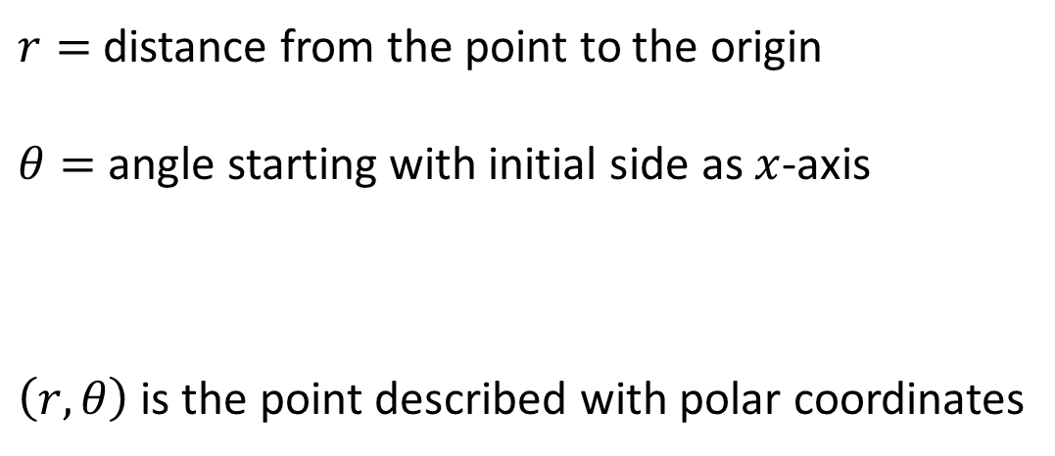
Plotting Points Using Polar Coordinates
.
$r=$ distance from the point to the origin
$θ=$ angle starting with initial side as $x$-axis
$\left(r,θ\right)$ is the point described with polar coordinates
Notes:
When we think about plotting points in the plane, we usually think of rectangular coordinates $(x,y)$ in the Cartesian coordinate plane. However, there are other ways of writing a coordinate pair and other types of grid systems. In this section, we introduce to polar coordinates, which are points labeled $(r,θ)$ and plotted on a polar grid. The polar grid is represented as a series of concentric circles radiating out from the pole, or the origin of the coordinate plane.

Slide 5
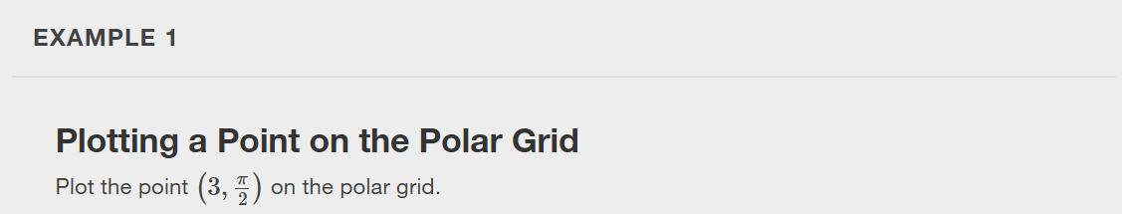
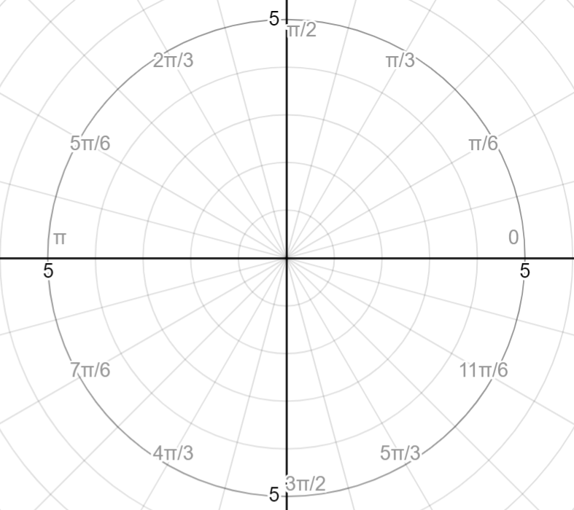

Slide 6
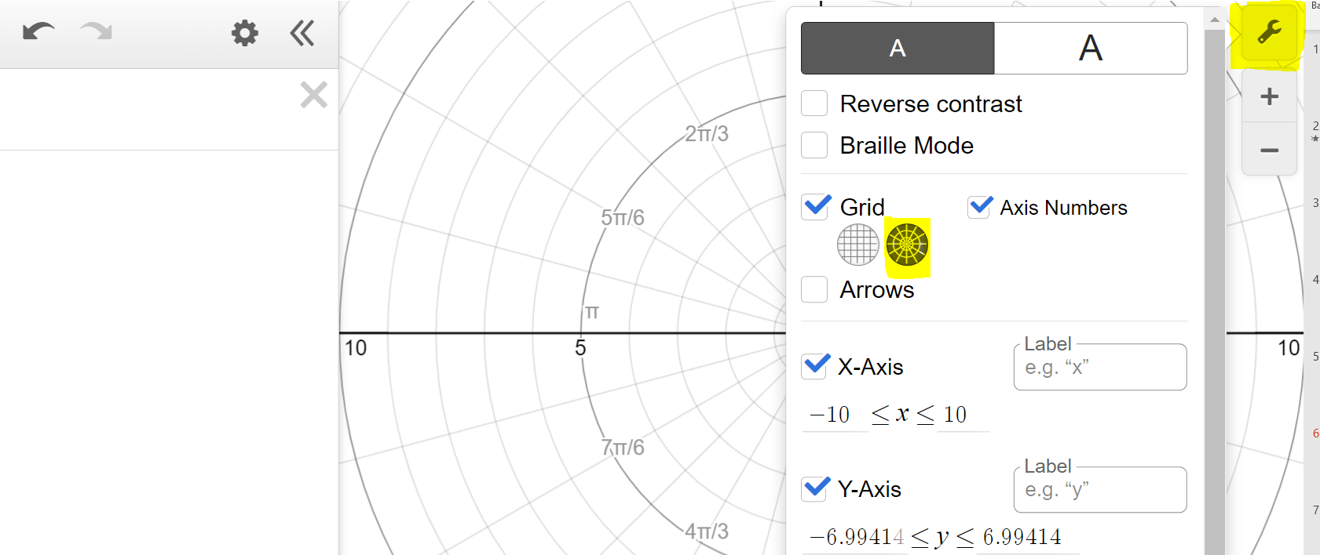
Using desmos.com/calculator
Notes:
You can change the grid in desmos by clicking on the tool button and clicking the polar option.

Slide 7


Slide 8
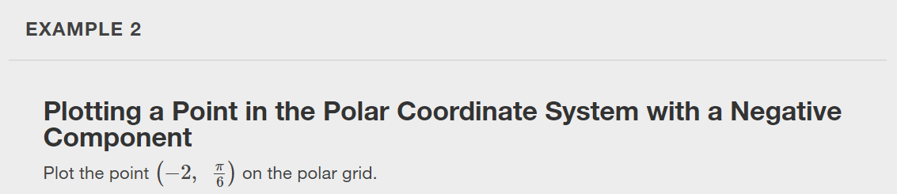

Slide 9


Slide 10
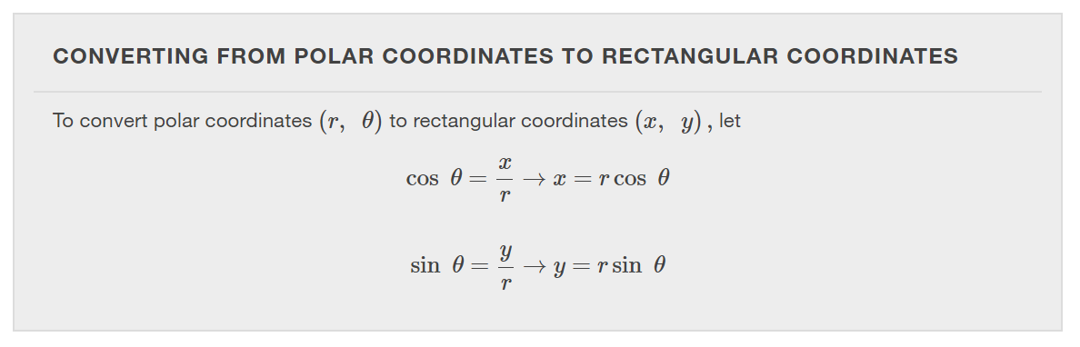
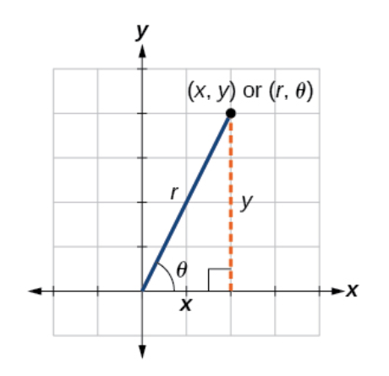

Slide 11
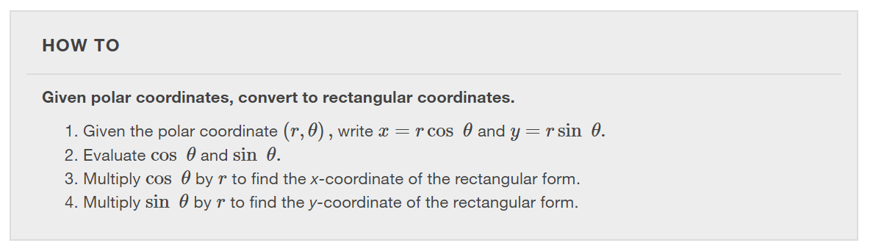

Slide 12
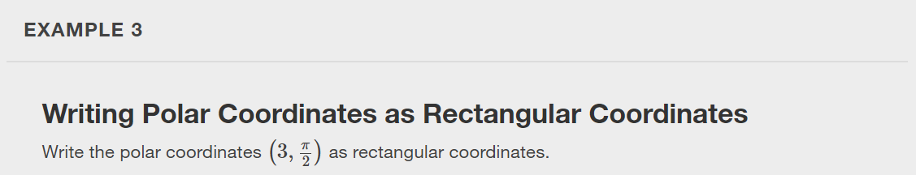

Slide 13
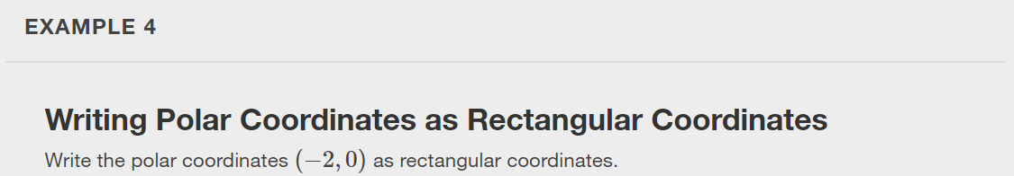

Slide 14


Slide 15

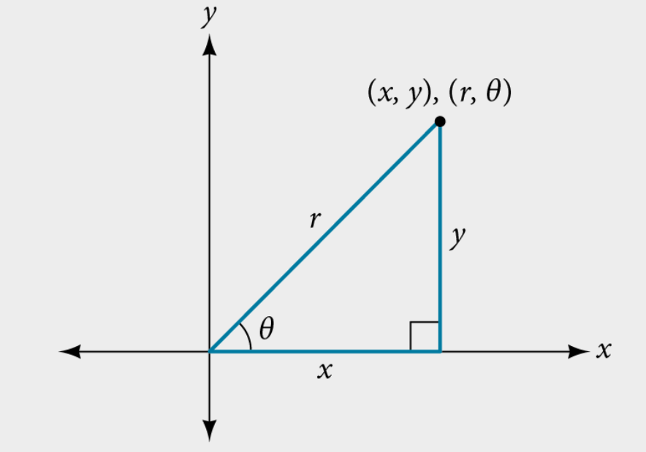





Slide 16
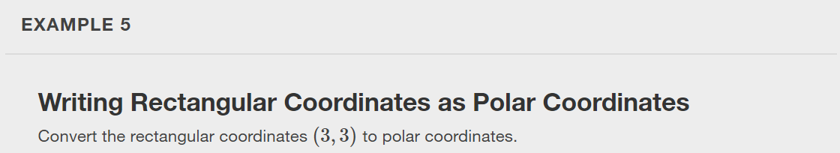
Notes:
Note: There are infinitely many answers to this question. Find a different pair of polar coordinates for the point.

Slide 17
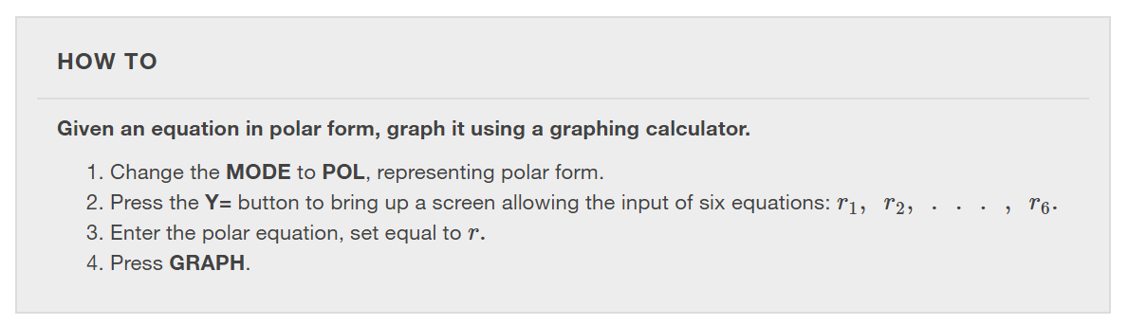

Slide 18
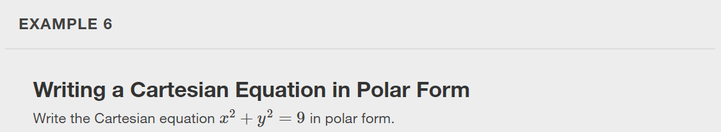

Slide 19
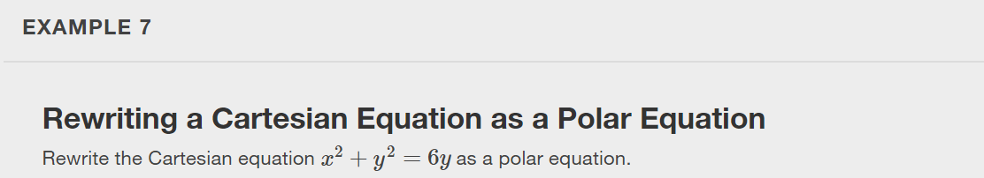
Notes:
Check your answer by graphing the Cartesian equation and the polar equation with a graphing calculator.

Slide 20
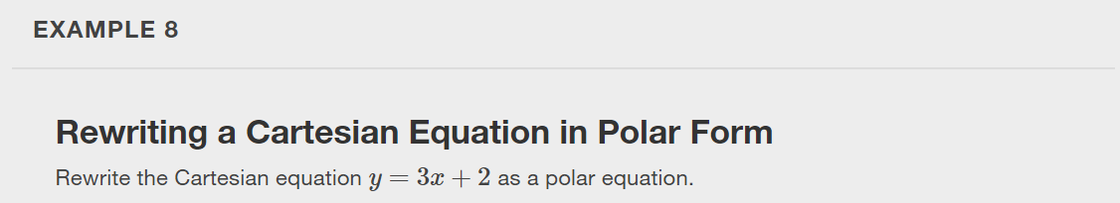

Slide 21


Slide 22
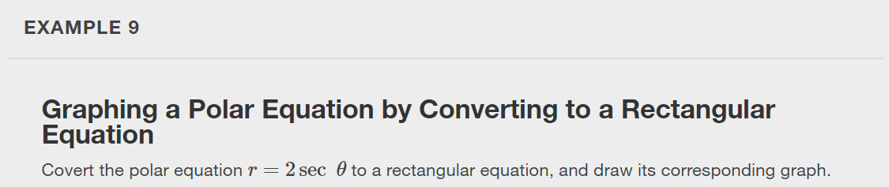

Slide 23


Slide 24
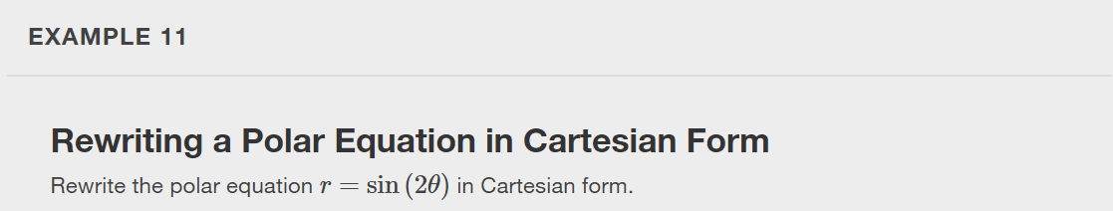

Slide 25
What did you learn in this section?
Plot points using polar coordinates.
Convert from polar coordinates to rectangular coordinates.
Convert from rectangular coordinates to polar coordinates.
Transform equations between polar and rectangular forms.
Identify and graph polar equations by converting to rectangular equations.
Notes:
Do you have any questions?

Slide 26
This resource is an adaptation of the OpenStax Algebra and Trigonometry 2e open textbook and is © Susan Aydelotte under a CC BY-NC-SA 4.0 International license; it may be reproduced or modified for noncommercial purposes only but must be attributed to OpenStax, Rice University and any changes must be noted. Any adaptation must be shared under the same type of license.

