Slide 1
Further Applications of Trigonometry
Chapter 10
Algebra and Trigonometry 2e, OpenStax, Jay Abramson
Notes:
Images and notes within these slides are from the OpenStax textbook Algebra and Trigonometry 2e

Slide 2
10.2 Non-right Triangles: Law of Cosines
Notes:
Images and notes within these slides are from the OpenStax textbook Algebra and Trigonometry 2e

Slide 3
What are the learning objectives for this section?
Use the Law of Cosines to solve oblique triangles.
Solve applied problems using the Law of Cosines.
Use Heron’s formula to ﬁnd the area of a triangle.

Slide 5
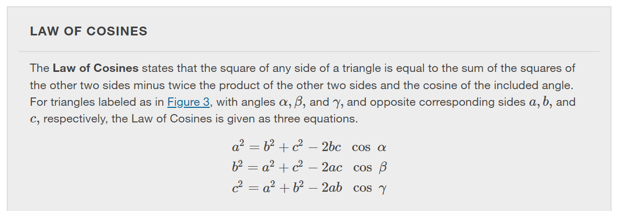
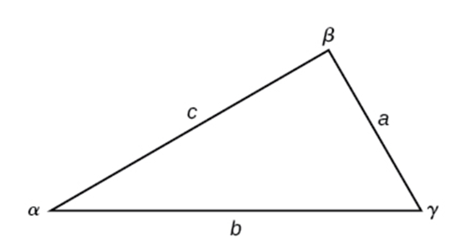
Notes:
Notice that to solve for a missing side measurement, the corresponding opposite angle measure is needed.

Slide 7
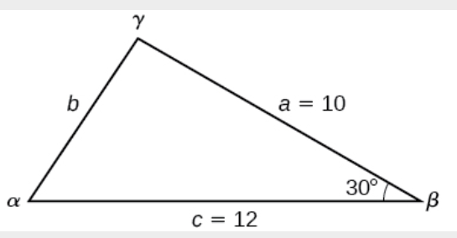

Slide 9
Notes:
Solving the equations stated earlier for the Law of Cosines for the cosine function yields this second version of the Law of Cosines. This type of question would be the case where each side length is known, ie. the SSS (side-side-side) case.

Slide 10
Notes:
RECALL: The range of the inverse cosine is between 0 and 180 degrees. This means that there will not be any ambiguous cases using this method.

Slide 12
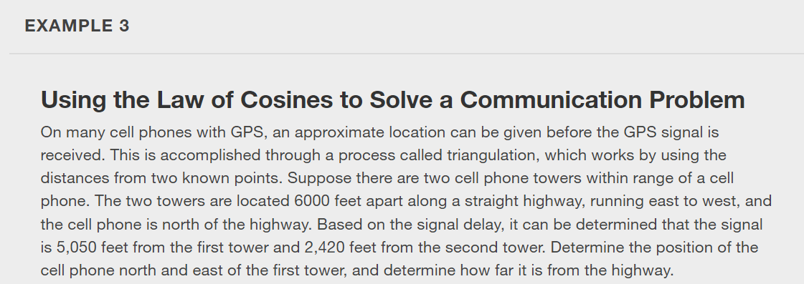
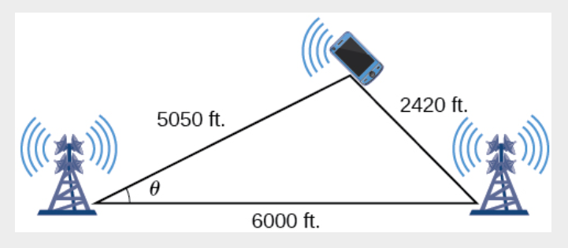

Slide 13
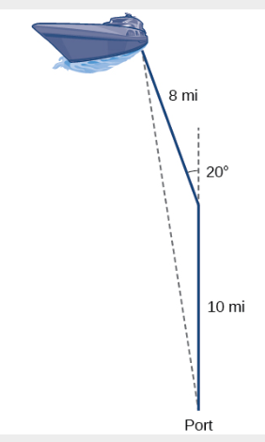

Slide 14
Notes:
We already learned how to find the area of an oblique triangle when we know two sides and an angle. We also know the formula to find the area of a triangle using the base and the height. When we know the three sides, however, we can use Heron’s formula instead of finding the height. Heron of Alexandria was a geometer who lived during the first century A.D. He discovered a formula for finding the area of oblique triangles when three sides are known.

Slide 15
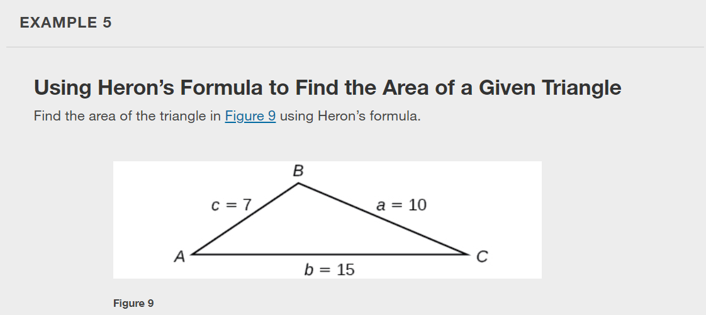

Slide 17
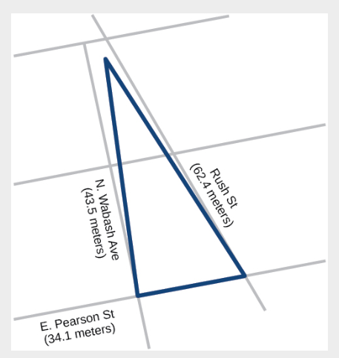

Slide 19
What did you learn in this section?
Use the Law of Cosines to solve oblique triangles.
Solve applied problems using the Law of Cosines.
Use Heron’s formula to ﬁnd the area of a triangle.
Notes:
Do you have any questions?

Slide 20
This resource is an adaptation of the OpenStax Algebra and Trigonometry 2e open textbook and is © Susan Aydelotte under a CC BY-NC-SA 4.0 International license; it may be reproduced or modified for noncommercial purposes only but must be attributed to OpenStax, Rice University and any changes must be noted. Any adaptation must be shared under the same type of license.

