Slide 1
Further Applications of Trigonometry
Chapter 10
Algebra and Trigonometry 2e, OpenStax, Jay Abramson
Notes:
Images and notes within these slides are from the OpenStax textbook Algebra and Trigonometry 2e

Slide 2
10.1 Non-right Triangles: Law of Sines
Notes:
Images and notes within these slides are from the OpenStax textbook Algebra and Trigonometry 2e

Slide 3
What are the learning objectives for this section?
Use the Law of Sines to solve oblique triangles.
Find the area of an oblique triangle using the sine function.
Solve applied problems using the Law of Sines.

Slide 4
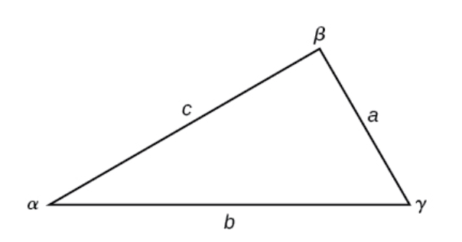
Non-right Triangles
Any triangle that is not a right triangle is an oblique triangle.
Solving an oblique triangle means finding the measurements of all three angles and all three sides. To do so, we need to start with at least three of these values, including at least one of the sides.

Slide 6
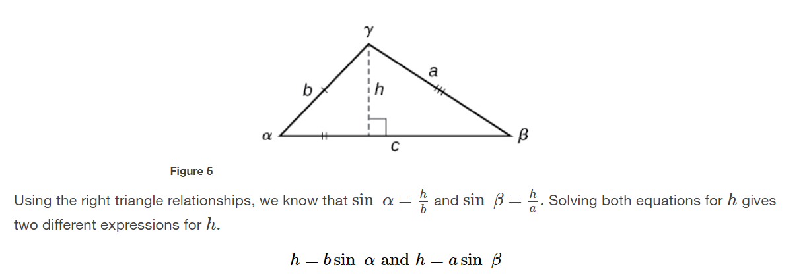
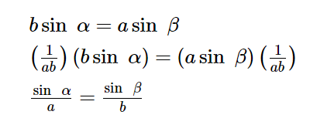
Notes:
[Move the box to reveal each step.] Similarly, we can compare the other ratios. Collectively, these relationships are called the Law of Sines.

Slide 7
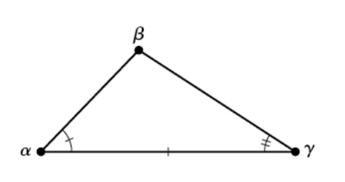
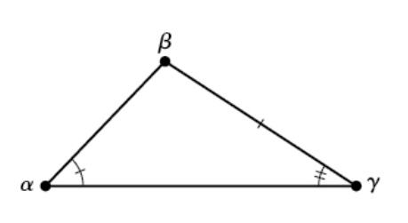
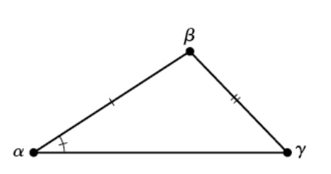
Using the Law of Sines to Solve Oblique Triangles
ASA (angle-side-angle) AAS (angle-angle-side) SSA (side-side-angle)
Notes:
Remember that to solve an oblique triangle means finding the measurements for three angles and three sides, and we need to start with at least three of the values, including at least one of the sides. Here are three possibilities.

Slide 9
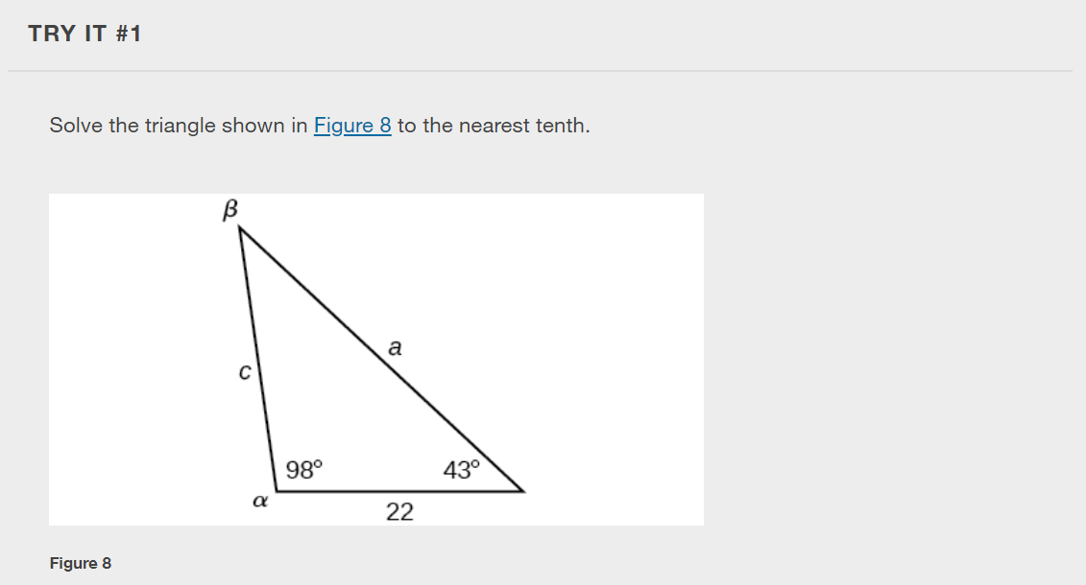

Slide 10
Notes:
We can use the Law of Sines to solve any oblique triangle, but some solutions may not be straightforward. In some cases, more than one triangle may satisfy the given criteria, which we describe as an ambiguous case. Triangles classified as SSA, those in which we know the lengths of two sides and the measurement of the angle opposite one of the given sides, may result in one or two solutions, or even no solution.

Slide 11
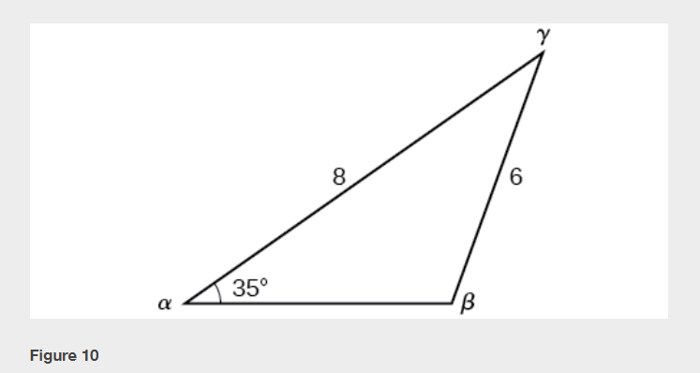

Slide 13
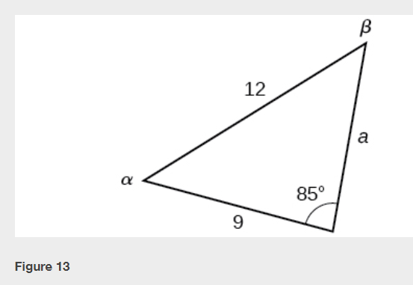
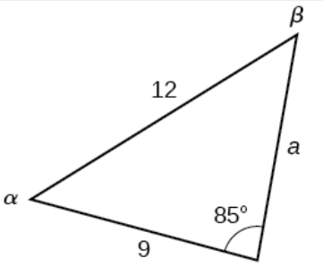

Slide 17
Notes:
RECALL: sin ( 180 – A ) = sin A , where 0 < A < 180.

Slide 18
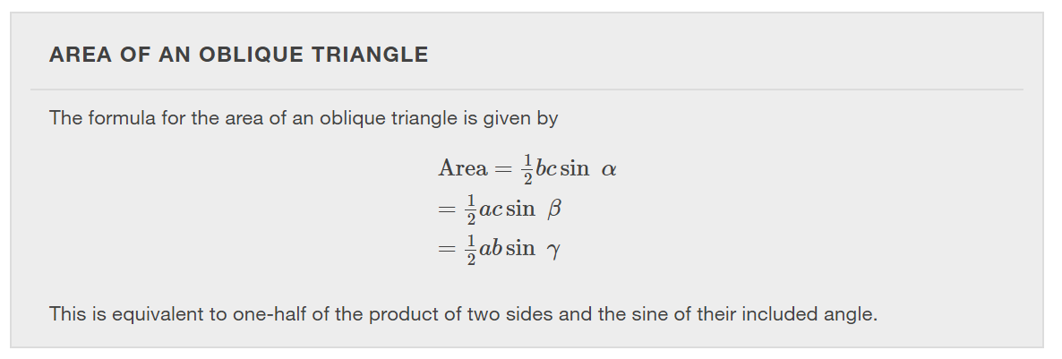

Slide 21
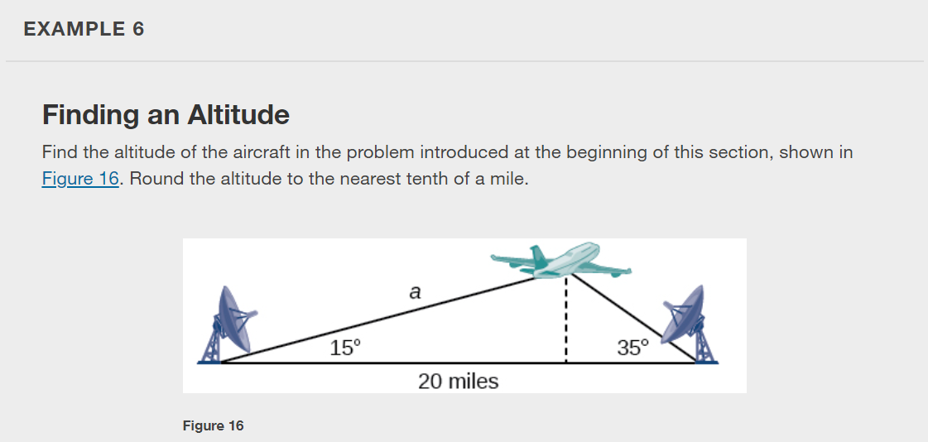

Slide 22
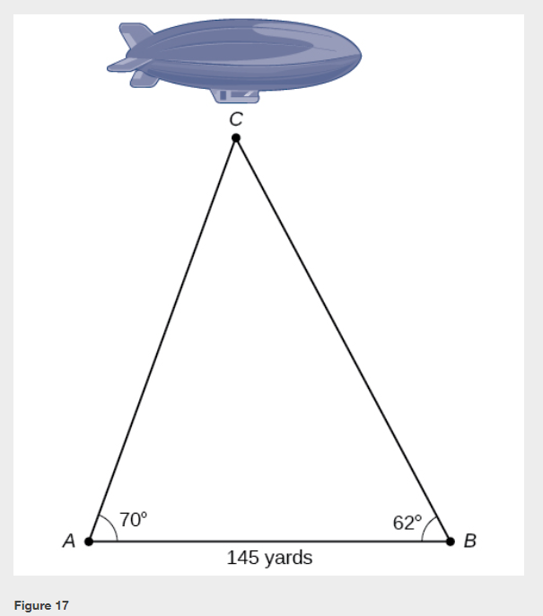

Slide 23
What did you learn in this section?
Use the Law of Sines to solve oblique triangles.
Find the area of an oblique triangle using the sine function.
Solve applied problems using the Law of Sines.
Notes:
Do you have any questions?

Slide 24
This resource is an adaptation of the OpenStax Algebra and Trigonometry 2e open textbook and is © Susan Aydelotte under a CC BY-NC-SA 4.0 International license; it may be reproduced or modified for noncommercial purposes only but must be attributed to OpenStax, Rice University and any changes must be noted. Any adaptation must be shared under the same type of license.

