Slide 1
Chapter 6 applications of integration

Slide 2
Integrals, exponential functions, and Logarithms
Section 6.7

Slide 3
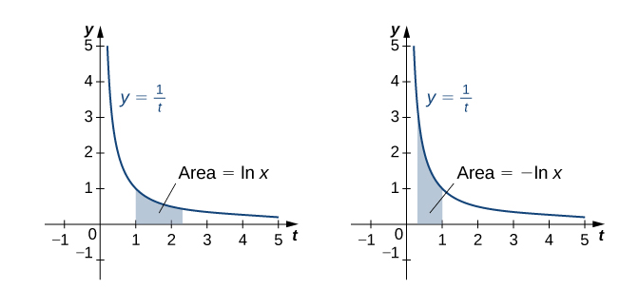

Slide 4
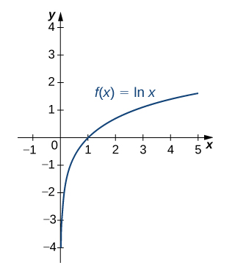

Slide 6
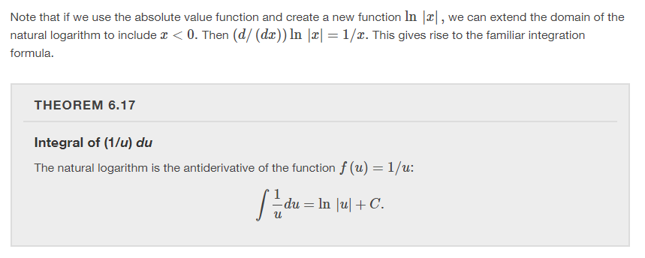

Slide 8
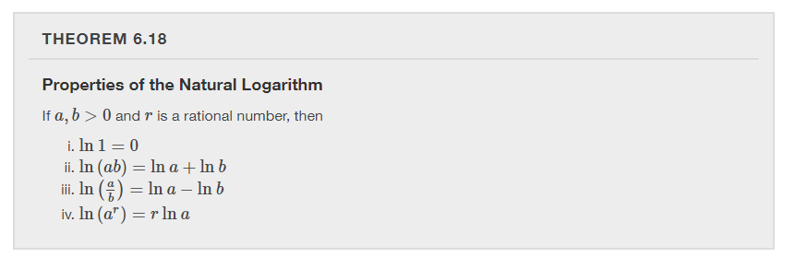

Slide 10
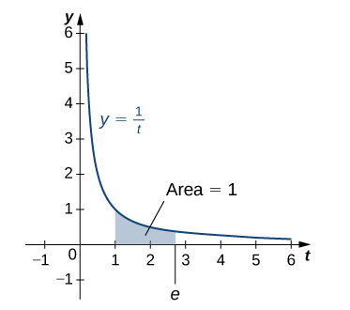

Slide 11
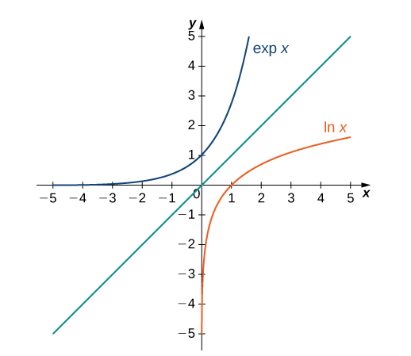

Slide 12
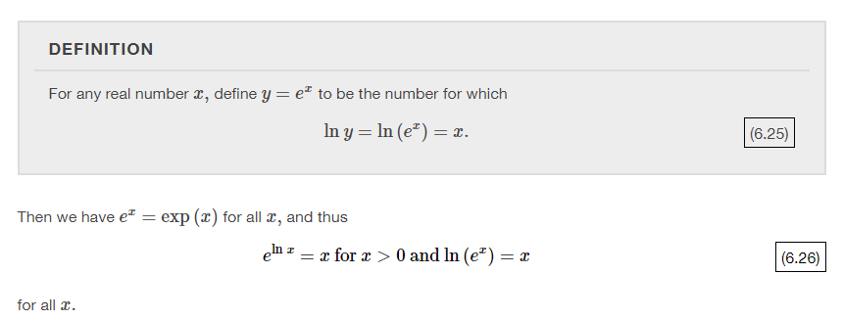

Slide 14
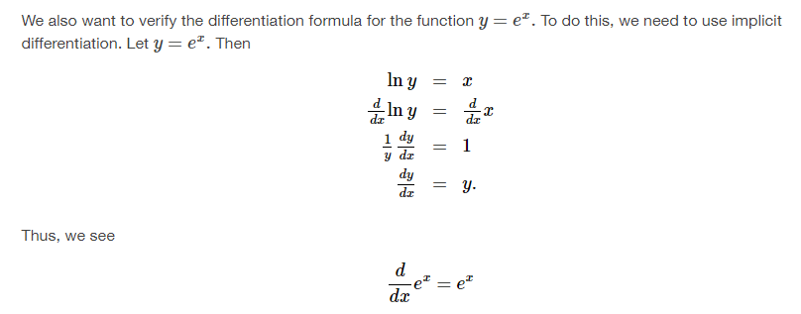

Slide 18
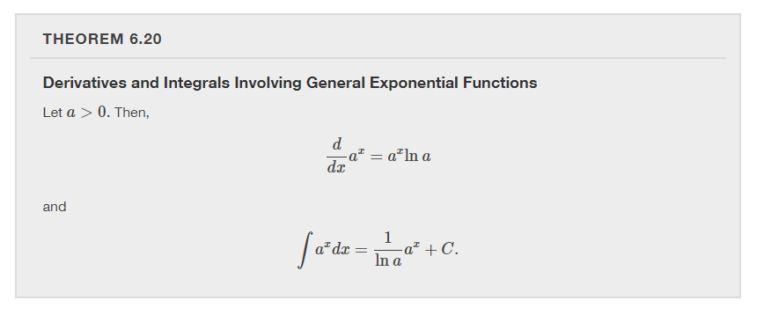

Slide 19
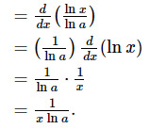

Slide 22
Exponential growth and decay
Section 6.8

Slide 23
Notes:
Note that Step 4. states “Solve the resulting equation for y if possible.” It is not always possible to obtain y as an explicit function of x. Quite often we have to be satisfied with finding y as an implicit function of x.

Slide 24
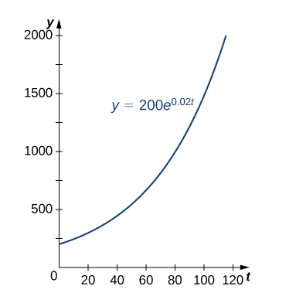
Notes:
If we know this equation for y, we can show the derivative is proportional to y, and vice versa.

Slide 27
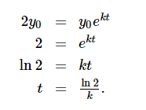

Slide 29
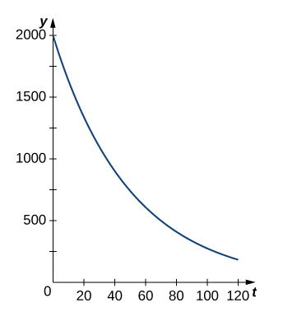

Slide 30
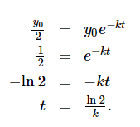

Slide 31
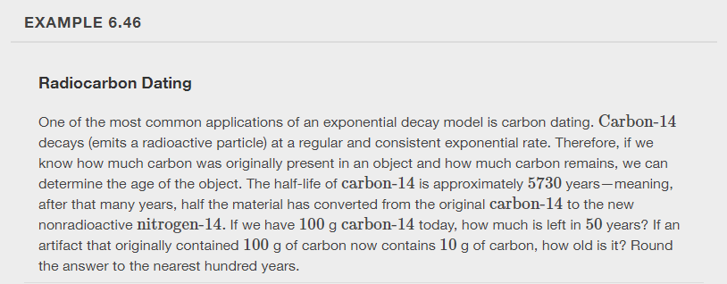

Slide 32
Newton’s law of cooling says that an object cools at a rate proportional to the difference between the temperature of the object and the temperature of the surroundings.

Slide 34
Calculus of the hyperbolic functions
Section 6.9

Slide 35
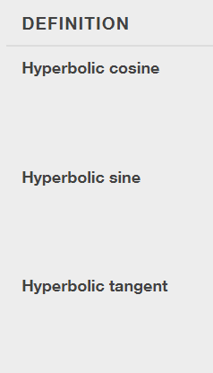
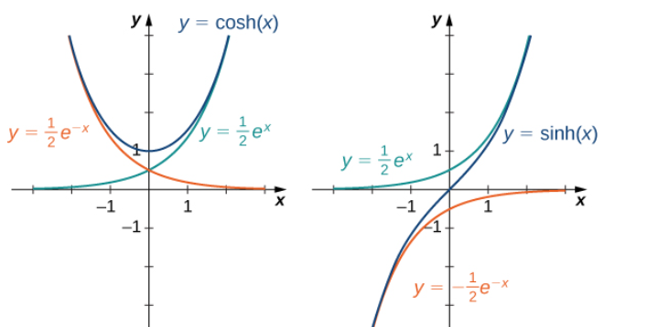
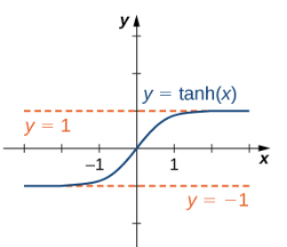

Slide 36
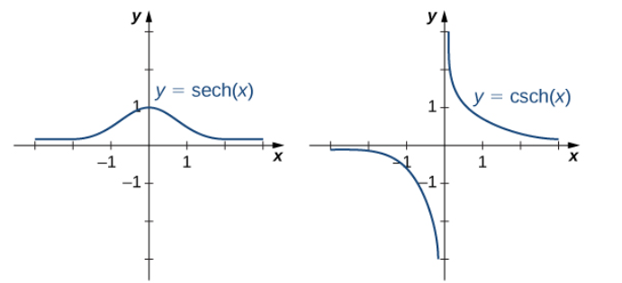
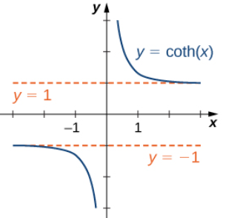
Notes:
Using the definitions of the hyperbolic functions, we can find the formulas for the derivatives of the hyperbolic functions.

Slide 37
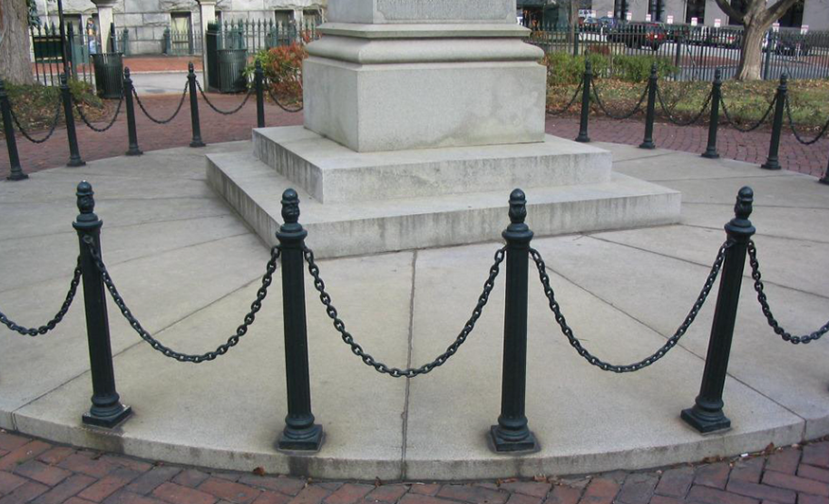
Applications
One physical application of hyperbolic functions involves hanging cables. If a cable of uniform density is suspended between two supports without any load other than its own weight, the cable forms a curve called a catenary. High-voltage power lines, chains hanging between two posts, and strands of a spider’s web all form catenaries. The following figure shows chains hanging from a row of posts.
$$y\left(x\right)=a\cosh{(x/a)}$$

Slide 38
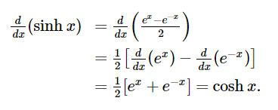

Slide 39
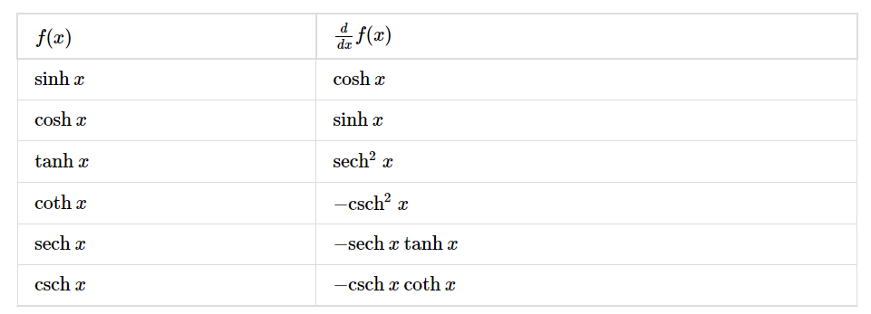

Slide 41
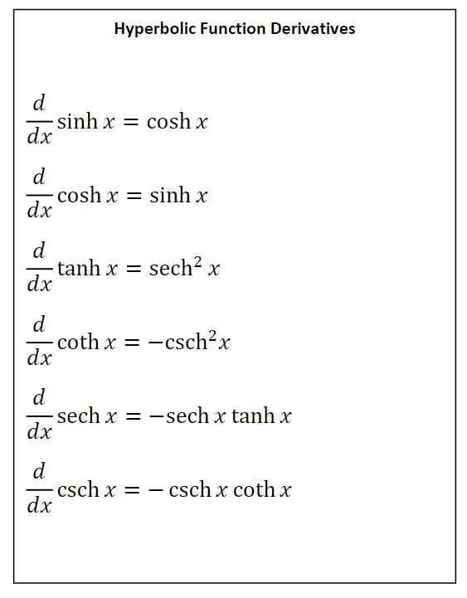
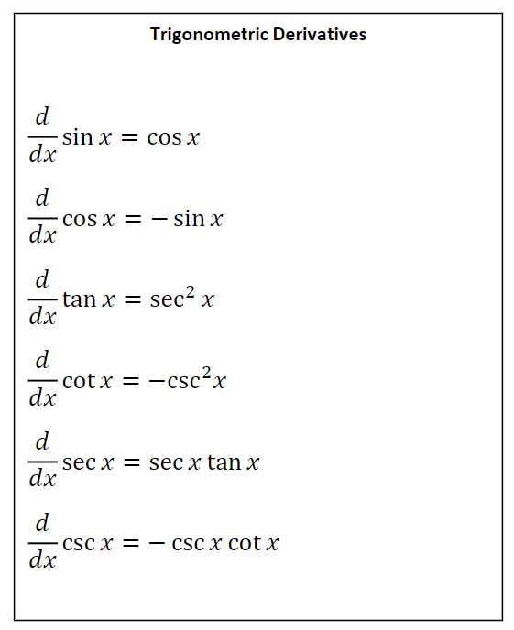
Notes:
Compare and recognize any patterns.

Slide 44
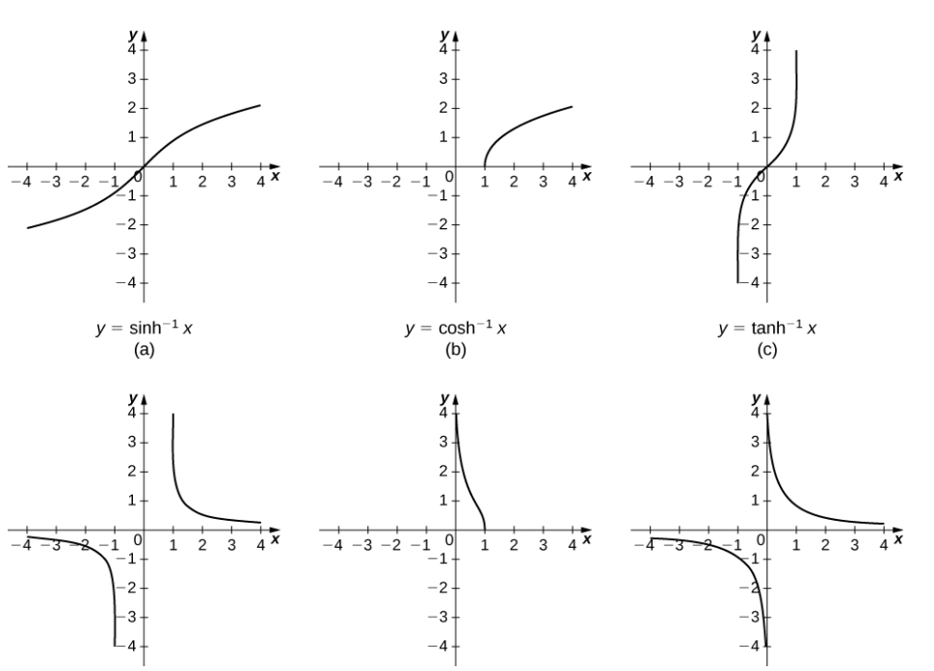

Slide 46
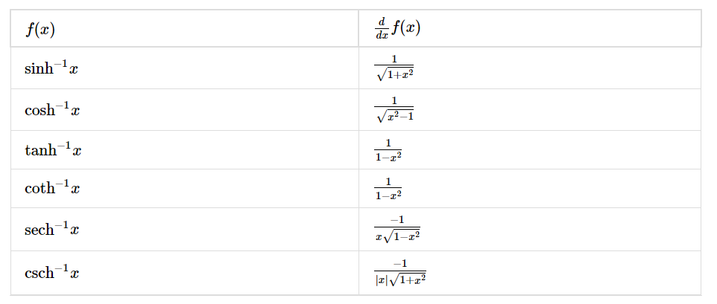
Derivatives of the Inverse Hyperbolic Functions

Slide 48
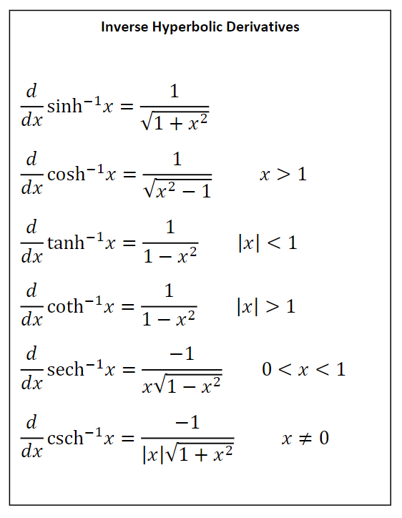
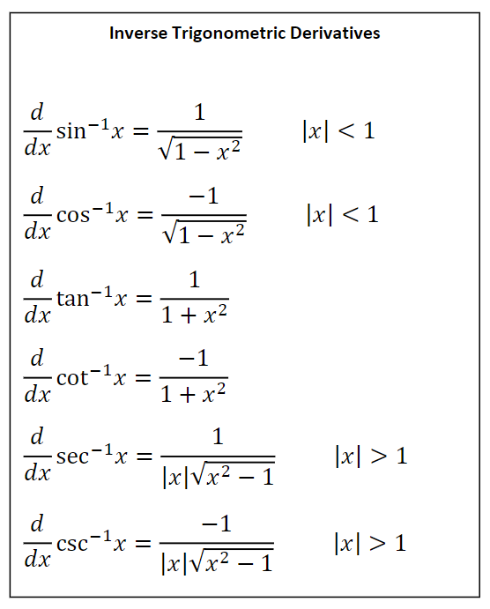
Notes:
Compare and recognize any patterns.

