Slide 1
Chapter 6 applications of integration

Slide 2
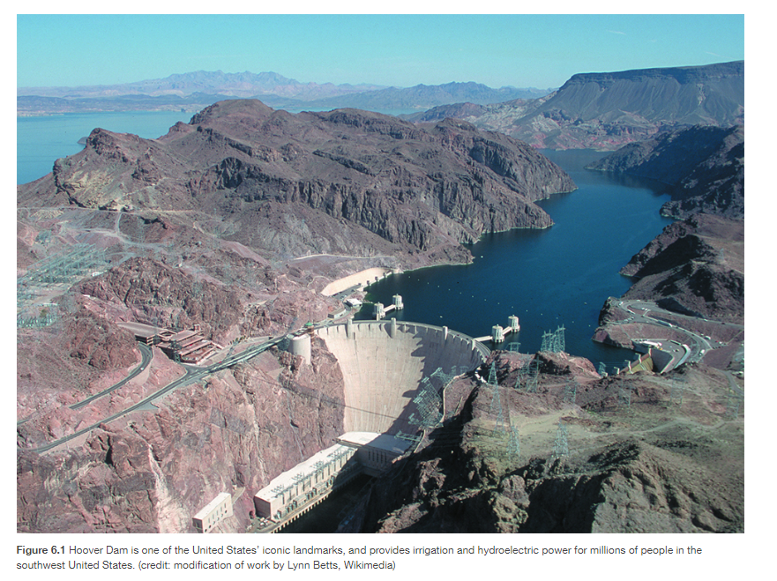
Notes:
The Hoover Dam is an engineering marvel. When Lake Mead, the reservoir behind the dam, is full, the dam withstands a great deal of force. However, water levels in the lake vary considerably as a result of droughts and varying water demands. Later in this chapter, we use definite integrals to calculate the force exerted on the dam when the reservoir is full and we examine how changing water levels affect that force (see Example 6.28).
Hydrostatic force is only one of the many applications of definite integrals we explore in this chapter. From geometric applications such as surface area and volume, to physical applications such as mass and work, to growth and decay models, definite integrals are a powerful tool to help us understand and model the world around us.

Slide 3
Areas between curves
Section 6.1

Slide 4
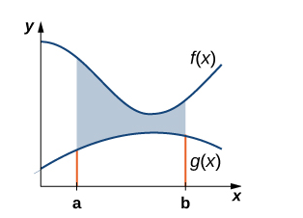
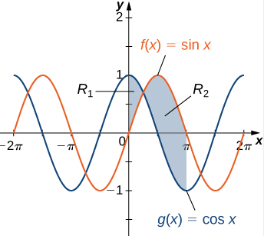
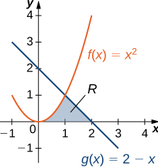
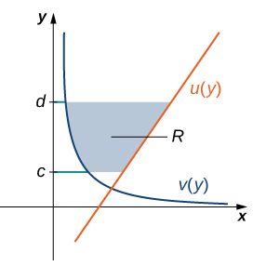

Slide 5
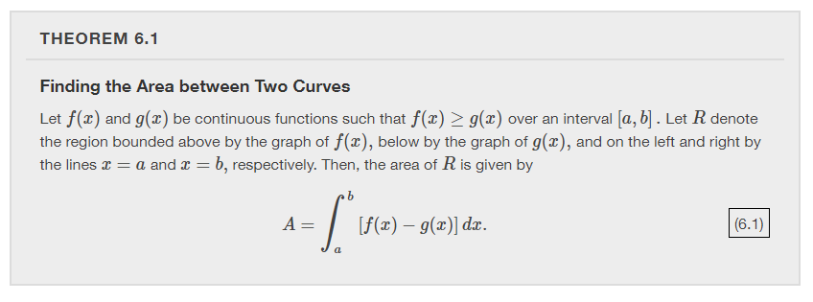
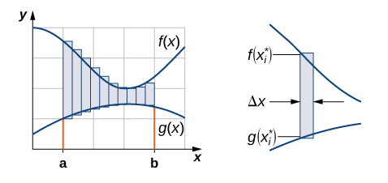

Slide 6
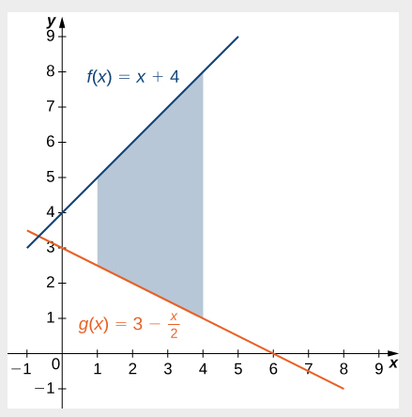

Slide 7
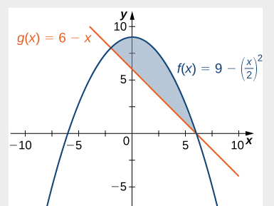

Slide 8
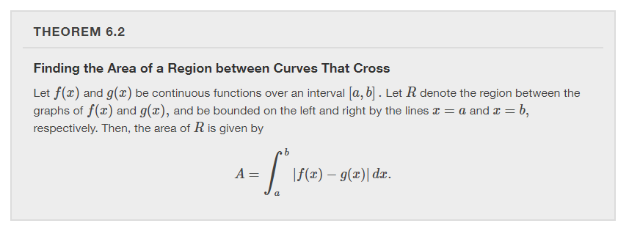

Slide 9
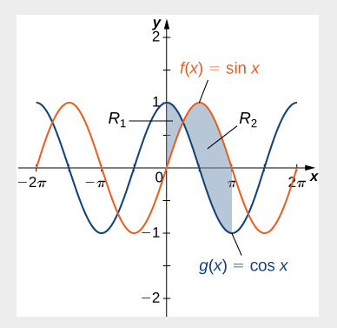

Slide 10
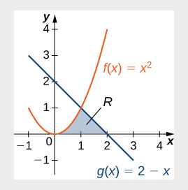

Slide 11
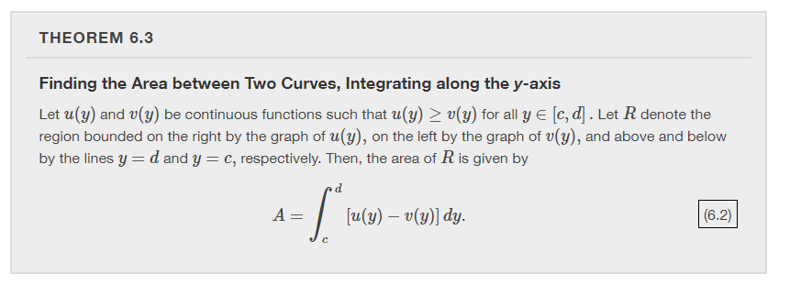
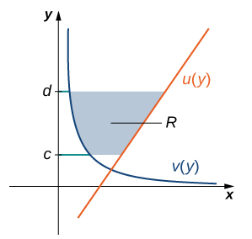
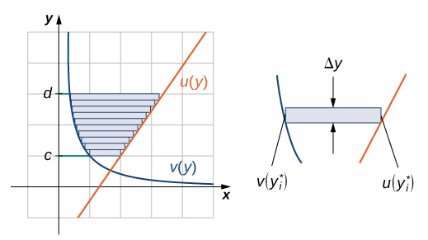

Slide 12
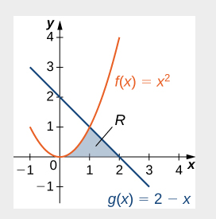

Slide 13
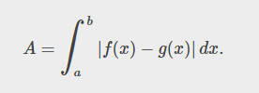
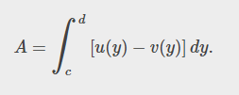

Slide 14
Determining volumes by slicing
Section 6.2

Slide 15
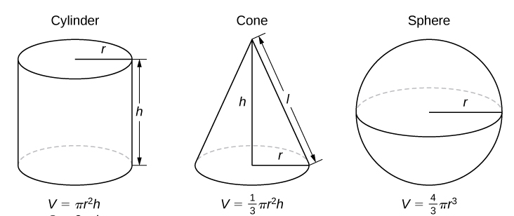
What do you already know about volume?

Slide 16
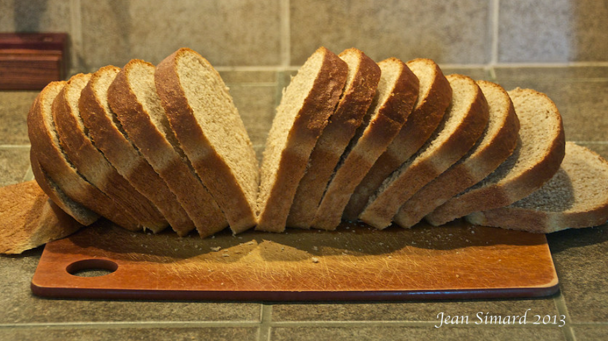
How would you estimate the volume of a loaf of bread?
Notes:
Assume the average volume of one slice of bread is 35 cubic centimeters and the loaf has 14 slices.

Slide 17
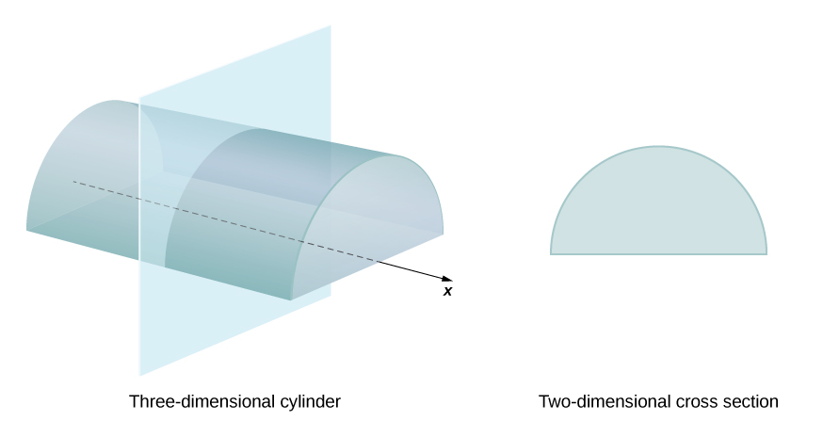
We define the cross-section of a solid to be the intersection of a plane with the solid.
Notes:
Note: The cross-section is perpendicular to the x-axis.

Slide 18
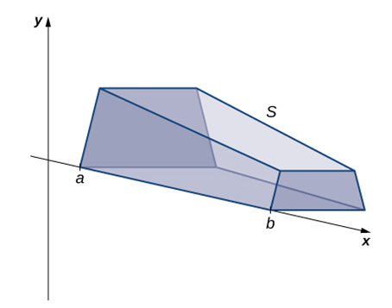
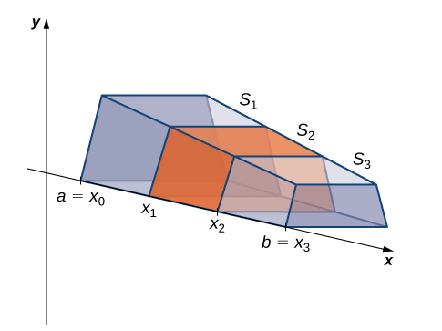
Notes:
Possibilities for A(x) include area of a triangle, square, rectangle, trapezoid, circle, etc.

Slide 20
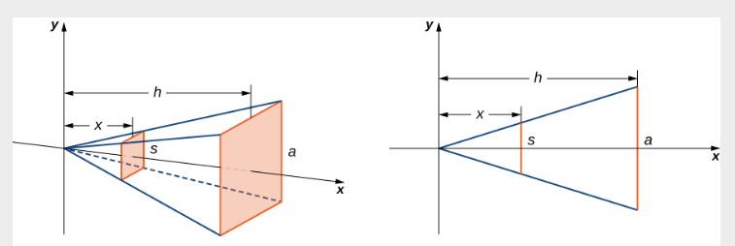
Notes:
One special case where the slicing method can be applied is when the cross-section is a disk (with the cross-sectional area being the area of a circle).

Slide 21
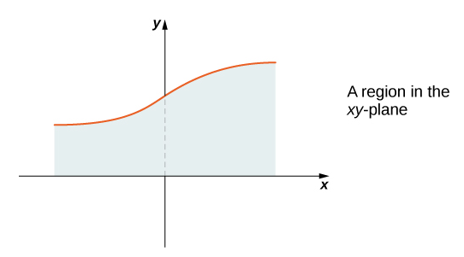
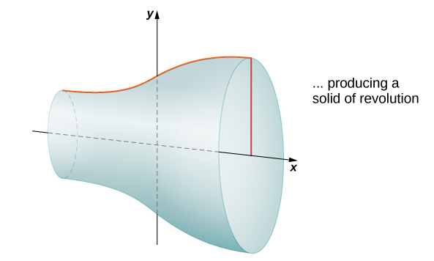
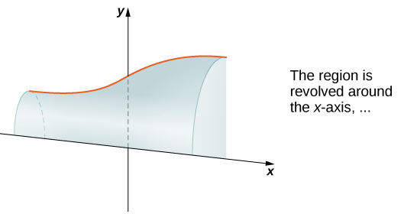
Notes:
One way to create a solid that has disks as its slices is to revolve a region about an axis. What do you notice about the cross-sectional area? Taking slices perpendicular to the x-axis, the cross-sections are disks with area pi times the radius squared. What is the radius? The radius is the distance between the axis and the curve, which is y=f(x).

Slide 22
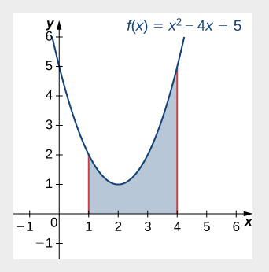
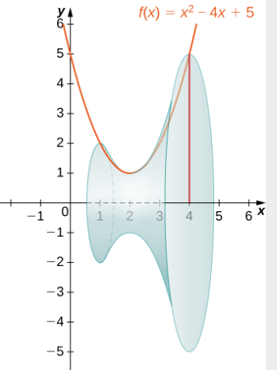

Slide 23
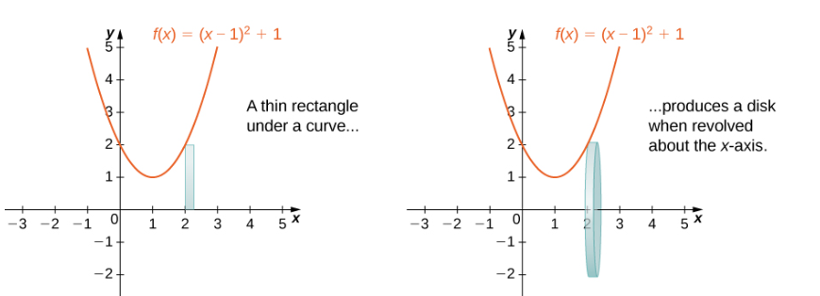

Slide 25
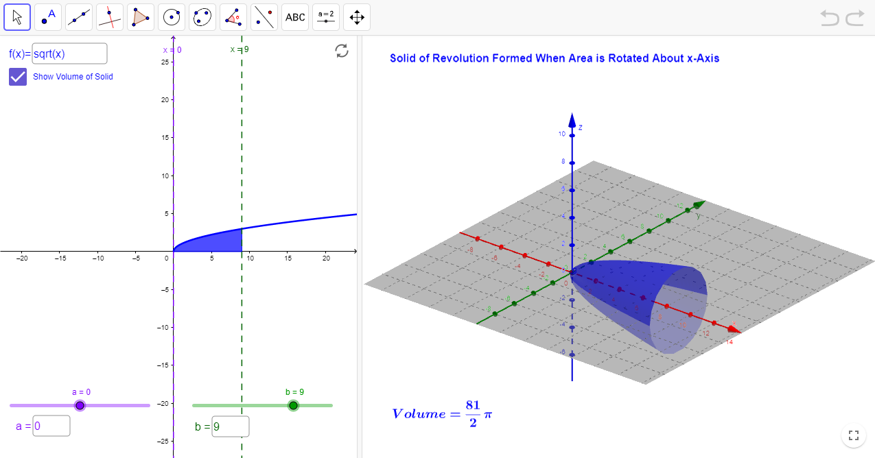
https://www.geogebra.org/m/mzWq2Cet

Slide 27
Notes:
So far, our examples have all concerned regions revolved around the x-axis, but we can generate a solid of revolution by revolving a plane region around any horizontal or vertical line. In the next example, we look at a solid of revolution that has been generated by revolving a region around the y-axis. The mechanics of the disk method are nearly the same as when the x-axis is the axis of revolution, but we express the function in terms of y and we integrate with respect to y as well.

Slide 29
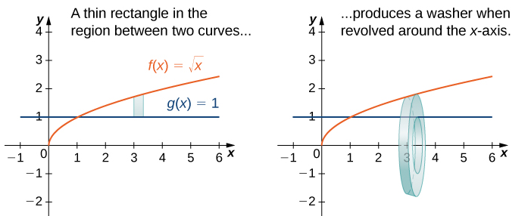
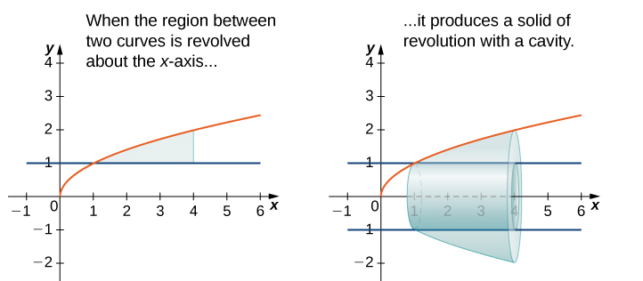
When the solid of revolution has a cavity in the middle, the slices used to approximate the volume are not disks, but washers (disks with holes in the center).

Slide 30
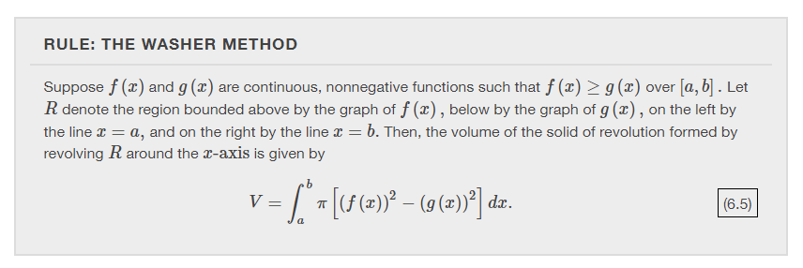

Slide 31
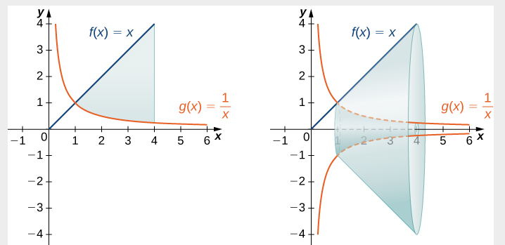

Slide 33
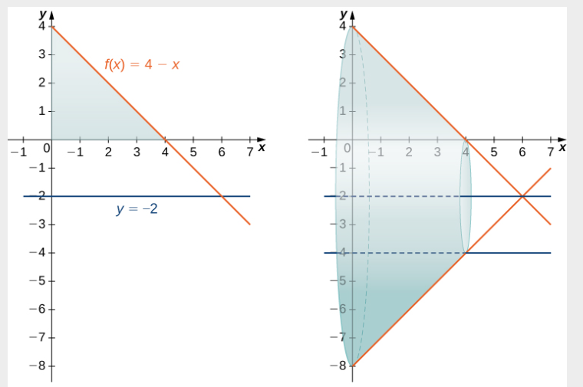

Slide 34
Volumes of revolution: cylindrical shells
Section 6.3

Slide 35
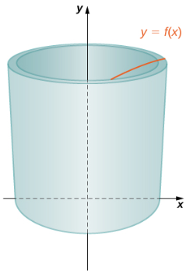
What is a cylindrical shell?
Notes:
Think of taking a regular piece of paper (8.5x11) and wrapping it around a can. When the paper is wrapped around the can, it has the shape of a cylindrical shell – illustrated here.

Slide 36
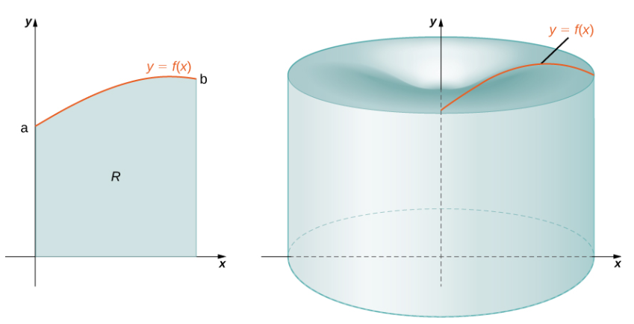
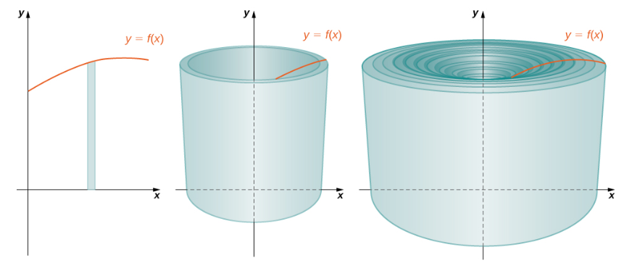
Notes:
What is the volume of the solid of revolution? The sum of the volumes of the cylindrical shells. How do we calculate the volume of a typical cylindrical shell?

Slide 37
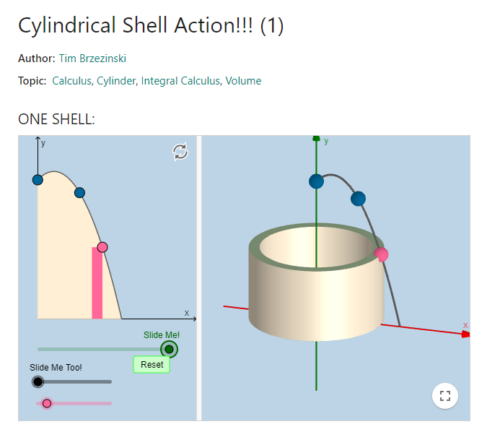
https://www.geogebra.org/m/TvkwtNqC
Notes:
To visualize cylindrical shells with animation, go to https://www.geogebra.org/m/TvkwtNqC

Slide 38
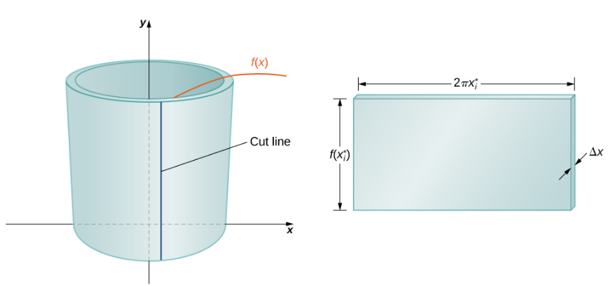
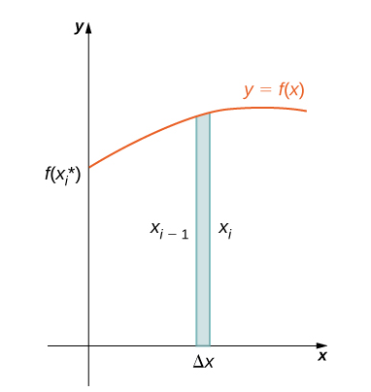

Slide 40
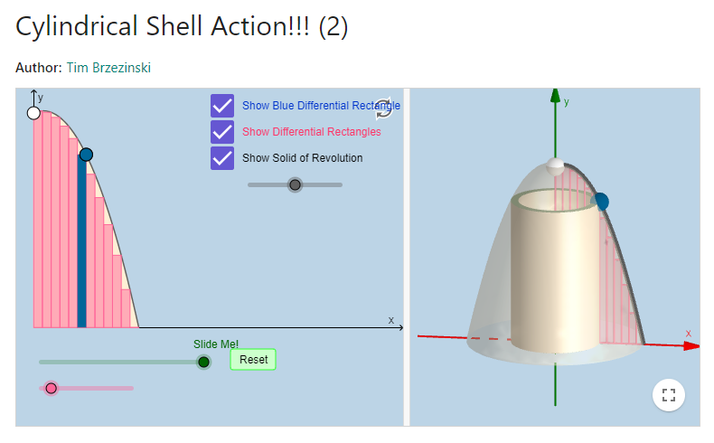
https://www.geogebra.org/m/SWBXZQxR

Slide 41
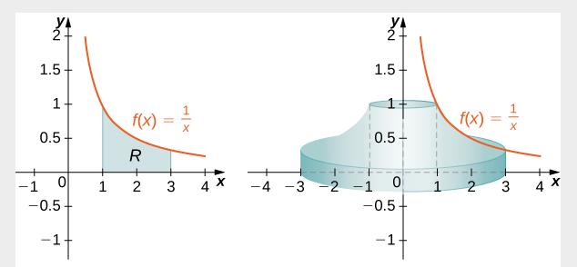

Slide 43
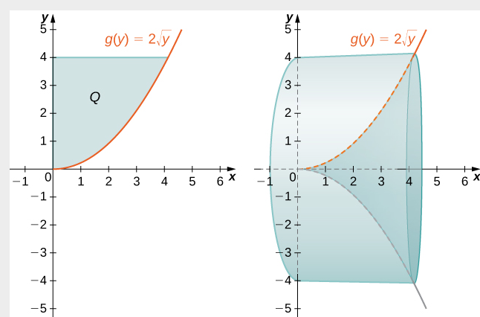

Slide 44
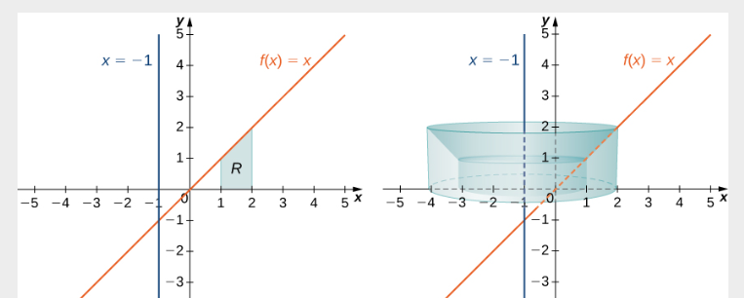

Slide 45
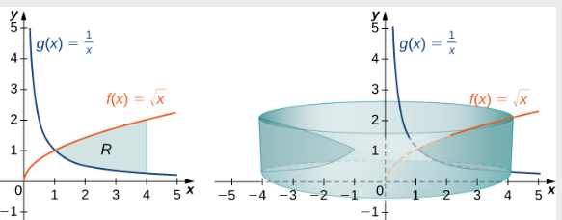

Slide 46
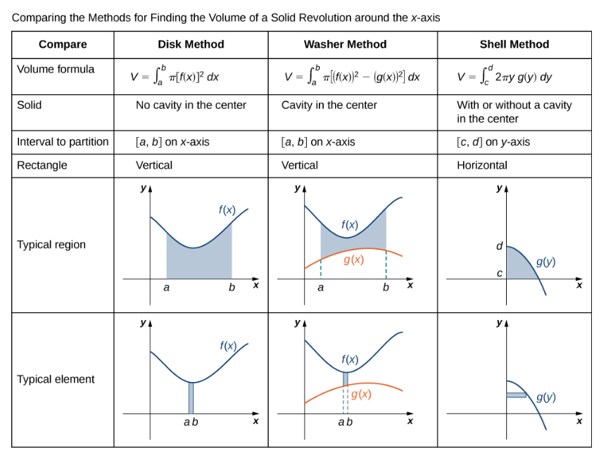

Slide 47
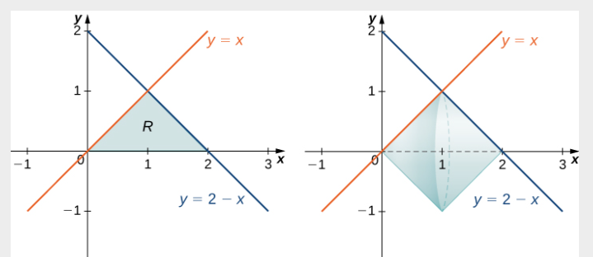

Slide 48
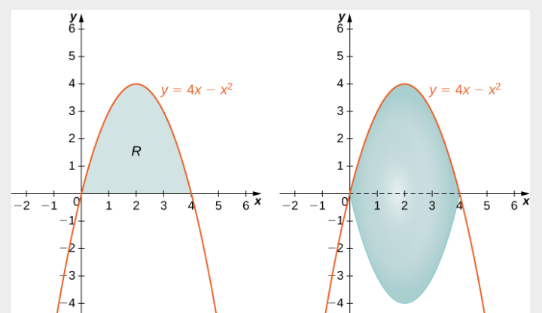

Slide 49
Physical applications
Section 6.5
Notes:
In this section we will talk about how to calculate (1) mass based on a density function (linear density and radial density) (2) work done by a variable force (Hooke’s law for springs), (3) work done to pump a liquid from one height to another, and (4) hydrostatic force against a submerged vertical plate.

Slide 50
Mass = (constant linear density)(distance)
Mass = (constant radial density)(area)
Work = (constant force)(distance)
Hydrostatic Force = (constant weight density)(area)(depth)
Hydrostatic Pressure =(constant weight density)(depth)
Notes:
Mass is measured in kilograms in the metric system, and in avoirdupois pounds in the English system. Linear density is measured in kilograms per foot or kilograms per meter. Distance is measure in feet or meters. Force is measure in Newtons or pounds. Work is measured in Newton-meters (or joules) and in foot-pounds. The weight density of water is 62.4 lb/cubic foot (or 9810 N/cubic meter). Pressure is measured in pounds per square inch (psi) or N per square meter (or Pascal, Pa). The Greek letter rho (lower case) is used to denote density.

Slide 51
Notes:
First we consider a thin rod or wire. Orient the rod so it aligns with the x-axis, with the left end of the rod at x=a and the right end of the rod at x=b (Figure 6.48). Note that although we depict the rod with some thickness in the figures, for mathematical purposes we assume the rod is thin enough to be treated as a one-dimensional object.

Slide 57
Notes:
In the English system, the unit of force is the pound and the unit of distance is the foot, so work is given in foot-pounds. In the metric system, kilograms and meters are used. One newton is the force needed to accelerate 11 kilogram of mass at the rate of 11 m/sec². Thus, the most common unit of work is the newton-meter. This same unit is also called the joule. Both are defined as kilograms times meters squared over seconds squared (kg⋅m2/s2).

Slide 59
The Work Required to Stretch or Compress a Spring
According to Hooke’s law, the force required to compress or stretch a spring from an equilibrium position is given by
$$F\left(x\right)=kx$$
for some constant $k$, which depends on the physical characteristics of the spring. The constant $k$, is called the spring constant and is always positive.
Notes:
Now let’s look at the specific example of the work done to compress or elongate a spring. Consider a block attached to a horizontal spring. The block moves back and forth as the spring stretches and compresses. Although in the real world we would have to account for the force of friction between the block and the surface on which it is resting, we ignore friction here and assume the block is resting on a frictionless surface. When the spring is at its natural length (at rest), the system is said to be at equilibrium. In this state, the spring is neither elongated nor compressed, and in this equilibrium position the block does not move until some force is introduced. We orient the system such that x=0 corresponds to the equilibrium position (see the following figure).

