Slide 1
Chapter 5 integration

Slide 2
Integrals involving exponential and logarithmic functions
Section 5.5

Slide 6
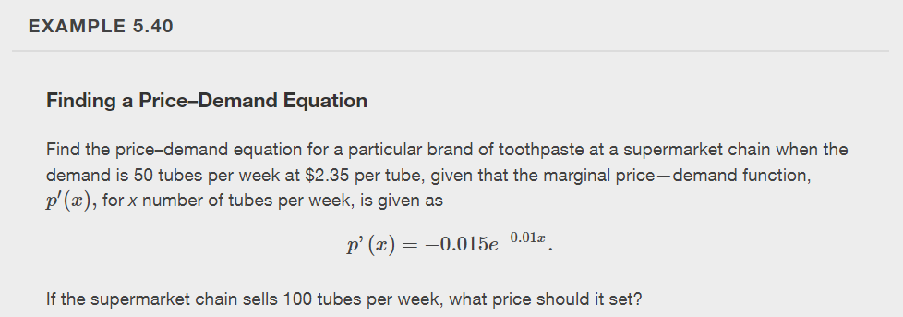

Slide 7
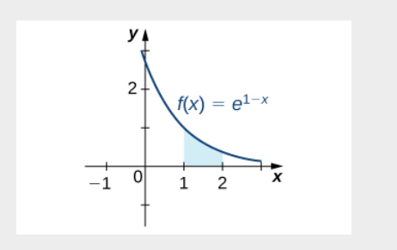

Slide 11
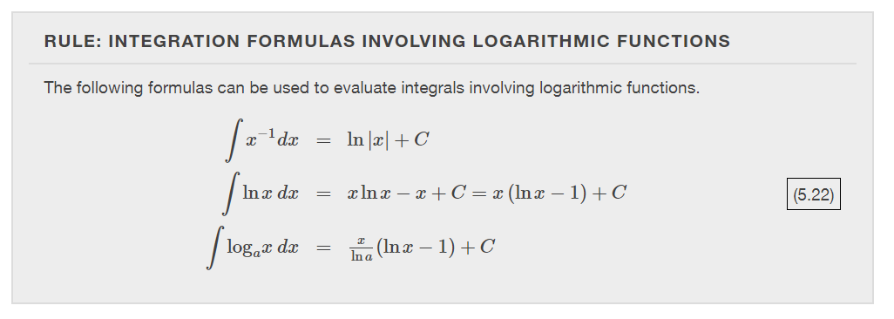

Slide 16
Integrals resulting in inverse trigonometric functions
Section 5.7

Slide 18
