Slide 1
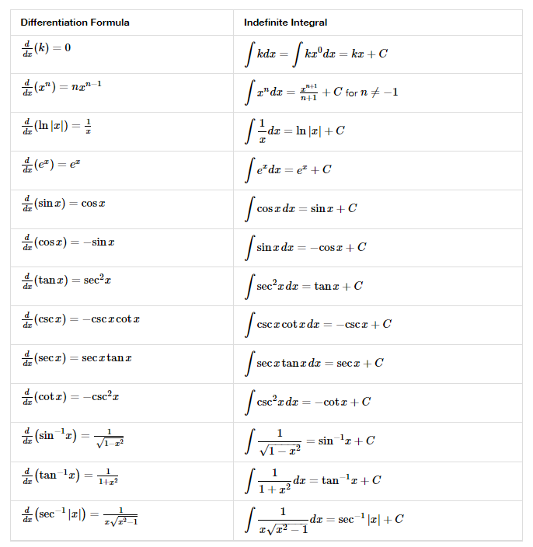
4.10 ANTIDERIVATIVES

Slide 2

5.1 APPROXIMATING AREAS

Slide 3

5.2 THE DEFINITE INTEGRAL

Slide 4
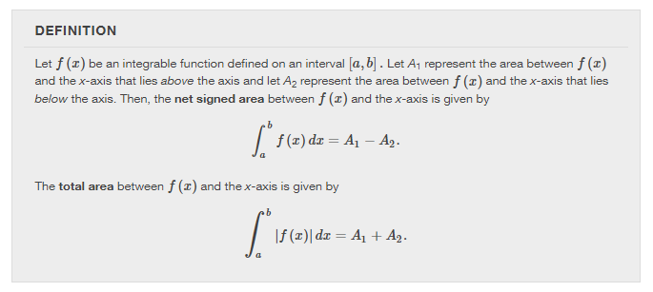
5.2 THE DEFINITE INTEGRAL

Slide 5

Chapter 5 integration

Slide 6
The fundamental theorem of calculus
Section 5.3

Slide 7
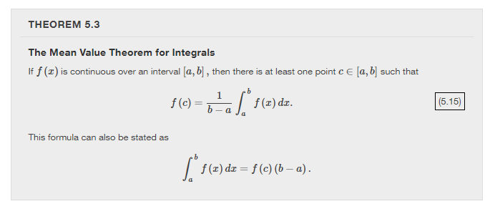

Slide 8
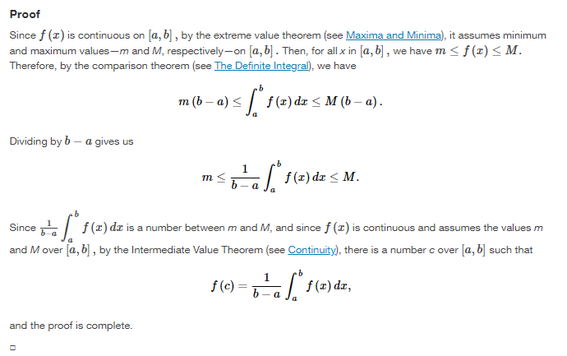

Slide 9


Slide 10


Slide 11




















ACCUMULATION FUNCTION

Slide 12

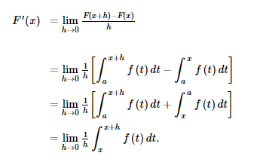


Slide 13
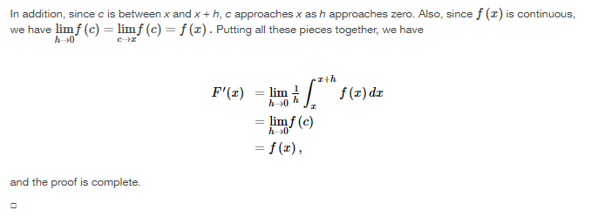

Slide 14


Slide 15


APPLYING THE CHAIN RULE:

Slide 16


Slide 17


Slide 18



Slide 19


Slide 20
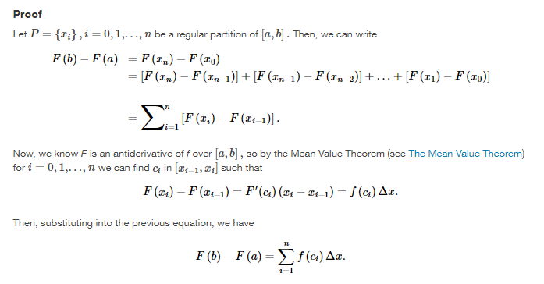

Slide 21
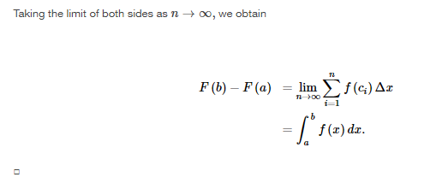

Slide 22


Slide 23


Slide 24


Slide 25
Integration formulas and the net change theorem
Section 5.4

Slide 26
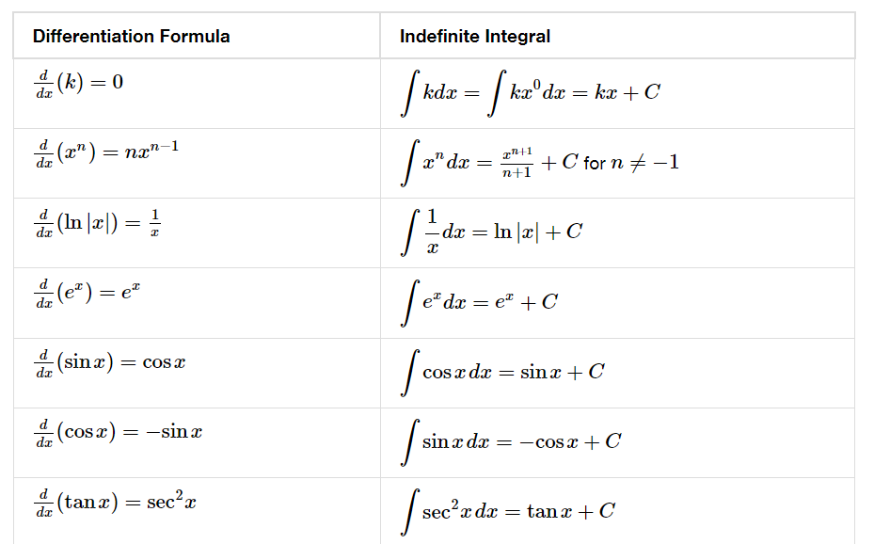

Slide 27


Slide 28
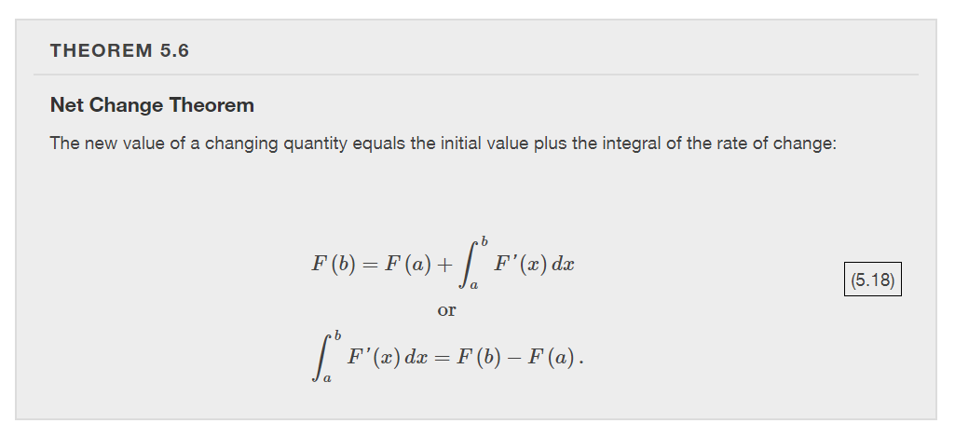

Slide 29

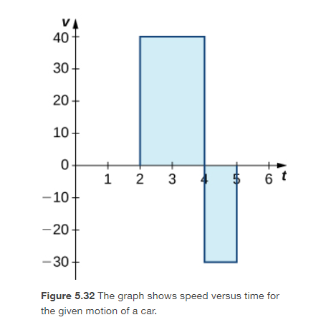

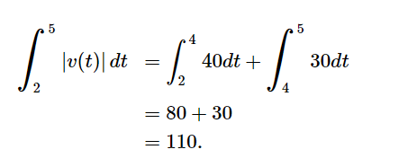


Slide 30


Slide 31


Slide 32


Slide 33


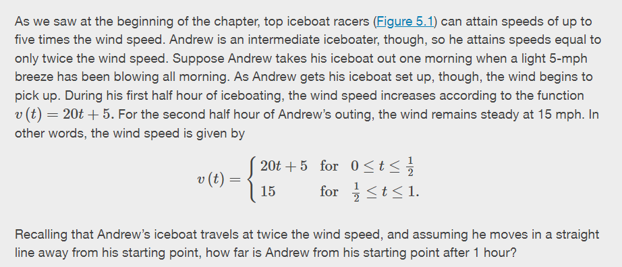

Slide 34
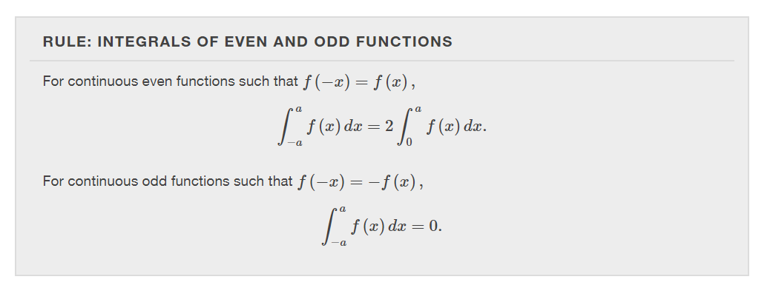

Slide 35


Slide 36


Slide 37
substitution
Section 5.5

Slide 39
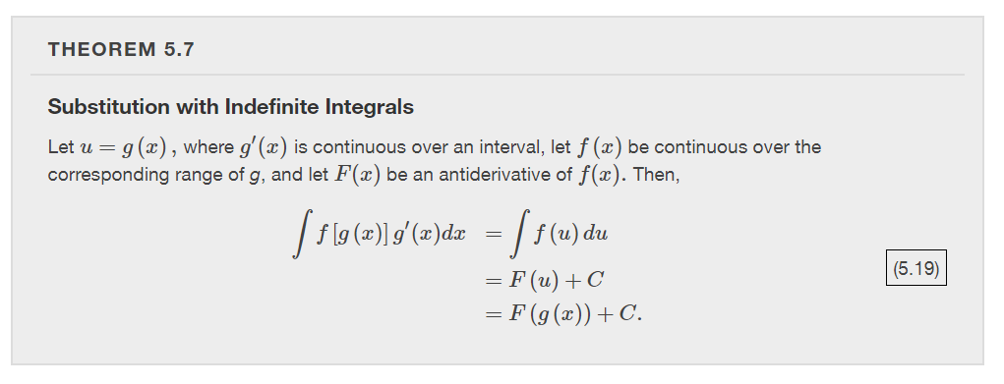


Slide 40
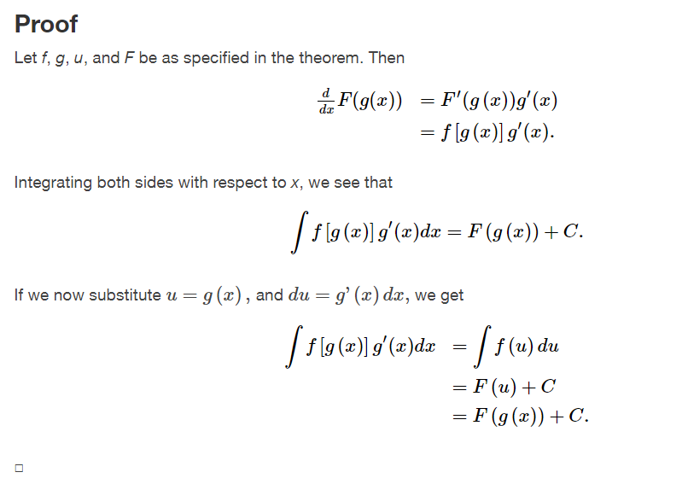

Slide 41


Slide 42
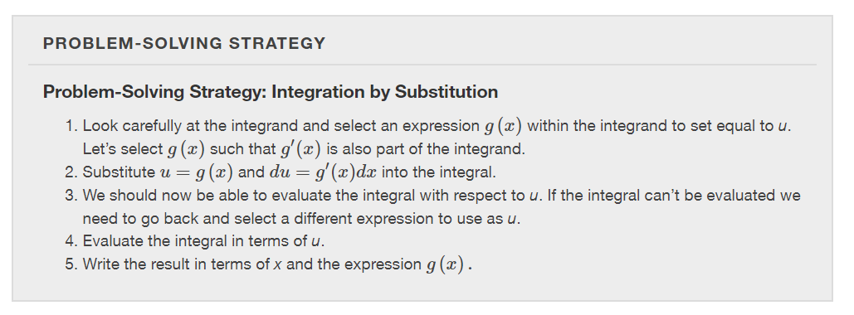

Slide 43


Slide 44


Slide 45


Slide 46


Slide 47


Slide 48


Slide 49


Slide 50


