Slide 1

Chapter 4 applications of derivatives

Slide 2
L’Hôpital’s Rule
Section 4.8

Slide 3

Indeterminant Forms:
$\frac{0}{0}$ and $\frac{∞}{∞}$
$0∙∞ ,$ $∞−∞ , { 1}^{∞} ,{ ∞}^{0} , { 0}^{0}$

Slide 4
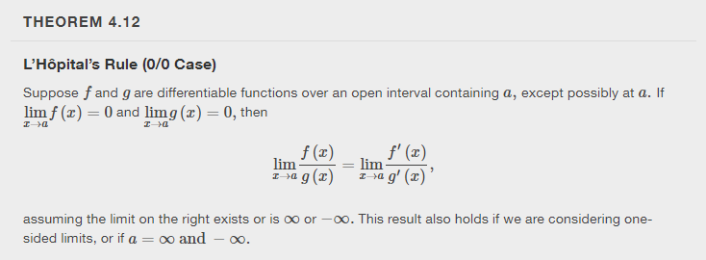

Slide 5
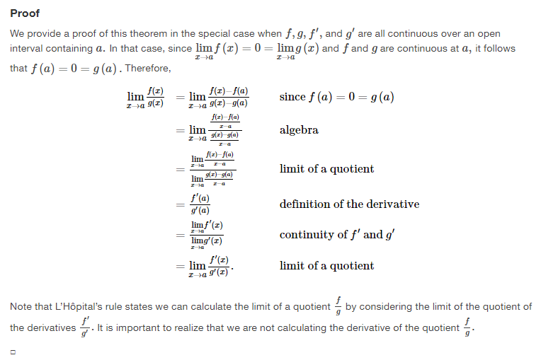

Slide 6
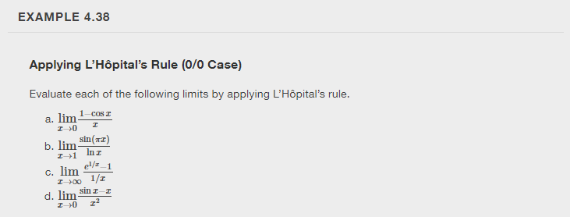

Slide 7
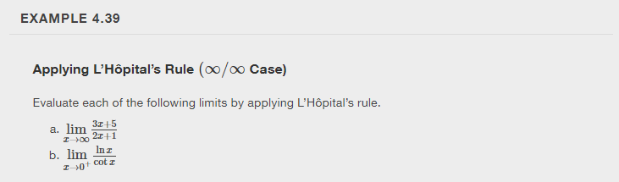

Slide 8
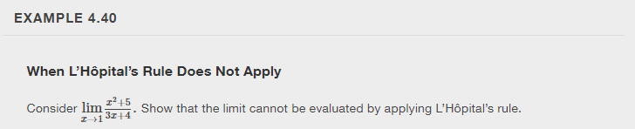

Slide 9
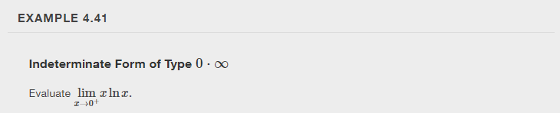

Slide 10
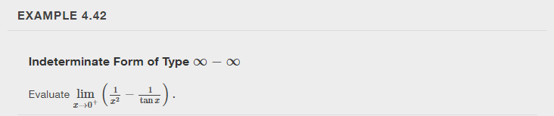

Slide 11
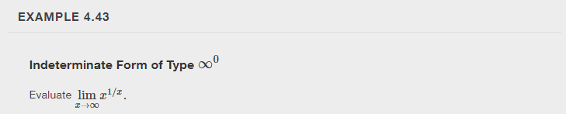

Slide 12
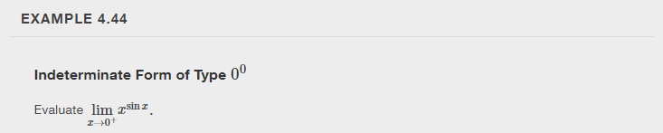

Slide 13

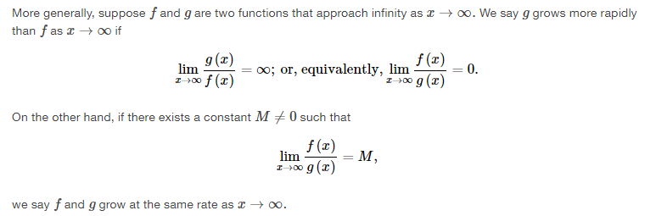

Slide 14
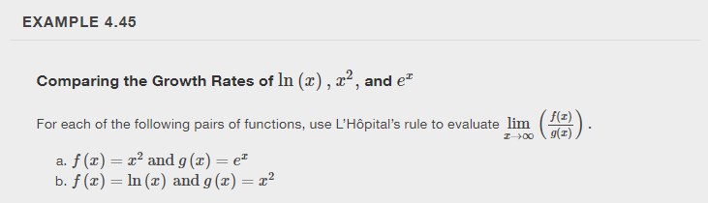

Slide 15
Newton’s Method
Section 4.9

Slide 16
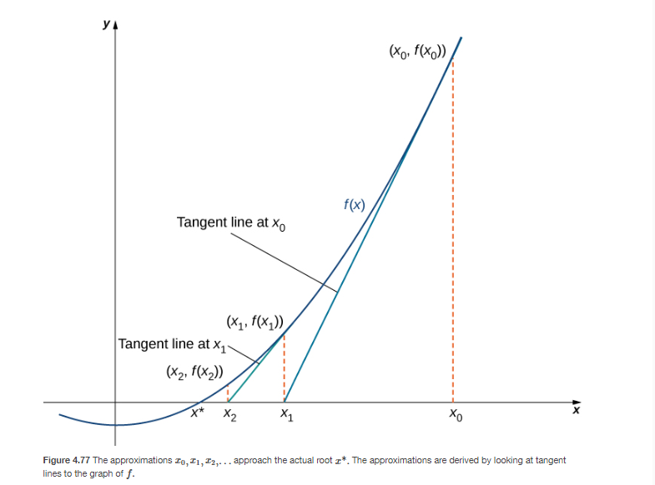


Slide 17
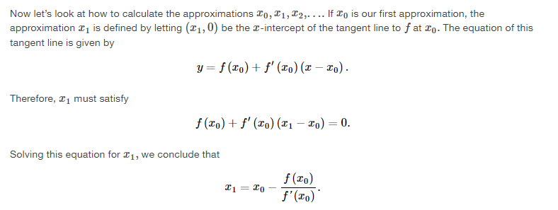

Slide 18
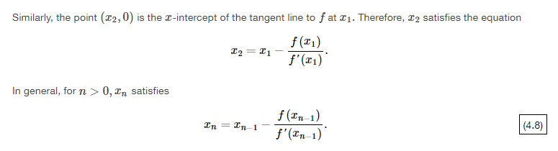
This is an example of an iterative process.

Slide 19
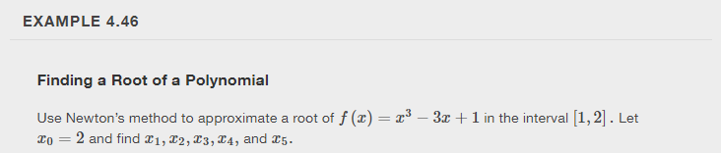
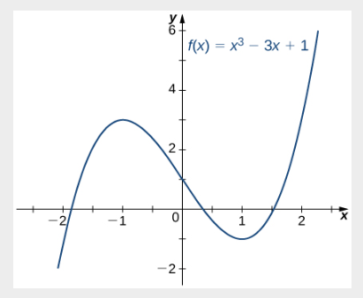

Slide 20
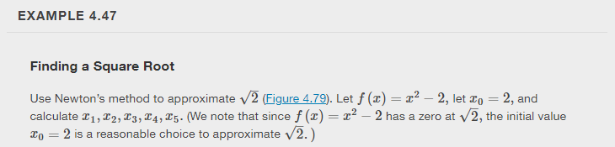

Slide 21
Desmos app for Newton’s Method
https://www.desmos.com/calculator/pjxjvdbt7i

Slide 22
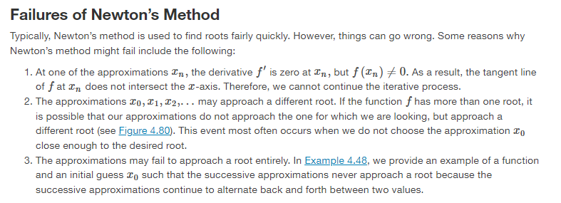

Slide 23
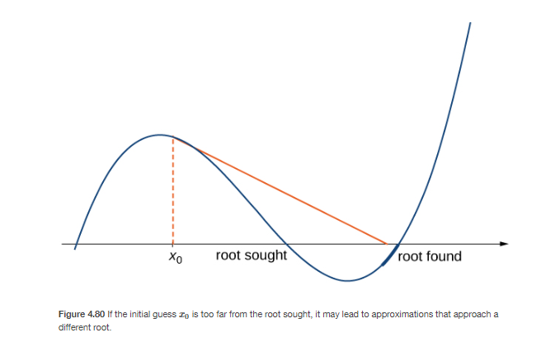

Slide 24
