Slide 1

Chapter 4 applications of derivatives

Slide 2


Slide 3
Related rates
Section 4.1

Slide 4


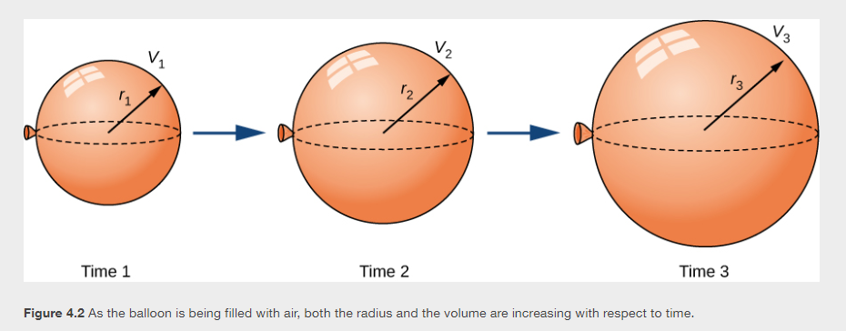

Slide 5


Slide 6

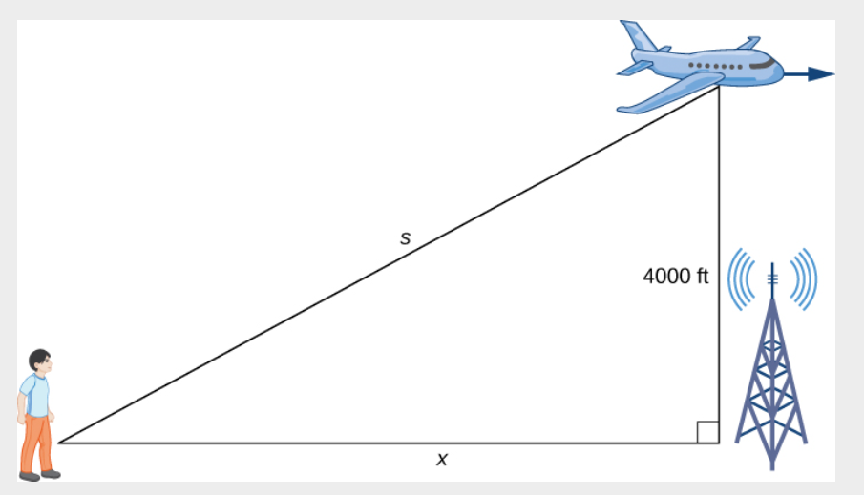


Slide 7



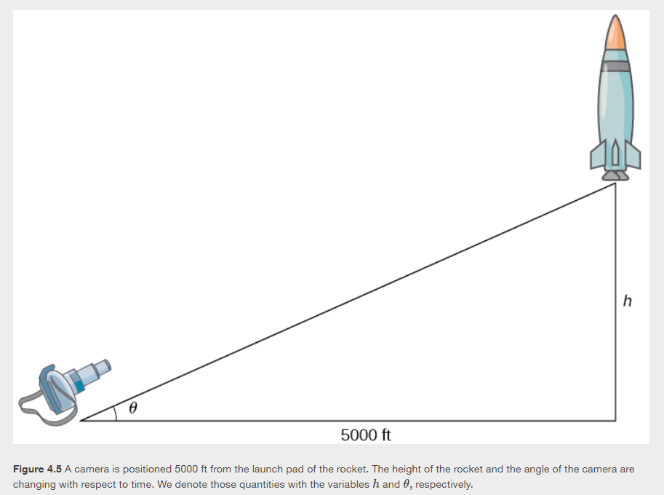

Slide 8

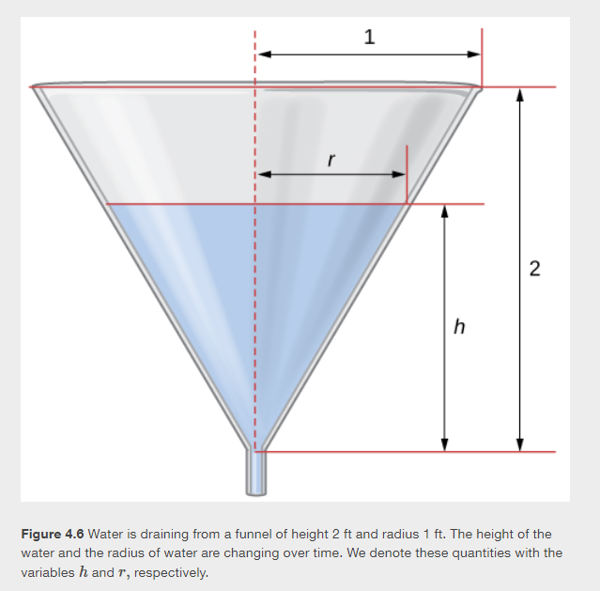

Slide 9
Linear approximations and differentials
Section 4.2

Slide 10
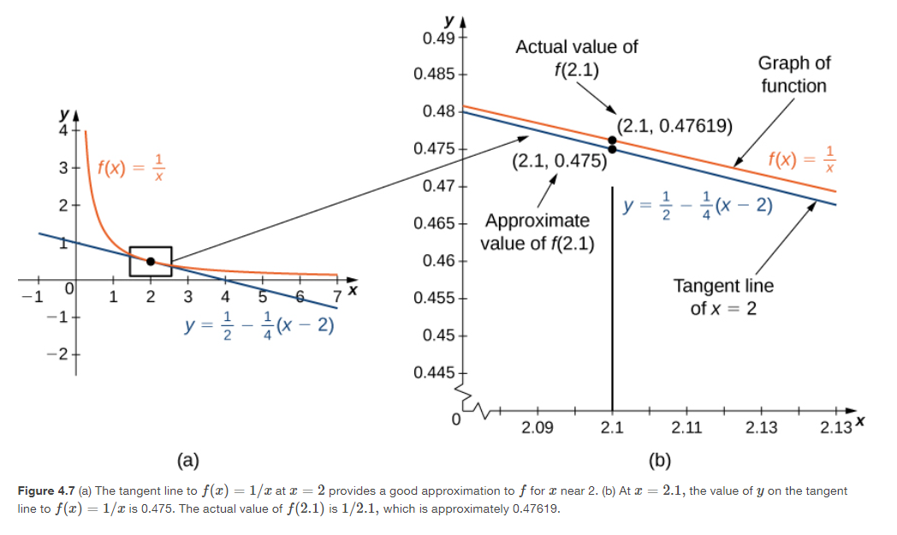

Slide 11



Slide 12


Slide 13


Slide 14


Slide 15

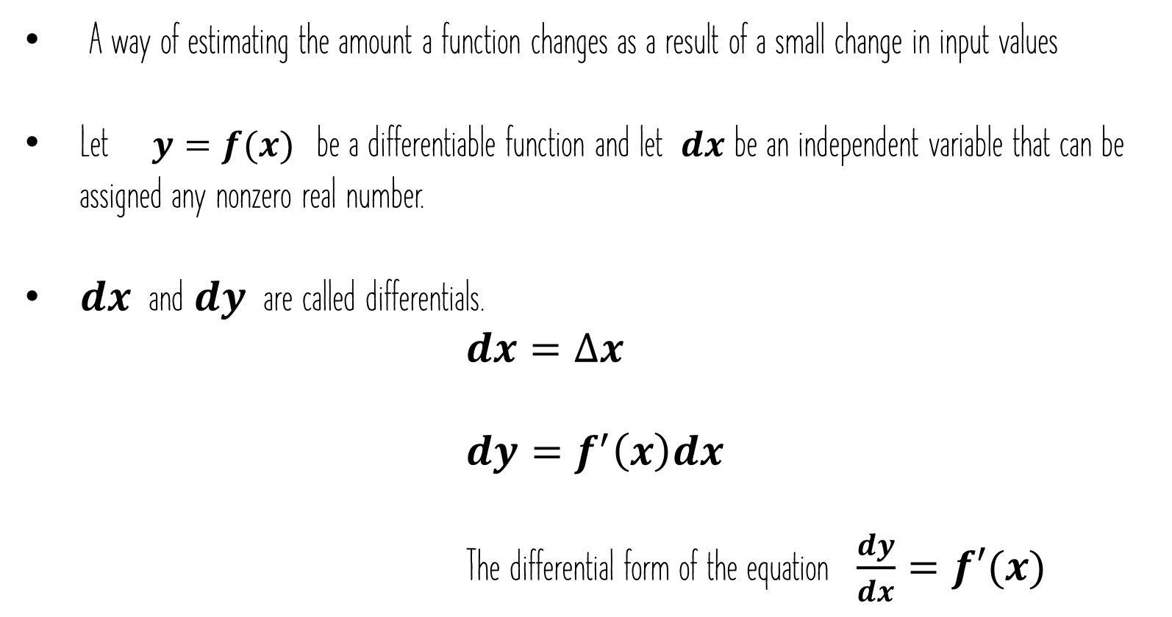
A way of estimating the amount a function changes as a result of a small change in input values
Let $y=f(x)$ be a differentiable function and let $dx$ be an independent variable that can be assigned any nonzero real number.
$dx$ and $dy$ are called differentials.
                $$dx=∆x$$
                $$dy=f^{′}\left(x\right)dx$$
                The differential form of the equation $\frac{dy}{dx}=f′(x)$

Slide 16


Slide 17
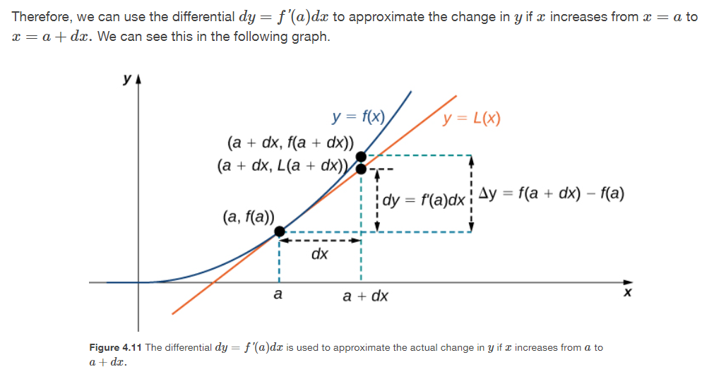

Slide 18


Slide 19

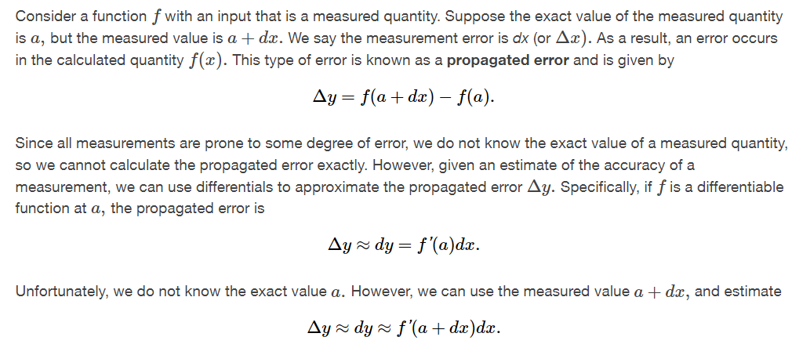

Slide 20


Slide 21


Slide 22



Slide 23
Maxima and minima
Section 4.3

Slide 24

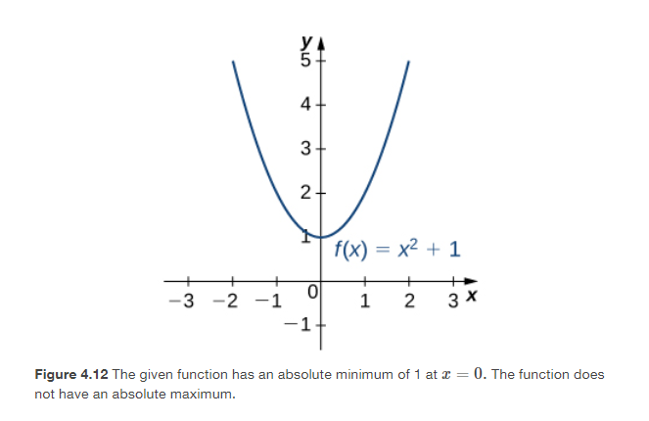

Slide 25
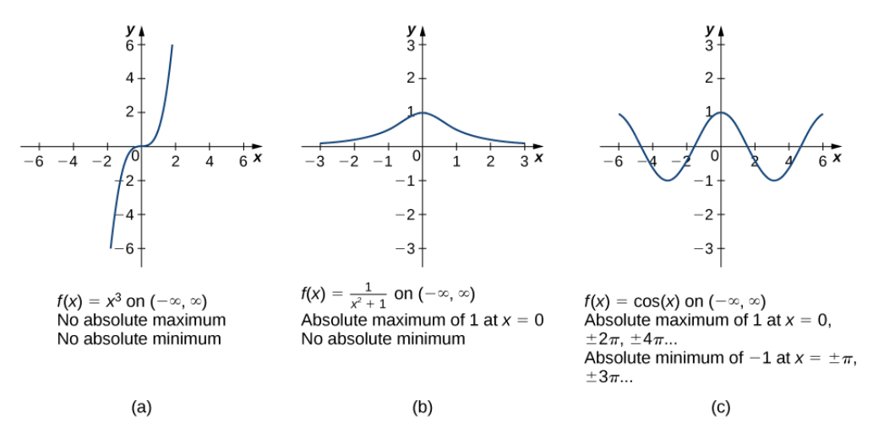

Slide 26
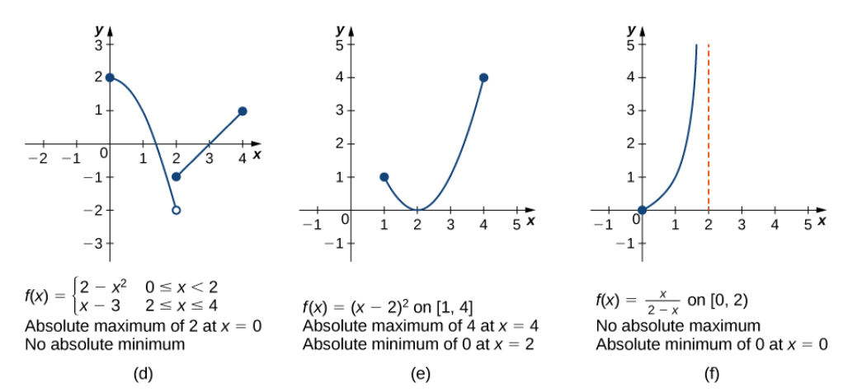

Slide 27


Slide 28


Slide 29
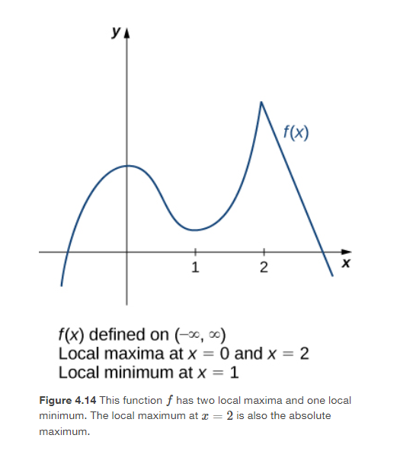

Slide 30


Slide 31


Slide 32


Slide 33
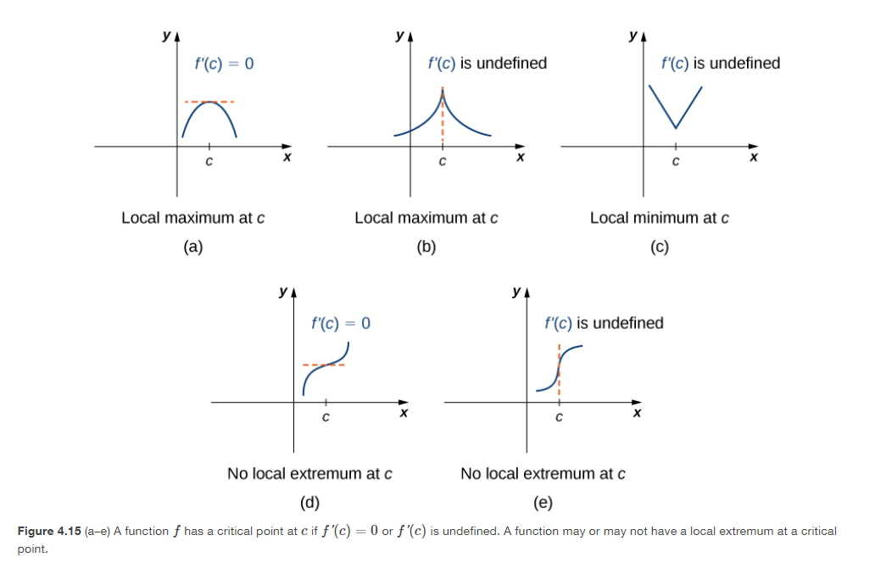

Slide 34
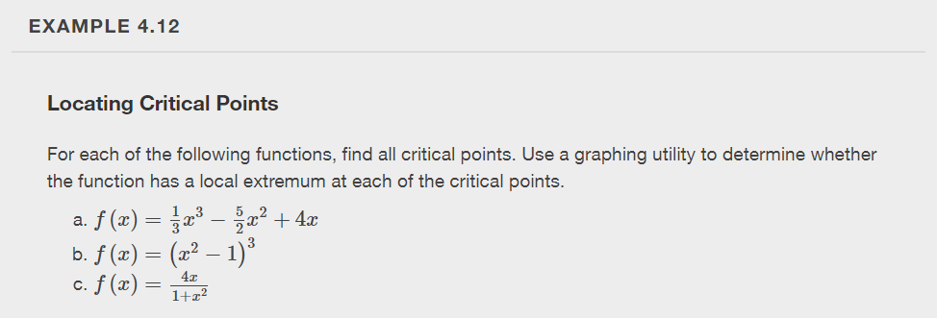

Slide 35


Slide 36


Slide 37


Slide 38
The mean value theorem
Section 4.4
Notes:
The Mean Value Theorem is one of the most important theorems in calculus. We look at some of its implications at the end of this section. First, let’s start with a special case of the Mean Value Theorem, called Rolle’s theorem.

Slide 39
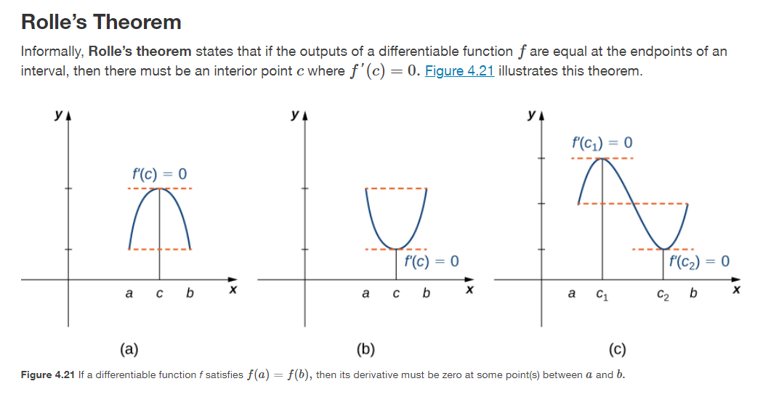

Slide 40


Slide 41
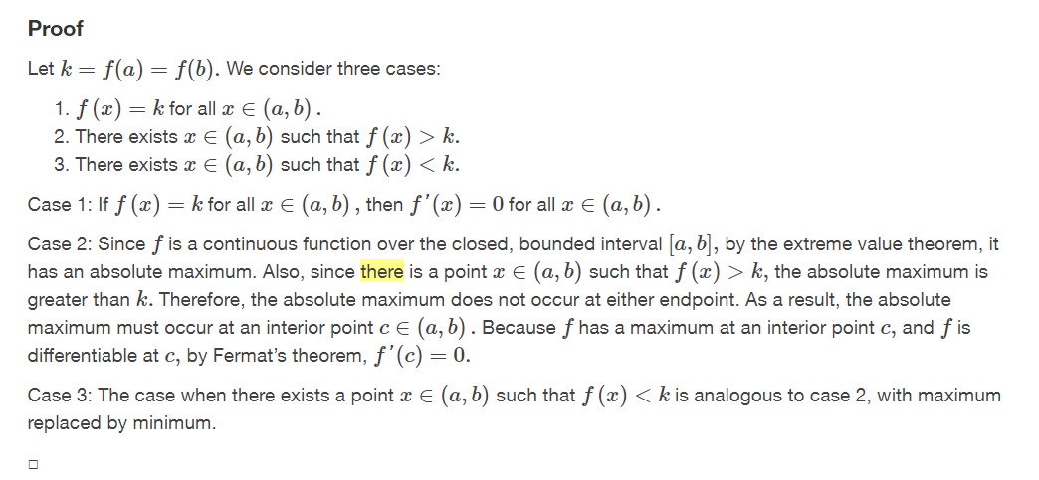

Slide 42
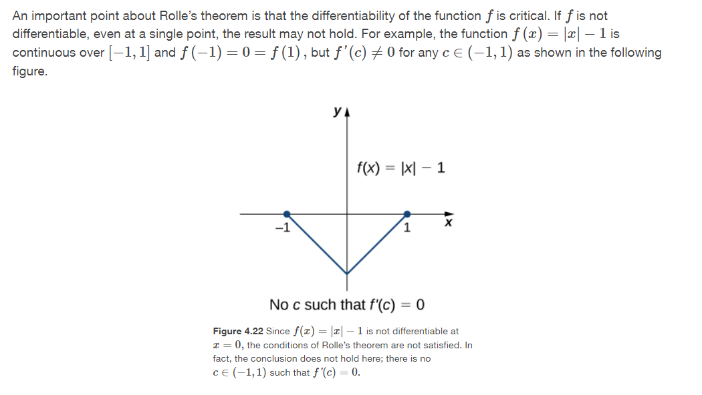

Slide 43


Slide 44
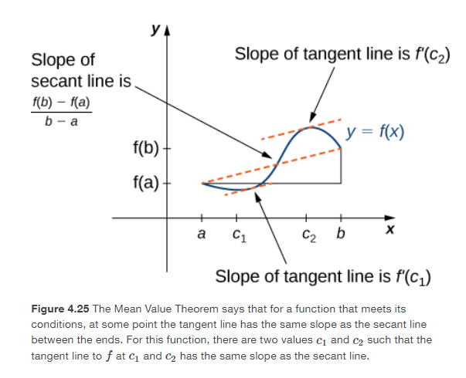

Slide 45


https://openstax.org/books/calculus-volume-1/pages/4-4-the-mean-value-theorem

Slide 46


Slide 47
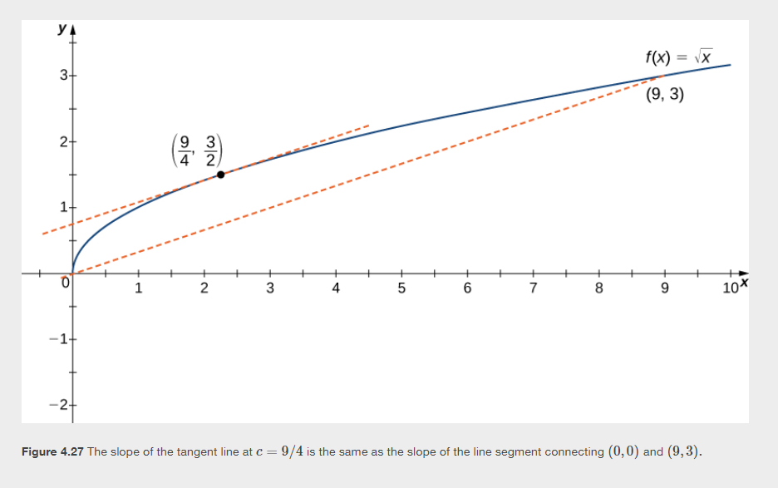

Slide 48
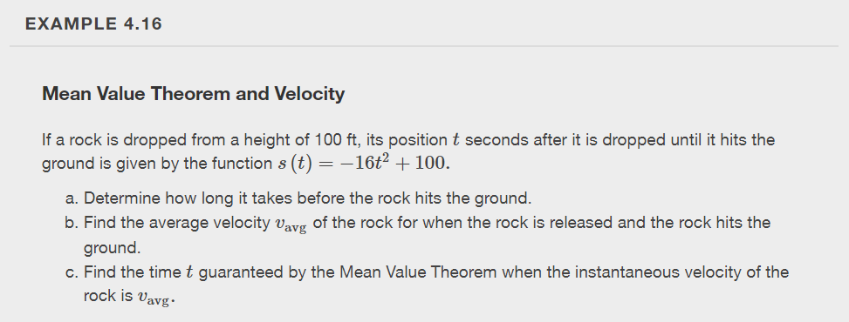

Slide 49
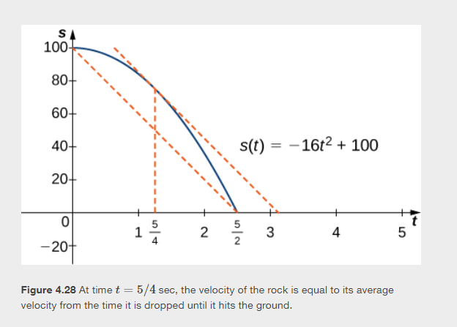

Slide 50





Slide 51
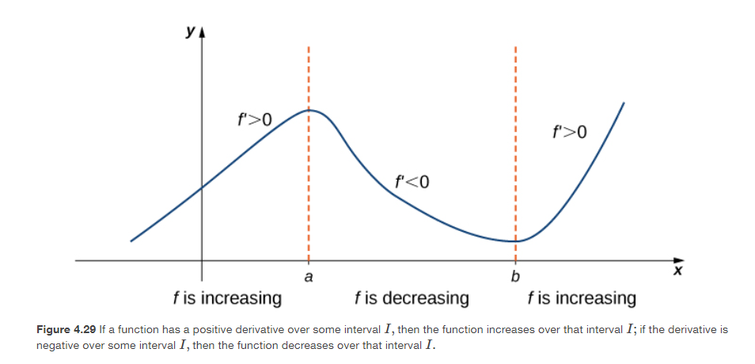

Slide 52


