Slide 1
Chapter 3 derivatives

Slide 2
Implicit differentiation
Section 3.8

Slide 6
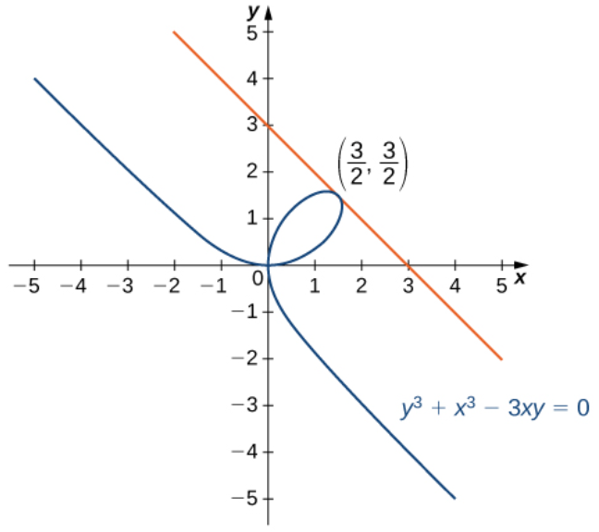

Slide 8
Derivatives of exponential and logarithmic functions
Section 3.9

Slide 14
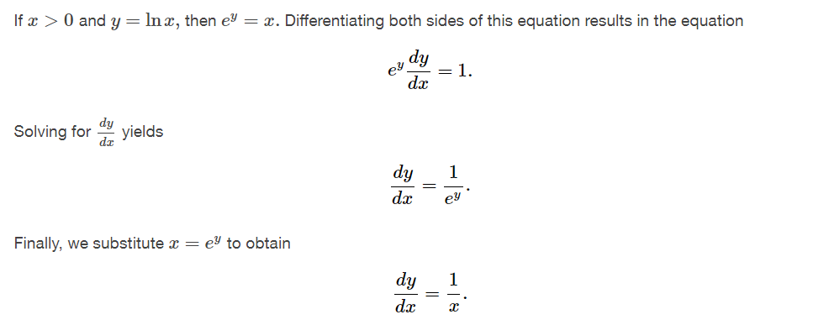
Proof: Method of Implicit Differentiation

Slide 15
Proof: Using the Inverse Function Theorem

Slide 19
Proof:
$\frac{d}{dx}\left(\log_{b}x\right)=$
$\frac{d}{dx} (b^{x})=$

