Slide 1
Chapter 3 derivatives

Slide 2
Derivatives of trigonometric functions
Section 3.5

Slide 3
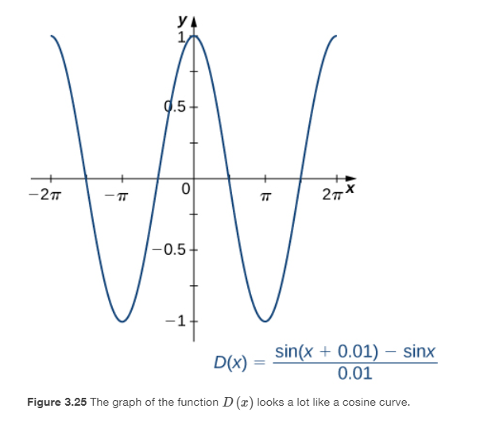
What is the derivative of $sin⁡x$?

Slide 5
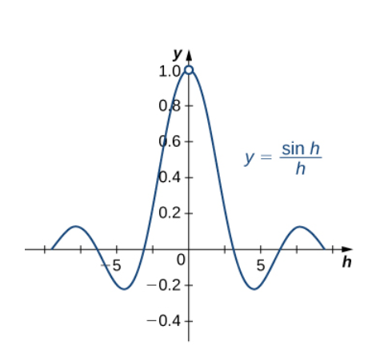
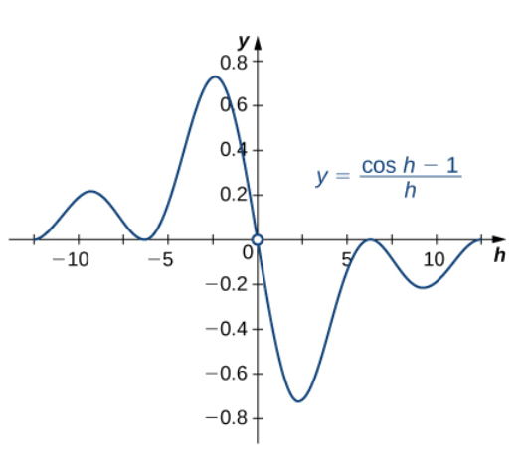
Recall:

Slide 7
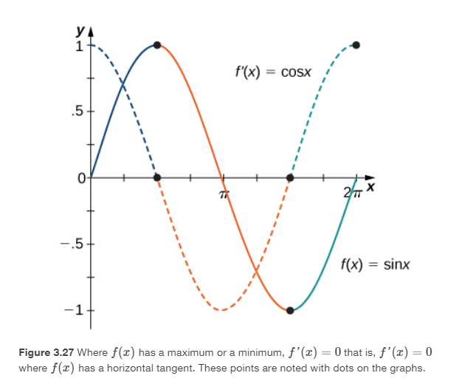

Slide 17
The chain rule
Section 3.6

Slide 18
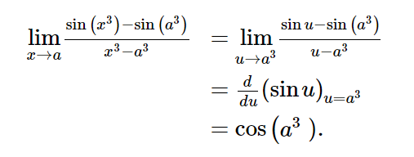
What is the derivative of ?

Slide 19
The Chain Rule states that the derivative of a composite function is the derivative of the outer function evaluated at the inner function times the derivative of the inner function.

Slide 20
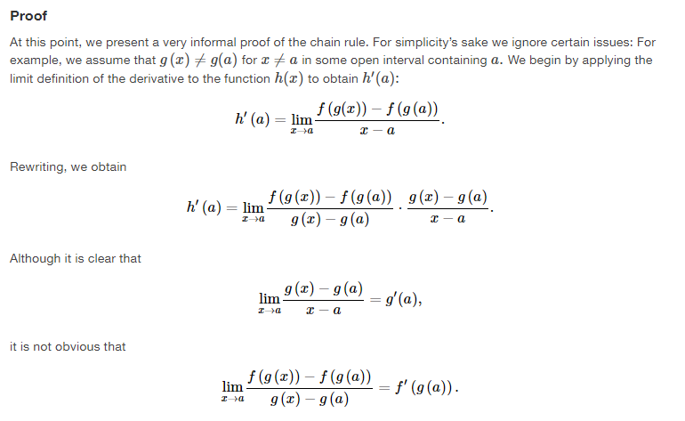

Slide 21
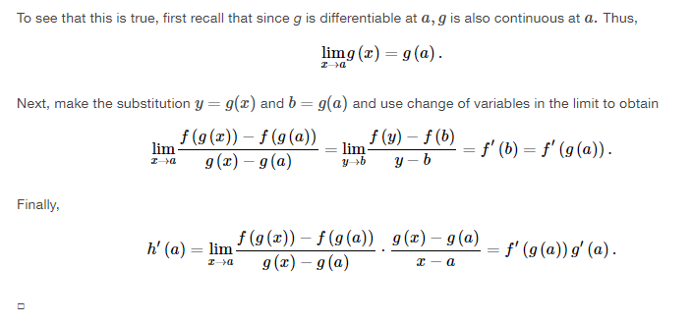

Slide 22
http://webspace.ship.edu/msrenault/GeoGebraCalculus/derivative_intuitive_chain_rule.html

Slide 32
Derivatives of inverse functions
Section 3.7

Slide 33
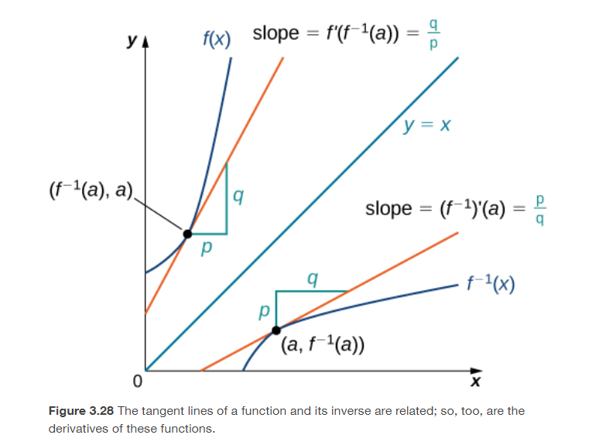

Slide 38
