Slide 1

Chapter 3 derivatives

Slide 2


Slide 3
Defining the derivative
Section 3.1

Slide 4

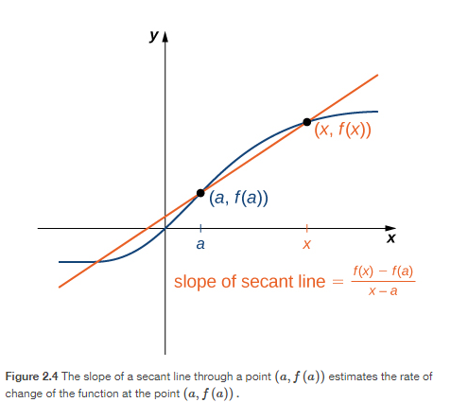
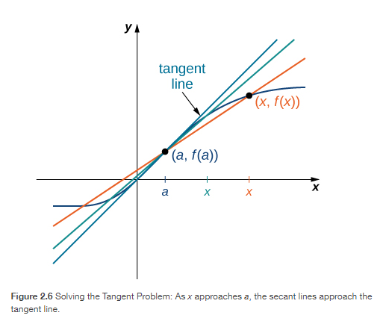

Slide 5

https://www.geogebra.org/m/MeMdCUEm

Slide 6
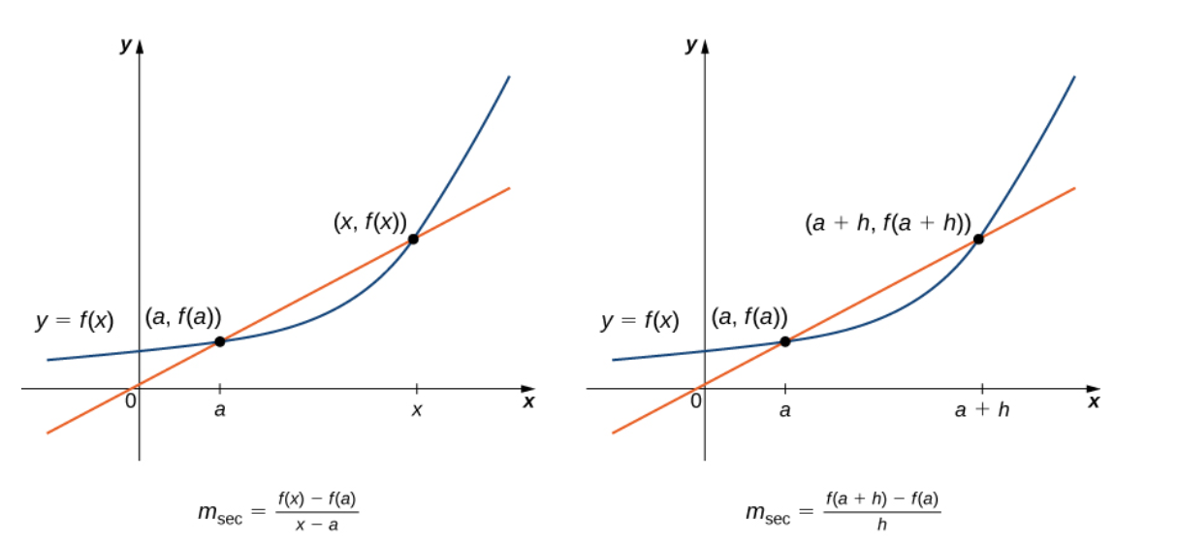

Slide 7
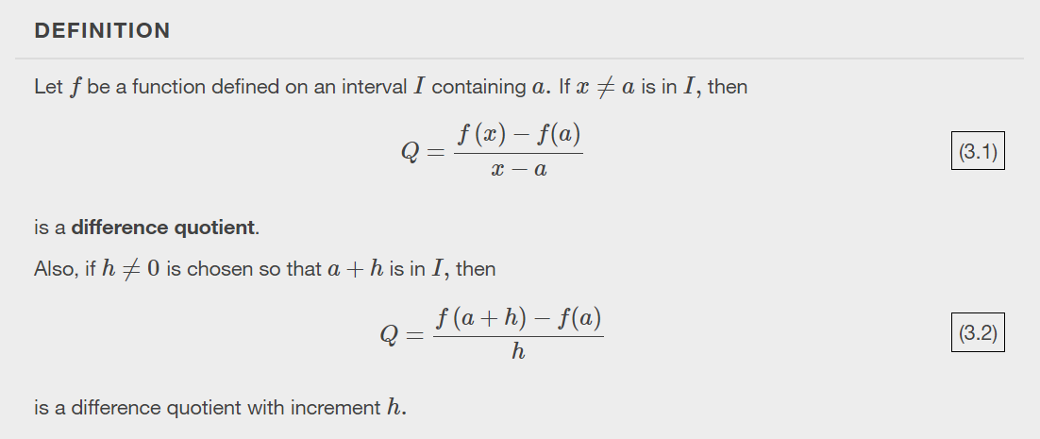

Slide 8
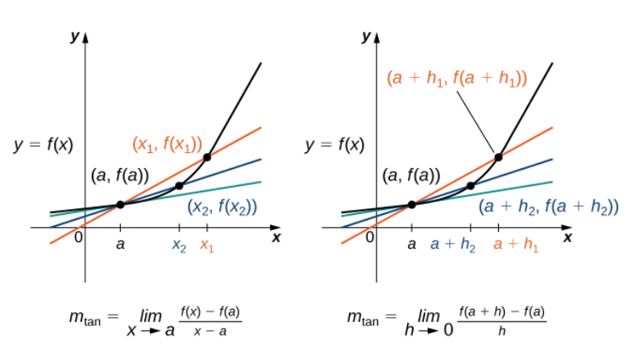

Slide 9
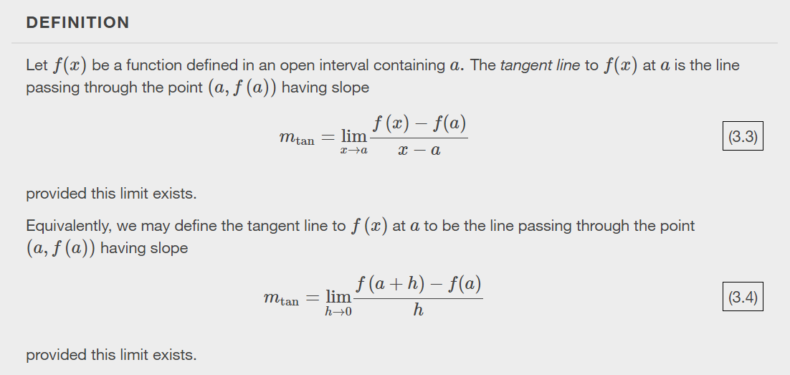

Slide 10


Slide 11


Slide 12


Slide 13

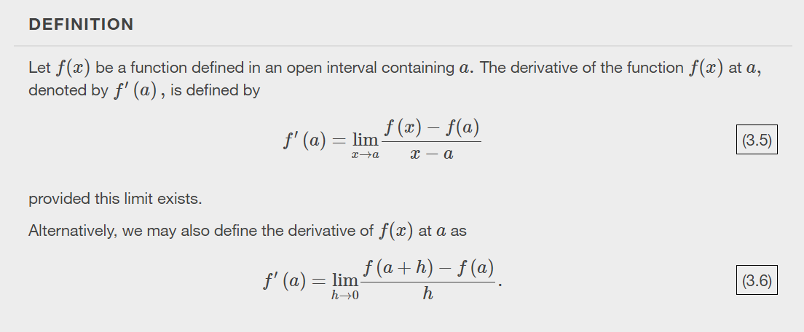

Slide 14

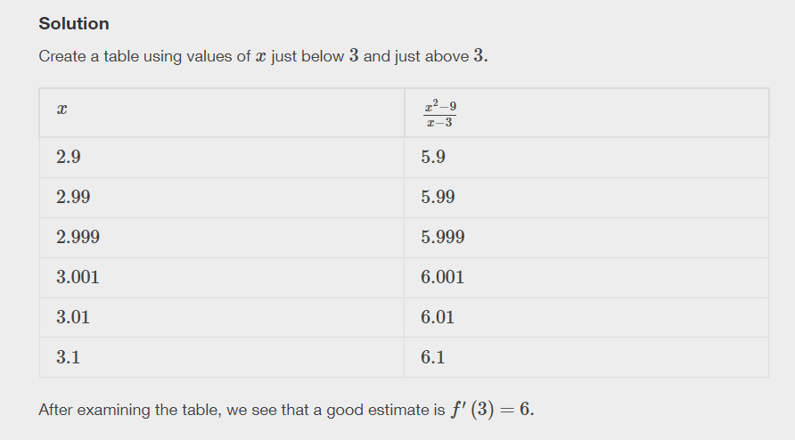

Slide 15


Slide 16


Slide 17
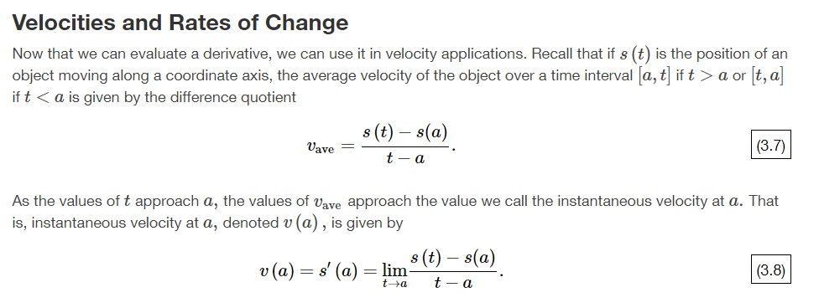

Slide 18
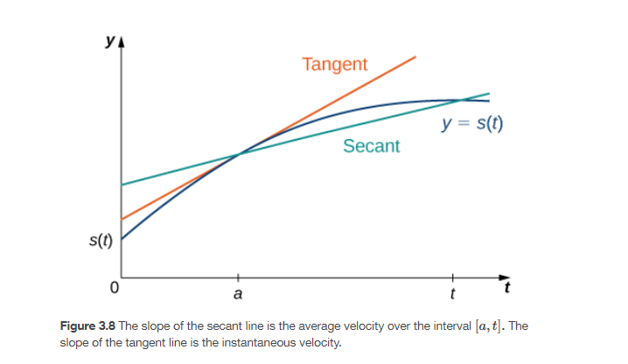

Slide 19
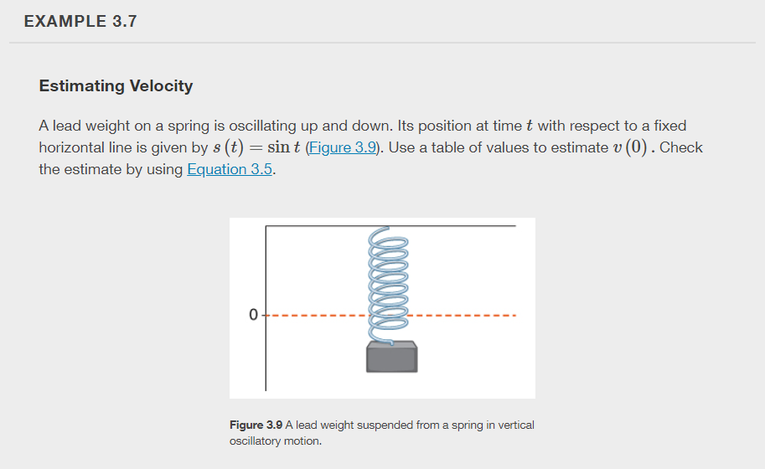

Slide 20
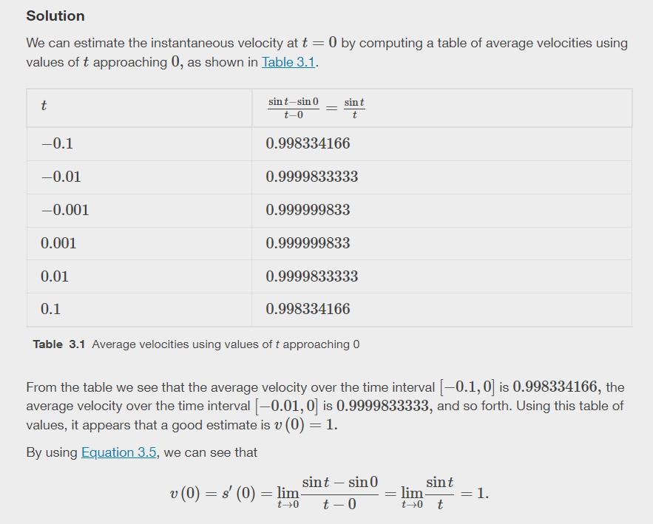

Slide 21


Slide 22


Slide 23


Slide 24
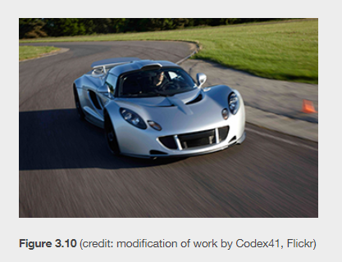


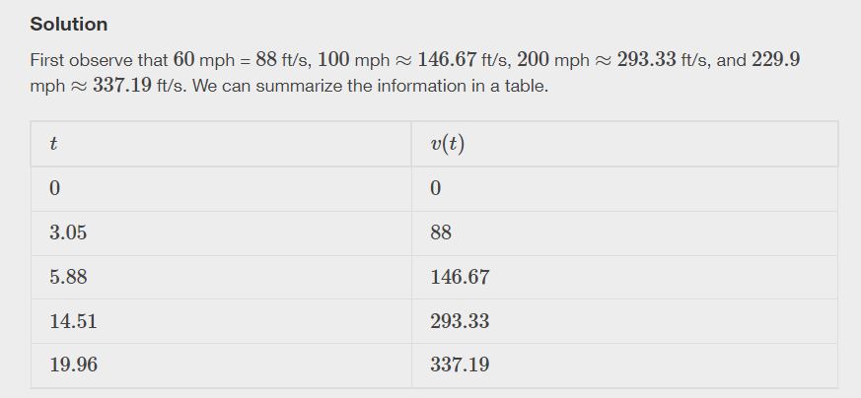
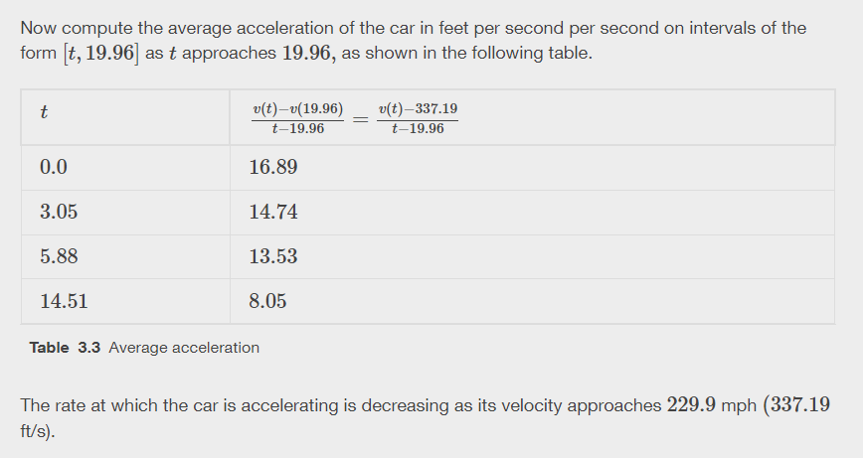

Slide 25
The derivative as a function
Section 3.2

Slide 26






Slide 27
https://www.geogebra.org/m/MeMdCUEm
So cool, let’s look at this again!

Slide 28
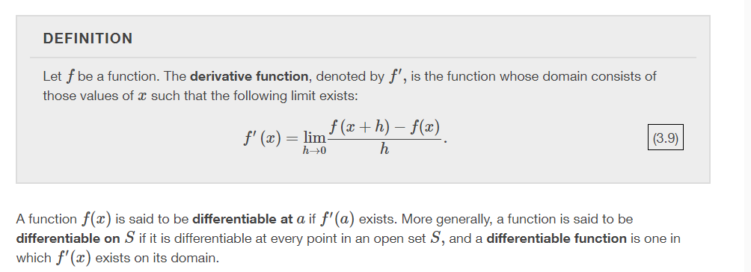

Slide 29


Slide 30


Slide 31


Notation for Derivatives

Slide 32
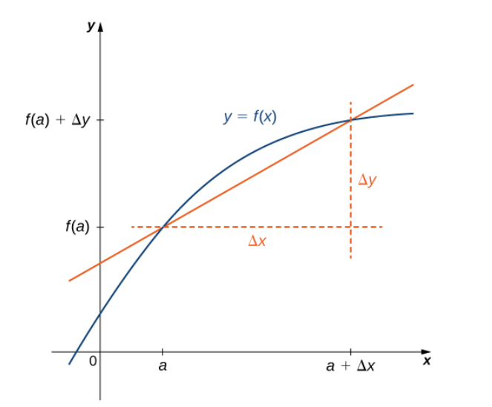
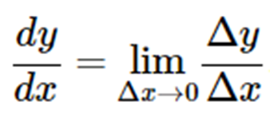



Slide 33


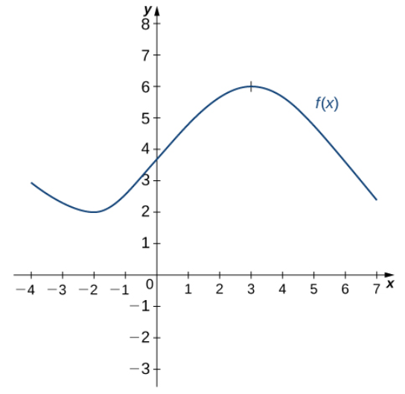
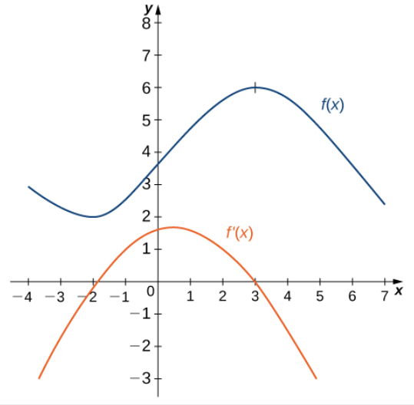

Slide 34

Differentiable at x=a
Continuous at x=a

Slide 35
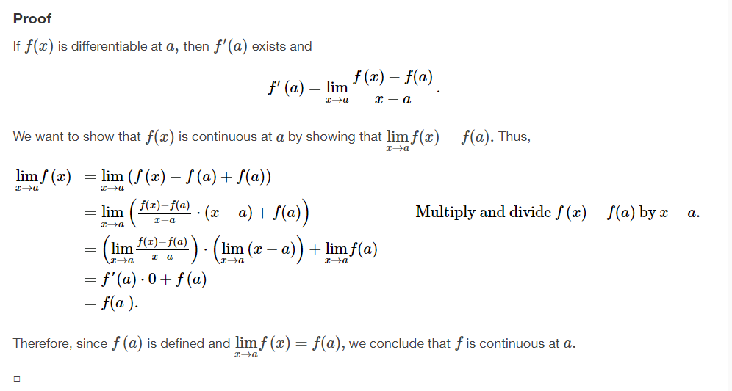

Slide 36
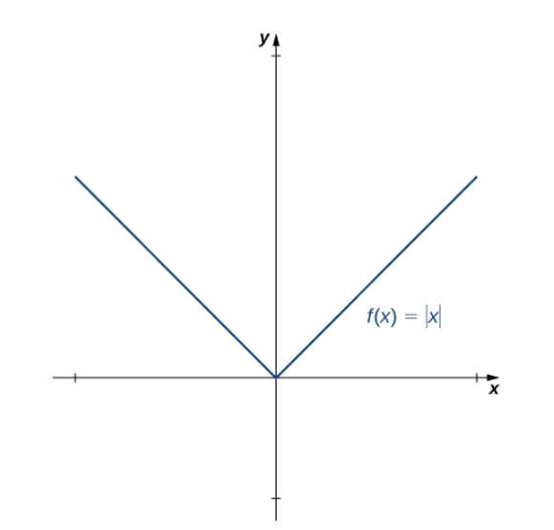
Is the function continuous?
Is the function differentiable?

Slide 37



Is the function continuous?
Is the function differentiable?

Slide 38
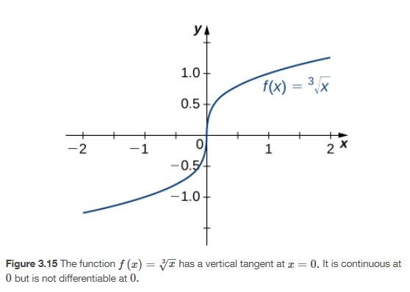



Slide 39
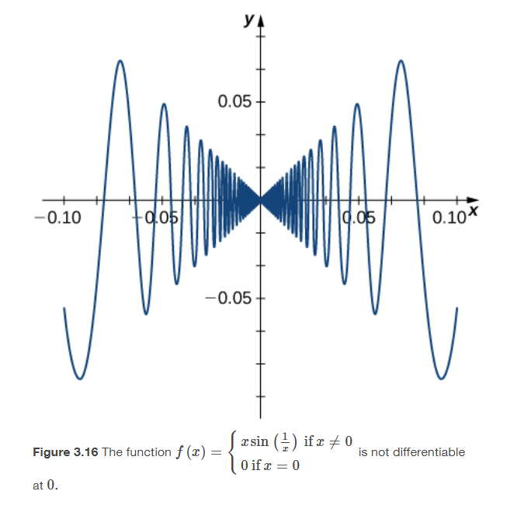



Slide 40


Slide 41

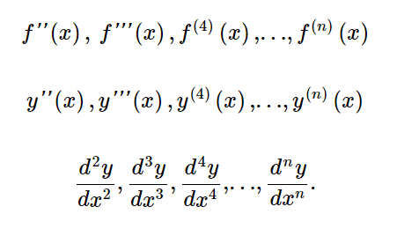

Slide 42


Slide 43


Slide 44
Differentiation rules
Section 3.3

Slide 45


Slide 46


Slide 47
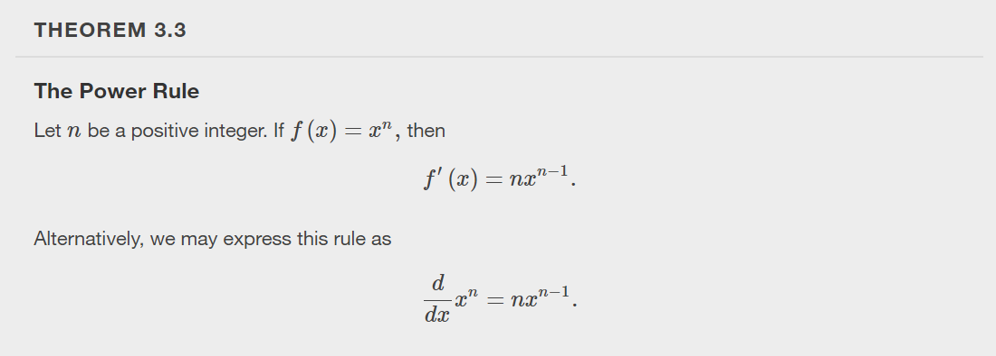

Slide 48
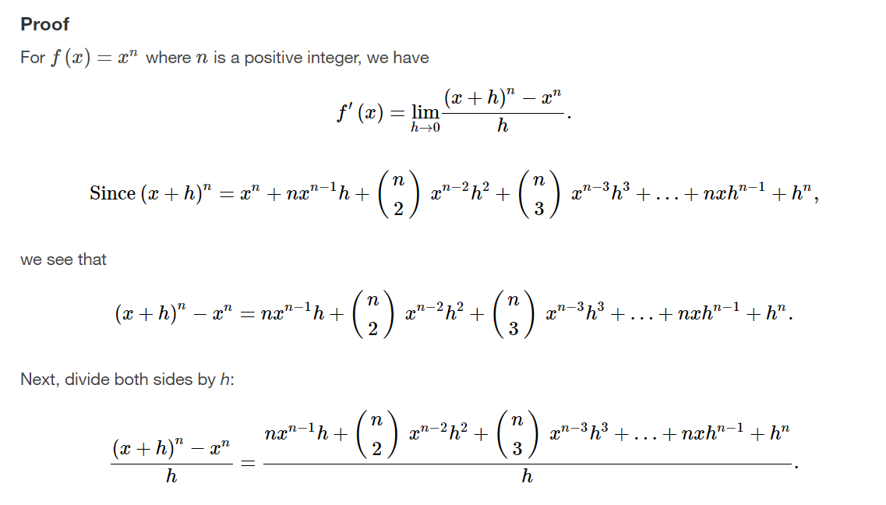

Slide 49
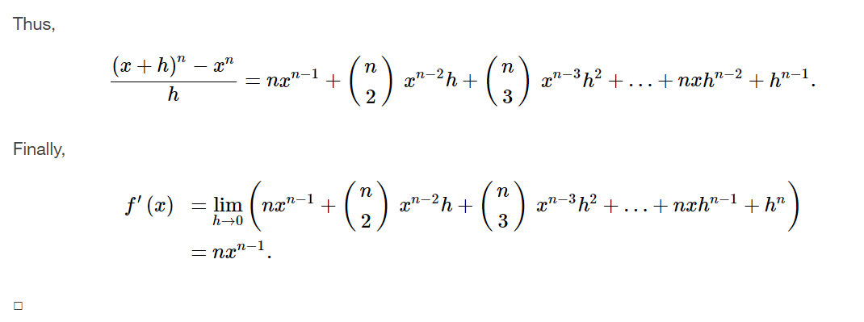

Slide 50
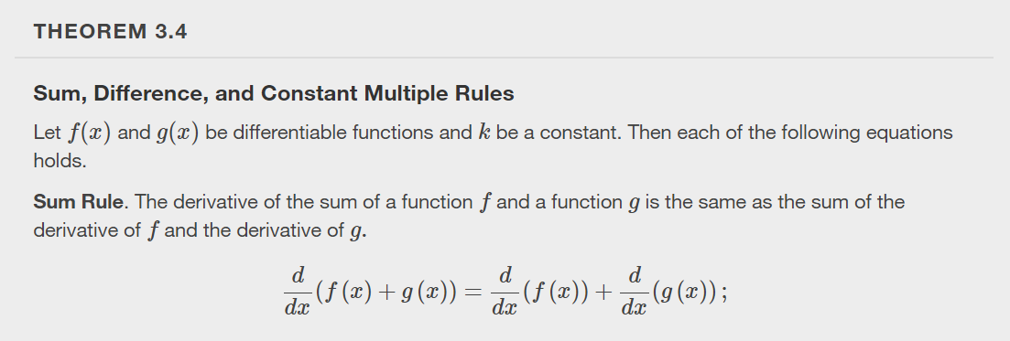

Slide 51


Slide 52


Slide 53


Slide 54


Slide 55


Slide 56


Slide 57
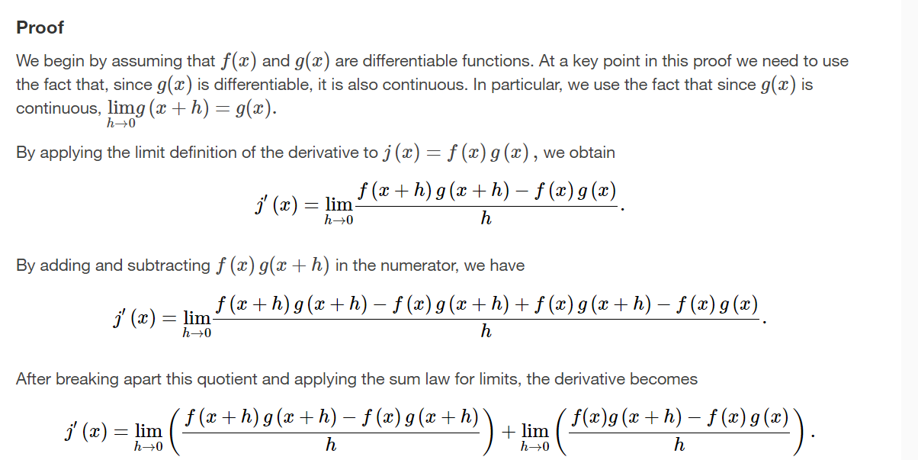

Slide 58
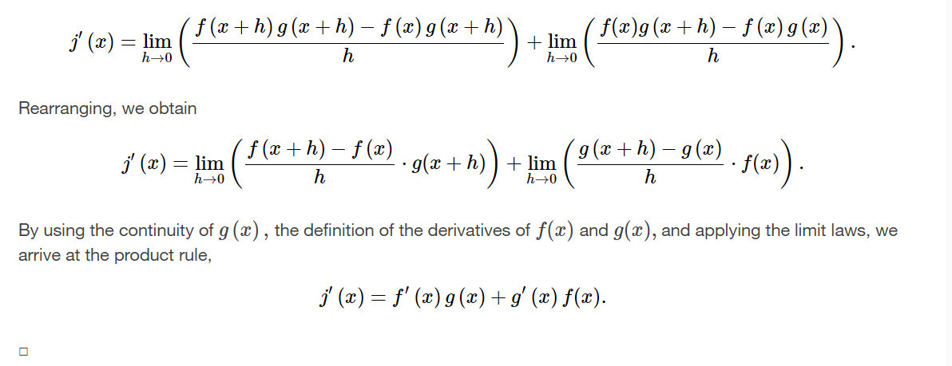

Slide 59


Slide 60


Slide 61


Slide 62


Slide 63


Slide 64
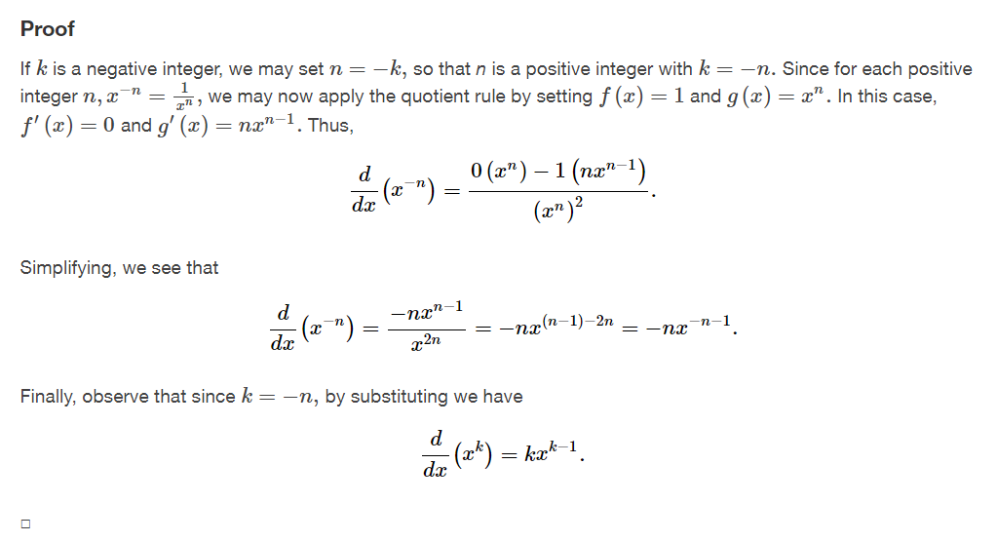

Slide 65


Slide 66


Slide 67


Slide 68


Slide 69


Slide 70


Slide 71


Slide 72
Derivatives as rates of change
Section 3.4

Slide 73
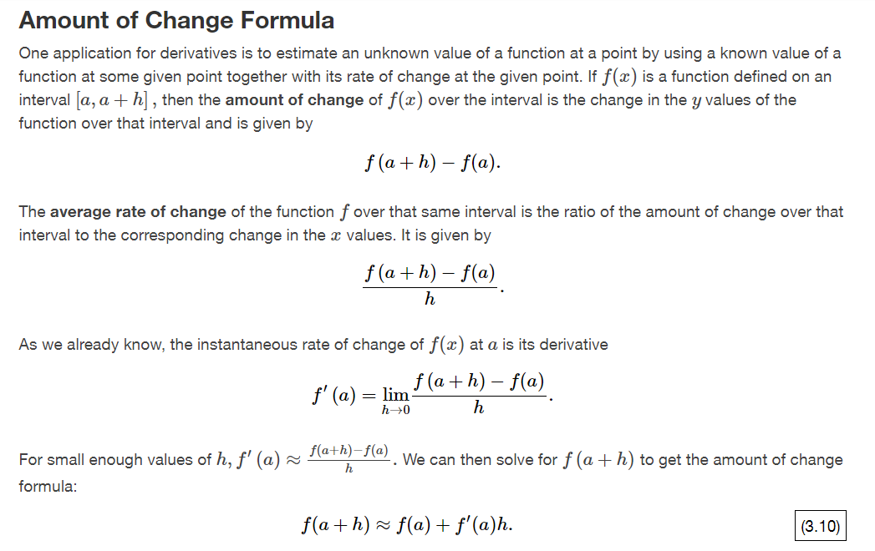

Slide 74
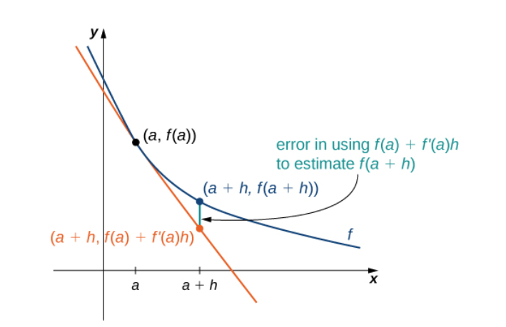


Slide 75


Slide 76



Applications that use derivatives as rates of change

Slide 77



Slide 78


Slide 79



Slide 80
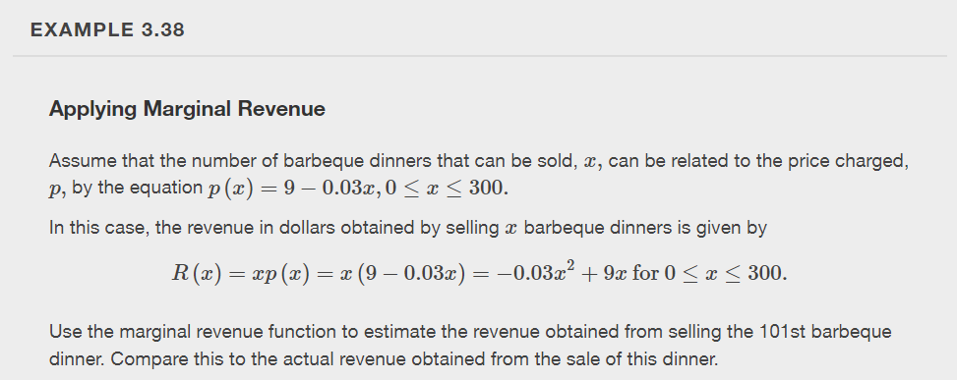

Slide 81



Slide 82
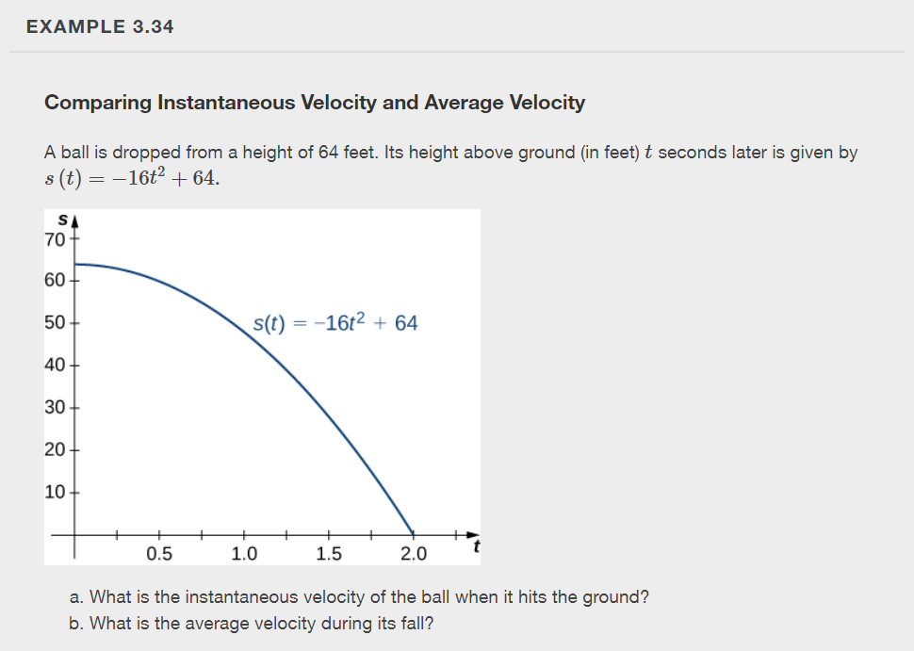

Slide 83


Slide 84
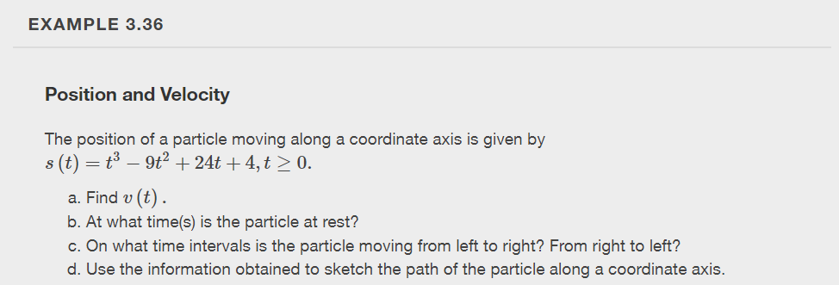

Slide 85


