Slide 1
continuity
Section 2.4

Slide 2
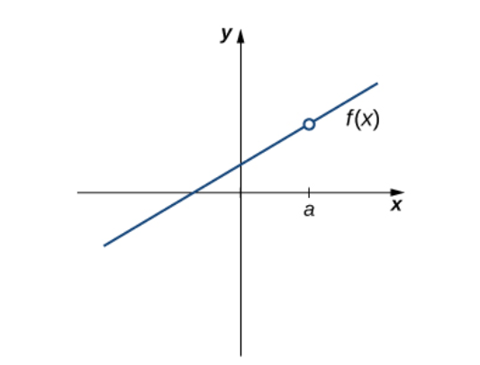
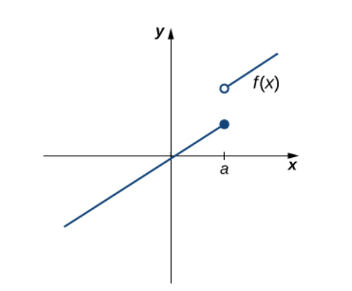
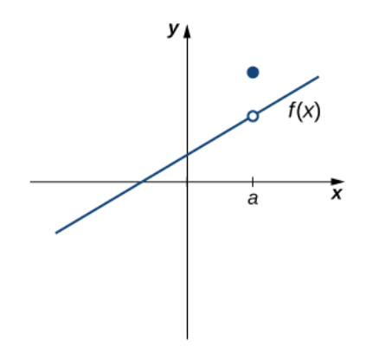
What is common about the following graphs at x=a ?

Slide 3
What is common about the following graphs at x=a ?
The limit does not exist as x approaches a .
The limit exists as x approaches a but does not equal f(a).
f(a) is undefined.

Slide 10
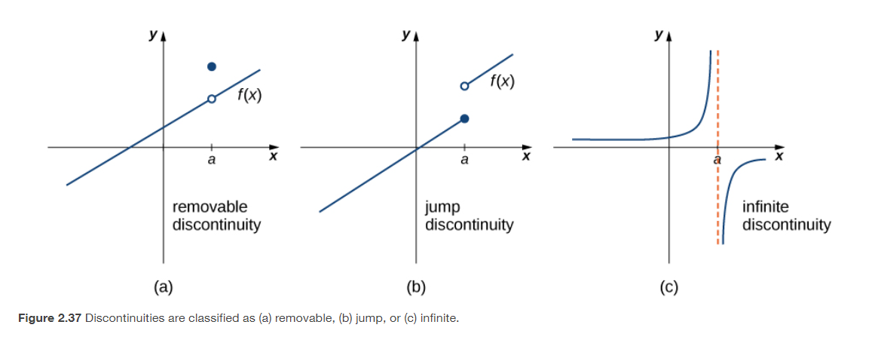

Slide 11
The one-sided limits exist as x approaches a but are not equal.
The one-sided limits are $±$ infinity as x approaches a .
The limit exists as x approaches a .

Slide 20
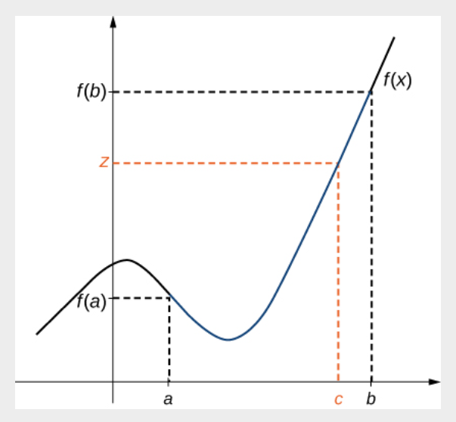

Slide 25
The precise definition of a limit
Section 2.5

Slide 28
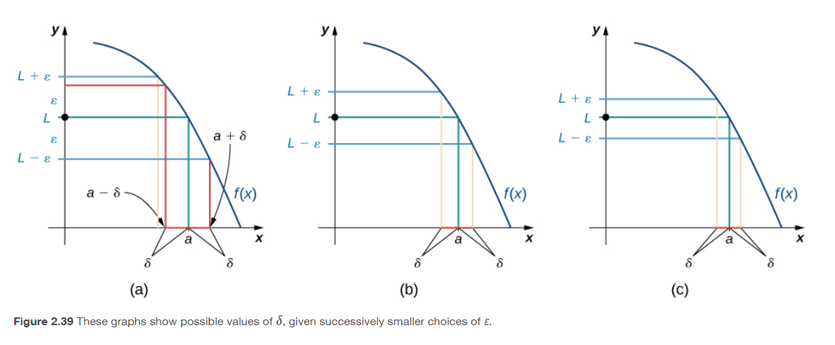

Slide 29
https://www.geogebra.org/m/FQwxkVbK

Slide 32
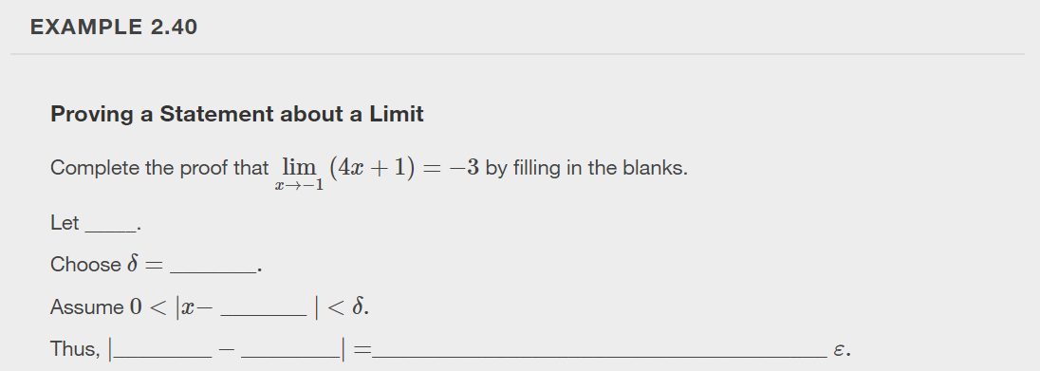

Slide 33
https://openstax.org/books/calculus-volume-1/pages/2-5-the-precise-definition-of-a-limit

Slide 34
Exercise 2.5 #9

Slide 35
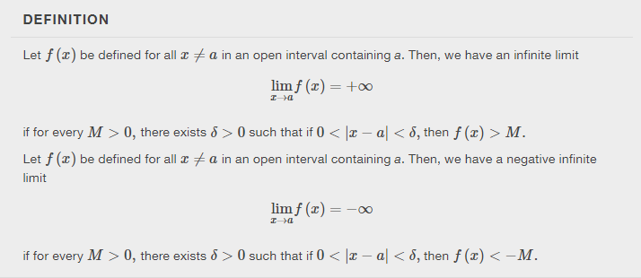

Slide 36
This resource is an adaptation of the OpenStax Calculus Volume 1 open textbook and is © Susan Aydelotte under a CC BY-NC-SA 4.0 International license; it may be reproduced or modified for noncommercial purposes only but must be attributed to OpenStax, Rice University and any changes must be noted. Any adaptation must be shared under the same type of license.

