Slide 1
Equations and Inequalities
Chapter 2
Algebra and Trigonometry 2e
OpenStax
Jay Abramson
Notes:
Images and notes within these slides are from the OpenStax textbook Algebra and Trigonometry 2e

Slide 2
Linear Inequalities and Absolute Value Inequalities
Section 2.7
Notes:
Solve quadratic equations by factoring.
Solve quadratic equations by the square root property.
Solve quadratic equations by completing the square.
Solve quadratic equations by using the quadratic formula.
Use the Pythagorean Theorem.

Slide 3
What are the skills discussed in this section?
Use interval notation
Use properties of inequalities.
Solve inequalities in one variable algebraically.
Solve absolute value inequalities.
Notes:
Do you have any questions?

Slide 4
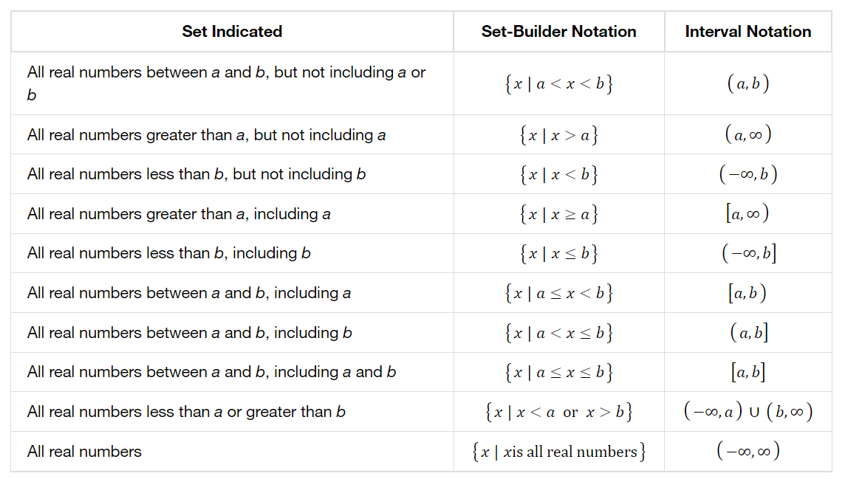
Set-Builder Notation and Interval Notation
Notes:
Do you have any questions?

Slide 5
Notes:
Do you have any questions?

Slide 6
Notes:
Do you have any questions?

Slide 7
Notes:
Do you have any questions?

Slide 8
Notes:
Do you have any questions?

Slide 9
Using the Properties of Inequalities
When we work with inequalities, we can usually treat them similarly to but not exactly as we treat equalities. We can use the addition property and the multiplication property to help us solve them. The one exception is when we multiply or divide by a negative number; doing so reverses the inequality symbol.
Notes:
Do you have any questions?

Slide 10
Notes:
Do you have any questions?

Slide 11
Notes:
Do you have any questions?

Slide 12
Notes:
Do you have any questions?

Slide 13
Notes:
Do you have any questions?

Slide 14
Notes:
Do you have any questions?

Slide 15
Notes:
Do you have any questions?

Slide 16
Notes:
Do you have any questions?

Slide 17
Notes:
Do you have any questions?

Slide 18
Understanding Compound Inequalities
A compound inequality includes two inequalities in one statement.
There are two ways to solve compound inequalities: separating them into two separate inequalities or leaving the compound inequality intact and performing operations on all three parts at the same time. We will illustrate both methods.
Notes:
Do you have any questions?

Slide 19
Notes:
Do you have any questions?

Slide 20
Notes:
Do you have any questions?

Slide 21
Notes:
Do you have any questions?

Slide 22
Notes:
Do you have any questions?

Slide 23
Notes:
Do you have any questions?

Slide 24
Notes:
Do you have any questions?

Slide 25
Notes:
Do you have any questions?

Slide 26
Notes:
Do you have any questions?

Slide 27
Notes:
Do you have any questions?

Slide 28
What did you learn in this section?
Use interval notation
Use properties of inequalities.
Solve inequalities in one variable algebraically.
Solve absolute value inequalities.
Notes:
Do you have any questions?

Slide 29
This resource is an adaptation of the OpenStax Algebra and Trigonometry 2e open textbook and is © Susan Aydelotte under a CC BY-NC-SA 4.0 International license; it may be reproduced or modified for noncommercial purposes only but must be attributed to OpenStax, Rice University and any changes must be noted. Any adaptation must be shared under the same type of license.

