Slide 1

Systems of Equations and Inequalities
Chapter 11
Algebra and Trigonometry 2e, OpenStax, Jay Abramson
Notes:
Images and notes within these slides are from the OpenStax textbook Algebra and Trigonometry 2e

Slide 2
11.3 Systems of Nonlinear Equations and Inequalities: Two Variables
Algebra and Trigonometry 2e, OpenStax, Jay Abramson
Notes:
Images and notes within these slides are from the OpenStax textbook Algebra and Trigonometry 2e

Slide 3
What are the learning objectives for this section?
Solve a system of nonlinear equations using substitution.
Solve a system of nonlinear equations using elimination.
Graph a nonlinear inequality.
Graph a system of nonlinear inequalities.

Slide 4
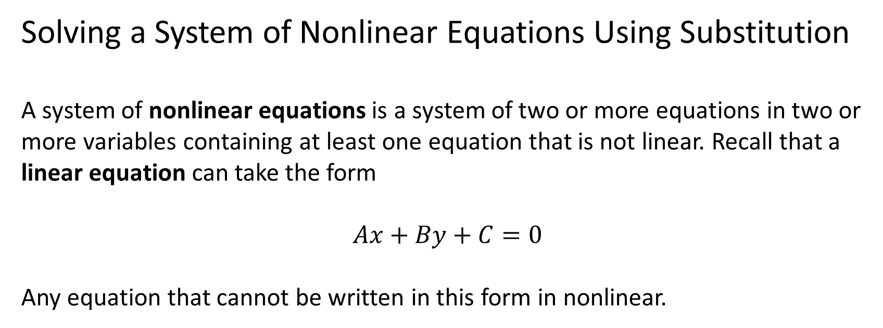
Solving a System of Nonlinear Equations Using Substitution
A system of nonlinear equations is a system of two or more equations in two or more variables containing at least one equation that is not linear. Recall that a linear equation can take the form
$$Ax+By+C=0$$
Any equation that cannot be written in this form in nonlinear.
Notes:
The substitution method we used for linear systems is the same method we will use for nonlinear systems. We solve one equation for one variable and then substitute the result into the second equation to solve for another variable, and so on. There is, however, a variation in the possible outcomes.

Slide 5
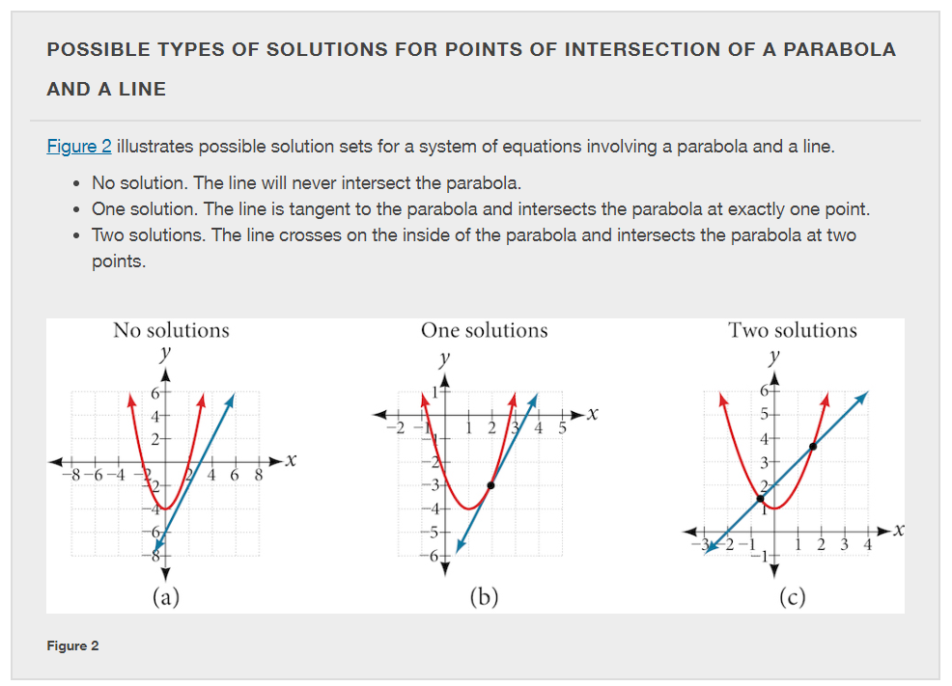

Slide 6
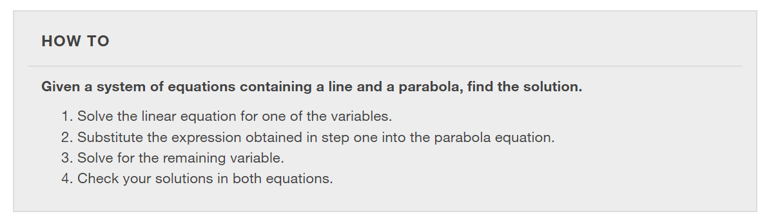

Slide 7
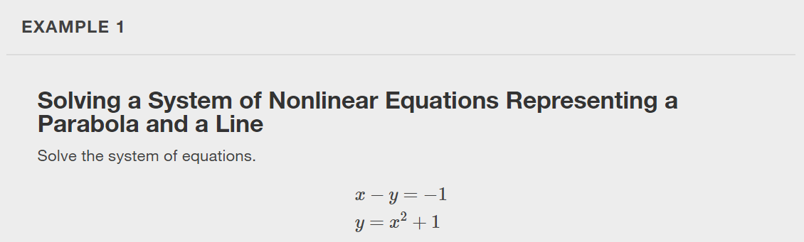

Slide 8

Notes:
Yes, but because x is squared in the second equation this could give us extraneous solutions for x.

Slide 9
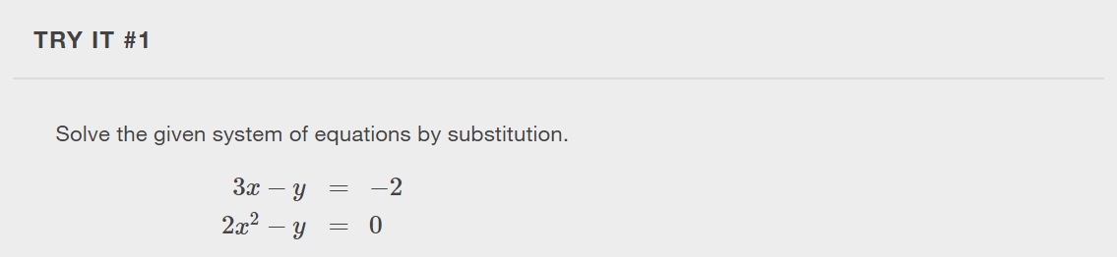

Slide 10
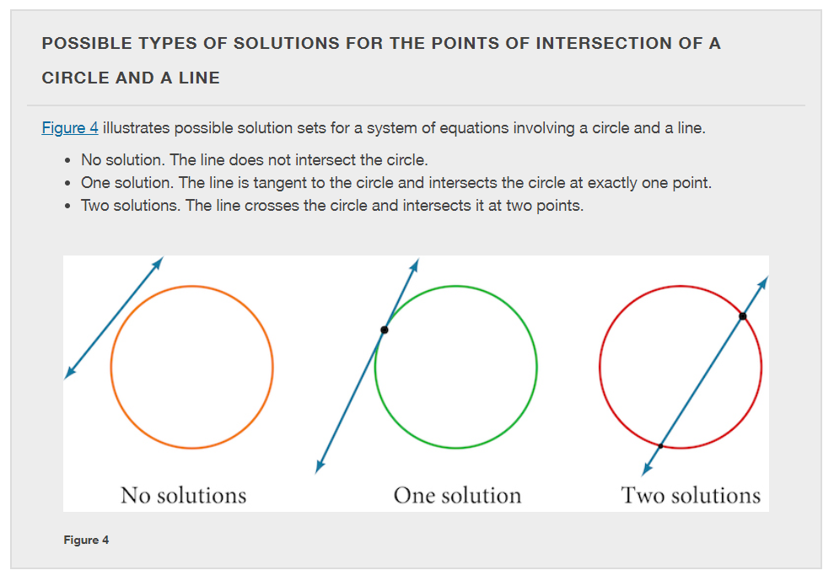

Slide 11
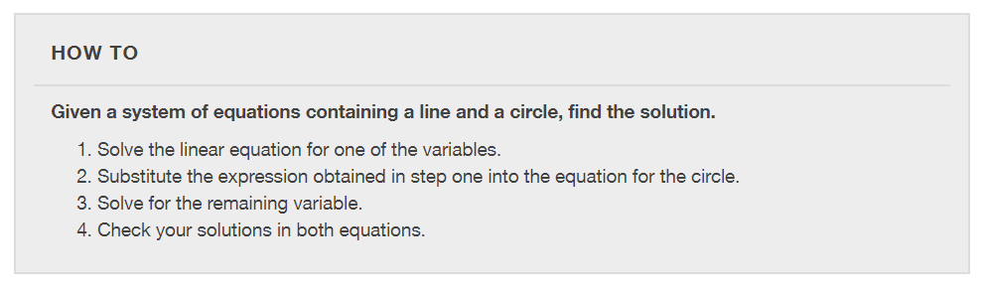

Slide 12
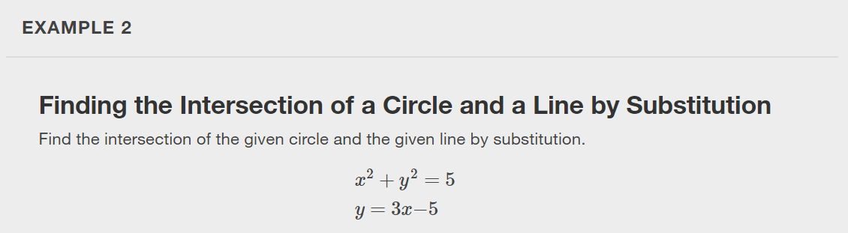

Slide 13
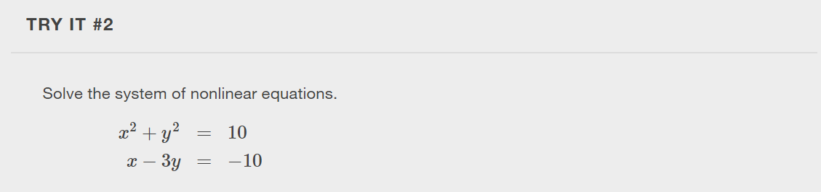

Slide 14
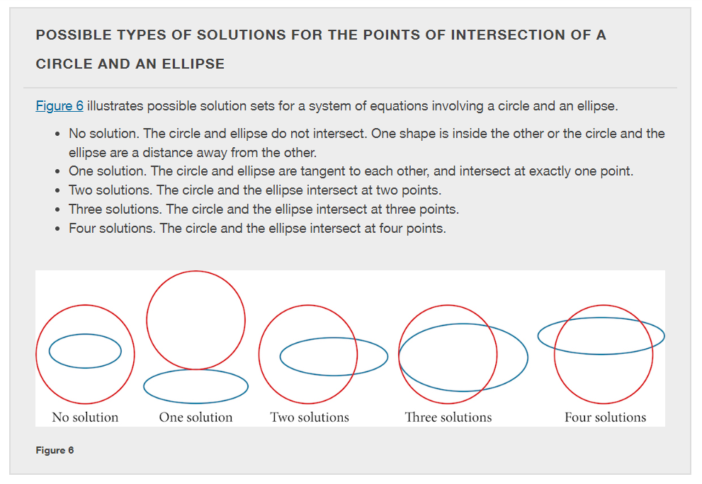

Slide 15
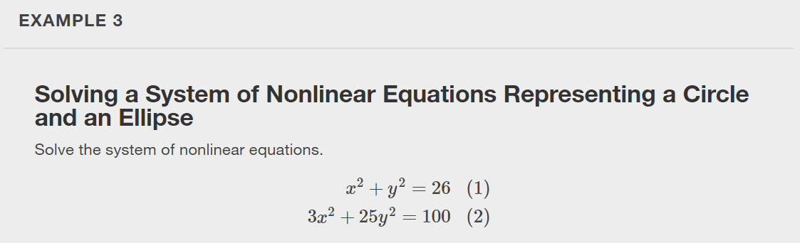

Slide 16


Slide 17
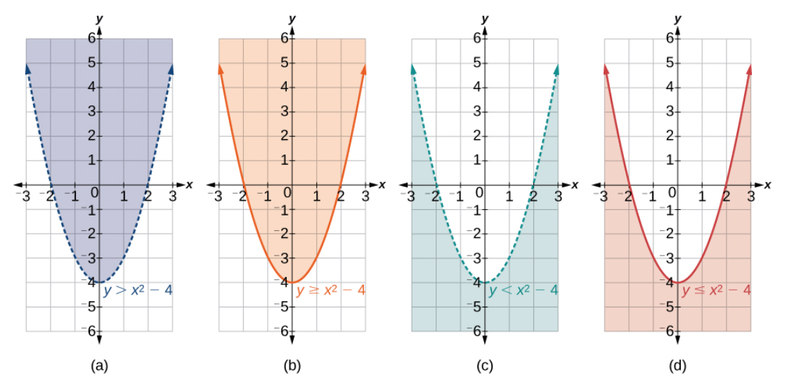
Graphing a Nonlinear Inequality
A nonlinear inequality is an inequality containing a nonlinear expression. Graphing a nonlinear inequality is much like graphing a linear inequality.
Notes:
All of the equations in the systems that we have encountered so far have involved equalities, but we may also encounter systems that involve inequalities. We have already learned to graph linear inequalities by graphing the corresponding equation, and then shading the region represented by the inequality symbol. Now, we will follow similar steps to graph a nonlinear inequality so that we can learn to solve systems of nonlinear inequalities. The graphs will create regions in the plane, and we will test each region for a solution. If one point in the region works, the whole region works. That is the region we shade.

Slide 18
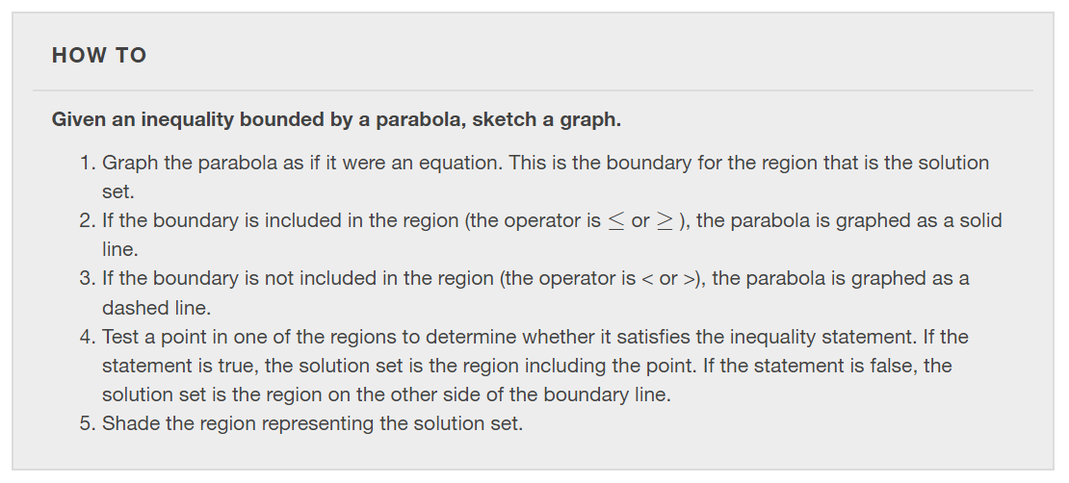

Slide 19
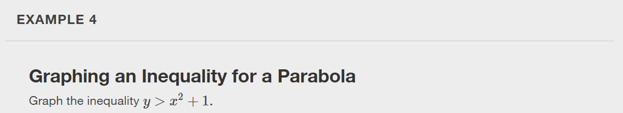

Slide 20
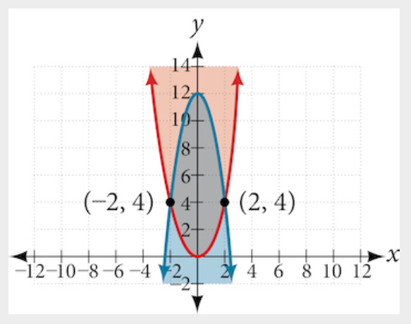
Graphing a System of Nonlinear Inequalities
A system of nonlinear inequalities is a system of two or more inequalities in two or more variables containing at least one inequality that is not linear.
The solution to a nonlinear system of inequalities is the region of the graph where the shaded regions of the graph of each inequality overlap, or where the regions intersect, called the feasible region.
Notes:
Now that we have learned to graph nonlinear inequalities, we can learn how to graph systems of nonlinear inequalities. Graphing a system of nonlinear inequalities is similar to graphing a system of linear inequalities. The difference is that our graph may result in more shaded regions that represent a solution than we find in a system of linear inequalities.

Slide 21
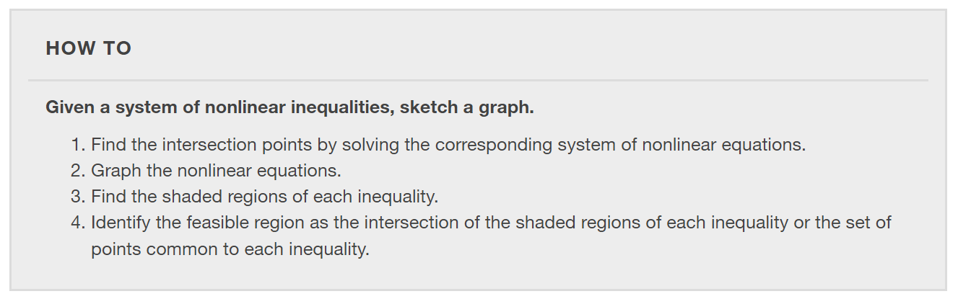

Slide 22
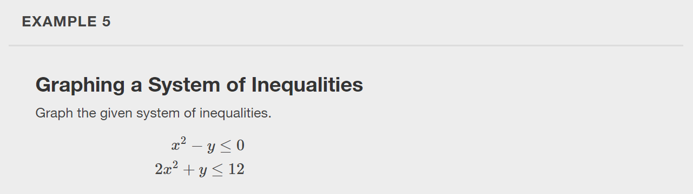
Notes:
Draw the graph by hand and confirm using desmos.com/calculator.

Slide 23
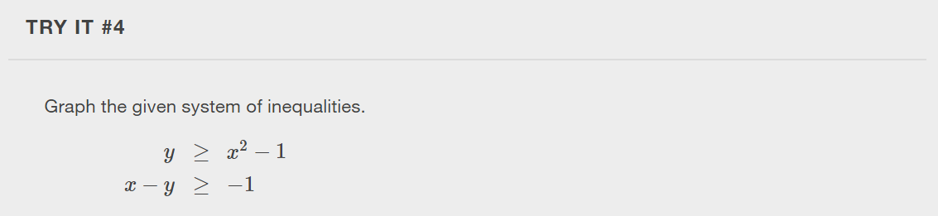

Slide 24
What did you learn in this section?
Solve a system of nonlinear equations using substitution.
Solve a system of nonlinear equations using elimination.
Graph a nonlinear inequality.
Graph a system of nonlinear inequalities.
Notes:
Do you have any questions?

Slide 25
This resource is an adaptation of the OpenStax Algebra and Trigonometry 2e open textbook and is © Susan Aydelotte under a CC BY-NC-SA 4.0 International license; it may be reproduced or modified for noncommercial purposes only but must be attributed to OpenStax, Rice University and any changes must be noted. Any adaptation must be shared under the same type of license.

