Slide 1
Antiderivatives
Section 4.10

Slide 2
What is the derivative of the function?
What function has a derivative equal to $f(x)$?

Slide 5
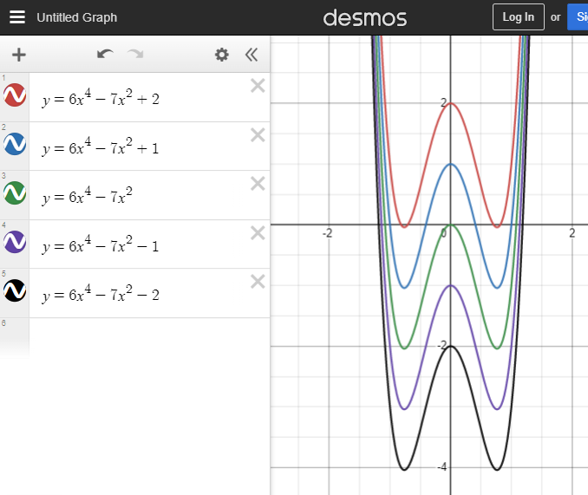
What is the most general
antiderivative for $y′$ ?
What is the derivative for each of
the functions listed above?
$$y^{′}=$$

Slide 6
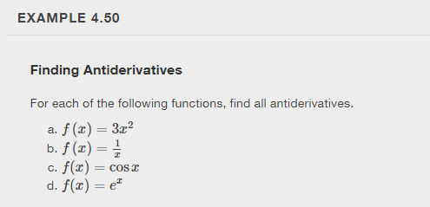

Slide 7
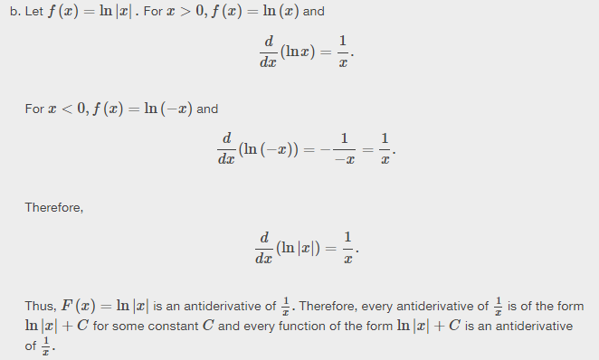
What is the antiderivative of $f\left(x\right)=\frac{1}{x}$ ?

Slide 8
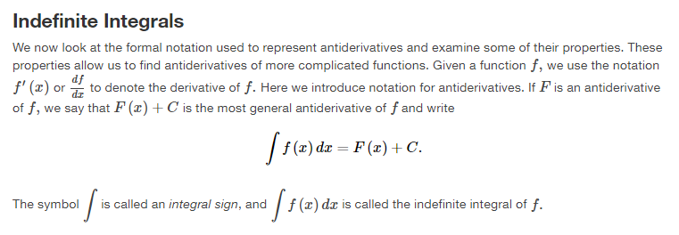

Slide 9
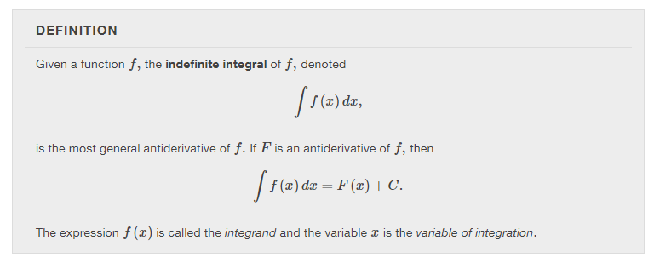

Slide 10
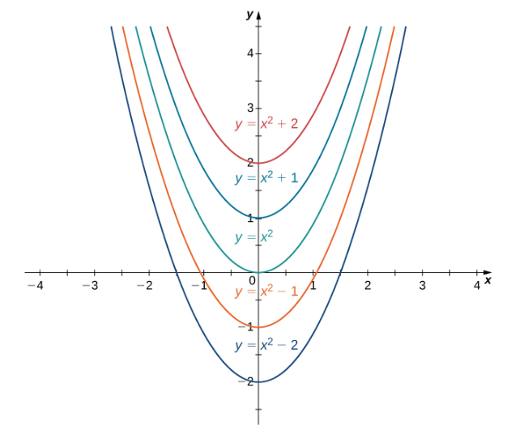

Slide 11
$$\int{x dx=}$$
$$\int{x^{2} dx=}$$
$$\int{x^{3}dx=}$$
$$\int{x^{n}dx=}$$

Slide 13
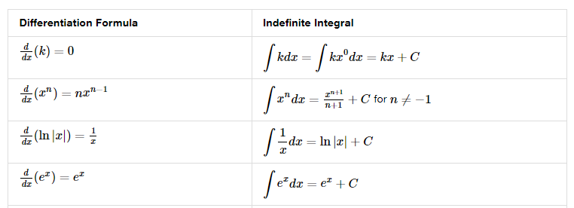

Slide 14
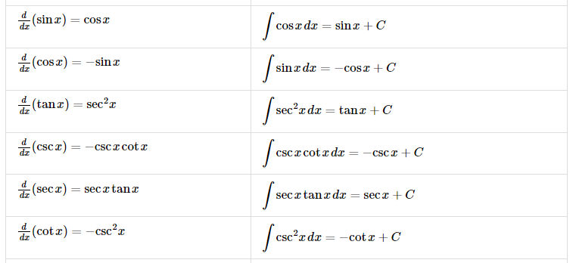

Slide 16
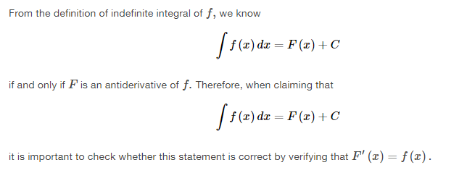

Slide 17
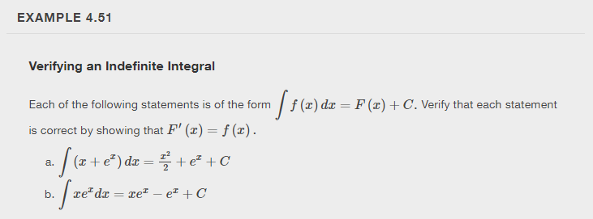

Slide 18
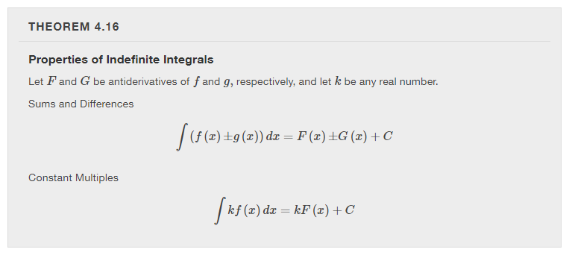

Slide 19
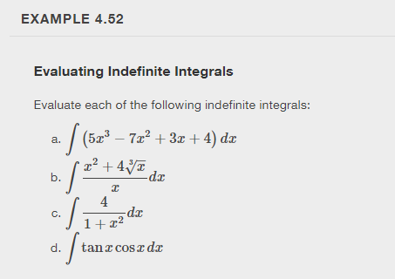

Slide 20
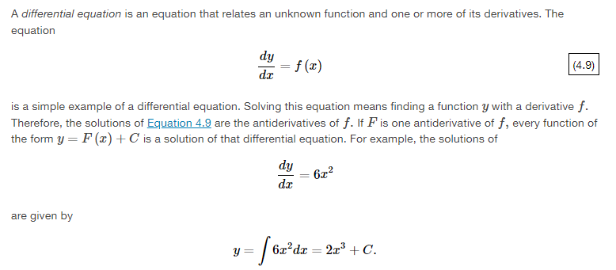

Slide 24
Chapter 5 integration

Slide 25
Approximating areas
Section 5.1

Slide 28
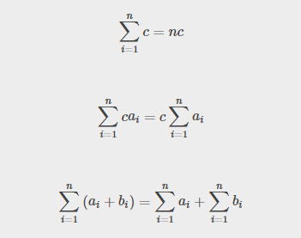
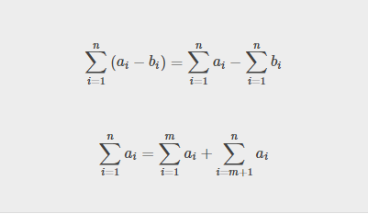

Slide 31
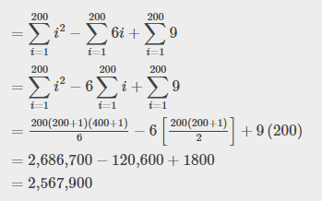

Slide 32
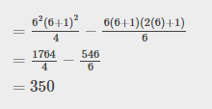

Slide 33
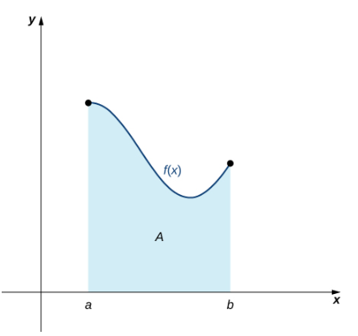
How do we approximate the
area under this curve?
Two methods:
Left-endpoint approximation
Right-endpoint approximation

Slide 35
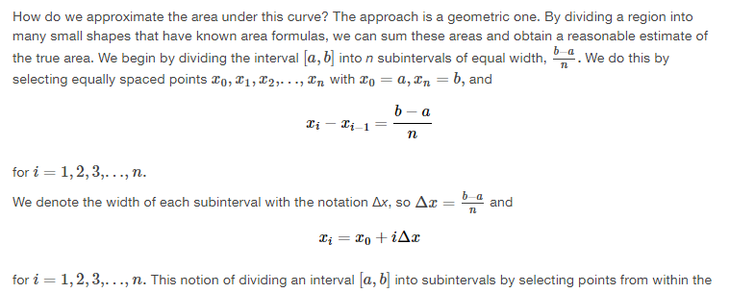

Slide 36
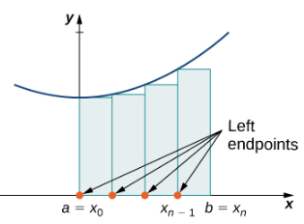

Slide 37
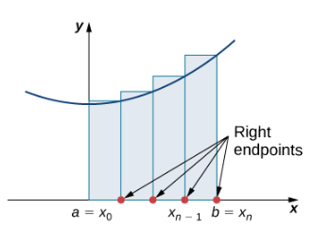

Slide 38
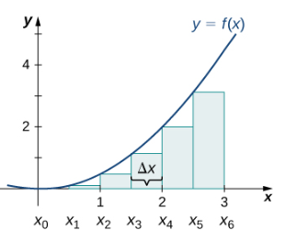

Slide 39
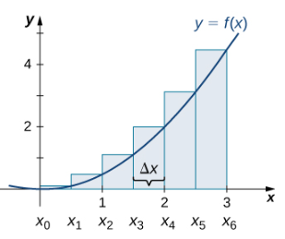

Slide 40
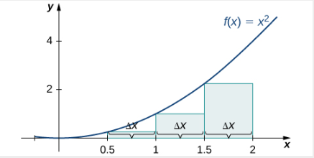
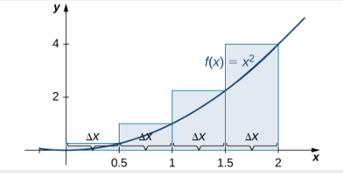

Slide 41
Right-endpoint Approximation using more rectangles
https://teacher.desmos.com/activitybuilder/custom/59ef35772aae8e060e6908b2#preview/2cf1e681-10fc-4dcd-96fe-d0ebe3cce1d5

Slide 42
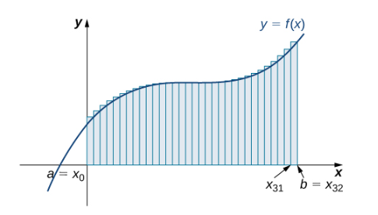
Example

Slide 47
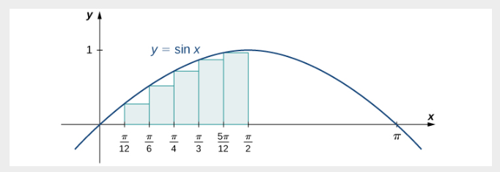

Slide 48
The definite integral
Section 5.2

Slide 49
Note: The function is not required to be continuous and nonnegative.

Slide 50
Indefinite Integral:
Definite Integral:
Family of functions
= a number
Limits of integration, lower limit, upper limit, integrand, variable of integration

Slide 55
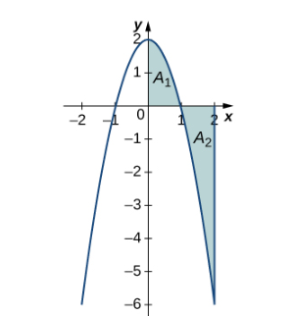

Slide 56
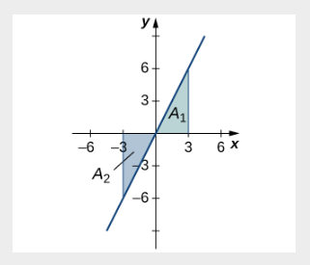

Slide 57
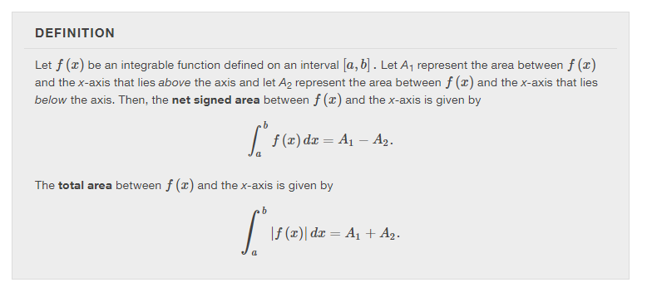

Slide 58
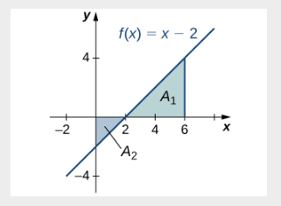

Slide 60
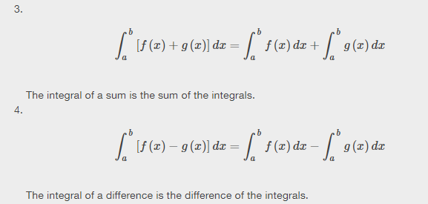

Slide 61
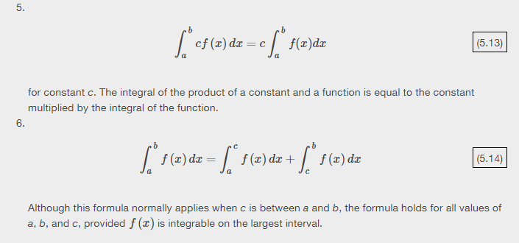

Slide 66
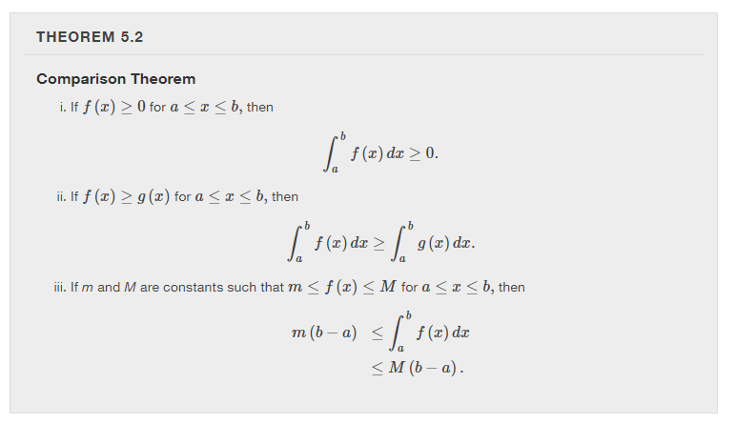
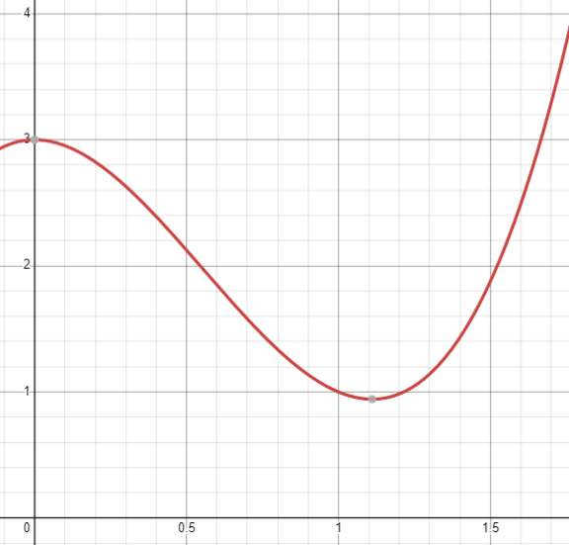
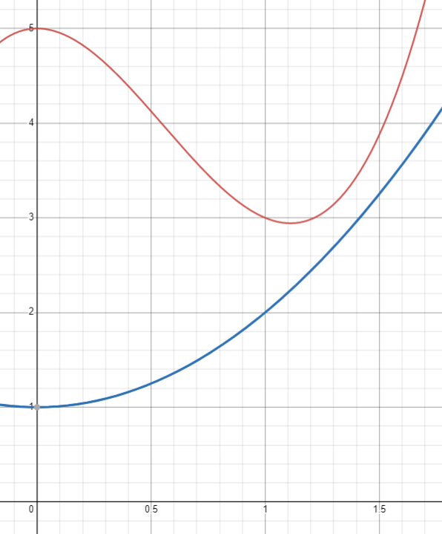

Slide 67
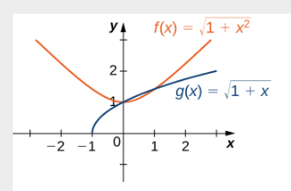

Slide 68
AVERAGE VALUE
What is the average value for $70, 80, 90, and 80$?
What is the average value for $1, 2, 3, 4 , …, n$?
What is the average value for a list of values $x_{1},$ $x_{2},$ $x_{3},…x_{n}$?

Slide 70
