Slide 1
Trigonometric Identities and Equations
Chapter 9
Algebra and Trigonometry 2e, OpenStax, Jay Abramson
Notes:
Images and notes within these slides are from the OpenStax textbook Algebra and Trigonometry 2e

Slide 2
9.5 Solving Trigonometric Equations
Notes:
Images and notes within these slides are from the OpenStax textbook Algebra and Trigonometry 2e

Slide 3
What are the learning objectives for this section?
Solve linear trigonometric equations in sine and cosine.
Solve equations involving a single trigonometric function.
Solve trigonometric equations using a calculator.
Solve trigonometric equations that are quadratic in form.
Solve trigonometric equations using fundamental identities.
Solve trigonometric equations with multiple angles.
Solve right triangle problems.

Slide 4
Solving Linear Trigonometric Equations in Sine and Cosine
Trigonometric equations are equations that involve trigonometric functions.
Sometimes we will solve a trigonometric equation over a specified interval and other times we will find all possible solutions. Because trigonometric functions are periodic, trigonometric equations may have an infinite number of solutions. Recall that
Notes:
Since $θ$ and$θ+2kπ$, where $k$ is any integer, are co-terminal angles, they have the same values for the trigonometric functions. If we find all the solutions within an interval that has length equal to the period of the trigonometric function in the equation, then we also list those angles plus $2kπ$ to describe all possible solutions.

Slide 18
Notes:
Solving a quadratic equation may be more complicated, but once again, we can use algebra as we would for any quadratic equation. Look at the pattern of the equation. Is there more than one trigonometric function in the equation, or is there only one? Which trigonometric function is squared? If there is only one function represented and one of the terms is squared, think about the standard form of a quadratic. Replace the trigonometric function with a variable such as xx or u.u. If substitution makes the equation look like a quadratic equation, then we can use the same methods for solving quadratics to solve the trigonometric equations.

Slide 28
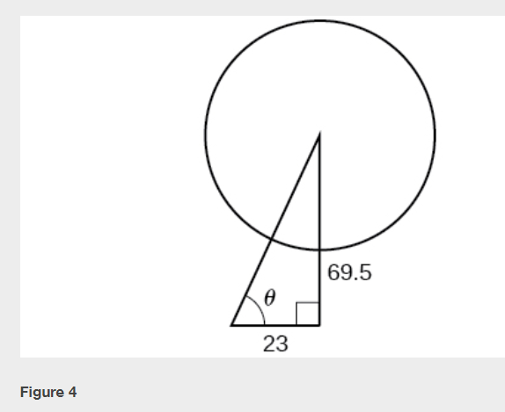

Slide 30
What did you learn in this section?
Solve linear trigonometric equations in sine and cosine.
Solve equations involving a single trigonometric function.
Solve trigonometric equations using a calculator.
Solve trigonometric equations that are quadratic in form.
Solve trigonometric equations using fundamental identities.
Solve trigonometric equations with multiple angles.
Solve right triangle problems.
Notes:
Do you have any questions?

Slide 31
This resource is an adaptation of the OpenStax Algebra and Trigonometry 2e open textbook and is © Susan Aydelotte under a CC BY-NC-SA 4.0 International license; it may be reproduced or modified for noncommercial purposes only but must be attributed to OpenStax, Rice University and any changes must be noted. Any adaptation must be shared under the same type of license.

