Slide 1
Periodic Functions
Chapter 8
Algebra and Trigonometry 2e, OpenStax, Jay Abramson
Notes:
Images and notes within these slides are from the OpenStax textbook Algebra and Trigonometry 2e

Slide 2
8.1 Graphs of the Sine and Cosine Functions
Notes:
Images and notes within these slides are from the OpenStax textbook Algebra and Trigonometry 2e

Slide 3
What are the learning objectives for this section?
Graph variations of $y=sin⁡(x)$and $y=cos⁡(x).$
Use phase shifts of sine and cosine curves.

Slide 4
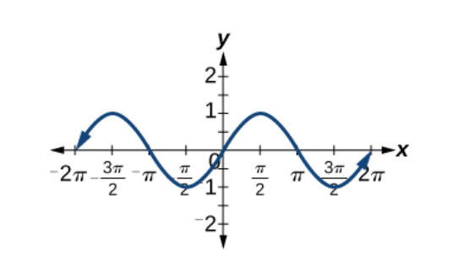
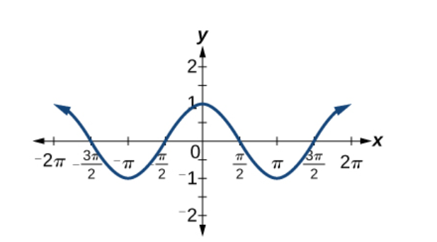
Notes:
One of these graphs is the graph of the cosine function and the other is of the sine function. Which is which? And how do you know?
What do you notice about the period of each graph? What is the domain for each function? Which one is symmetric about the origin? Which one is symmetric about the y-axis?

Slide 6
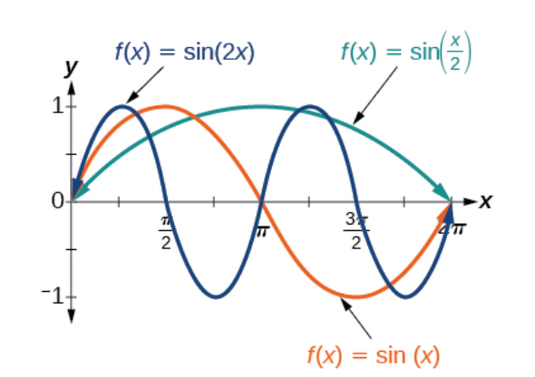
Notes:
Use the period formula to determine the period for the sin(2x) and sin(x/2). Then confirm the period for sin(2x) using the graph.

Slide 7
Notes:
Use the period formula and graph the function to confirm.

Slide 9
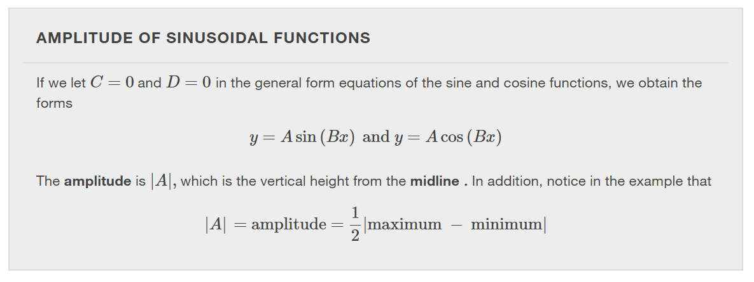
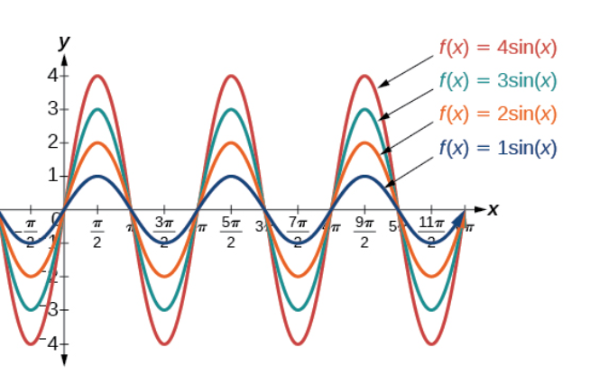
Notes:
The midline for these examples is the x-axis.

Slide 10
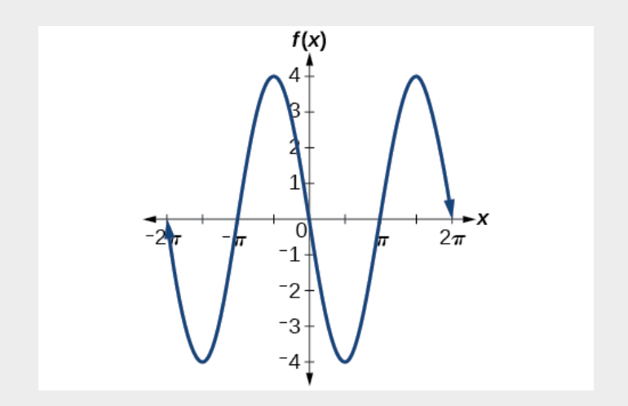

Slide 12
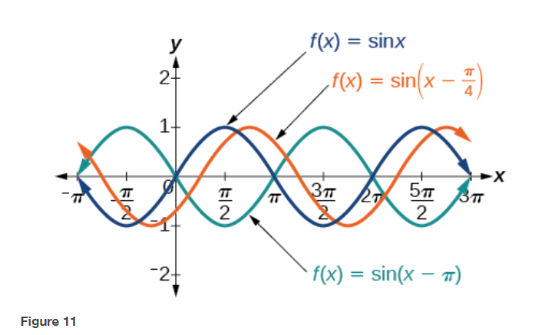
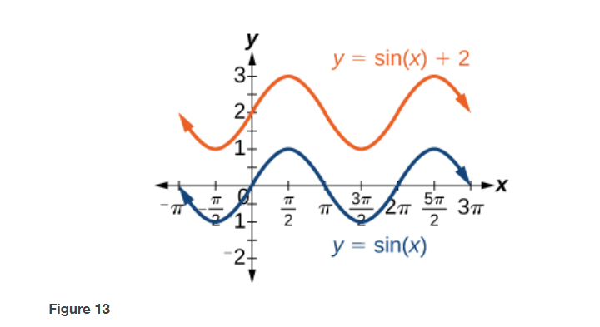
Notes:
Figure 11 illustrates a phase shift of $\frac{π}{4}$ and a phase shift of $π$. Figure 13 is an example of a vertical shift of 2 units upward.

Slide 18
Notes:
Make the calculations using the formulas and then confirm using a graph of the function.

Slide 21
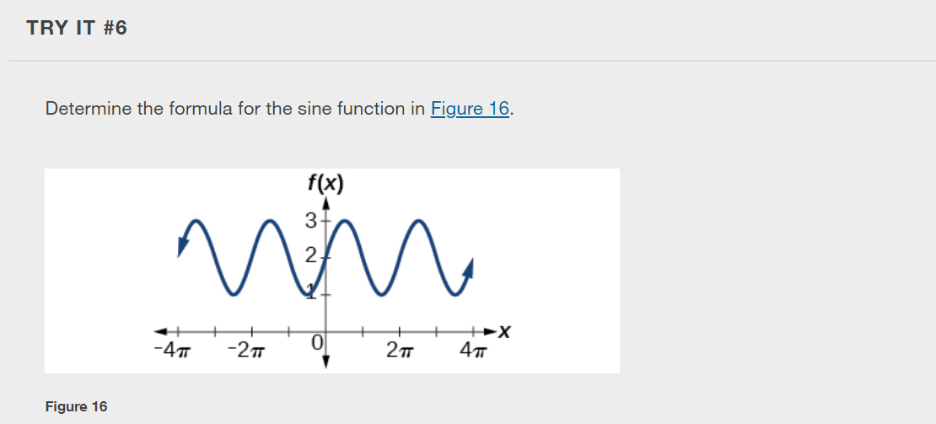

Slide 23
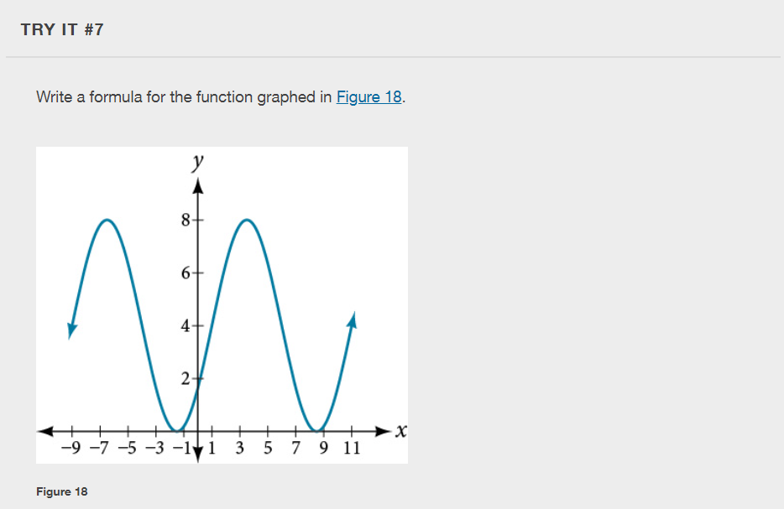

Slide 24
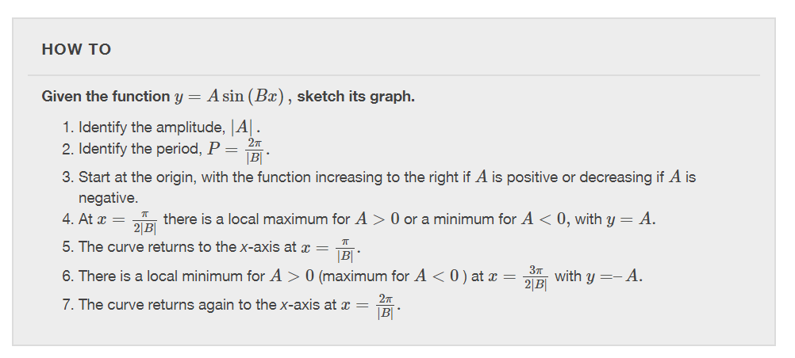

Slide 27
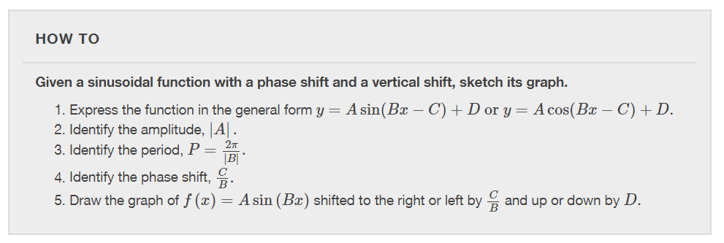

Slide 33
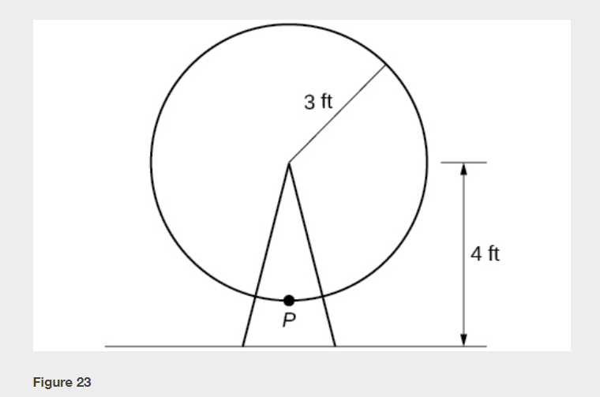

Slide 34
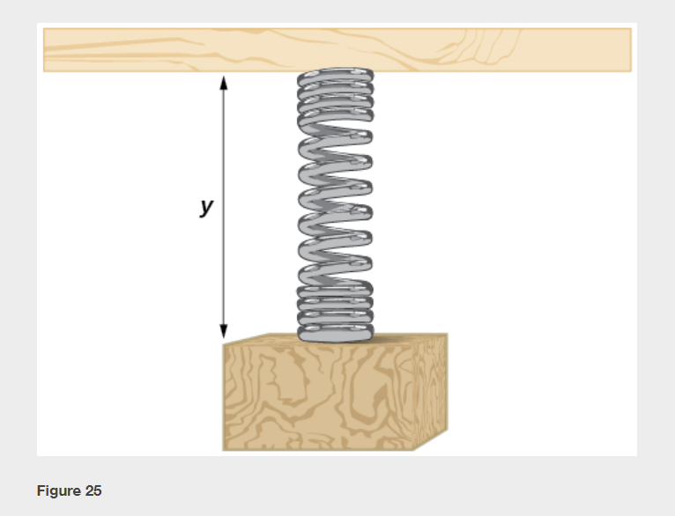

Slide 36
What did you learn in this section?
Graph variations of $y=sin⁡(x)$and $y=cos⁡(x).$
Use phase shifts of sine and cosine curves.
Notes:
Do you have any questions?

Slide 37
This resource is an adaptation of the OpenStax Algebra and Trigonometry 2e open textbook and is © Susan Aydelotte under a CC BY-NC-SA 4.0 International license; it may be reproduced or modified for noncommercial purposes only but must be attributed to OpenStax, Rice University and any changes must be noted. Any adaptation must be shared under the same type of license.

