Slide 1
Exponential and Logarithmic Functions
Chapter 6
Algebra and Trigonometry 2e, OpenStax, Jay Abramson
Notes:
Images and notes within these slides are from the OpenStax textbook Algebra and Trigonometry 2e

Slide 2
6.5 Logarithmic Properties
Notes:
Images and notes within these slides are from the OpenStax textbook Algebra and Trigonometry 2e

Slide 3
What are the learning objectives for this section?
Use the product rule for logarithms.
Use the quotient rule for logarithms.
Use the power rule for logarithms.
Expand logarithmic expressions.
Condense logarithmic expressions.
Use the change-of-base formula for logarithms.

Slide 24
Condensing Logarithmic Expressions

Slide 33
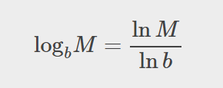
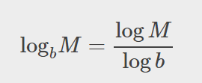

Slide 37
Type in the logarithm above as is into desmos.com/calculator and compare the values.

Slide 38
Type in the logarithm above as is into desmos.com/calculator and compare the values.

Slide 39
What did you learn in this section?
Use the product rule for logarithms.
Use the quotient rule for logarithms.
Use the power rule for logarithms.
Expand logarithmic expressions.
Condense logarithmic expressions.
Use the change-of-base formula for logarithms.
Notes:
Do you have any questions?

Slide 40
This resource is an adaptation of the OpenStax Algebra and Trigonometry 2e open textbook and is © Susan Aydelotte under a CC BY-NC-SA 4.0 International license; it may be reproduced or modified for noncommercial purposes only but must be attributed to OpenStax, Rice University and any changes must be noted. Any adaptation must be shared under the same type of license.

