Slide 1
Exponential and Logarithmic Functions
Chapter 6
Algebra and Trigonometry 2e, OpenStax, Jay Abramson
Notes:
Images and notes within these slides are from the OpenStax textbook Algebra and Trigonometry 2e

Slide 2
6.4 Graphs of Logarithmic Functions
Notes:
Images and notes within these slides are from the OpenStax textbook Algebra and Trigonometry 2e

Slide 3
What are the learning objectives for this section?
Identify the domain of a logarithmic function.
Graph logarithmic functions.

Slide 4
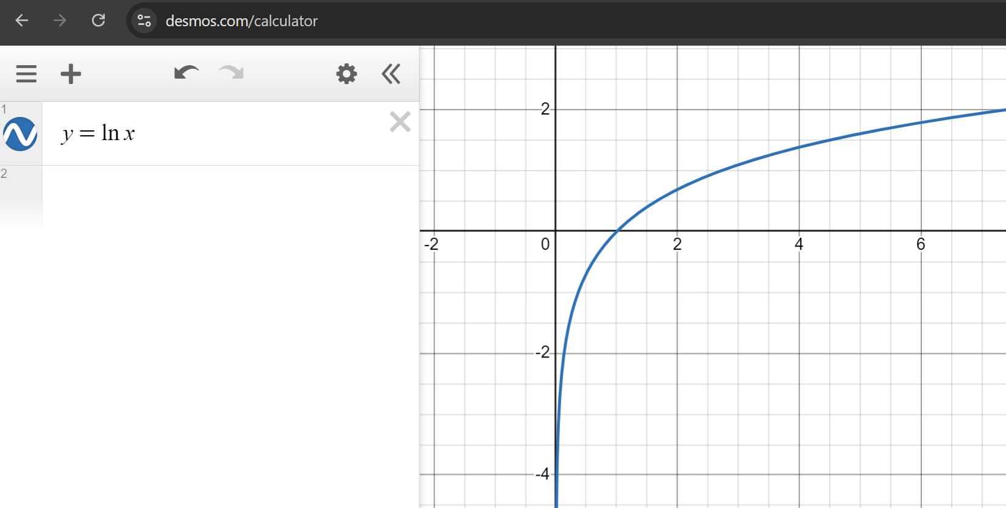
What is the domain of the function? What is the range of the function?

Slide 5
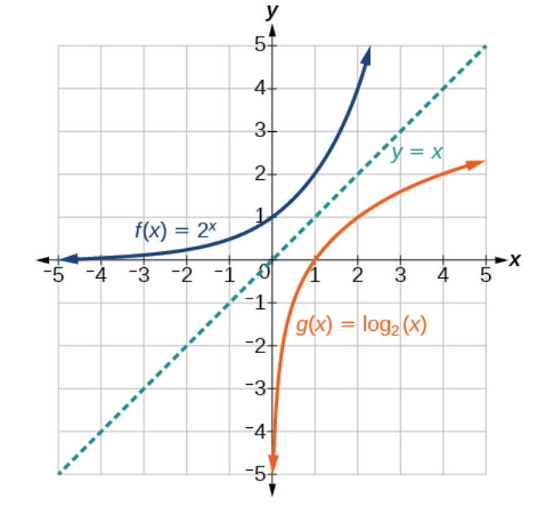

Slide 11
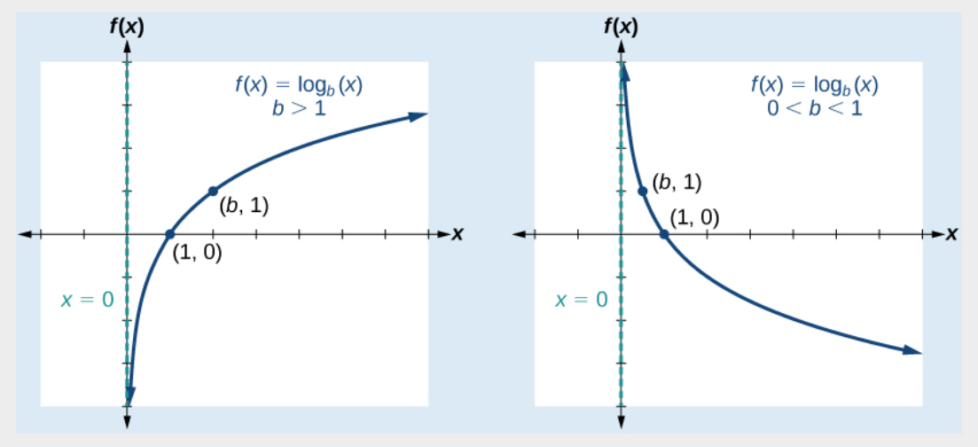

Slide 12
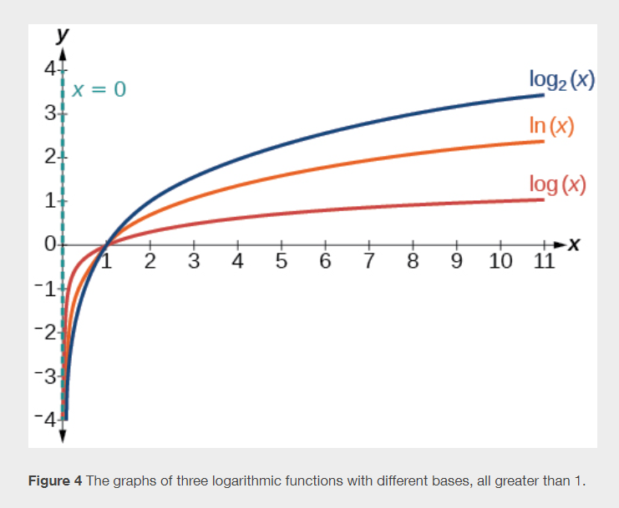

Slide 16
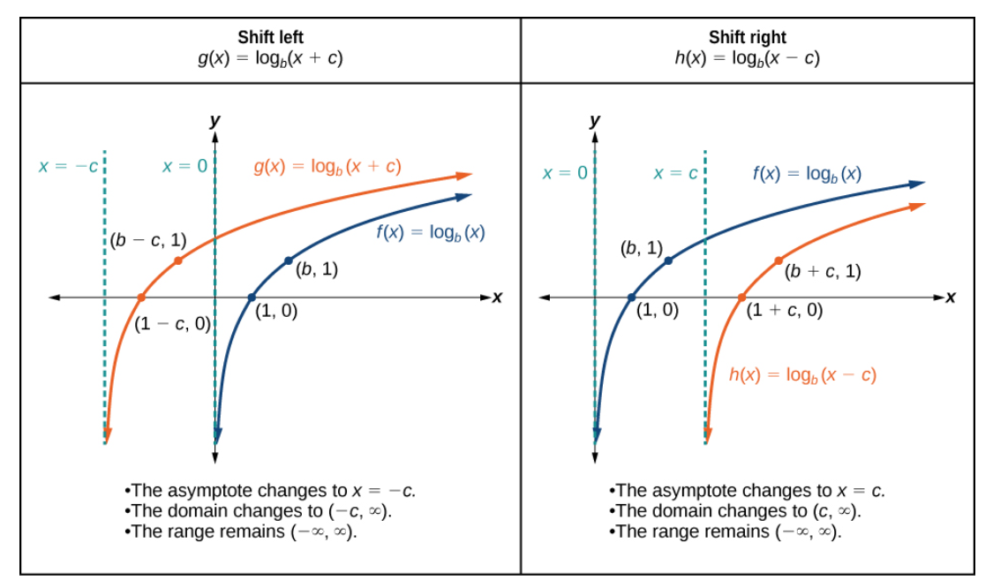

Slide 18
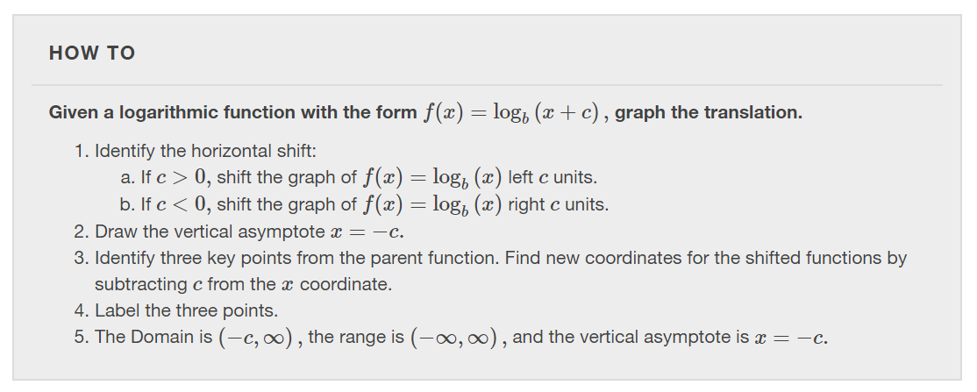

Slide 21
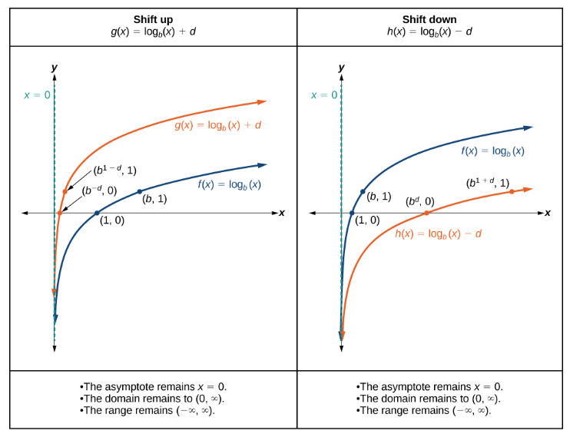

Slide 23
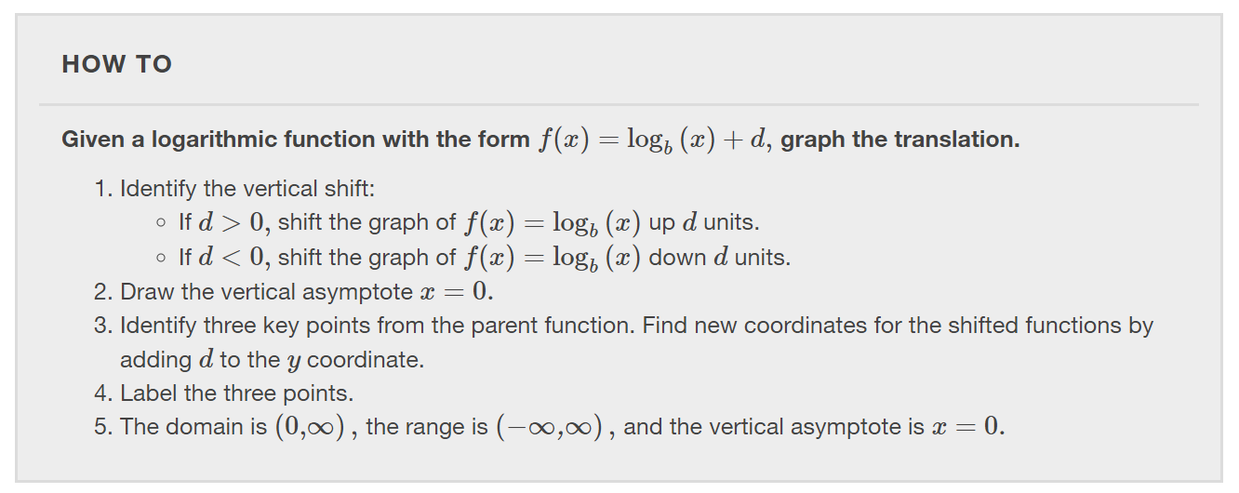

Slide 26
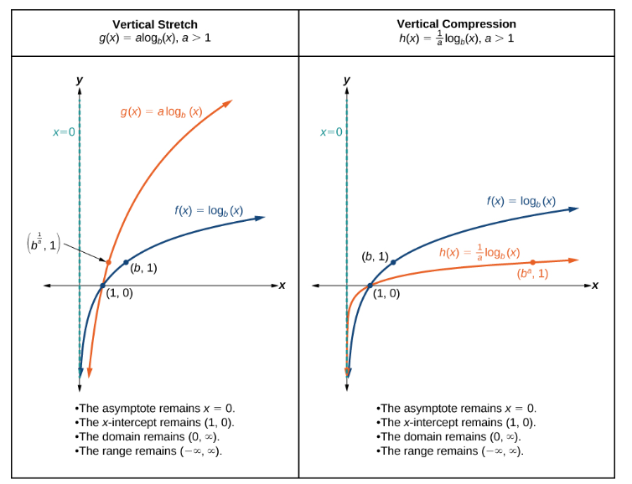

Slide 27
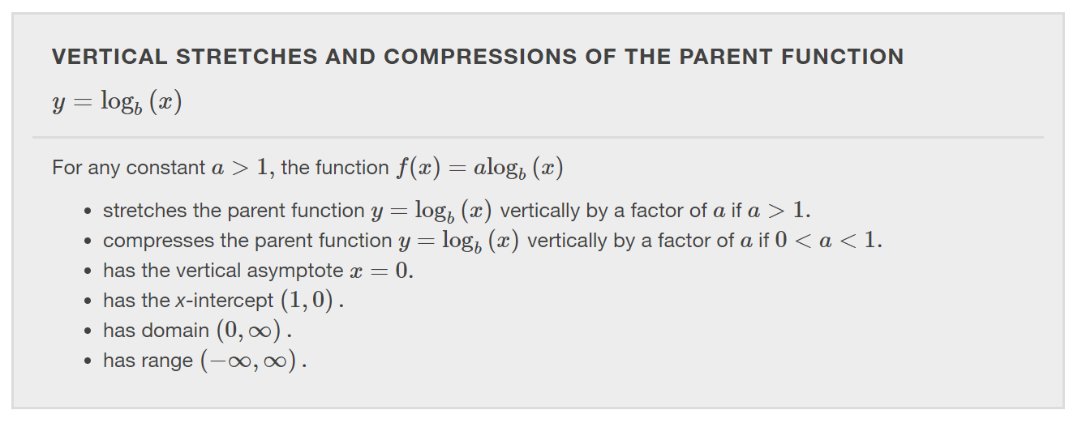

Slide 28
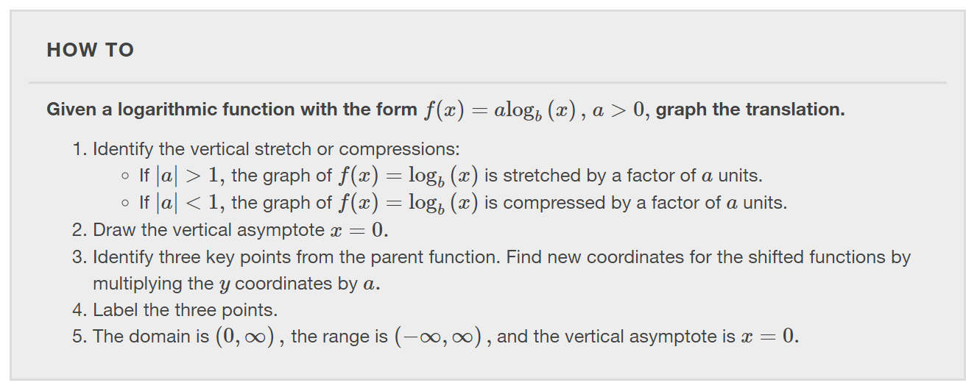

Slide 33
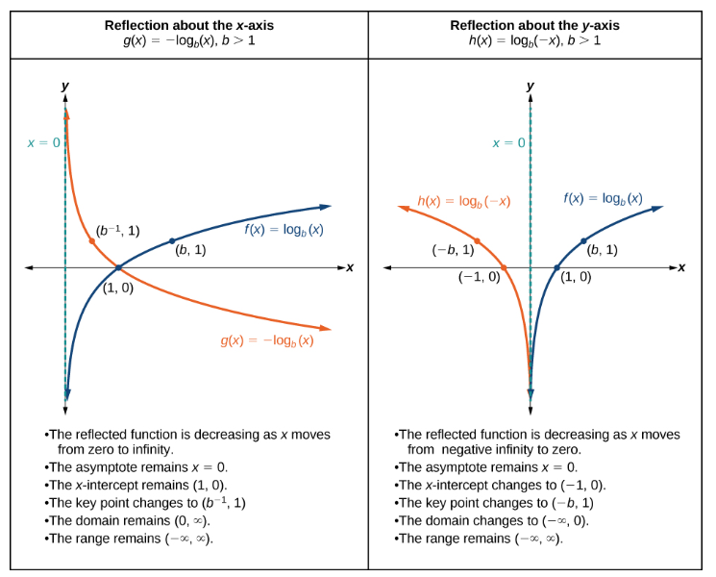

Slide 34
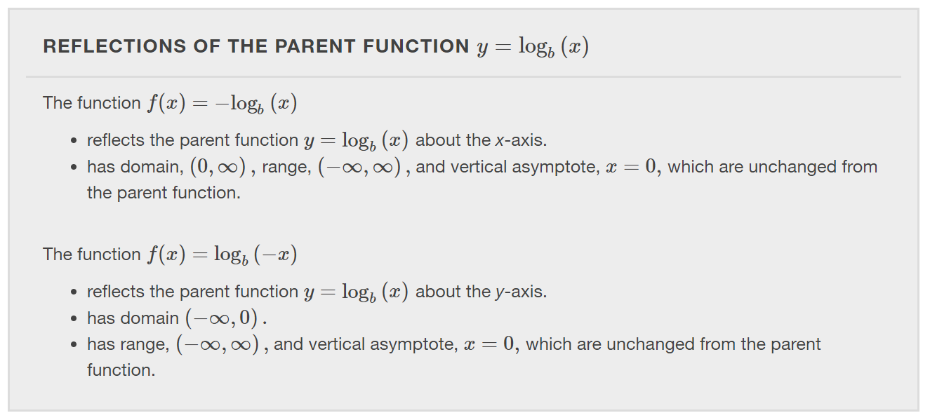

Slide 35
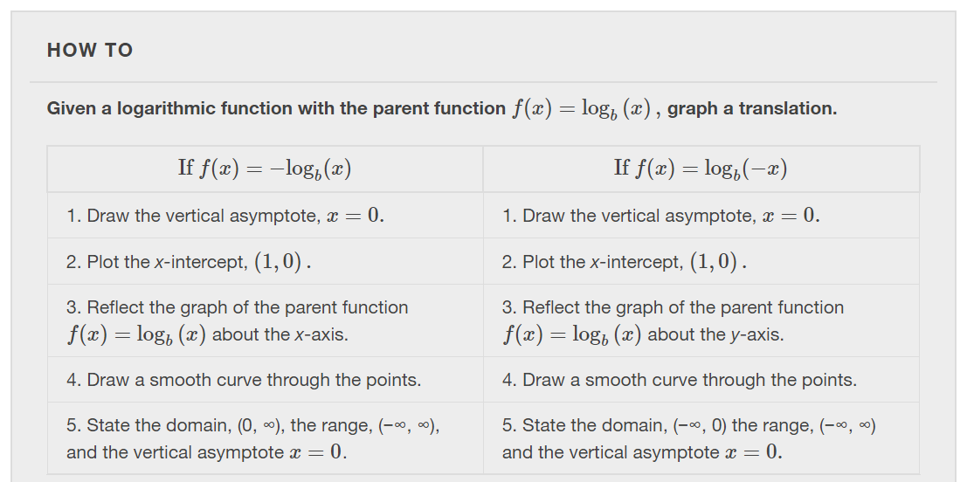

Slide 41
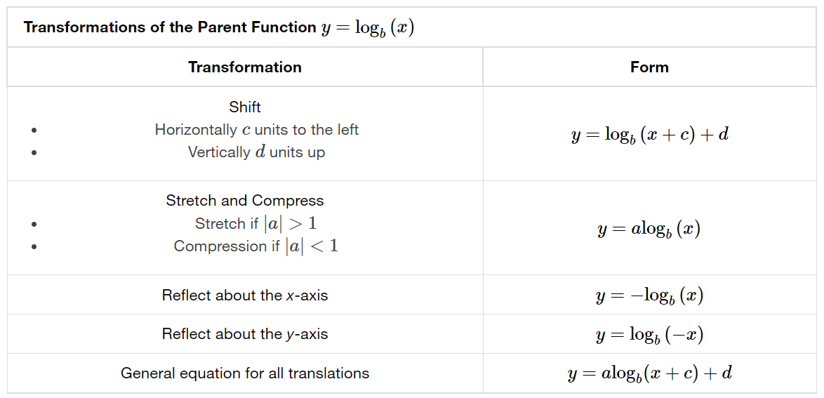

Slide 45
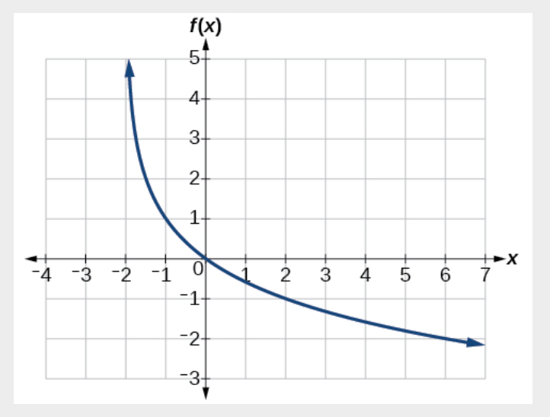

Slide 46
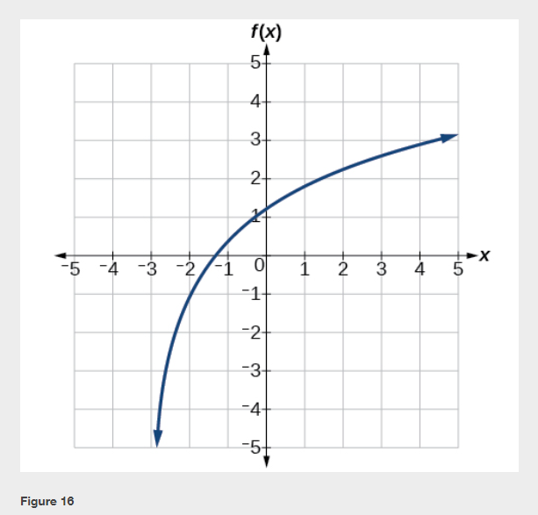

Slide 48
What did you learn in this section?
Identify the domain of a logarithmic function.
Graph logarithmic functions.
Notes:
Do you have any questions?

Slide 49
This resource is an adaptation of the OpenStax Algebra and Trigonometry 2e open textbook and is © Susan Aydelotte under a CC BY-NC-SA 4.0 International license; it may be reproduced or modified for noncommercial purposes only but must be attributed to OpenStax, Rice University and any changes must be noted. Any adaptation must be shared under the same type of license.

