Slide 1
Equations and Inequalities
Chapter 2
Algebra and Trigonometry 2e
OpenStax
Jay Abramson
Notes:
Images and notes within these slides are from the OpenStax textbook Algebra and Trigonometry 2e

Slide 2
Complex Numbers
Section 2.4
Notes:
Add and subtract complex numbers.
Multiply and divide complex numbers.
Simplify powers of i

Slide 3
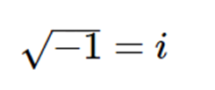
Notes:
Note that we call a+bi the standard form of a complex number.

Slide 4
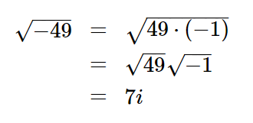
Expressing Square Roots of Negative Numbers as Multiples of $i$

Slide 7
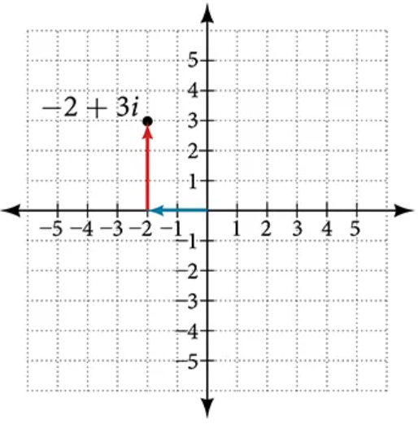
Plotting a Complex Number on the Complex Plane
We cannot plot complex numbers on a number line as we might real numbers. However, we can still represent them graphically. To represent a complex number, we need to address the two components of the number. We use the complex plane, which is a coordinate system in which the horizontal axis represents the real component and the vertical axis represents the imaginary component.
Complex numbers are the points on the plane, expressed as ordered pairs $(a,b)$, where $a$ represents the coordinate for the horizontal axis and $b$ represents the coordinate for the vertical axis.
COMPLEX PLANE
imaginary
real

Slide 8
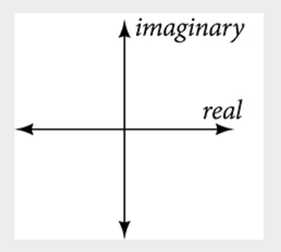

Slide 14
Multiplying Complex Numbers
Multiplying complex numbers is much like multiplying binomials. The major difference is that we work with the real and imaginary parts separately.

Slide 17
Multiplying Complex Numbers Together
Now, let’s multiply two complex numbers. We can use either the distributive property or more specifically the FOIL method because we are dealing with binomials. Recall that FOIL is an acronym for multiplying First, Inner, Outer, and Last terms together. Remember we will get a squared term, $i^{2}$, which equals $−1$.

Slide 18
Multiplying Complex Numbers Together

Slide 24
Dividing Complex Numbers
Dividing two complex numbers is more complicated than adding, subtracting, or multiplying because we cannot divide by an imaginary number, meaning that any fraction must have a real-number denominator to write the answer in standard form $a+bi$.
We need to find a term by which we can multiply the numerator and the denominator that will eliminate the imaginary portion of the denominator so that we end up with a real number as the denominator. This term is called the complex conjugate of the denominator, which is found by changing the sign of the imaginary part of the complex number. In other words, the complex conjugate of $a+bi$is $a−bi$.

Slide 27
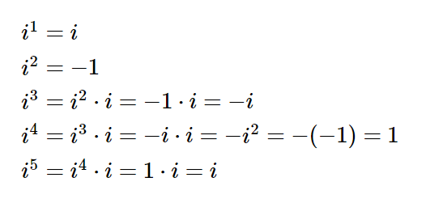
Simplifying Powers of $i$
The powers of $i$ are cyclic. Let’s look at what happens when we raise $i$ to increasing powers.
Notes:
The cycle is repeated continuously, every four powers.

Slide 30
What did you learn in this section?
Add and subtract complex numbers.
Multiply and divide complex numbers.
Simplify powers of $i$
Notes:
Do you have any questions?

Slide 31
This resource is an adaptation of the OpenStax Algebra and Trigonometry 2e open textbook and is © Susan Aydelotte under a CC BY-NC-SA 4.0 International license; it may be reproduced or modified for noncommercial purposes only but must be attributed to OpenStax, Rice University and any changes must be noted. Any adaptation must be shared under the same type of license.

