Slide 1
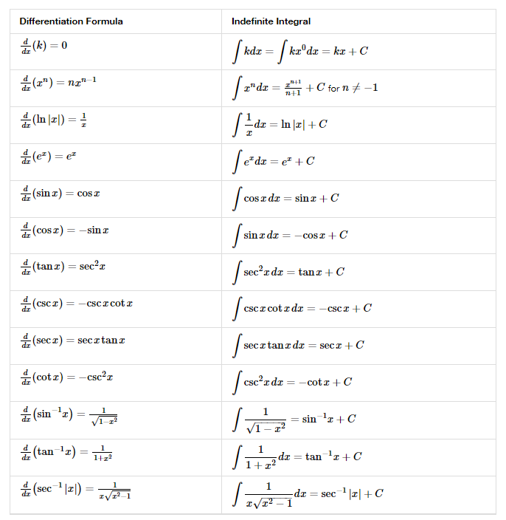
4.10 ANTIDERIVATIVES

Slide 2
5.1 APPROXIMATING AREAS

Slide 3
5.2 THE DEFINITE INTEGRAL

Slide 4
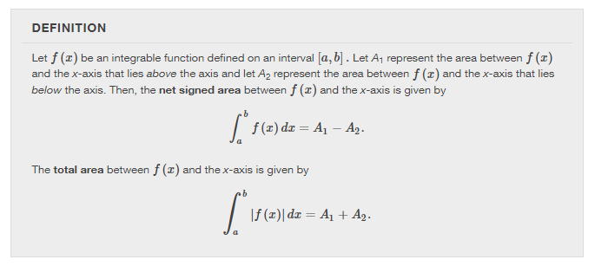
5.2 THE DEFINITE INTEGRAL

Slide 5
Chapter 5 integration

Slide 6
The fundamental theorem of calculus
Section 5.3

Slide 7
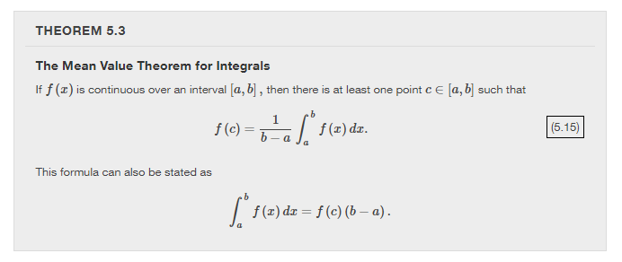

Slide 11
ACCUMULATION FUNCTION

Slide 12
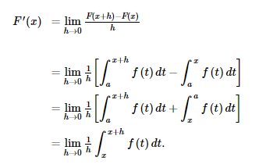

Slide 13
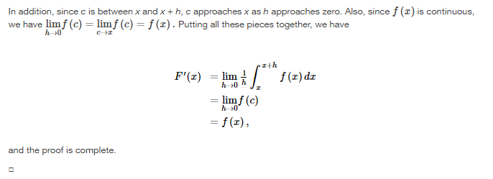

Slide 15
APPLYING THE CHAIN RULE:

Slide 20
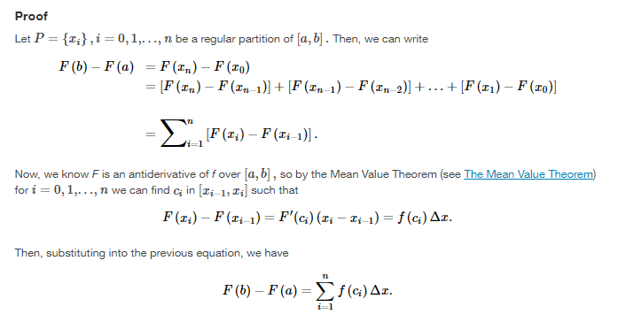

Slide 21
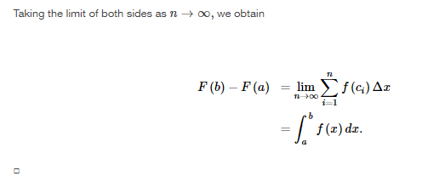

Slide 25
Integration formulas and the net change theorem
Section 5.4

Slide 26
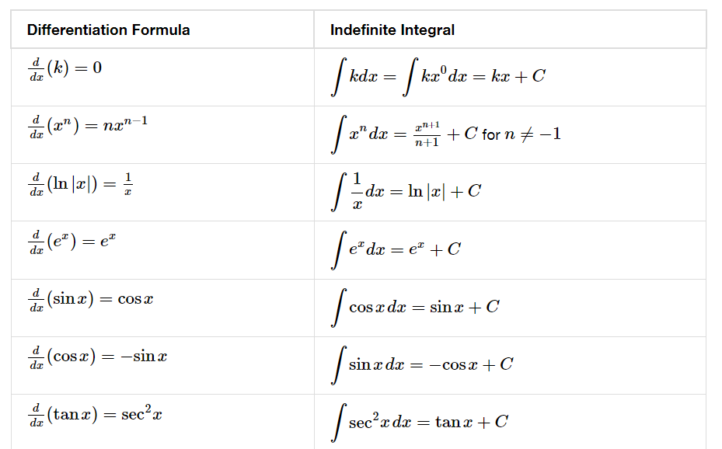

Slide 28
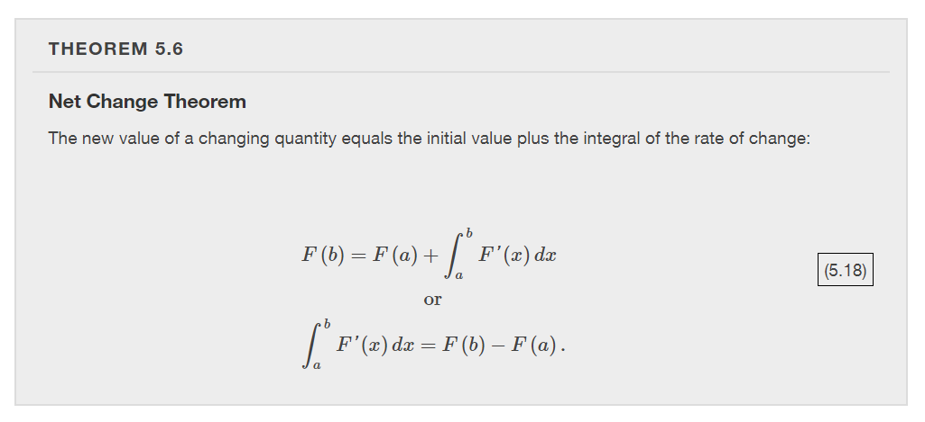

Slide 29
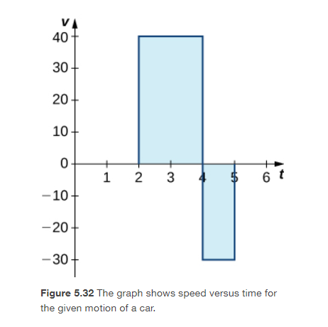
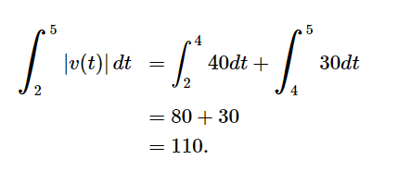

Slide 33
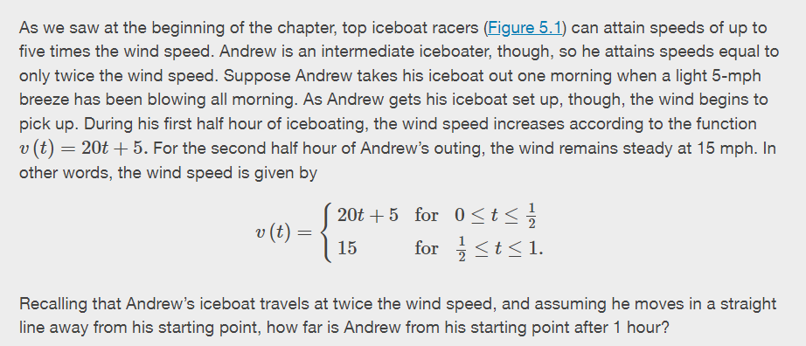

Slide 34
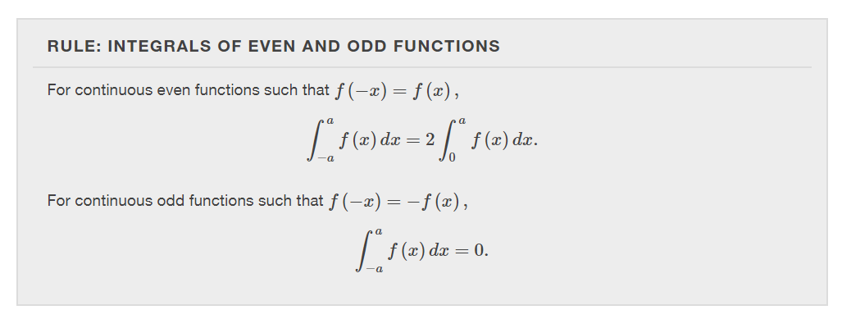

Slide 37
substitution
Section 5.5

Slide 39
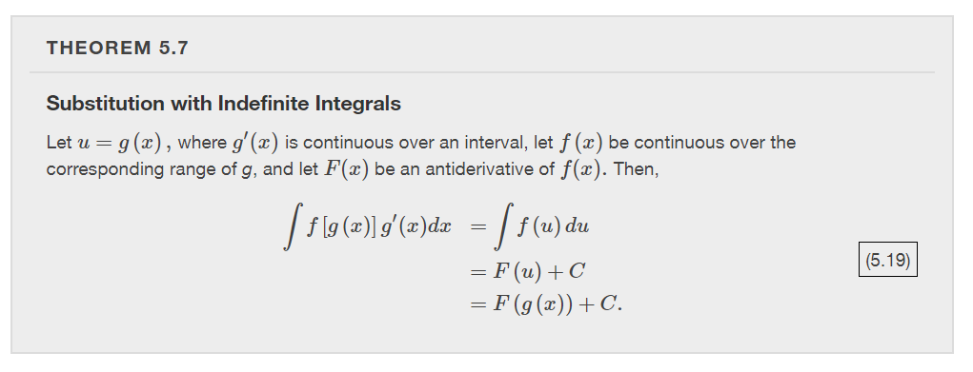

Slide 40
