Slide 1
Chapter 4 applications of derivatives

Slide 2
L’Hôpital’s Rule
Section 4.8

Slide 3

Indeterminant Forms:
$\frac{0}{0}$ and $\frac{∞}{∞}$
$0∙∞ ,$ $∞−∞ , { 1}^{∞} ,{ ∞}^{0} , { 0}^{0}$

Slide 4
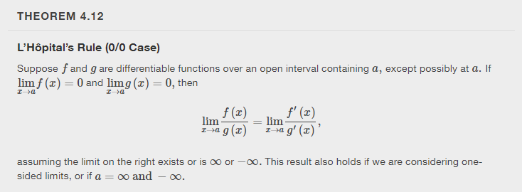

Slide 5
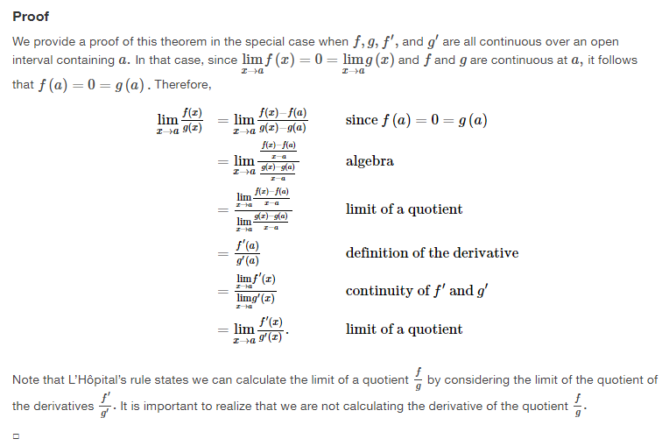

Slide 6
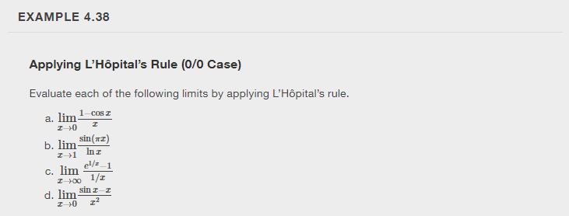

Slide 15
Newton’s Method
Section 4.9

Slide 16
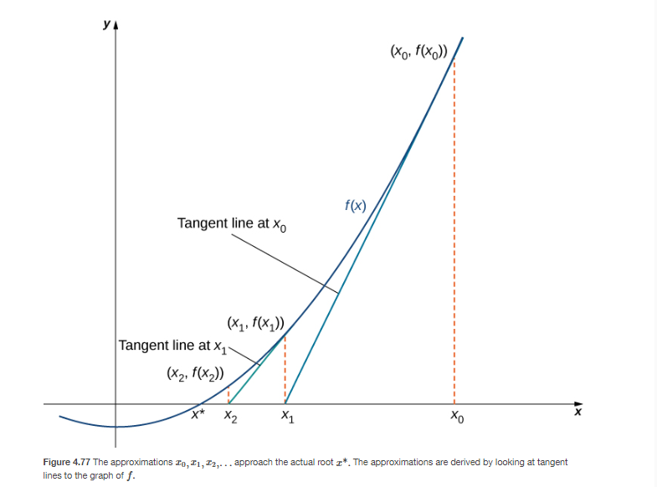

Slide 17
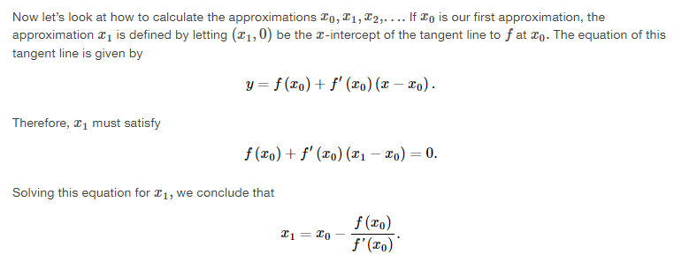

Slide 18
This is an example of an iterative process.

Slide 19
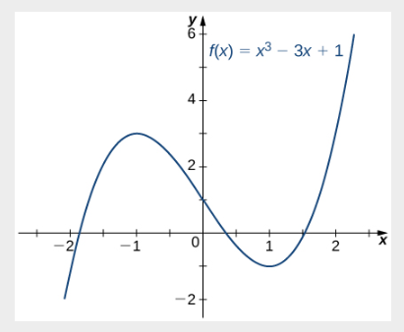

Slide 21
Desmos app for Newton’s Method
https://www.desmos.com/calculator/pjxjvdbt7i

Slide 23
